Slide 1
SCAMP: lightweight membership service for gossip-based protocols
Ayalvadi Ganesh, Anne-Marie Kermarrec
& Laurent Massoulié
Microsoft Research
Cambridge, UK
Notes:
Good morning
This morning I’m going to present Scamp, a membership service for gossip-based algorithms
Joint work with Ayalvadi Ganesh and Laurent Massoulie from MSR Cambridge

Slide 2
Probabilistic multicast
Scalable and reliable group communication
Gossip-based algorithms
  Scalable
  Reliable
    Probabilistic guarantees
    Graceful degradation in the presence of failure
Non scalable membership protocol
Notes:
Gossip-based probabilistic multicast algorithms are a scalable solution for reliable multicast in groups composed of a large group of members. Gossip-based algorithms have been used for consistency maintenance, failure detection, oublish-subscribe….
Gossip-based algorithms are scalable: they rely on a P2P interaction model and each member of the group participates in the multicast, the load impose on each member id in the order of log N which grows slowly when the size of the node gets its part of the load and the load increases only in the order of log N as the size of the group increases. They are very simple
They are highly resilient to node and link failures and provide some probabilistic guarantee: instead of providing the strong atomicity properties of either everybody gets a message or nobody gets it, they provide an almost atomicity : either almost everybody gets it or almost nobody. However the parameter might be tuned to actually ensure as much reliability as possible. They use randomization to fight random unreliability of the underlying network and are highly resilient to node and links failures.
However they usually rely on non scalable assumption in term of membership, traditional gossip-based algorithm assume that each participant has a global knowledge of the membership, everybody know everybody else which limit their applicatbility. This is what Scamp provides a decentralized membership algorithm to support

Slide 3
Background: gossip-based protocol
Fanout = k
Probability of reliable delivery : P = exp(-exp(-s))
If k = log n + s
3
4
0
5
1
2
9
8
7
6
Notes:
Gossip-based algorithms randomly pick up other member to gossip to. Gossip-based algorithms differ by the number of time they gossip a same message or the number or the number of gossip targets they select each time.
One of gossip-based algorithms works as follow. A node receiving a multicast, select randomly among the group members k (k is called the fanout, 3 in this example) others nodes to gossip to. And so on and so forth. Eventually the message reach everybody with a certain probability. Note that this algorithm have a bimodal behavior either the fanout is too low and the algorithm dies very quickly with reaching almost nobody or it reaches almost evrybody.
In a previous work, we actually showed that the probability of fanout can be related to the fanout.
Log(N) id usually a good value

Slide 4
Background: gossip-based protocol
3
4
0
5
1
2
9
8
7
6
Notes:
Gossip-based algorithms randomly pick up other member to gossip to. Gossip-based algorithms differ by the number of time they gossip a same message or the number or the number of gossip targets they select each time.
One of gossip-based algorithms works as follow. A node receiving a multicast, select randomly among the group members k (k is called the fanout, 3 in this example) others nodes to gossip to. And so on and so forth. Eventually the message reach everybody with a certain probability. Note that this algorithm have a bimodal behavior either the fanout is too low and the algorithm dies very quickly with reaching almost nobody or it reaches almost evrybody.
In a previous work, we actually showed that the probability of fanout can be related to the fanout.
Log(N) id usually a good value

Slide 5
Membership
Global knowledge
  Storage and consistency maintenance
Partial knowledge requires coordination
  Fanout setting to achieve a given probability of reliable delivery
  Fanout update
Notes:
Traditional gossip-based algorithm rely on non-scalable global membership service
Require to explicitly set the fanout to achieve a given probability of reliable delivery
Update fanout when N increases

Slide 6
Scamp: Self-organizing membership protocol
Partial knowledge of the membership: local view
Fanout automatically set = size of the local view
Fanout evolves naturally with the size of the group
  Size of local views converges towards clog(n)

Slide 7
Scamp: Subscription (c=1)
View sizes automatically converge to log(n)
Gossip protocol: Each node gossips to all the members of its view
Notes:
We are aiming size of log(N)

Slide 8
Subscription algorithm
s
Subscription to
a random member
Subscription forwarded
P=1/sizeof view
s
s
S
Ser
(1-P)
s
s
P=1/sizeof view
View sizes automatically converge to log(n)
Each node gossips to all the members of its view
s
s
(1-P)
s
P=1/sizeof view
s
(1-P)
Notes:
Links represent the local view a link from a to b is equivalent to have b in the view size of a

Slide 9
Subscription algorithm
7 6
Local view
1 4 5
6
4
0
6
7 2
3 6
6
6
1
2
6
0
8 3 6
7 0 1
5 6
6
6
5
8
7

Slide 10
Lease on subscriptions
Lease associated with each subscription
Periodically nodes have to re-subscribe
Nodes having failed permanently will time out
Re-balance the partial views

Slide 11
Unsubscriptions
Unsubscription broadcast with local view
When a node removes the unsubscribed node, it picks up randomly another node to incorporate in its view

Slide 12
Unsubscriptions
Local view
8 9 0
8 9 4
1 4 5
Unsub (0), [1,4,5]
4
x
x
0
7 3 0
7 3 5
1
y
y
5
6 0 2
6 0 1
z
z

Slide 13
Theoretical Analysis
System modelled as random directed graph
D(N) = Average out-degree for N-nodes system
Subscription adds D(N)+1 directed arcs, so
(N+1) D(N+1) = N D(N) + D(N)+1
Solution of this recursion is
D(N)=D(1)+1/2+1/3+…+1/N ≈ Log(N)
Notes:
This is an average case analysis. In reality, there are noise terms in this recurrence as we pick a node whose degree is only approximately d(N).
In order to prove that the argument is correct in the presence of this noise, we need to control the variance of that noise (and invoke the martingale convergence theorem!).

Slide 14
Scamp:Experiments
Simulation results
Convergence of view size
  Confirm theoretical analysis
  Impact of lease
Reliability
  Comparison with traditional gossip-based
  Attest to the “good” quality (uniformity) of views

Slide 15
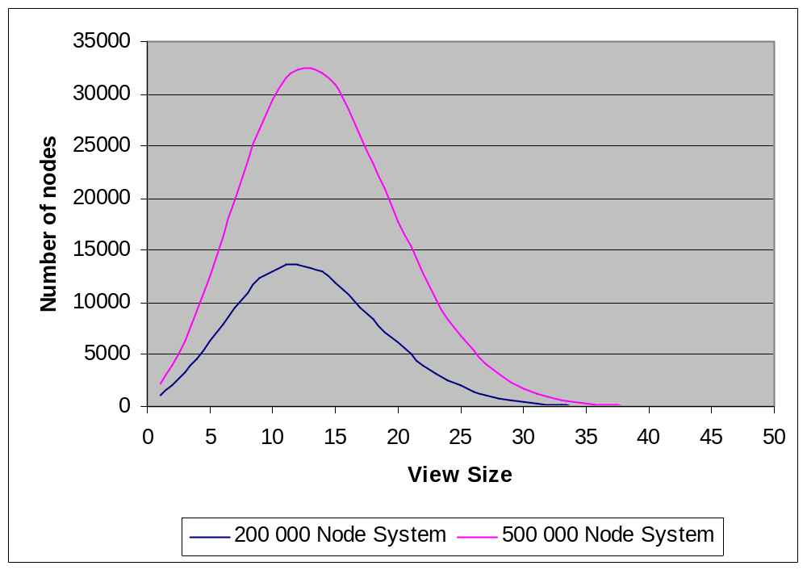
Distribution of view size
Log=13.12
Log=12.2
Notes:
The probabilistic guarantee for gossip depends only on the mean fanout (so long as the distribution is not “too skewed”) having the right value. It is not required that the fanout at each node be deterministic and equal to log n.

Slide 16
Impact of lease
5000 nodes
800
700
mean=7.53
mean=8.47
600
500
400
Number of nodes
300
200
100
0
1
4
7
10
13
16
19
22
25
View size

Slide 17
Reliability: 5000 node system
1
0.98
0.96
Reliability
0.94
0.92
0.9
0
500
1000
1500
2000
2500
Number of failures
SCAMP
Global membership knowledge, fanout=8
Global membership knowledge, fanout=9
Notes:
Proportion of ndoes reached.

Slide 18
Conclusion
Membership protocol
  Scalable: local view
  Self-organizing: truly peer-to-peer
    Local views naturally converge towards the “right” value without global directive
  Theoretical analysis and simulations
On going work
  Integration of locality
Notes:
Plus in the absence of failure, Scamp produces a fully connected graph
Also good convergence even if all nodes subscribe to the same node: new algo to tolerate this

Slide 19
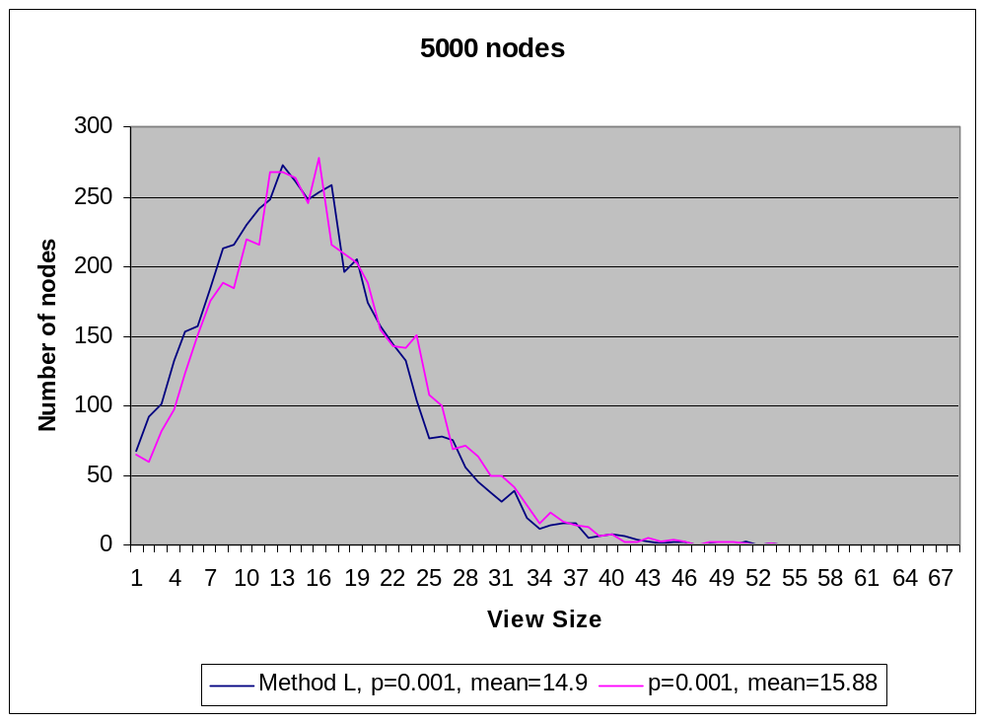
Centralized subscriptions

