Slide 1

Guardians of Transactions: Credit Card Fraud Detection
Guided By:
Pankaj Agarwal
Ass.Professor
CSE Department
PIET, Parul University
Internal Project Presentation 2024
Presented By:
LOKESH POTHURI (210304124223)
BHARATH PUJARI (210304124229)
RAHUL PEDDI (210304124188)
GOPINADH PASUPULETI (210304124173)

Slide 2
Content
Introduction
Background study (Research Paper Summary in Table form – Format shared in the next slide)
Objectives of the Project
What is exactly to be done?
Why is this project selected?
Where is the project is helpful?
When it can be implemented?
Who will be benefitted?
Project Team : Roles and Responsibilities
Schedule
UML Diagrams
Advantages of the System
Limitations of the System
Conclusion
Future Work
References

Slide 3
Research Papers studied
Sr. number | Paper Title | Publisher | Year | Take-away points
1. | Machine Learning-Based Credit Card Fraud Detection Using Genetic Algorithm | Journal of Big Data | 2022 | Fraud detection, machine learning, genetic algorithm.
2. | Credit Card Fraud Detection using Machine Learning and Data Science | SRM Institute of Science and Technology | 2019 | anomaly detection, fraud detection, local outlier factor, isolation forest algorithm
3. | A Survey of Machine Learning Techniques for Credit Card Fraud Detection | IEEE | 2018 | Machine Learning, Credit Card Fraud Detection, Survey
4. | Enhanced Credit Card Fraud Detection Using Ensemble Learning Techniques | Elsevier | 2020 | Ensemble Learning, Credit Card Fraud Detection, Machine Learning

Slide 4

Objectives of the Project (W5)
we're focused on developing a user-friendly website for credit card transactions. We'll create robust backend algorithms using machine learning or rules to spot potential fraud.
We selected this project to minimize credit card fraud by developing an advanced detection system within the website. Ensuring security is crucial to protect users and the organization from potential losses.
The project is helpful in various contexts, including e-commerce platforms, financial institutions, and online payment gateways. It enhances security measures, reduces financial risks, preserves user trust, and ensures compliance with regulatory standards related to credit card transactions.
The project can be implemented when resources, including skilled personnel and technological infrastructure, are secured, and planning stages are completed.
Users, businesses, financial institutions, and regulatory bodies benefit from enhanced security, reduced financial risks, and improved regulatory compliance.

Slide 5
Project Team : Roles and Responsibilities
Sr. number | Team member | Enrollment number | Role | Responsibility
1 | LOKESH POTHURI | 210304124223 | Project Lead | Coordinate, delegate, monitor, communicate, support
2 | BHARATH PUJARI | 210304124229 | Machine Learning Engineer | Research, implement, preprocess, evaluate, document
3 | RAHUL PEDDI | 210304124188 | Data Engineer | Collect, preprocess, design, ensure, document
4 | GOPINADH PASUPULETI | 210304124173 | Software Developer | Design, develop, test, collaborate, integrate

Slide 6
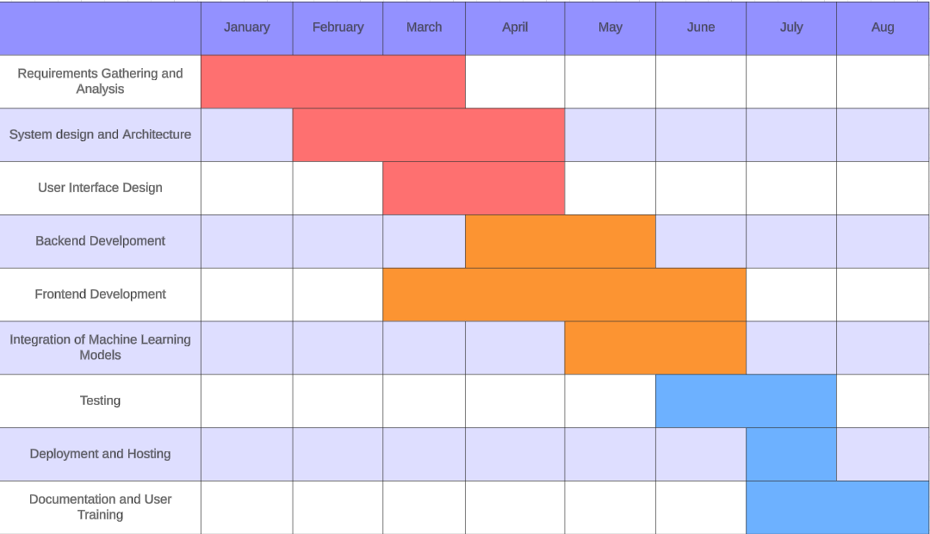
Time Line Chart - Schedule

Slide 7
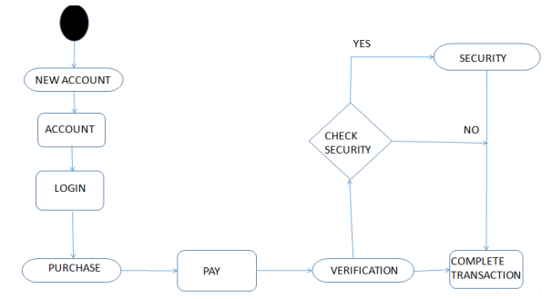
UML Diagrams

Slide 8
Advantages of the System
High Accuracy: Achieves precise fraud identification through advanced machine learning techniques, minimizing false positives and accurately pinpointing fraudulent transactions.
Real-time Detection: Enables instant recognition and response to suspicious activities, preventing potential financial losses and safeguarding both consumers and businesses in real-time.
Continuous Improvement: Adapts to evolving fraud patterns by continuously learning from new data, ensuring ongoing enhancement in detection capabilities and staying ahead of emerging threats.
Cost Efficiency: Streamlines operations and reduces manual efforts, leading to cost savings for financial institutions and businesses by automating the fraud detection process.
Enhanced Trust and Compliance: Builds customer trust by providing secure transactions and compliance with regulatory standards, demonstrating a commitment to financial security and fraud prevention.

Slide 9
Limitations of the System
Data Quality Dependency: The system's effectiveness heavily relies on the quality and completeness of the input data. Inaccurate or incomplete data may lead to less reliable fraud detection results.
Overfitting Risks: There's a potential for the machine learning models to overfit the training data, meaning they may perform exceptionally well on the training set but struggle with generalization to new, unseen data.
Algorithm Complexity: Implementing and maintaining complex machine learning algorithms and genetic algorithms can require significant computational resources and expertise, making it challenging for smaller organizations or those with limited technical capabilities.
Detection of New Fraud Patterns: While the system may adapt to known fraud patterns, it may struggle to detect entirely new or previously unseen fraud tactics until they are incorporated into the training data.
False Negative Rates: In an effort to minimize false positives, the system may inadvertently allow some fraudulent transactions to go undetected, leading to potential financial losses and compromised security for users.
Ethical and Privacy Concerns: The use of sensitive financial data for fraud detection purposes raises ethical and privacy concerns, necessitating careful handling and compliance with data protection regulations to ensure user confidentiality and trust.

Slide 10
Conclusion
In summary, the development of a credit card fraud detection system using machine learning and genetic algorithms marks a significant milestone in enhancing financial security. Through the utilization of advanced algorithms and real-time data analysis, our system promises heightened accuracy, diminished false positives, and refined fraud detection capabilities.
Despite its commendable advantages in curtailing financial risks and fortifying user interests, it is imperative to acknowledge the inherent limitations of the system. Factors such as data quality dependency and algorithmic complexity underscore the need for ongoing scrutiny and improvement.
Looking ahead, sustained research, iterative refinement, and collaborative efforts will be indispensable in surmounting these challenges and fortifying the efficacy and dependability of fraud detection mechanisms. By championing innovation, fostering collaboration, and prioritizing user trust, we can collectively steer towards the realization of a safer and more resilient financial ecosystem that serves the interests of all stakeholders.

Slide 11
Future Work
Enhanced Data Quality: Invest in methods to improve the quality and integrity of input data, potentially exploring data augmentation techniques or advanced data cleaning algorithms.
Algorithmic Refinement: Continuously refine and optimize machine learning algorithms to minimize overfitting, enhance model generalization, and adapt to emerging fraud patterns.
Integration of Advanced Technologies: Explore the integration of emerging technologies such as blockchain and anomaly detection methods to further enhance the robustness and resilience of the fraud detection system.
User-Centric Design: Prioritize user experience and usability by implementing intuitive interfaces, transparent communication of fraud detection processes, and mechanisms for user feedback and engagement.
Cross-Domain Collaboration: Foster collaboration with industry experts, regulatory bodies, and academia to share insights, best practices, and data resources for collective advancement in fraud detection research and implementation.

Slide 12
References
A Survey of Machine Learning Techniques for Credit Card Fraud Detection
Publisher: IEEE
Year: 2018
Keywords: Machine Learning, Credit Card Fraud Detection, Survey
Genetic Algorithm Based Feature Selection for Credit Card Fraud Detection"
Publisher: Springer
Year: 2019
Keywords: Genetic Algorithm, Feature Selection, Credit Card Fraud Detection
Enhanced Credit Card Fraud Detection Using Ensemble Learning Techniques
Publisher: Elsevier
Year: 2020
Keywords: Ensemble Learning, Credit Card Fraud Detection, Machine Learning

Slide 13

Thank you

