Slide 1
Rev PASSWORDMANAGER
Team Lead : Bharath adhi N
Team members : Kota Bharath
Varun Raj
Shaik. Athiya

Slide 2
APPLICAtion overview
Rev Password Manager implemented through microservices and designed to help users securely store and manage passwords for multiple online platforms.
The system focuses heavily on data security, encryption, and authentication, ensuring sensitive information is protected from unauthorized access.
The application provides:
Secure vault storage
Password generation
Security audit tools
Two-factor authentication simulation
Notification through In-app alerts.

Slide 3
Problem Statement
Many users reuse weak passwords or store credentials insecurely.
Common issues:
Weak password creation
Password reuse across platforms
Lack of encryption
No centralized password storage
Poor security awareness
This project solves these problems by:
Enforcing strong authentication
Encrypting stored credentials
Providing security audits
Generating strong passwords automatically

Slide 4
Technologies Used
Back- End
Java (Core Logic)
Spring Boot (REST APIs)
Maven (Build Tool)
Mockito for unit testing
Resiliance 4J
Centralised Config
Front End & Data Base
HTML, CSS, Angular & Type Script
MySQL(Data Base)
Development Tools
Git Version Control
Postman API Testing
VS Code / IntelliJ

Slide 5
System Architecture
Architecture Type: Microservices web application
Flow:
Frontend → REST API → Service Layer → Repository Layer → Database
Key Layers:
Controller Layer: Handles HTTP requests
Service Layer: Business Logic & Security validation
Repository Layer: Database operations
Security Layer: Encryption + Authentication
Key Services
User Service
Vault Service + Generator Service
Security Service
Notification Service

Slide 6
Work division
Bharath Kota
Authentication and User Management: Registration, Login, Forgot Password & 2FA.
Athiya Shaik
Password Vault and Management: Various functionalities and methods in Vault.
Varun Raj
Password Generator and Verification Logic: Generator logic & Verification Code generation
Bharath Adhi N
Import & Export functionalities and handled notification logics .

Slide 7
Authentication & Account Management
User Registration:
Email
Username
Master Password
Minimum 3 Security Questions
Login:
Secure authentication
Master password validation
Account Controls:
Update profile information
Change master password
2FA
Logout securely
Password Recovery:
Security question verification
Controlled reset workflow

Slide 8
Two Factor Authentication (2FA)
Users can enable or disable Two-Factor Authentication.
Workflow:
User logs in with credentials
Verification code generated
Code validated before granting access
Security Benefits:
Prevents unauthorized access
Adds extra verification layer
Simulates real authenticator apps

Slide 9
Password Vault Management
Core Vault Features:
Add password entries
Edit existing entries
Delete entries securely
Mark favorites
View categorized passwords
Stored Data:
Account Name
Website URL
Username / Email
Encrypted Password
Category
Notes

Slide 10
Search, Filter & Sorting
Search:
By website
Username
Account name
Filters:
Social Media
Banking
Email
Shopping
Work
Sorting:
Date Added
Date Modified
Alphabetical

Slide 11
Password Generator Module
Customizable options:
Length: 8–64 characters
Uppercase letters
Lowercase letters
Numbers
Special symbols
Exclude similar character
Additional Features:
Copy to clipboard
Save directly to vault
Generate multiple suggestions

Slide 12
Security Features
Implemented Security Controls:
Encryption before database storage
Master password verification before viewing sensitive data
Verification codes for critical actions
Expiring one-time tokens
Security Alerts:
Weak password detection
Reused password alerts
Old password warnings

Slide 13
Data Management & Encryption
Sensitive fields are encrypted before storage.
User Need to enter Master Password and Verification Code to save or do any operations over the Data Base.
Encryption ensures:
Password confidentiality
Secure data storage
Protection against database breaches

Slide 14
Notification module
Flow:
User Action / Service Event → Notification Service → In-App Alert
Core Functions:
Send In-App notifications
Trigger alerts after vault updates
Notify password changes
Generate event-based messages

Slide 15
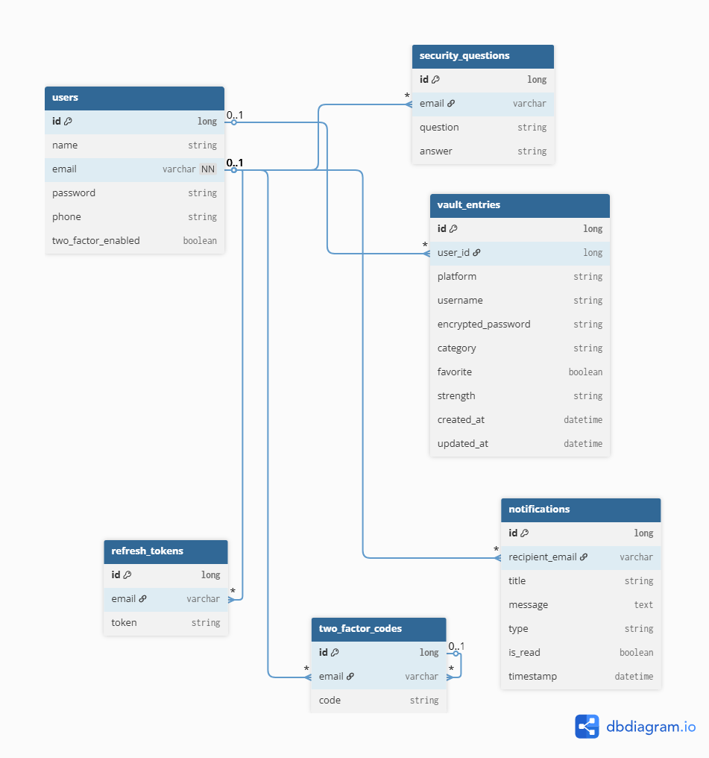
ER DIAGRAM

Slide 16
Testing Strategy
Testing performed using Mockito and service based tests.
Test Coverage Includes:
Authentication workflows
Vault operations
Password generator logic
Security validations
Advantages Of Testing:
Reduced bugs
Reliable backend services
Maintainable codebase

Slide 17
Resiliance 4j & Centralised configuration
Resiliance 4j helps when a service will crashes or not in working state
Users get pop up messages like this service is not available as of now
Make site runs smoothly even there is a failure
Centralised Config
Manages configuration of all microservices from one central location.
Eliminates duplicate files across services
Centralised Application.Properties management.

Slide 18
Challenges Faced during project
Secure Encryption Implementation: Ensuring strong encryption practices while maintaining performance and protecting sensitive credentials end-to-end.
Authentication & Authorization Flow Management: Designing reliable login, session handling, and access control mechanisms without introducing security gaps.
Sensitive Data Protection: Applying best practices for secure storage, transmission, and masking of confidential user information.
Service-to-Service Communication
Other microservices must call notification service correctly & Endpoint mapping and request formats must match

Slide 19
Future enhancements
Advanced Multi-Factor Authentication (MFA): Integrate real authenticator apps (Google Authenticator / Microsoft Authenticator) and biometric-based login for stronger identity verification
Audit Logging & Monitoring: Implement centralized logging using Log4J with analytics dashboards to track suspicious activities and improve security auditing.
Role-Based Access & Enterprise Features: Extend the system for team or enterprise usage with role-based permissions and shared vaults.
Enhanced Backup & Recovery: Support automated encrypted cloud backups and version history for password entries.

Slide 20
Conclusion
Secure Password Storage: Implements encrypted credential storage using strong hashing and secure data
Advanced Authentication: Includes layered authentication mechanisms such as master password verification, security questions, and optional two-factor authentication
Strong Encryption Practices: Applies industry-standard encryption strategies to safeguard passwords during storage and transmission, ensuring confidentiality and data integrity.
Applied clean layered architecture using Java, Spring Boot, and RESTful APIs to ensure maintainability and extensibility.

