Slide 1
NN Project Final review
Voice 2 Face-------19302,19329,19311,19322

Slide 2
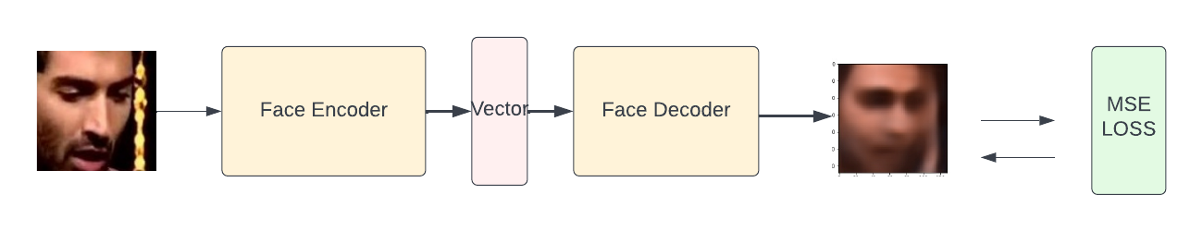
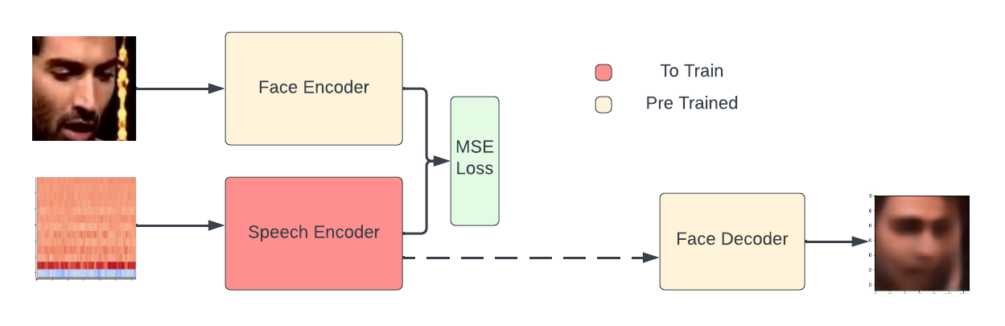
Architecture
Face Encoder Decoder
Voice 2 Face Model

Slide 3
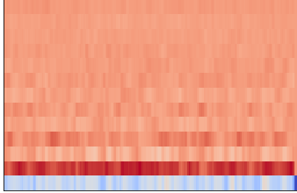

Preprocessing (mfcc)
LINK

Slide 4
step 1: 2500 images of each gender were chosen STEP 2: 1000 images of 5 AGE categories was chosen step 3: Face was cropped from the frame We had 4719 images after SOME LOSS DUE to Face Detection
DataSET SELECTION

Slide 5

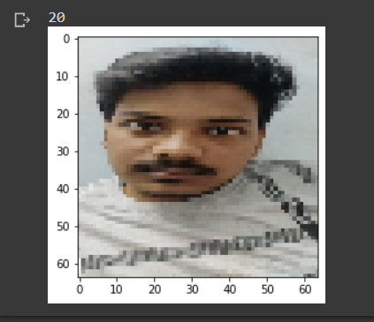
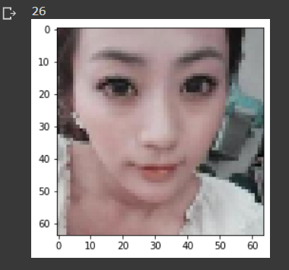
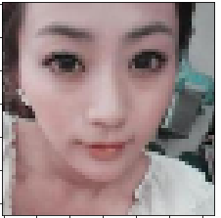
Gender Classification , Age detection
Output : Male
Output: 20
Output : Female
Output :26

Slide 6

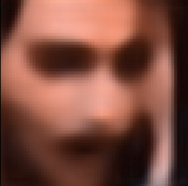
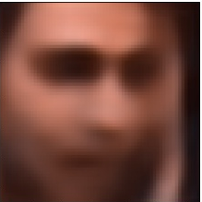

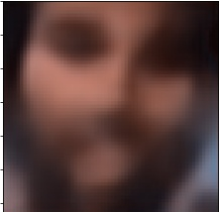
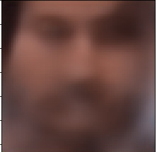

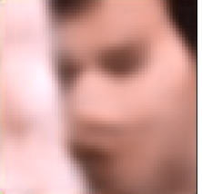
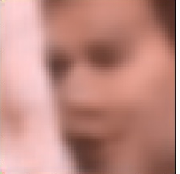
Results:
GT Faces
Face 2 Face
Voice 2 Face

Slide 7
InFerences
On Comparing Face2 Face and Voice2Face Models we can find that Hair Based Information such as Beard cant be inferred correctly through voice.
As suggested by Wav2Pix the pose of the speaker can be inferred from voice
The vector calculated by face encoder automatically corrected lighting variations as shown in Results second row.
The vector captures only Facial Information since the background information is almost nullified in all result images. Hence justifies the use of this vector to encode speech to a similar vector as the face vector.

