Slide 1
Jack the Hack Hackathon
Theme: Airport
Title: Digital Airport Application Powered By A Blockchain Based One-identity
Team Red Ross
Bharatharaj Babu
Suriyaa T
Gowtham A

Slide 2
Problem
Safety and efficiency of the customer’s journey has become an important concern especially during the pandemic times.
Travel has become very complicated with too many documents and forms that need to be filled.
Authenticating the passenger at every stage of the airport process has become very inefficient and redundant.

Slide 3
Solution
A one-stop web platform to simplify the passenger’s digital journey.
Some key features of our platform are:
F&B Contactless Ordering
Digital Duty Free
Powered by a blockchain based digital identity

Slide 4
F&B Contactless ordering
Solution involves embedding QR codes in socially distanced tables at the food court.
Avg waiting time at any F&B store is nearly 10 minutes per passenger.
Why QR Code?
Accurate, Cost efficient, and easily scalable
Create a new channel for potential offline retailers
Capture untapped market
Seamless customer experience
Digital Payment Friendly

Slide 5
F&B Contactless ordering Flow
Scan QR Code at Table
Display available F&B products
Add required products to cart
Checkout with digital payments
Display ETA on food delivery
Double factor authentication upon delivery

Slide 6
Digital Duty Free
E-commerce based platform to order products from duty-free shops.
Authenticate purchases using the digital identity and embed business logic to ensure validity of purchase.
Easy checkout
Digital Payment Friendly
Products delivered to gate
Delivery within authorized premises
One Step Authentication

Slide 7
Digital Duty Free Flow
Go to duty free page
Choose product category
Choose product
Checkout with digital payments
Schedule delivery of products once confirmed
Authenticate with digital identity

Slide 8
Blockchain Based Digital Identity
Creation of a single trusted identity using blockchain technology capable of authenticating the passenger throughout his journey.
Enable the digital identity to be used at any partner organizations inside the airport.
Register passenger onto blockchain network
Authenticate at various stages of airport process
Track passenger’s journey through airport.
Eliminate intermediaries in verification process
Enable storing essential travel documents such as Passport, AADHAR, etc.

Slide 9
Blockchain Based Digital Identity Flow
Register passenger with all details onto network
Authenticate passenger from government peer
Authenticate passenger at any partner organization
Store details related to reward points
Enable smart contract based checks at every stage to ensure authenticity
Track the passenger’s journey throughout the airport.

Slide 10
Some add-ons:
Dashboard Page:
Live Flight Status using a FlightRadar API
Live weather and currency exchange rates using APIs
Digital Boarding Pass
Announcements status at airports
Status of loyalty points
Status on forms if any (Varies based on destination)

Slide 11
Tech Stack
Frontend:
HTML, CSS, Javascript
ReactJS
Backend
Node JS, Express
APIs – OpenWeather, AeroDataBox, CurrencyExchange
Blockchain
Hyperledger Fabric V2.0
Node JS
Docker

Slide 12
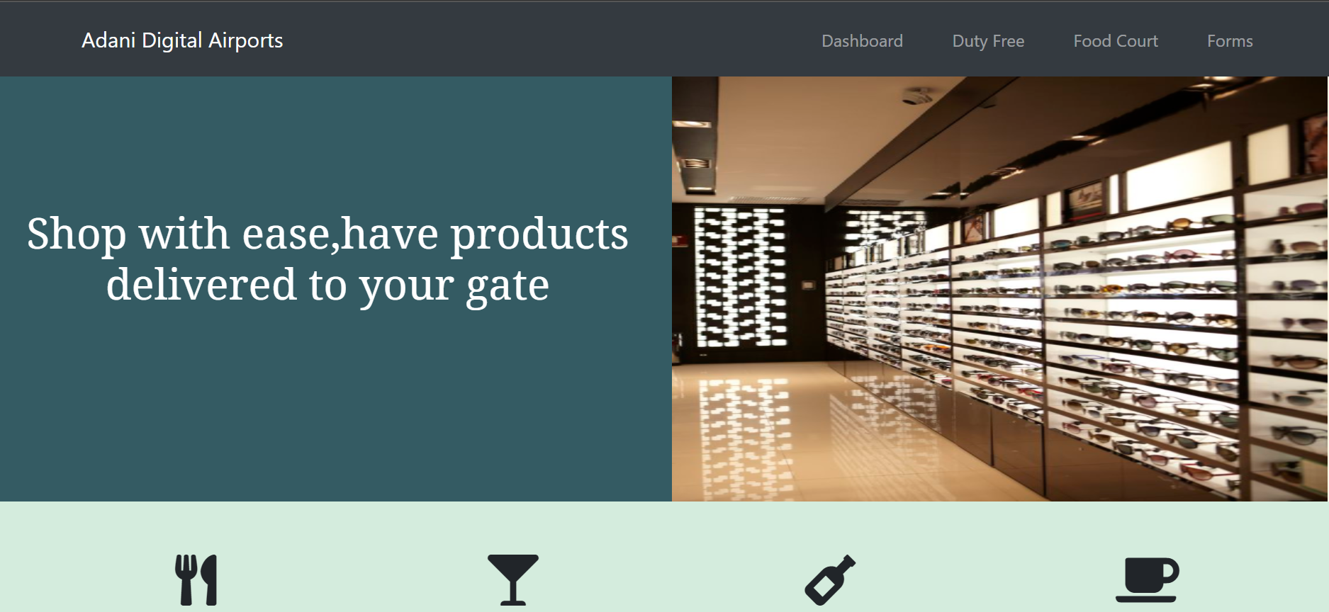

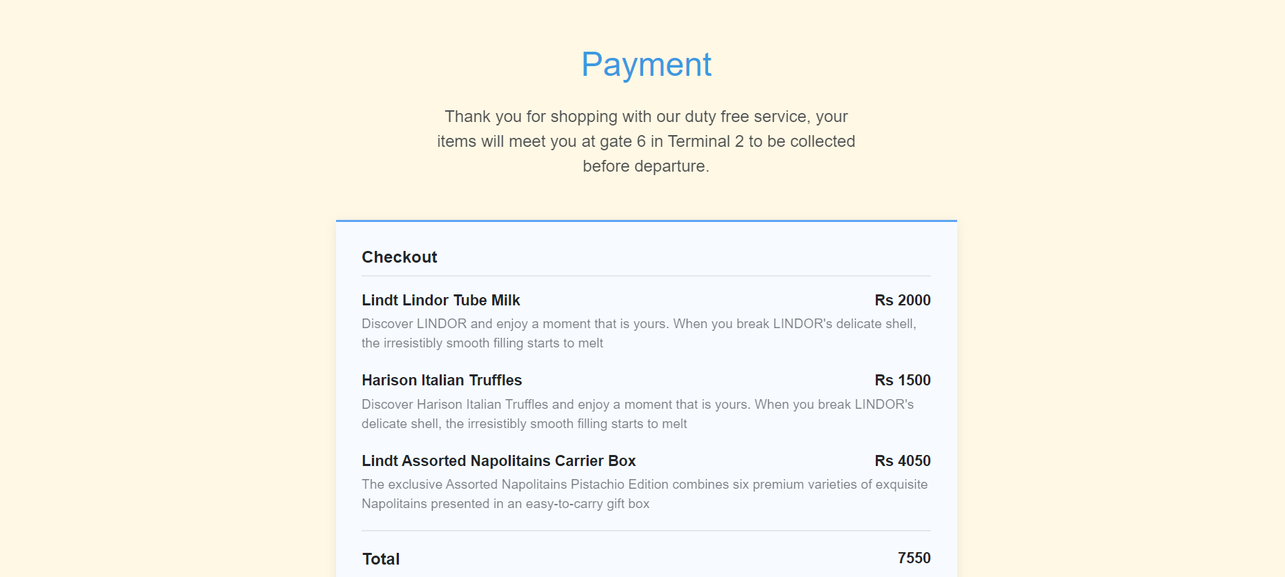
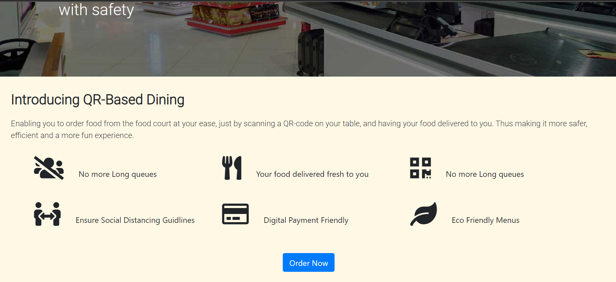
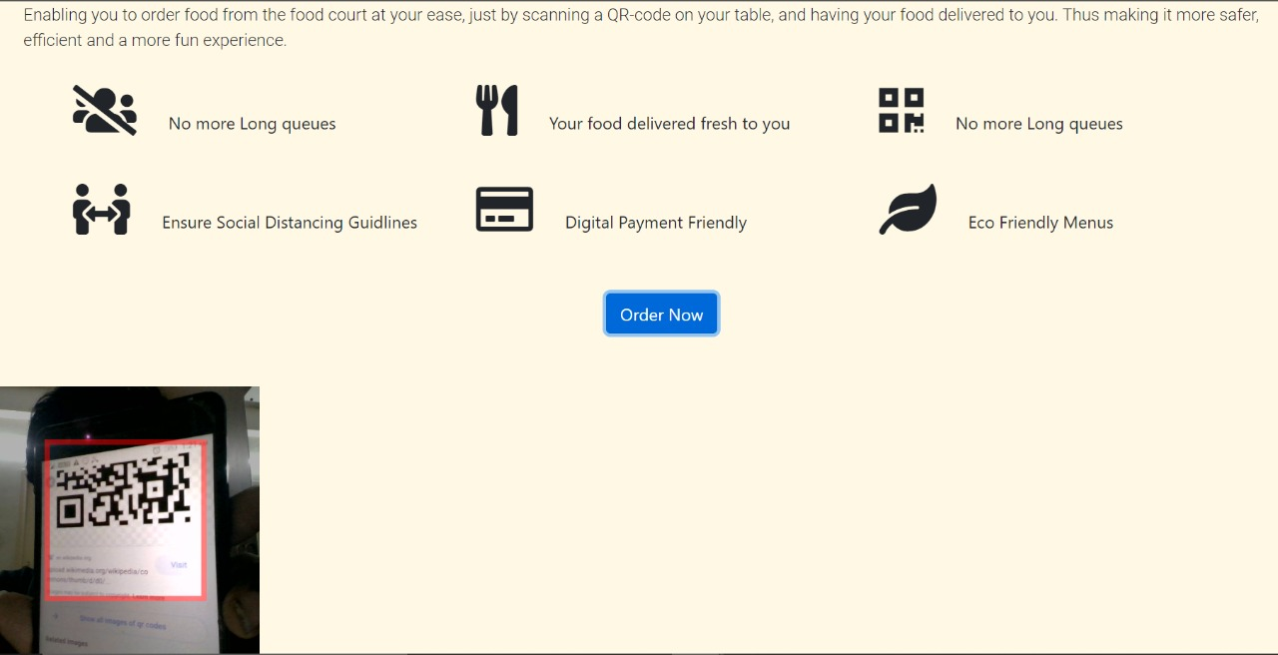

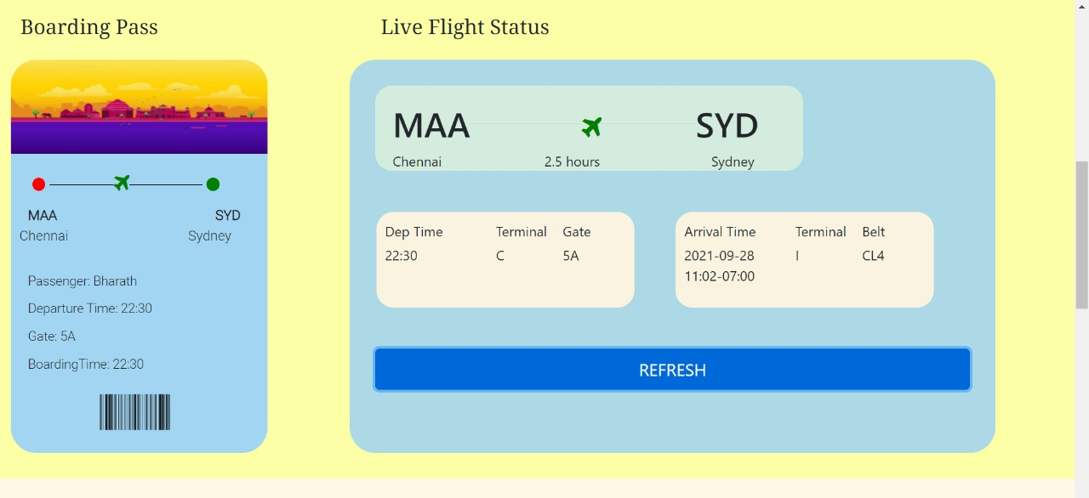
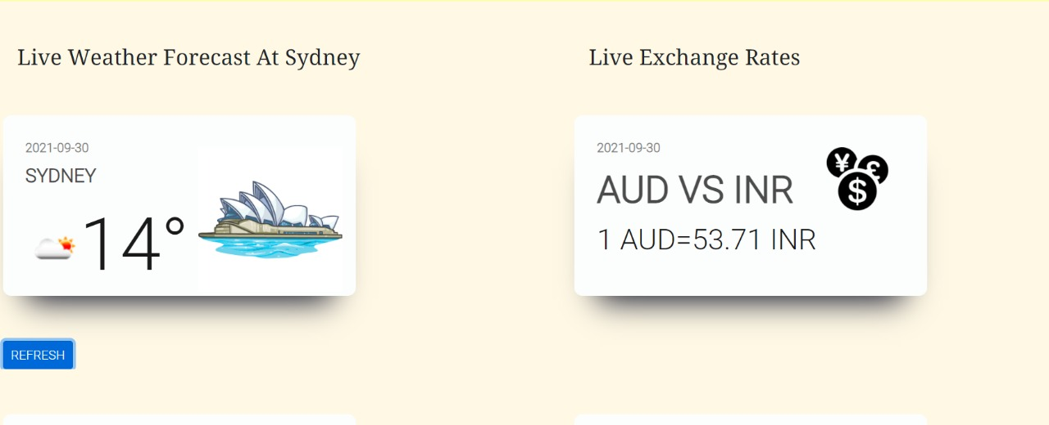
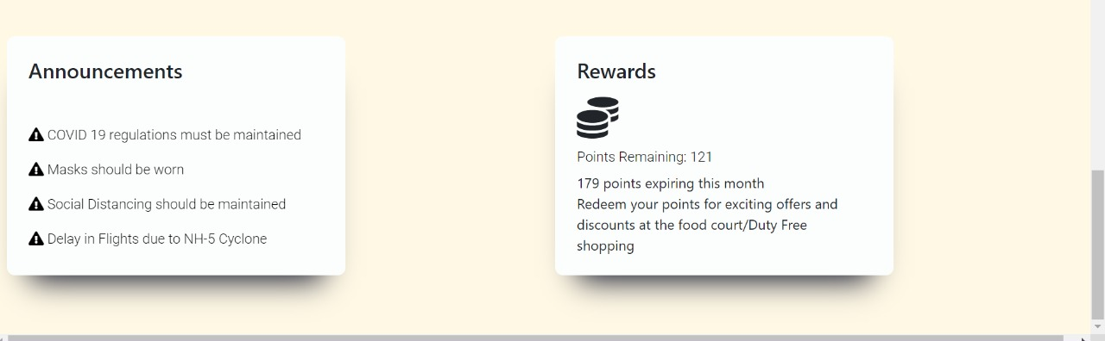
Product Screenshots:

Slide 13
Further Additions:
The entire application code can be found at https://github.com/suriyaa333/Jack-The-Hack-Hackathon-Project-Submission
The extended demo videos for the same can be found at https://drive.google.com/drive/folders/1KH3-sauyhEmMxCWLtVOKc3gQ4Dg-mJd0
Thank You

