Slide 1


7th International Conference for Convergence in Technology (7th I2CT 2022)
Title:Topic Modelling on Consumer Financial Protection Bureau Data: An Approach Using BERT Based Embeddings
Paper ID: 914
Presenter Name: Vasudeva Raju S.

Slide 2
Motivation and Background | 03
Problem Statement | 04
Aim & Objectives | 05
Methodology | 06
Results and Discussions | 11
Conclusions and Recommendations | 18
Research Presentation Outline

Slide 3
Motivation and Background
Background Financial Organizations receive hundreds of consumer complaints every day, manually routing them to subject matter expertise increase time of response and in the mean time customer may get irritated and escalate the issue to protection bureau which in turn is a reputational loss to the organization
Motivation
is to create an intelligent NLP solution for finance organizations to automatically assign the complaints received by consumers to the subject matter expert and thereby reduce the response time and also save the manual efforts of the customer service professionals

Slide 4
Problem Statement
The problem at hand is
to find out the best topic modelling technique to create the topics from complaints text data of financial organizations and to find a way to prioritize the complaints to save the organization from reputational loss.

Slide 5
Research Aim & Objectives
Aim
This research aims to comparative study of the existing word embedding techniques to extract topics for Topic modeling on a consumer complaint dataset and compare “Embedding Spaces” with different baselines.
Objective #1 To investigate the utility and performance of existing word embedding techniques (Finbert, BERT, RoBerta, DistilBert) in finding topics utilizing the proposed technique “Embedding Spaces”.
Objective #2 To compare “Embedding Spaces” with baselines, such as LSA and LDA.

Slide 6
Research Methodology I
Dataset :
Dataset has columns like Company, Product, State, Date of complaint along with the “Consumer complaint narrative ” text column
Dataset is CSV file format, which is directly downloaded from CFPB official website
The data identified for this study is an open source data from Consumer Financial Protection Bureau website
This is a quantitative study which evaluates the performance of different topic models on financial text data

Slide 7
Research Methodology II
Sample of Dataset :
Consumer complaint narrative
PayPal Resolution Center ignored their own policies in the determination of a dispute or complaint. I submitted a complaint to PayPal with whom I tried to buy a remote control professional grade bait boat from ( ( Seller info XXXX ) ) copied from the payment page on PayPal name shown. PayPal never gave me any fair chance to prove what actually happened. NOW PayPal is STALLING me from my listed ability by PayPal 's own regulations, that I can file an APPEAL since I do not agree with their seemingly biased decision in favor of the seller. PayPal declared the CASE CLOSED XXXX XXXX, 2017. YET they have NOT officially listed my case as CLOSED. This means I CAN NOT FILE ANY APPEAL. The deadline for my Appeal is XXXX XXXX, 2017
I am the personal representative of my sister 's estate. When preparing to sell her home I discovered that PHH Mortgage had been charging her for insurance that was already being paid by her homeowners association. PHH Mortgage has since closed the mortgage with the home sale but has not refunded the overcharges for unnecessary insurance.
Hello, three months ago I was in the process of obtaining a mortgage and signed up with Experian to obtain my detailed credit report from all three credit reporting agencies. At the time of signing up for this product, I was very careful to make sure I was not going to be billed monthly, I just needed the details from my credit reports at that particular time. I just realized that Experian has been charging me {$24.00} for the past three months, most recently on X/XX/17, X/XX/17 before that, and X/XX/17 before that.
I was provided incorrect information by Nelnet regarding what benefits my student loans, that are in my father 's name, are eligible for. At the time of consolidation, we were told that the newly consolidated loan could be deferred if I were to pursue further education. This was very important in our decision to consolidate the loans as we had always planned to pursue further education ( Both my sister and myself are impacted by this. She also consolidated her loans post her graduation as well ).
On XX/XX/XXXX I signed a digital contract with Equitable Acceptance Corporation ( also known as XXXX XXXX XXXX XXXX ) to pay them a specified amount ( $ XXXX/ month ) for a total financed amount of {$1300.00} over the course of 3 years for services rendered by The Student Loan Relief Department for student loan debt reconsolidation.

Slide 8
Research Methodology III
Methodology Comparison:
LDA & LSA
Matrix based models.
Topics are produced based on word frequency.
Fail to work on large corpus as they have sparsity issue.
Ignores the order of words, hence semantic relationship between the words is not captured.
Embedded Space Models
Vector based models.
Topics are extracted by grouping the similar meaning words together
Works effectively on large corpus.
Considers the order of words and captures the semantic relationship between the words.

Slide 9
Research Methodology IV
Model Architecture:
LSA
Tokenized Complaint Sentences
Topics
Lemmatization
TF-IDF
LDA
BERTopic
Vectorization
Dimension Reduction
Importance
of words
Clustering
Untokenized Complaint Sentences
Sentence Transformers
Topics
c-TF-IDF
UMAP
HDBSCAN
BERT , DistilBERT, FinBERT, RoBERTa

Slide 10
Research Methodology V
Evaluation metrics for topic models :
C_V metric measures the represents the inter-cluster distance which means that it signifies the distance between the two clusters and it should be maximum for the ideal model.
U_Mass metric calculates how often two words appear together in the cluster and it should be maximum for the ideal model.

Slide 11
Research Results and Discussions I
Topics Generated by Legacy Standard Topic Models
LSA :
Debt Collection
Mortgage loans
Disputes and Inquiries
Service fee
Credit Report
LDA :
Auto Loan
Mortgage loan
Account Charge-off
Account Reporting
Fraud
Debt Collection
Late fee payment
Credit card reporting

Slide 12
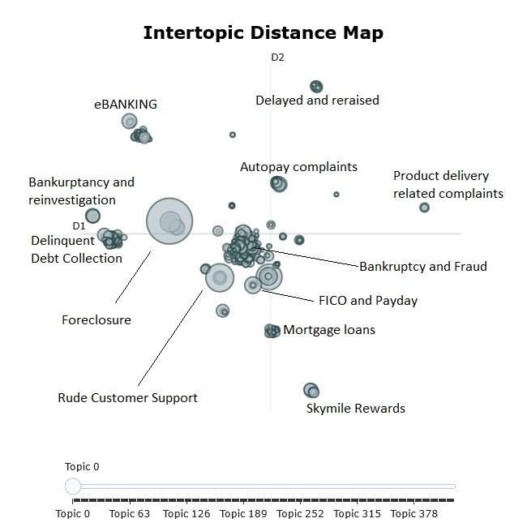
Research Results and Discussions II
Topics Generated by Embedded Space Models
# | Topic Name | Major words in the cluster
1 | Delayed and reraised Complaints Cluster | Autopay, eLoan, Statement, banker, penalty, alert, tape
2 | eBANKING | Payment, Judgement, reinvestigation, Bankruptcy, accounts, trade, major
3 | Autopay complaints | Autopay, cardholders, roll, Autotrack
4 | Delinquent Debt Collection | Delinquent, limit, Debt, recovery, Collection, discrepancy, major
5 | Foreclosure | Foreclosure, Income, value, preserve, equity, deed, specialist
6 | Rude Customer Support | dialler, harass, rude, talk, email, recipient, lot
7 | Skymile Rewards | Airline, signup, code, advantage, bonus, Skymiles, eligibility
8 | Mortgage loans | Mortgage, home, debt, lien, outdate
9 | FICO and Payday | Payday, bike, fico, Equifax, experience, inaccuracy, quick
10 | Bankruptcy and Fraud | Sadly, Bankruptcy, cheated, scam, game, report, unapproved
11 | Product delivery related complaints | Victim, delivery, related, associate, products
BERT

Slide 13
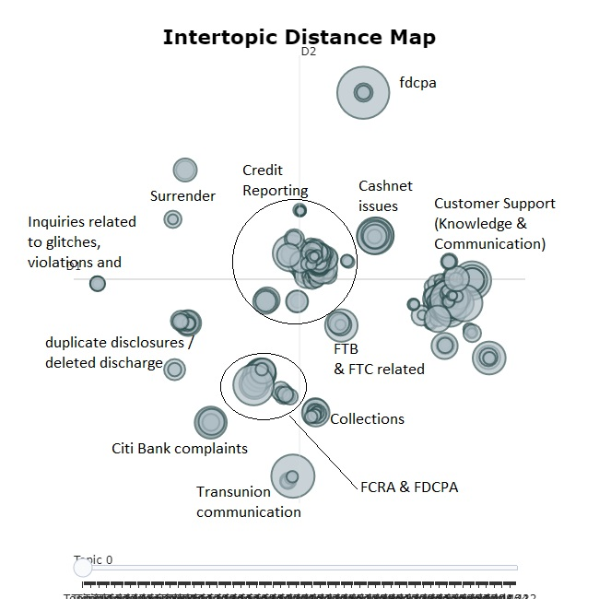
Research Results and Discussions III
Topics Generated by Embedded Space Models
# | Topic Name | Major words in the cluster
1 | Credit Reporting | Credit reporting, principal, interest, splitter, overdrawn, overcharge, approximate
2 | Glitches, violations related inquiries, and their resolutions | glitch, result, violations, inquiry, percentage, need, resolution
3 | Delete discharge / Duplicate disclosures | Damage, delete, diversify, discharge, disclosures
4 | Citi Bank complaints | citigold, citibank, citi, eligibility, promotion, promise, consecutive
5 | Transunion communication | Transunion, Equifax, statutory, fibula, fibril, fair, private
6 | FCRA & FDCPA | fdcpa, fcra, cra, signature, trustor
7 | Collections | somebody, information, loan deportment, property, filing, duplicate, collections
8 | FTB & FTC | affidavit, ftc, accounts, delete, ftc, debt, delinquency
9 | Customer Support (Knowledge & Communication) | harass, voicemail, mislead, criminal, contact, Knowledge, Support
10 | Cashnet issues | pennymac, affairs administration, cashnet USA, underwriting, live, payoff
FinBERT

Slide 14
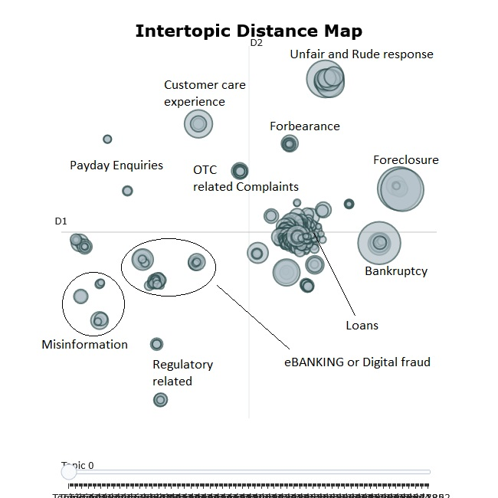
Research Results and Discussions IV
Topics Generated by Embedded Space Models
# | Topic Name | Major words in the cluster
1 | Customer care experience | cancelled in act, chat, consecutive, eligibility, key bank, advantage, response
2 | OTC related complaints | cashier, counter, unhappy, teller, frozen, handset, weekly
3 | Payday Enquiries | telephone, payday, fraudulent, harass, steady, defer, retail, cheques
4 | eBANKING or Digital fraud | glitch, fraudulent, voicemail, cyber, duplicate, telephone
5 | Misinformation | Inquiry, Misinformation, negative, share, satisfy, past, fair
6 | Regulatory related | Regulatory, surrender, entity, discrepancy, judgement, constitute, conserve
7 | Loans | Lien, finance, fedloan, mortgage, disclosure, creditkarma, signature, student, jewel
8 | Bankruptcy | Bankruptcy, validated, verified, convince, discharge, shellpoint, bsi
9 | Forbearance | forbear, payment, repossession, accuracy, trace, overdrawn
10 | Foreclosure | foreclosure, trust, income, qualify, ocwen, inspect
11 | Unfair and Rude response | hung, chat, resurge, rude, garnish, talk, delink, whenever
DistilBERT

Slide 15
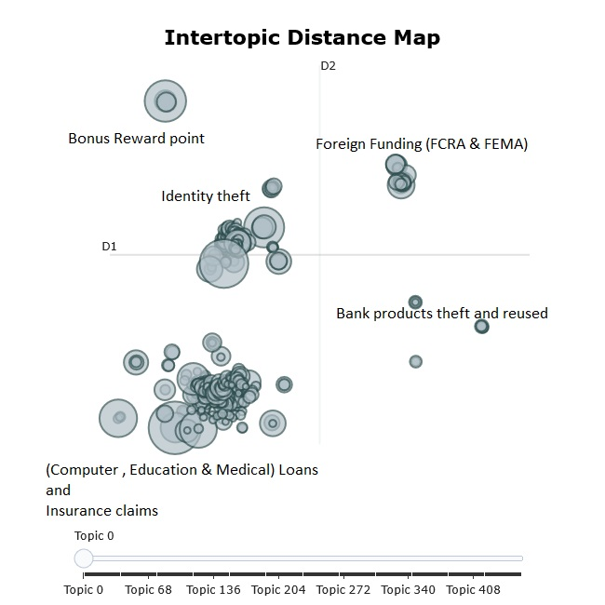
Research Results and Discussions V
Topics Generated by Embedded Space Models
# | Topic Name | Major words in the cluster
1 | Identification Theft | victim, modify, identify, theft, trust, employ, voice, fraudulent
2 | Foreign Funding (FCRA & FEMA) | FCRA, thank, notify, shortage, fay, fema
3 | Bonus Reward points | reward, membership, spend, bonus, promotion, advantage, consecutive
4 | (Computer, Education & Medical) Loans or Insurance claims | rehabilitation, student, course, interest, mortgage, roadlaon, visa, suntrust, pma, college, costco, ira, atm
5 | Bank products theft and reused | reinsert, grave, suffer, inquiry, reopen, grace, theft
RoBERTa

Slide 16
Research Results and Discussions VI
Topics Generated by Embedded Space Models
Topics in common | BERT | FinBERT | DistilBERT | RoBERTa
2 | eBanking |  | eBanking or Digital Fraud
 | Delinquent Debt Collection | Collections
 | Foreclosure |  | Foreclosure
 | FICO and payday |  | Payday Enquiries
 | Skymile Rewards |  |  | Bonus Reward Points
 |  | FCRA & FDCPA |  | Foreign Funding (FCRA & FEMA)
3 | Rude Customer Support | Glitches, violations related inquiries and their resolutions | Unfair and Rude response
 | Mortgage Loans |  | Loans | (Computer, Education & Medical) Loans or Insurance Claims
 | Delayed and Reraised | Customer Support (Knowledge & Communication) | Customer Care experience
 | Bankruptcy and Reinvestment | Delete discharge / Duplicate disclosures | Misinformation
 | Bankruptcy and Fraud |  | Bankruptcy | Identification Theft
4 | Product Delivery Related | Cashnet Issues | Regulatory Related | Bank Products Theft and Reused
1 | Autopay
 |  |  | OTC Related Complaints
 |  |  | Forbearance
 |  | Credit Reporting
 |  | Citi Bank Complaints
 |  | TransUnion Communications
 |  | FTB & FTC

Slide 17
Research Results and Discussions VII
Evaluating the Topic Models
Metrics/Algorithm | C_V | U_Mass
LSA | 0.2365 | -2.2675
LDA | 0.3197 | -6.1207
BERT | 0.3225 | -12.3169
FinBERT | 0.3327 | -12.6526
DistilBERT | 0.3249 | -11.2687
RoBERTa | 0.3269 | -11.521
Topic models are considered as best when C_V metric is maximum and U_Mass metric is maximum.
C_V metric measures the represents the inter-cluster distance which means that it signifies the distance between the two clusters and it should be maximum for the ideal model.
U_Mass metric calculates how often two words appear together in the cluster and it should be maximum for the ideal model.
From the above table, we can tell FinBERT gave best results compared to other topic models as its C_V score is maximum and U_Mass metric is maximum. This is because FinBERT is extensively pre-trained on finance text data. Also, in the previous slide we can notice that FinBERT is able to identify more number of unique topics when compared with other Topic models.

Slide 18
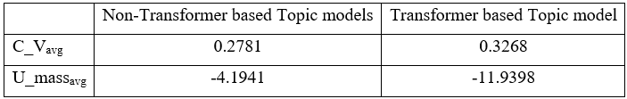
Conclusions
Conclusion #1
Conclusion #2
Conclusion #3
Based on our experiences and review of relevant literature, legacy standard topic modeling techniques do not capture the importance of context as these algorithms ignore the order of the words but sentence-based transformers capture the importance of the order of text and capture the context.
By comparing U_mass and C_V metrics of Transformer based topic models (BERT, FinBERT, DistilBERT & RoBERTa) and non-Transformer based topic models (LSA & LDA) we can say that transformer-based topic model performs very well in capturing the context and topics with acceptable intercluster distance and intracluster distance.
Out of Transformer based Embedded space topic modelling techniques, “FinBERT” works better on financial data.
FinBERT demonstrated good intercluster and intracluster bonding.
FinBERT is able to identify unique topics in finance when compared with other pretrained BERTs.

Slide 19
Future Scope
Recommendation 1
BERTopic package uses UMAP dimension reduction technique, to improve the efficiency UMAP can be replaced with variational autoencoders. Also, we can play with dimension reduction (whether 20, 30, 50) as a hyperparameter tuning.
Recommendation 2
Find a way to automatically assign the new complaint to one of the clusters (write now we have to run the whole process again to bucket the new complaint which consumes a lot of time) which might be a good opportunity for further research.
Recommendation 3
Because of the timeout error and out of memory error with BERTopic package, study is limited only to 2016 data, that can be worked on to handle the complete dataset which would be beneficial in future studies.

Slide 20


