Slide 1
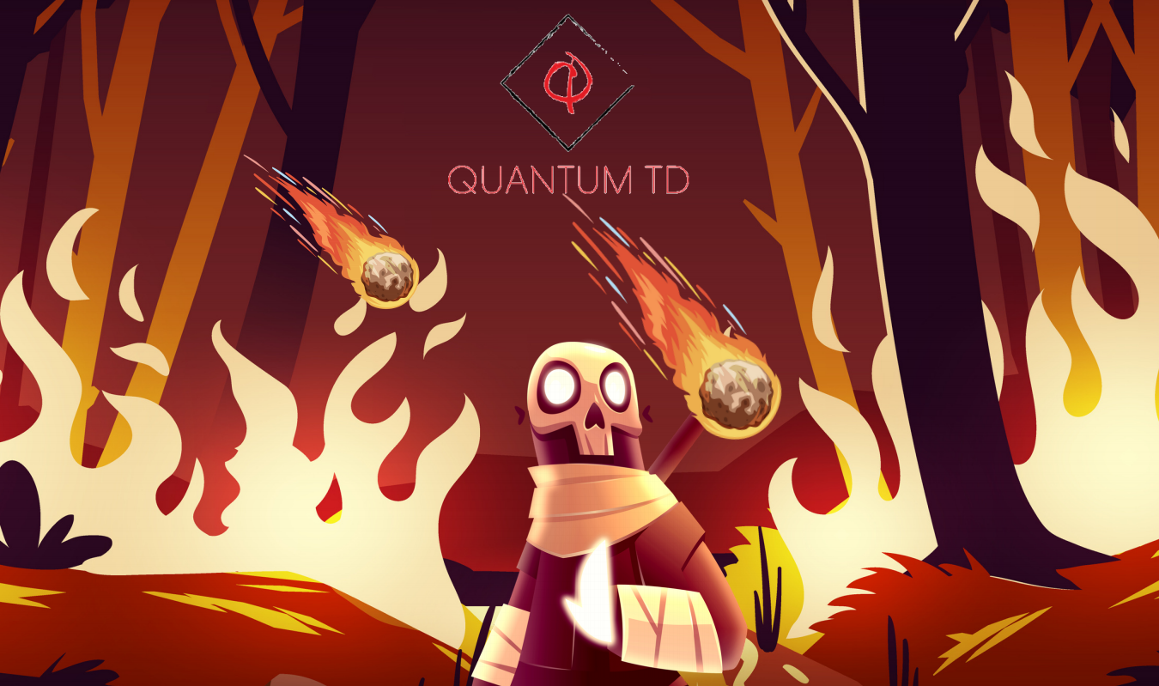

Slide 2
Quantum
Tower Defence
Enemies come in waves,
Can you protect your home?
Orbital 2021 by Tee Chin & Bharath

Slide 3
Quantum
Tower Defence
They come from two worlds
Orbital 2021 by Tee Chin & Bharath

Slide 4
Quantum
Tower Defence
But you don't know which
Orbital 2021 by Tee Chin & Bharath

Slide 5
Quantum
Tower Defence
The enemies exist in superposition, only to be decided on contact with a Quodite projectile
Orbital 2021 by Tee Chin & Bharath

Slide 6
Quantum
Tower Defence
Or you can use a Tensor projectile, which can do more interesting things
Orbital 2021 by Tee Chin & Bharath

Slide 7
Quantum
Tower Defence
Orbital 2021 by Tee Chin & Bharath

