Slide 1
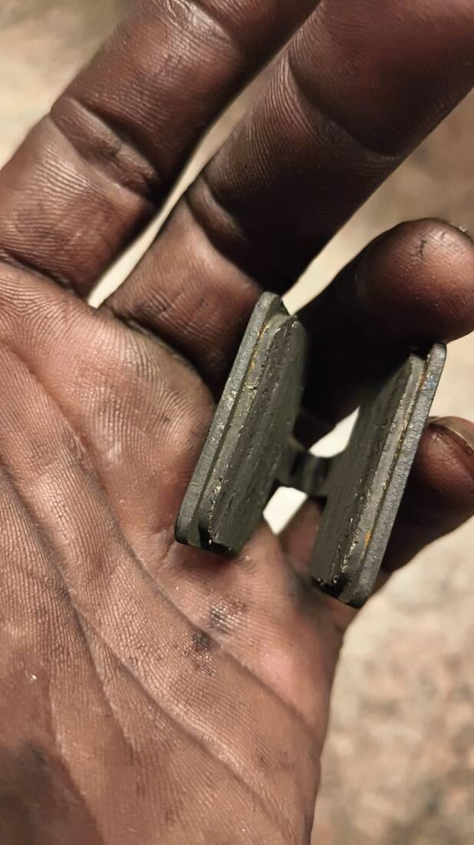
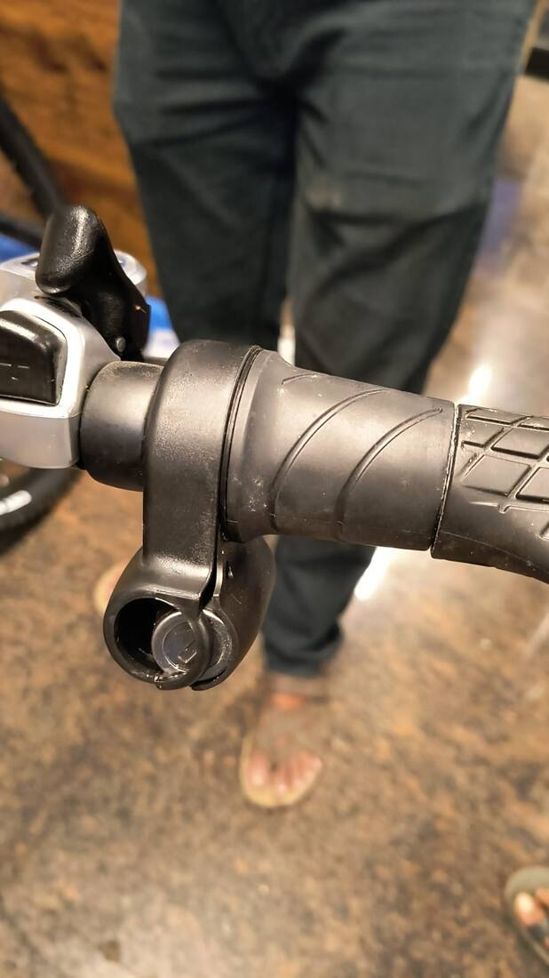
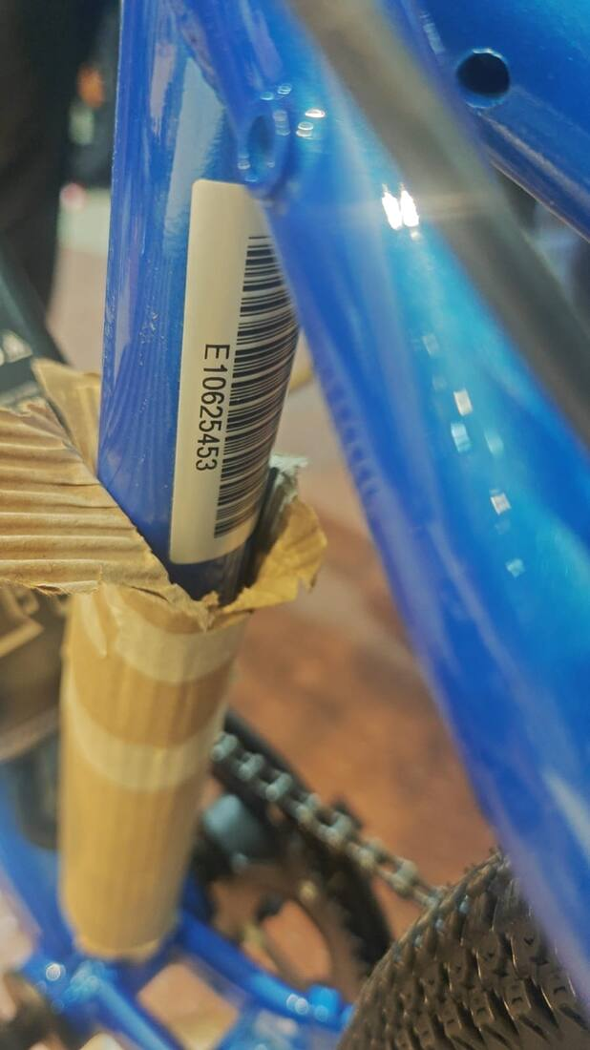
SERVICE PERFORMANCE REVIEW · PREPARED BY BHARAT CYCLE HUB
Bharat Cycle Hub × EMotorad
840 days of service issues,
documented in our own chat.
Every finding in this deck is reconstructed verbatim from the WhatsApp group “Bch X EM service team” — its messages, ticket numbers and photos. Nothing here is opinion.
8,820
280+
711
1,020
MESSAGES
TICKET NUMBERS
FOLLOW-UP CHASES
EVIDENCE PHOTOS
PERIOD COVERED: 24 FEB 2024 — 12 JUN 2026
EVIDENCE: WORN BRAKE PADS AT 527 KM · FORK BENT IN TRANSIT · NEW-BOX THROTTLE DAMAGED

Slide 2
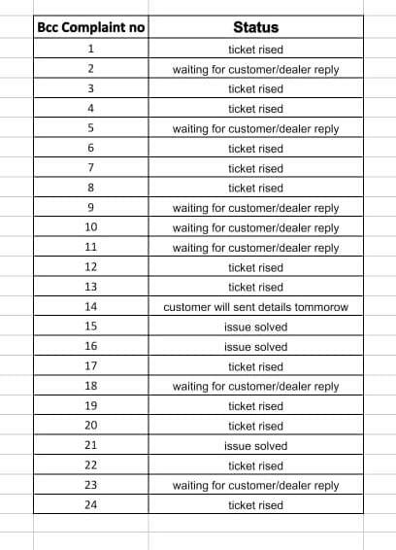
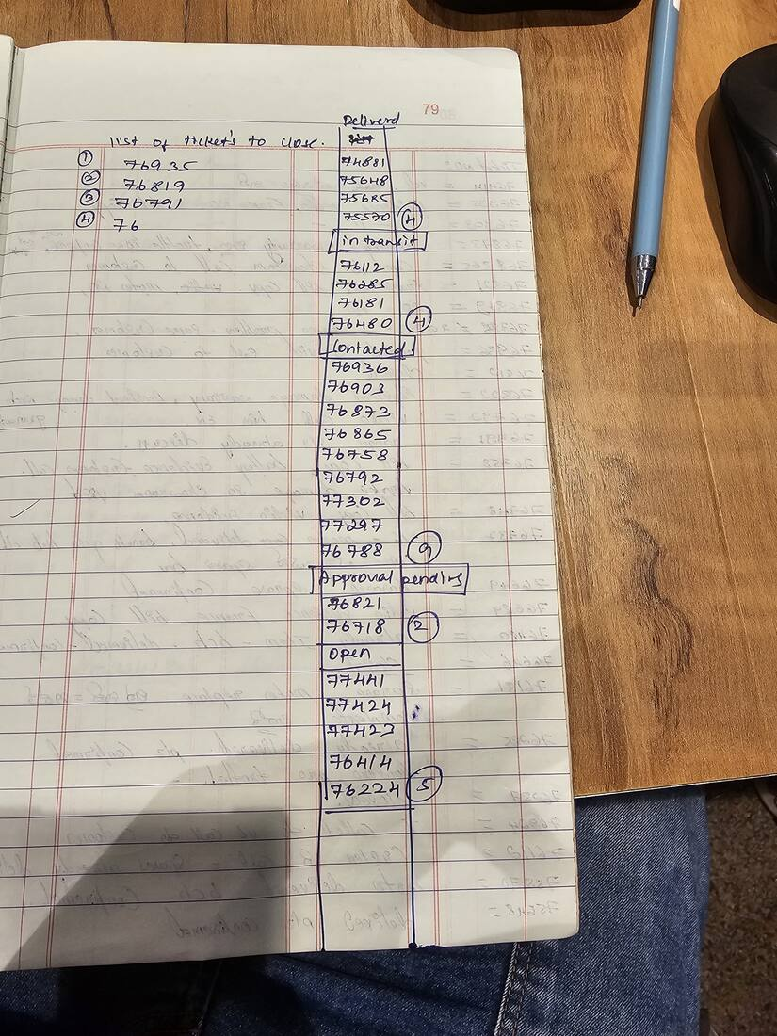
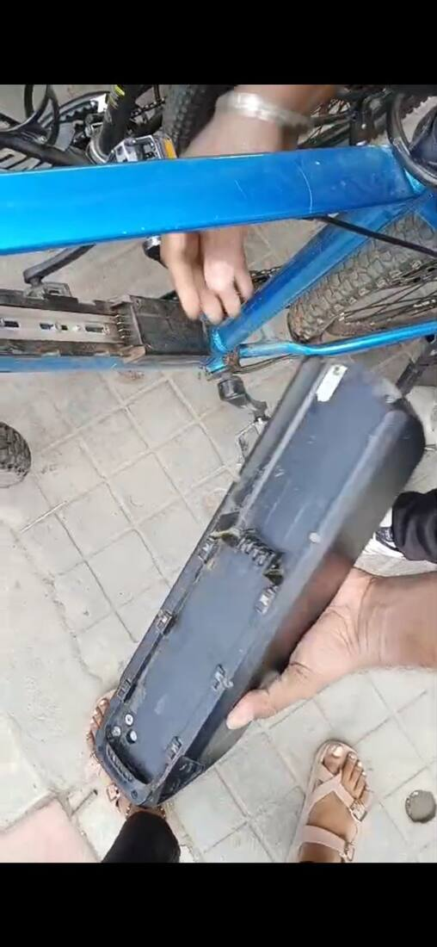
EXECUTIVE SUMMARY
The capability exists. The consistency doesn’t.
The same chat shows a charger replaced in 4 days when intake was clean — and a throttle that took 88 days. Issues move at normal speed only after senior management is tagged.
8 days
average resolution (April 2025 audit: 50 tickets, 37 unclosed)
VS THE 48-HOUR PROMISE
711
follow-up chase messages BCH had to send over 28 months
PEAK 225 IN Q3 2025
EM’s own audit of BCH’s 24-case backlog — only 12 ever ticketed (5 Jun 2024)
88·80·55
days for the worst throttle, motor and replacement-cycle cases
TICKETS #81618 · #84001 · #89002/4
6 of 16
issues from the past 3 months are still open or unclear today
AS OF 12 JUN 2026
April 2025 ticket ledger · battery sticker dispute
02 · BCH × EMOTORAD SERVICE REVIEW

Slide 3
CLASSIFICATION
Every issue falls into six repeating categories
1
PRODUCT QUALITY
2
SPARE PARTS DELAY
3
COMMUNICATION DELAY
Motors, batteries, displays, brakes, frames — incl. DOA units and whole defective lots.
Replacements take days to months; stock-outs with no ETA.
Days of silence; BCH chases for updates, LR numbers, ticket status.
EXAMPLE An entire T-Rex+ lot arrived missing headset spacers (Sep 2025).
EXAMPLE A throttle requested 8 Apr 2025 arrived ~88 days later (#81618).
EXAMPLE 5 days with zero reply while a customer waited in-store (Jun 2026).
4
LOGISTICS FAILURE
5
WARRANTY DISPUTE
6
PROCESS / TICKETING
Lost shipments, untraceable LRs, disputed PODs, transit damage.
Claims denied on contested grounds; commitments walked back.
No ticket numbers, premature closures, wrong parts shipped.
EXAMPLE A Viper display was lost in courier — admitted after 20 days (Jun 2026).
EXAMPLE A promised battery became “we will correct the manual” (Mar 2026).
EXAMPLE 30% of complaints had no ticket number (Oct 2024).
03 · BCH × EMOTORAD SERVICE REVIEW

Slide 4
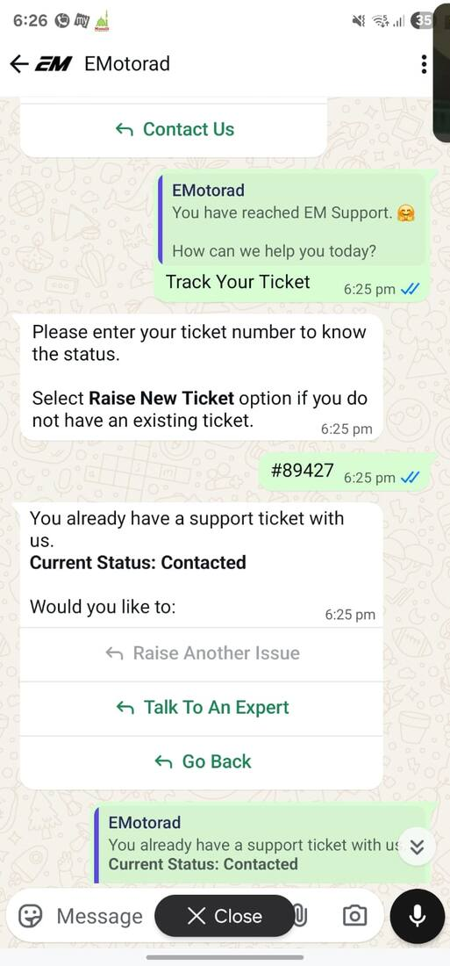
THE COST OF FOLLOWING UP
711 chase messages that should never have been needed
Store-side messages like “any update?”, “please reply”, “LR number?”, “customer is asking” — per quarter. The Q3 2025 peak was later traced in the chat itself: EM agents’ Zoho ticket comments were set to “private” and invisible to BCH.
225
chases in Q3 2025 — more than 3 per working day
* Q2 2026 covers 1 Apr – 12 Jun only.
The root cause, found Sep 2025: Zoho comments marked “private”
04 · BCH × EMOTORAD SERVICE REVIEW

Slide 5
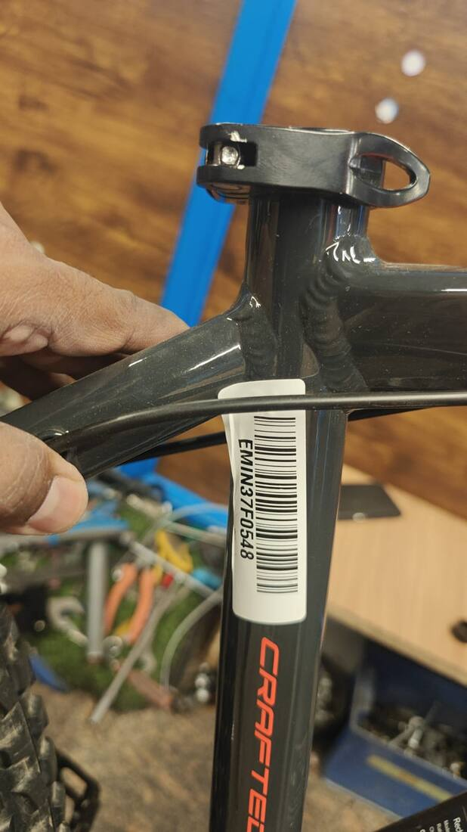
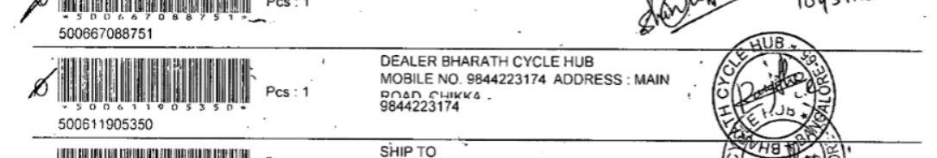
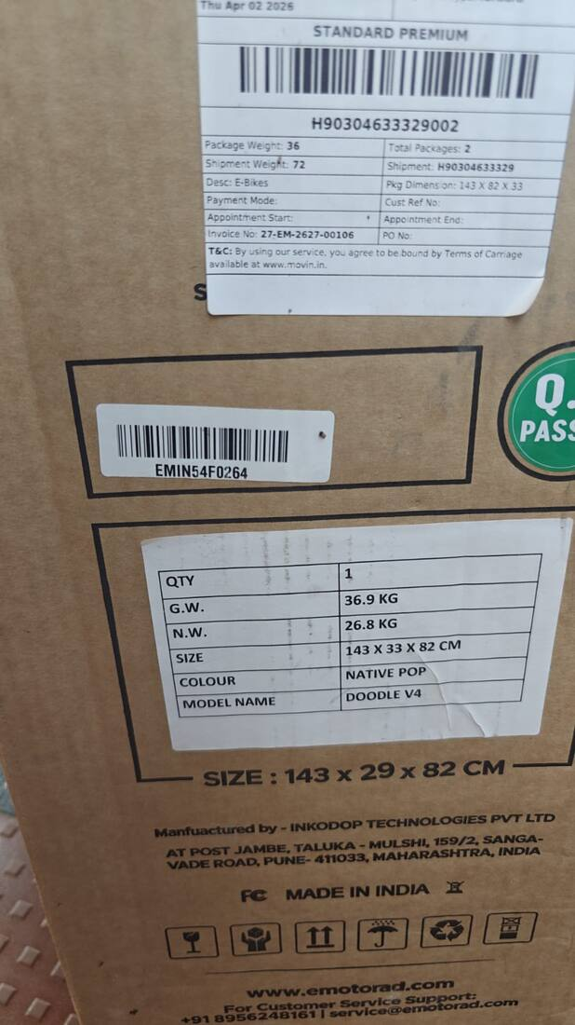
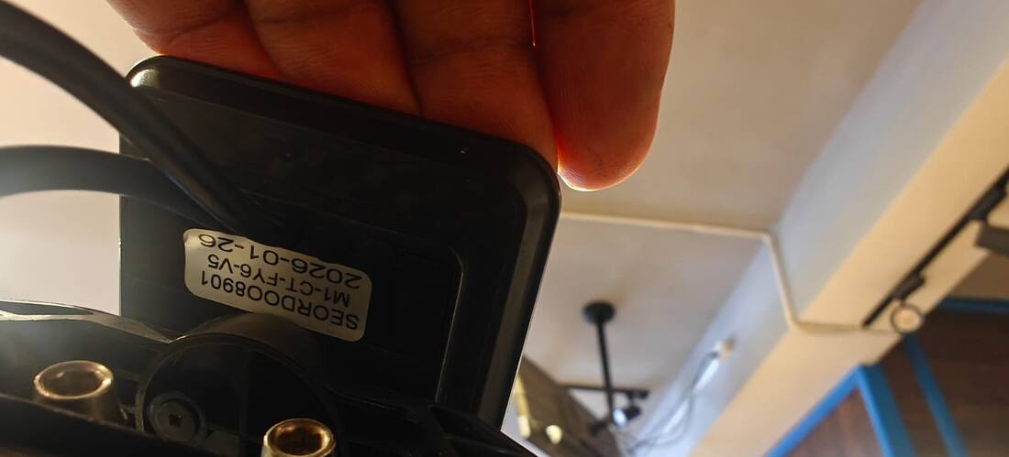
SPOTLIGHT · 12 MAR – 12 JUN 2026
The past three months: 16 issues, 6 unresolved
975 messages and ≈101 store-side chases in 90 days — including bursts of 5–6 identical “any update” messages before EM responded.
6
STILL OPEN / UNCLEAR
10
RESOLVED — AVG 16 DAYS
PRODUCT QUALITY
6
PROCESS / TICKETING
3
LOGISTICS FAILURE
3
SPARE PARTS DELAY
2
Docket said display, contained a motor
Throttle key missing, new unit
COMMUNICATION DELAY
2
WARRANTY DISPUTE
1
ISSUES BY CATEGORY (LAST 3 MONTHS)
“Delivered” part that never arrived
X1 total brake failure
05 · BCH × EMOTORAD SERVICE REVIEW

Slide 6
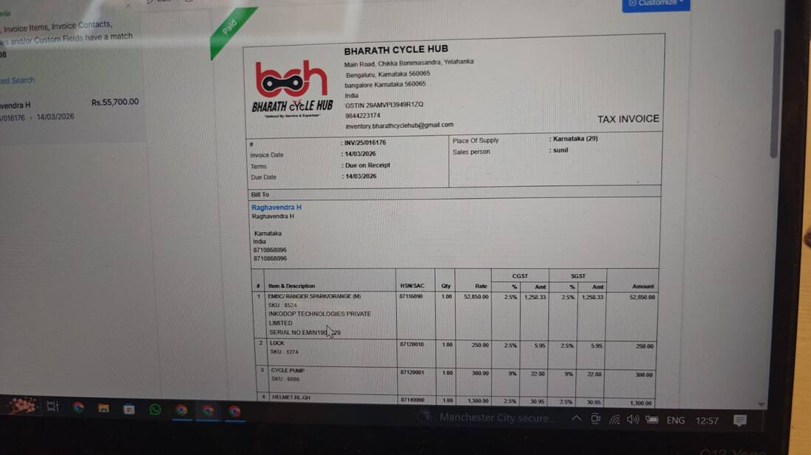
CASE STUDY 01 · TICKET #104372
One week old, every part swapped — a month to replace
PRODUCT QUALITY
23 MAR
E007 error on a week-old cycle. Motor, controller, display and 7-in-1 harness ALL swapped on EM’s instructions — in front of the waiting customer. Nothing works.
24 MAR
Customer shouting in-store. Replacement approved only after BCH tags senior management the same evening.
EARLY APR
Reverse pickup stalls — EM’s year-end audit freezes dispatches.
The failed cycle packed for reverse pickup (24 Mar 2026)
Store coordinator · 24 Mar, 6:12 PM
“Sir any one please respond customer is shouting on us please respond 🙏🙏🙏”
23 APR
Replacement bike finally ships. 31 days end to end, for a bike that failed in week one.
Sandeep Sir, EMotorad · 24 Mar, 6:36 PM
“commitment must not failed at any cost”
31 days from failure to replacement — EM’s advertised resolution is 48 hours.
06 · BCH × EMOTORAD SERVICE REVIEW

Slide 7
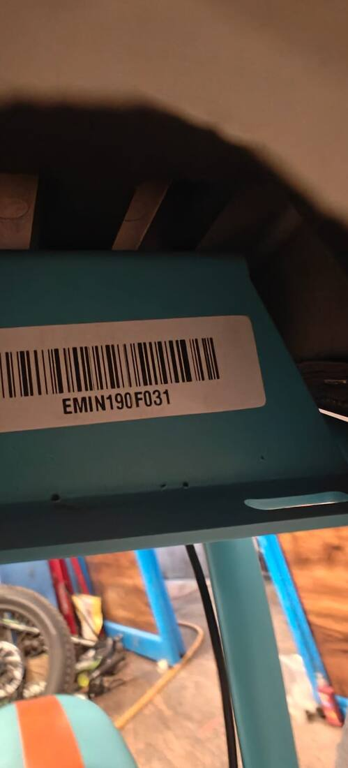
CASE STUDY 02 · TICKET #109192 — STILL OPEN
Brakes: a systemic defect, then the wrong parts twice
PRODUCT QUALITY
527 km. Pads changed twice. Caliper once.
All replaced free of cost by the store. The same pattern shows on X1 (total front + rear brake failure, May 2026) and Viper. BCH asked for a root-cause fix on 1 Jun — what arrived a week later were the wrong (resin) pads, and EM then discovered the order had been placed for calipers, not pads.
Syed, BCH · 1 Jun 2026
“This is purely hitting the customer experience, this is purely hitting the store reputation.”
Brake pads worn through at 527 km — photo shared in chat, 8 Jun 2026
Sahil Sehgal, EMotorad · 8 Jun 2026
“@Rigzen this is wrong pads I called you for this. Why we have not given metal pads?”
STATUS 12 JUN 2026: METAL PADS / CALIPERS STILL NOT DISPATCHED
X1 brake failure (May) · replacement controller under repair (Jun)
07 · BCH × EMOTORAD SERVICE REVIEW

Slide 8
CASE STUDY 03 · CUSTOMER BHARGAV — STILL OPEN
“Sending display” → a motor arrives → lost in courier
LOGISTICS FAILURE
22 MAY
EM: “SENDING DISPLAY” for a Viper customer.
9 JUN
The docket EM shared turns out to contain a motor — not the display.
10 JUN
Store: “it’s almost 20 days over, please check.”
The docket in question — contents: a motor (9 Jun 2026)
11 JUN
EM admits: “This is lost somewhere in courier — no response from courier team.” A fresh dispatch is promised in 3–4 days.
Bikash Kumar, EMotorad · 11 Jun, 11:05 AM
“This is lost some where in courier - No response from courier team. We will dispatch another display from here - Please give 3-4days time”
12 JUN
Still unconfirmed as this report is generated.
A fresh TrackOn docket (500618219426) was finally shared on the evening of 11 Jun.
20+ days before anyone checked where the shipment actually was.
08 · BCH × EMOTORAD SERVICE REVIEW

Slide 9
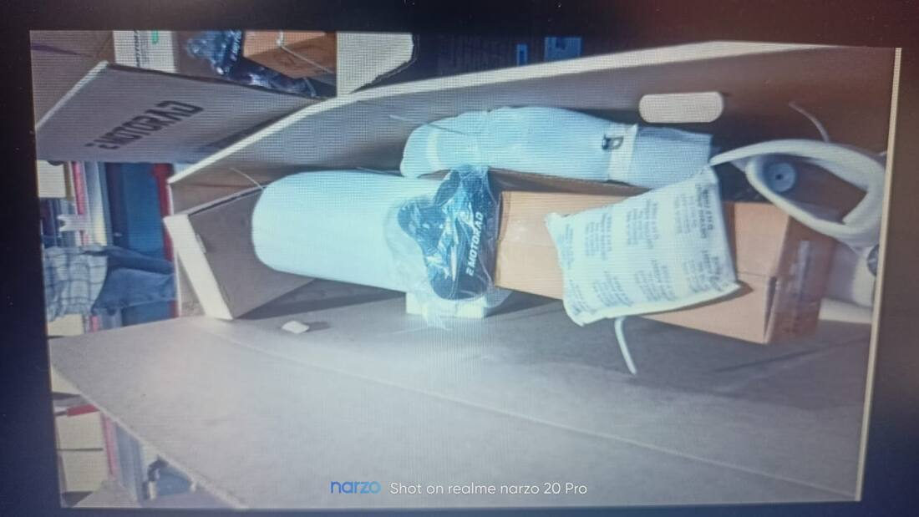
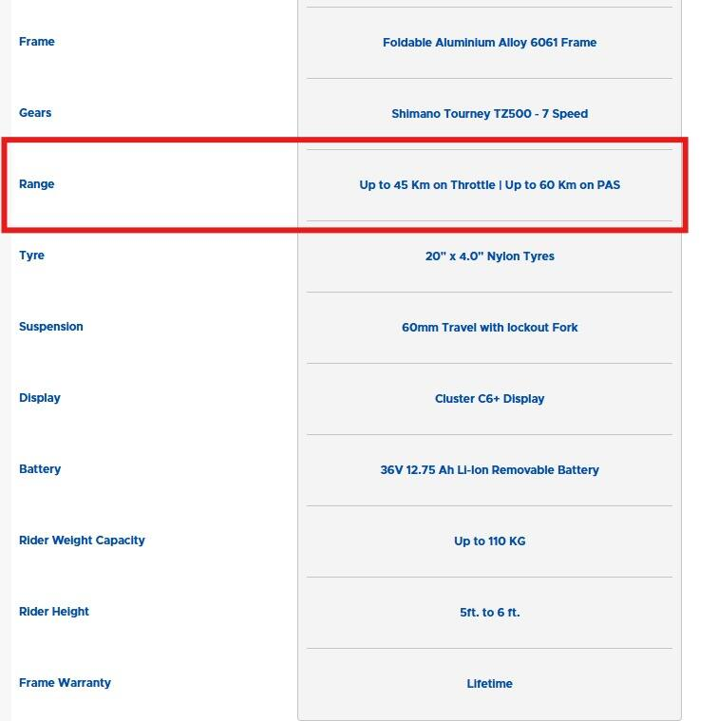
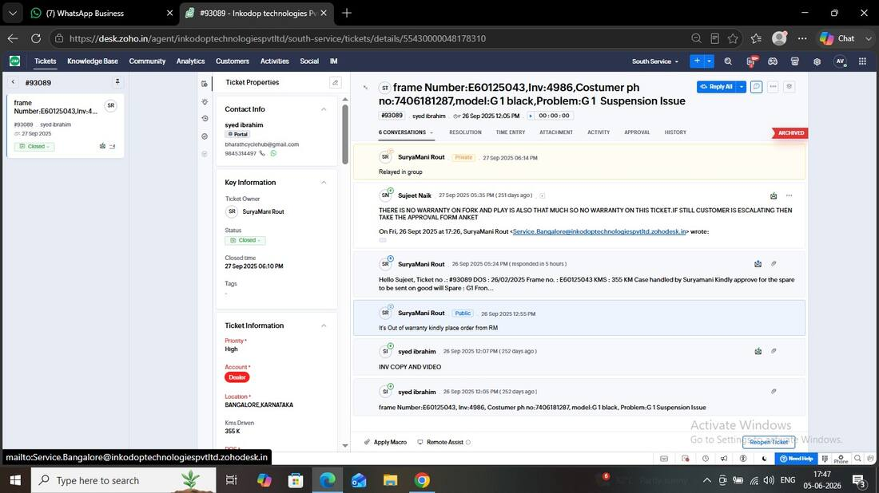
THE PAST 3 MONTHS, CONTINUED
Six more cases from 90 days
Toolkit missing — dealer blamed first
Year-end audit froze dispatches
“Delivered” — but it never arrived
EM’s approval team suggested the dealer “mistakenly put the PDI box somewhere else.” Part dispatched 24 days later.
9 tickets pending at once on 2 Apr; EM admitted 4+ dispatches stalled by its audit — then threatened to force-close cases in 3 days.
EM pressed for delivery confirmation; the store produced video proof it never came. EM re-sent the next day.
#104205 · 24 DAYS
8 TICKETS LISTED
#104811 · RESOLVED
Range promise walked back
Invoice colour field blocks replacement
Sep 2025 complaint — silent 6+ months
A battery replacement committed on a Google Meet became “we are getting the correction done in the manual book.”
X1 replacement halted 4 days because the bill said Phantom Grey instead of Beige Desert Hawk.
“The customer has already been waiting for more than six months.” EM: “We informed that time also - Not applicable.”
#103240 · DENIED
4 DAYS LOST
#93089 · UNCLEAR
09 · BCH × EMOTORAD SERVICE REVIEW

Slide 10
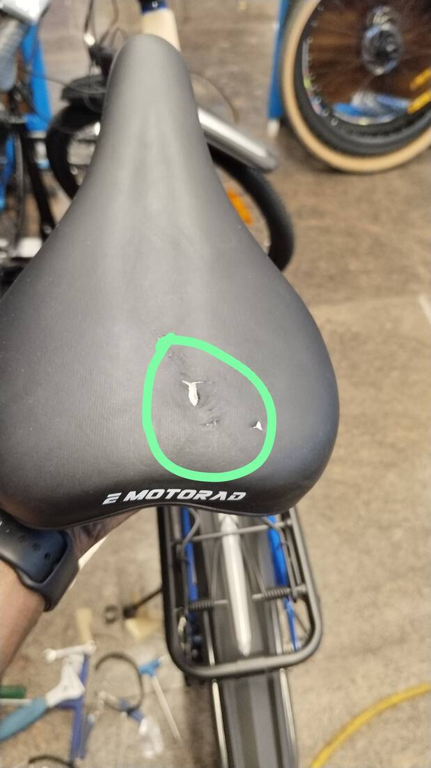
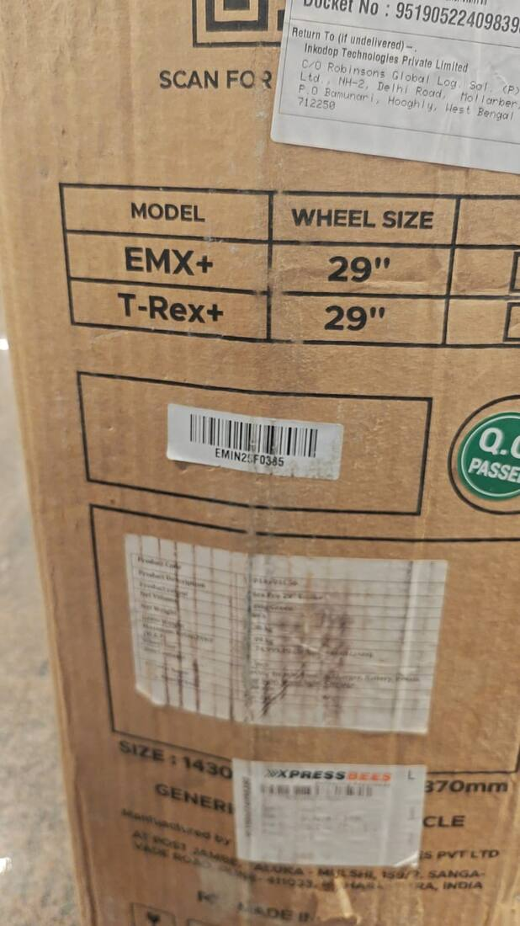
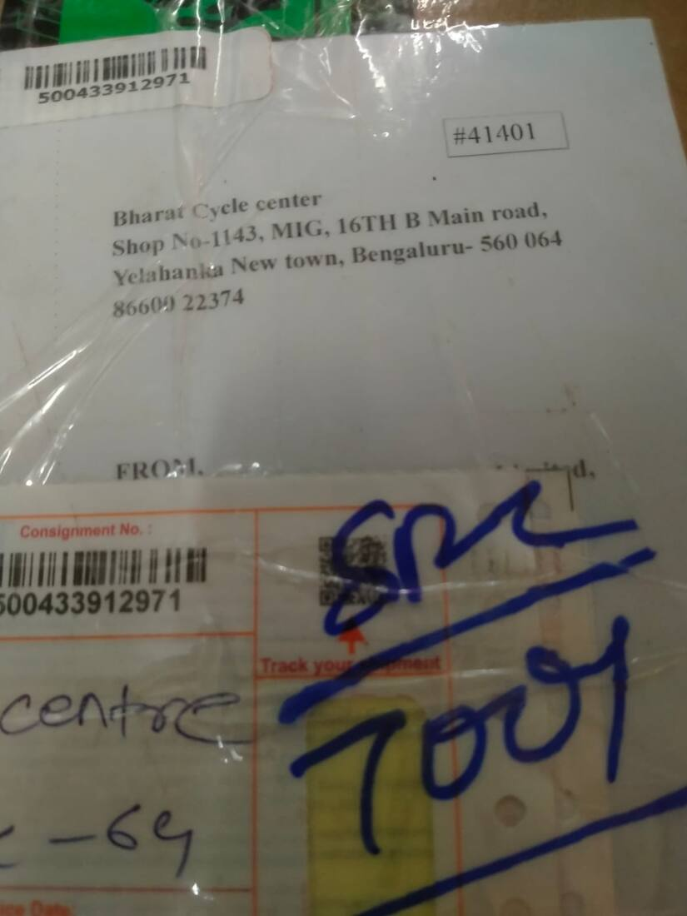
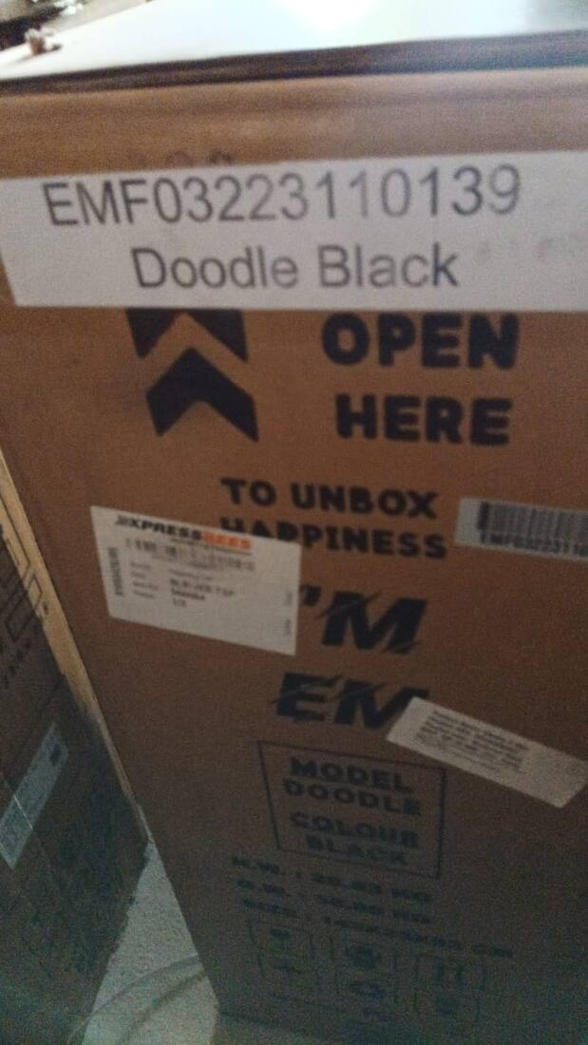
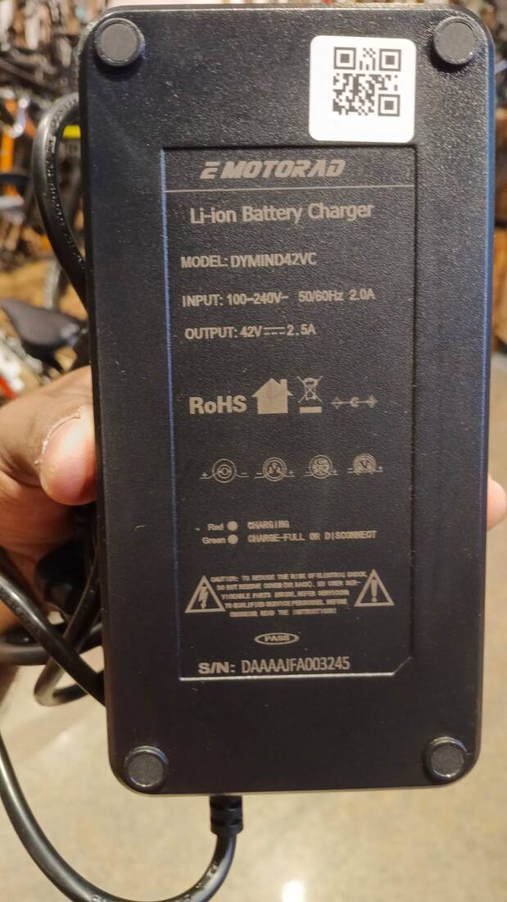
PHOTO EVIDENCE
How new bikes arrive
Out-of-box and dead-on-arrival defects, photographed at the store across 2024–2026. Every photo below was shared in the service group on the day it was found.
Fork bent in transit — new box piece (Dec 2024)
Seat damaged in sealed box (Apr 2025)
Throttle damaged, new unit (Mar 2026)
Throttle key missing (Apr 2026)
Frame paint defect — unit boxed for replacement (Mar 2026)
Replacement frame — damaged in transit (Aug 2024)
New cycle missing battery, charger, toolkit (May 2024)
Replacement spare arrived defective (Oct 2025)
10 · BCH × EMOTORAD SERVICE REVIEW

Slide 11
QUARTER BY QUARTER
The same six failures, repeating for ten quarters
Q1 2024
Q2 2024
Q3 2024
Q4 2024
Q1 2025
First complaint waits 16 days for an answer.
24-case backlog; EM’s audit finds only 12 ever ticketed.
TAT slips to 4–5 days; both replacement frames arrive damaged.
“30% of issues have no ticket number”; CEO intervenes.
Wrong part sent 3× to one customer; “7th escalation”.
10 chases
40 chases
38 chases
57 chases
54 chases
Q2 2025
Q3 2025
Q4 2025
Q1 2026
Q2 2026
50 tickets in April, 37 unclosed; the 88-day throttle.
Consumer case filed; whole T-Rex+ lot unsellable.
Returned bike untraceable; 55-day replacement cycles.
Tickets closed “no response” despite posted evidence.
Display lost in courier; systemic brake failures; audit freeze.
102 chases
225 chases
58 chases
26 chases
101 chases
11 · BCH × EMOTORAD SERVICE REVIEW

Slide 12
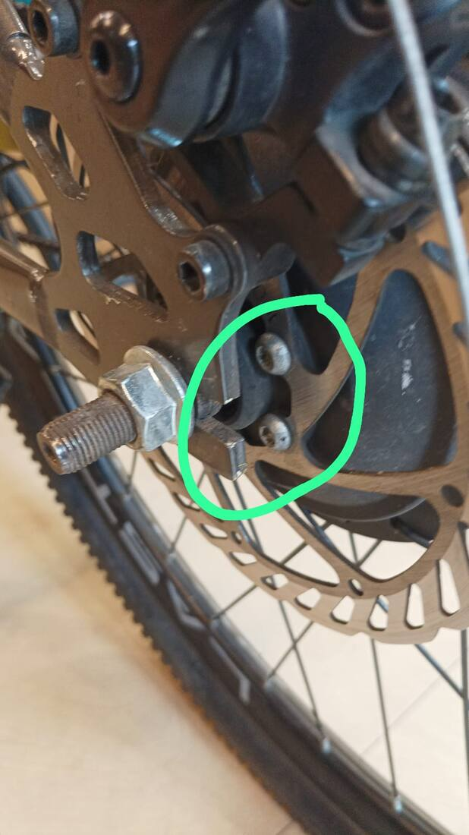
2024 · THE PATTERN SETS IN
Year one: no tracking system, growing backlog
PRODUCT QUALITY
COMMUNICATION DELAY
LOGISTICS FAILURE
LOGISTICS FAILURE
Week 1: the first defect
The 24-case backlog
Both frames arrive damaged
New boxed bike, bent fork
Disc-brake bolt slipping on a demo X1. Answered 16 days and three chases later — the group’s very first exchange.
“How many cases can the team resolve today? 24 pending cases.” EM’s own audit: 12 ticketed, 4 resolved.
Two warranty replacement frames shipped to BCH — both damaged in transit, restarting the whole cycle.
Transit damage on an unsold T-Rex Pro. Replaced in 7 days; the replacement arrived missing its mudguard.
FEB 2024
JUN 2024
AUG 2024
DEC 2024
ALSO IN 2024: “30% of issues have no ticket number” (Oct) · duplicate ticket IDs · freewheel shipped against a motor complaint · CEO reprimand (15 Oct)
12 · BCH × EMOTORAD SERVICE REVIEW

Slide 13
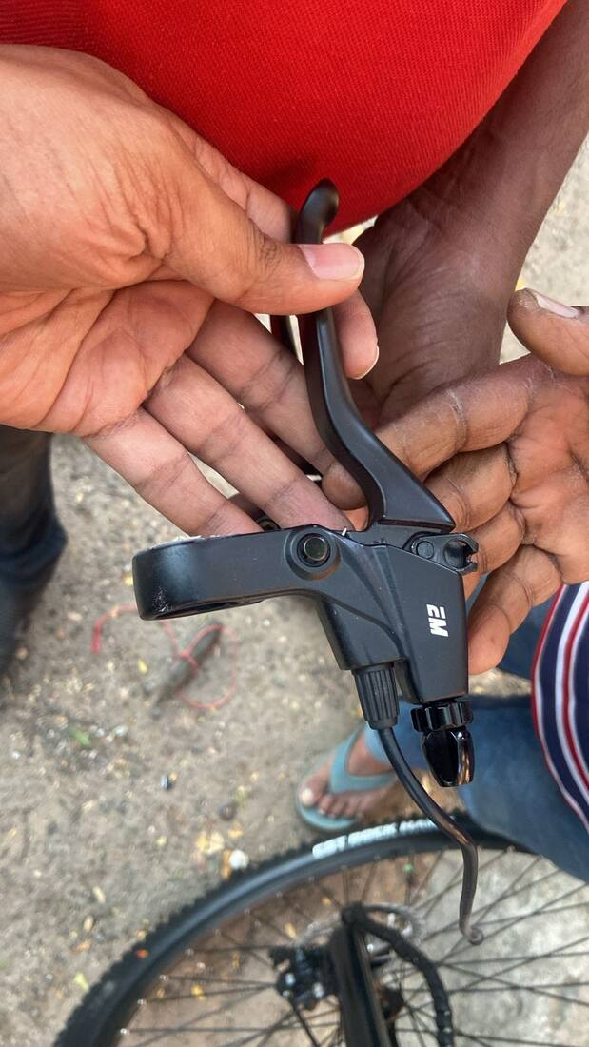
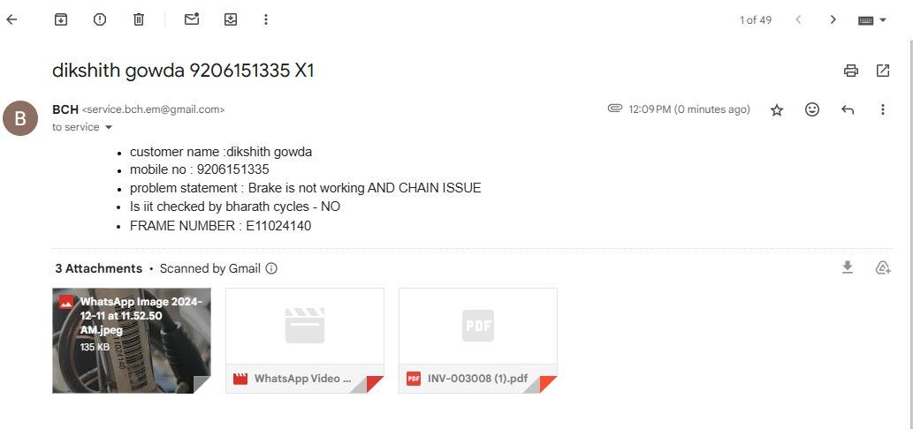
2025 · JANUARY – JUNE
Wrong parts, evidence loops, and an 8-day average
PROCESS / TICKETING
PROCESS / TICKETING
COMMUNICATION DELAY
PRODUCT QUALITY
Wrong part — three times
Closed while still broken
April, measured
Out-of-box continues
Customer Praveen received the wrong brake lever 3 consecutive times in a week. CEO: “6-7 hour TAT to respond is pathetic.”
Zoho showed “customer repaired the cycle at nearby shop” — as the customer called the store a 4th time about his undelivered motor.
50 tickets in one month, 37 unclosed, average 8 days to resolve. EM’s own target of 72 hours was never met.
Seat damaged inside a sealed box; new units missing pedals and toolkits; a unit dead on arrival the same week.
FEB–MAR 2025
JAN 2025
APR 2025
APR 2025
ALSO: same details given to 4 different EM numbers (Jan) · Zoho access took 2 months of asking (Apr) · 3 wrong throttles left one bike in stock 3 months (May)
13 · BCH × EMOTORAD SERVICE REVIEW

Slide 14
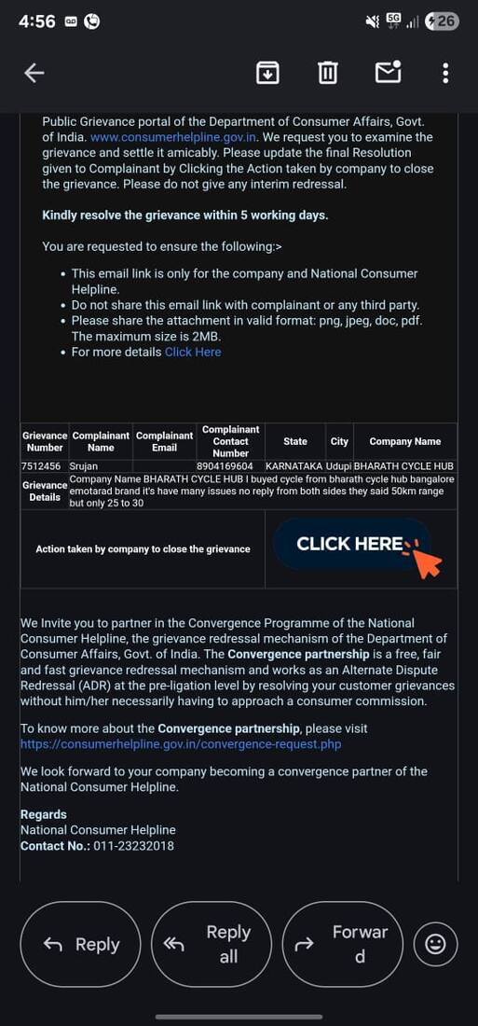
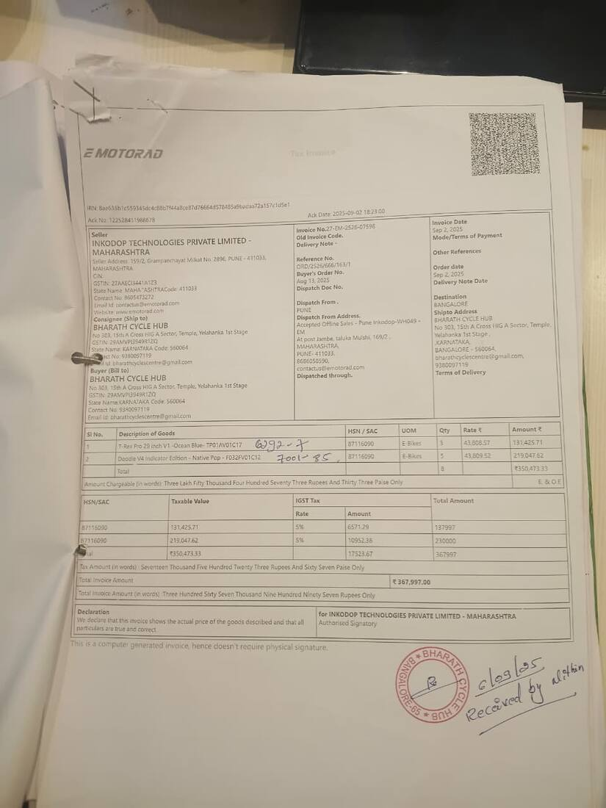
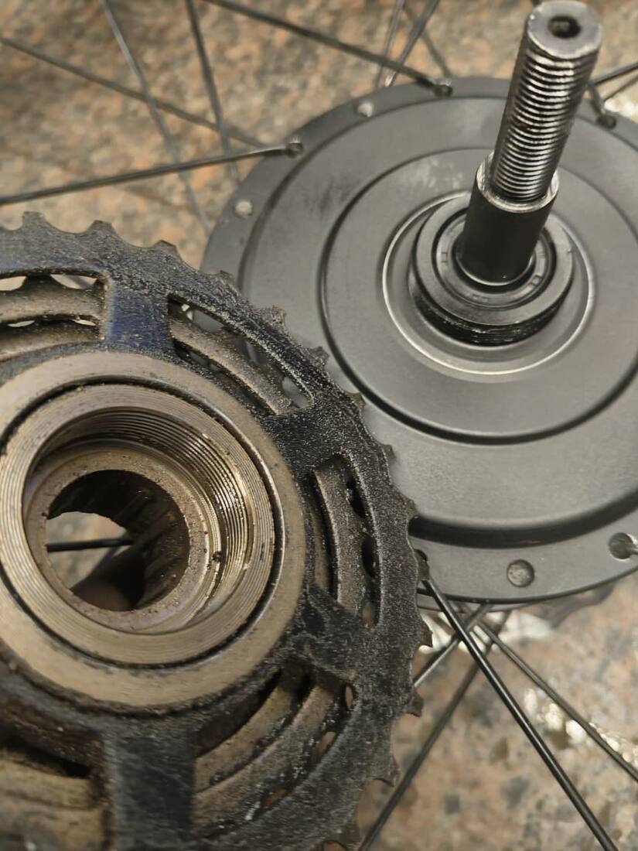
2025 · JULY – DECEMBER
The breaking point — and the root cause, found
COMMUNICATION DELAY
PRODUCT QUALITY
PROCESS / TICKETING
PRODUCT QUALITY
A consumer case is filed
A whole lot, unsellable
The smoking gun
Gears first, motor later
After weeks of unanswered chases, a customer formally filed a consumer court case on 23 Jul. More legal threats followed in August.
Entire T-Rex+ shipment missing headset spacers. “Not able to sell a single bike sir. We have 10 more units in the warehouse.”
Two years of chasing explained: EM agents’ Zoho comments were set to PRIVATE — invisible to BCH. Fixed only after BCH escalated.
Motor-noise protocol sent planetary gears that failed to fix it — twice — before the motor followed. Replacement gears arrived leaking grease.
JUL 2025
SEP 2025
SEP 2025
OCT–NOV 2025
ALSO: motor #84001 took ~80 days · returned bike untraceable in Pune (Oct–Nov) · charger serial asked 6× after being shared · 55-day replacement cycles
14 · BCH × EMOTORAD SERVICE REVIEW

Slide 15
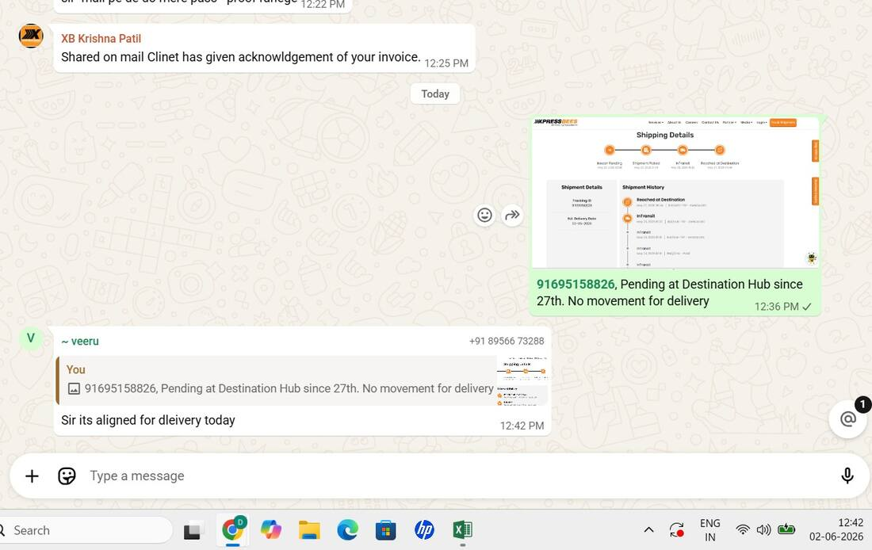
2026 · JANUARY – JUNE
This year: closures without consent, denials by default
WARRANTY DISPUTE
WARRANTY DISPUTE
PROCESS / TICKETING
LOGISTICS FAILURE
“Sticker tampered”
Manual, corrected
Dealer blamed first
Rolling “tomorrow”
Battery warranty contested over a sticker; 15-day replacement timeline for a 3-day-old ticket. EM’s own manager: “Why we have such a long waiting for battery?”
The Doodle range complaint was closed by promising to fix the spec in the manual — not the battery that was verbally committed.
Missing toolkit met with “tell dealer to check if he mistakenly put that PDI somewhere else.” Part dispatched 24 days later.
Replacement cycle delivery promised “today/tomorrow” for four straight days; the store had no ticket number until it asked repeatedly.
DEC 2025–JAN
MAR 2026
MAR–APR 2026
JUN 2026
ALSO: tickets #99827 & #100251 closed for “no response” despite evidence · tyre/tube out of stock 22 days · coordinators unreachable all morning (7 Feb)
15 · BCH × EMOTORAD SERVICE REVIEW

Slide 16
RESOLUTION TIMES
The promise is 48 hours. The record says otherwise.
Days from first report to resolution, for measurable cases in the chat record.
44×
the promised TAT, on the worst case (88 days vs 48 hours)
4 days
charger case #106261 — proof the pipeline works when intake is clean and stock exists
16 · BCH × EMOTORAD SERVICE REVIEW

Slide 17
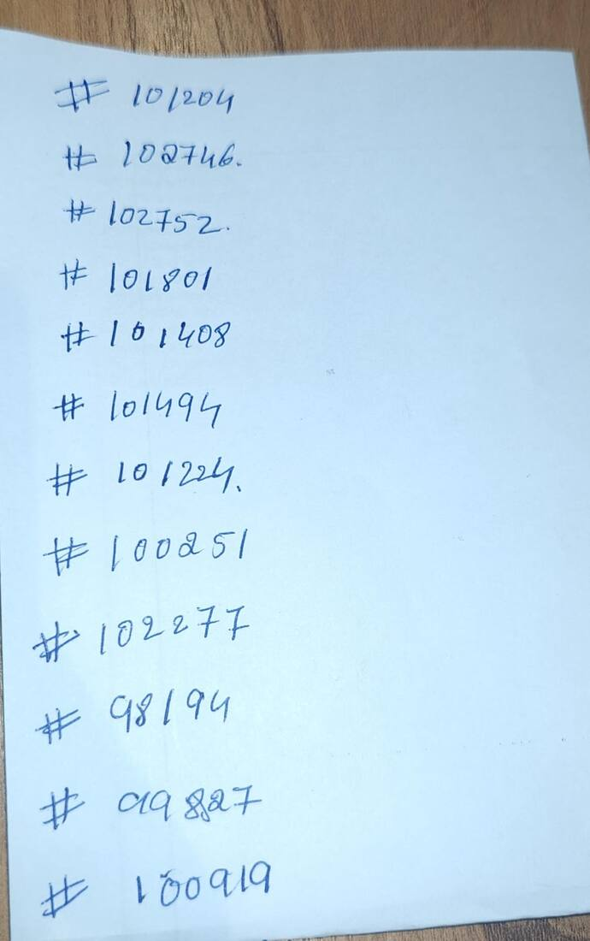
THE PAPER TRAIL
It’s all in writing
Screenshots and documents from the chat: backlogs, closures, denials and admissions — the system telling on itself.
EM’s audit of the 24-case backlog (Jun 2024)
Ticket closed — customer still broken (Jan 2025)
April 2025: the 50-ticket ledger
Consumer case filed (Jul 2025)
Zoho comments “private” — root cause (Sep 2025)
“We will correct the manual” (Mar 2026)
6 months, no update — “Not applicable” (Jun 2026)
Range test the customer had to repeat (Mar 2026)
17 · BCH × EMOTORAD SERVICE REVIEW

Slide 18
RECOMMENDATIONS · 1 OF 2
Fix the source: quality, stock, and silence
Pre-dispatch inspection that actually catches defects
WHY 3 of 3 assembled units shared one wiring fault (2024); an entire lot missing spacers (2025); pads dead at 527 km (2026).
1
Signed PDI photos attached to every unit’s invoice · treat a repeated defect as a batch issue and inspect the whole lot · open a root-cause investigation on the mechanical brake system.
Regional spare stock — promised Aug 2024, still pending
WHY “We will try stocking spares at Bangalore soon” — EMotorad, 9 Aug 2024.
2
Stock the top-10 failure SKUs at the dealer or a Bangalore/Hyderabad depot · every stock-out gets an ETA within 24h · service dispatches exempt from audit freezes · let the dealer fix small warranty items against a monthly credit note.
Written SLAs with automatic escalation
WHY Today’s de-facto escalation path is the dealer tagging the CEO on WhatsApp.
3
First response in 4 working hours, dispatch decision in 48h, resolution in 72h · any ticket silent 24h auto-escalates · one named owner per ticket · a 10-minute daily standup on open tickets.
18 · BCH × EMOTORAD SERVICE REVIEW

Slide 19
RECOMMENDATIONS · 2 OF 2
Close the loop: logistics, warranty, tickets
LR at dispatch, POD at delivery — every time
WHY A display lost in courier for 20 days; “delivered” parts that never arrived; two frames damaged in transit.
4
Share the docket within 24h of every dispatch · never close on courier status alone — require dealer/customer confirmation · stale tracking for 5 days auto-triggers a replacement · better packaging for frames and gears.
A published warranty matrix and a one-time evidence checklist
WHY Display warranty discovered to be 6 months only at denial; a promised battery became a manual correction.
5
Component-level warranty terms public to dealer and customers · define complete evidence per defect type up front — once submitted, never re-asked · grey-zone cases go to a 48-hour senior review · honour commitments made in meetings.
Every issue gets a number; nothing closes without consent
WHY 30% of complaints unticketed (2024); private comments hid updates for months (2025); “ticket number not given” again in Jun 2026.
6
Auto-issue ticket numbers at intake (incl. stock units) · ban “closed — no response” when evidence exists · quarterly joint Zoho visibility audit · barcode check at the spare-parts pick line · a shared quarterly scorecard: TAT, first-response, wrong-dispatch count, DOA rate.
19 · BCH × EMOTORAD SERVICE REVIEW

Slide 20
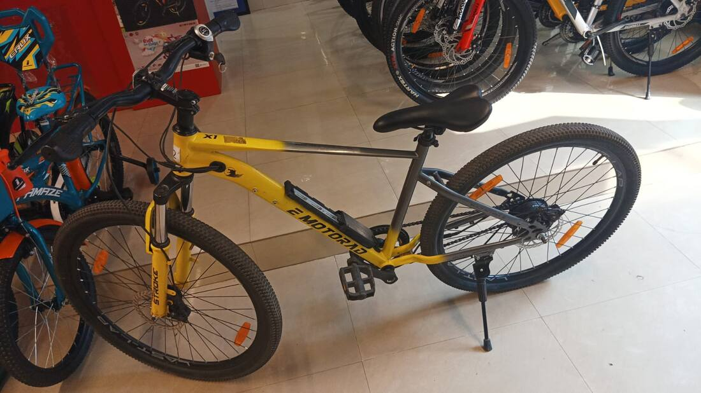
THE ONE FIX THAT MATTERS MOST
Take the dealer out of
the follow-up loop.
Every category in this review shows the same signature: nothing moves until BCH chases, and everything moves once leadership is tagged. A written SLA with automatic escalation, a shared scorecard, and regional spare stock would eliminate most of the 711 chase messages documented here — and the customer experiences behind them.
01
Agree the SLA + escalation matrix in the next Wednesday meet
02
Commit a date for regional spare stocking (top-10 SKUs)
WHERE IT STARTED: THE FIRST COMPLAINT, 24 FEB 2024
03
Adopt the shared quarterly scorecard from Q3 2026
Prepared by Bharat Cycle Hub · from the complete export of “Bch X EM service team” · 12 June 2026

