Slide 1
Direct Indexing Simulators
Bharath Darapu

Slide 2
The Vision
Part I:
Simplify custom portfolio/model creation
Get historical performance of a model for analytics
Part II:
Simulate scenarios (i.e. direct indexing) on these models

Slide 3
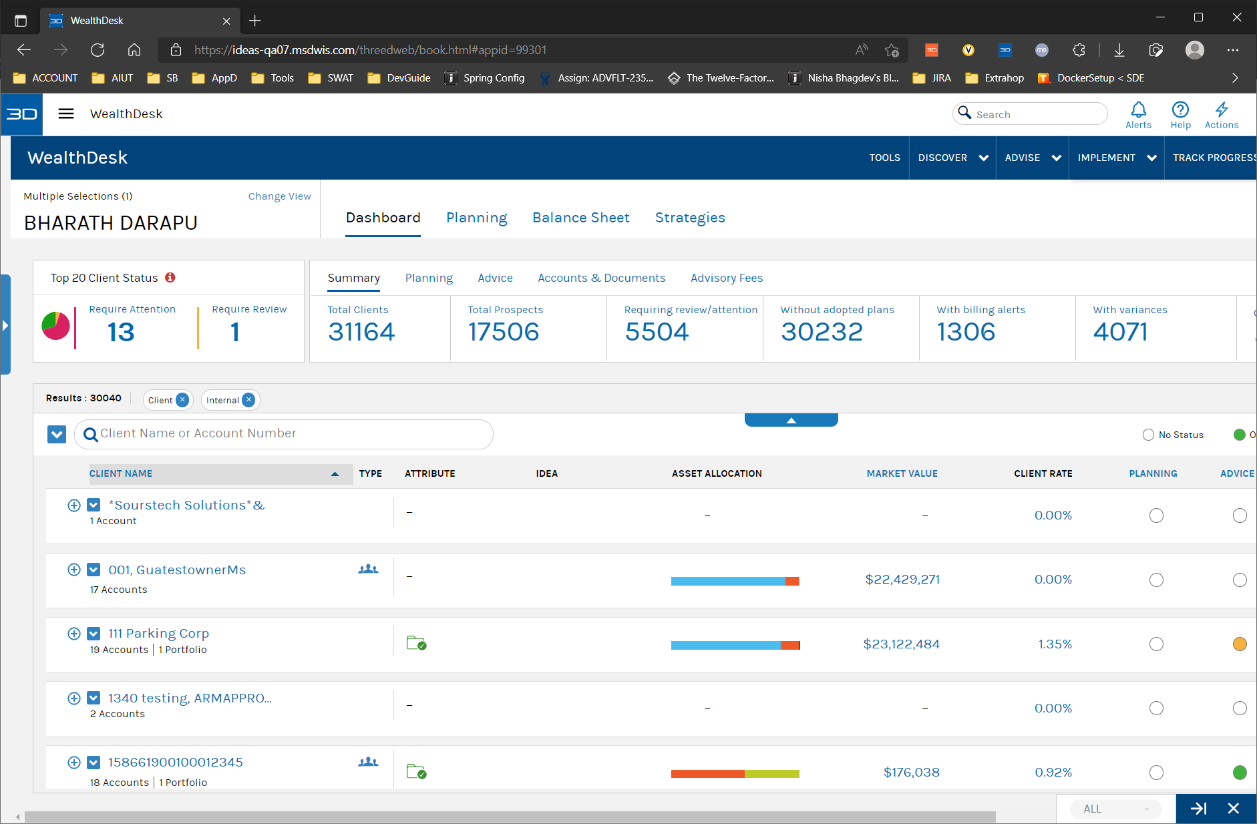
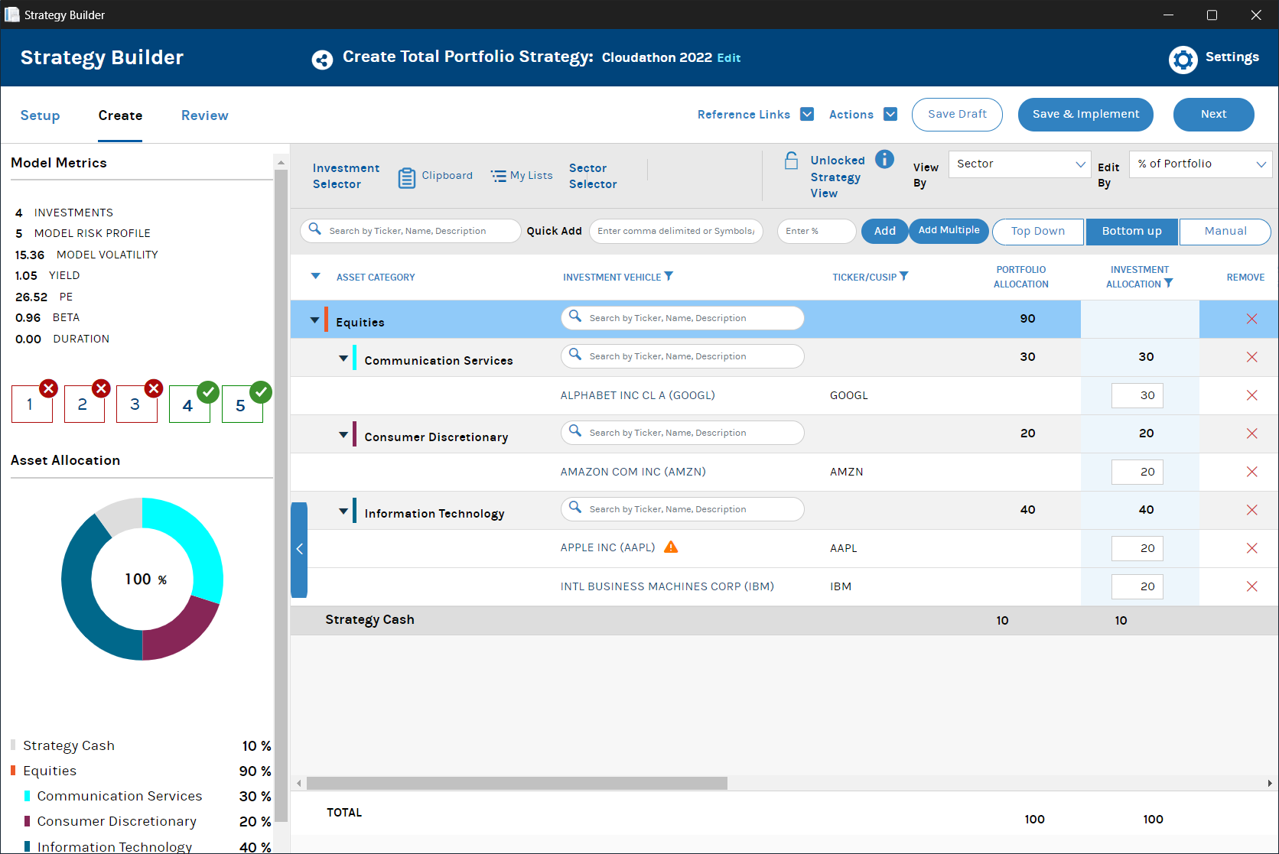
Current State

Slide 4
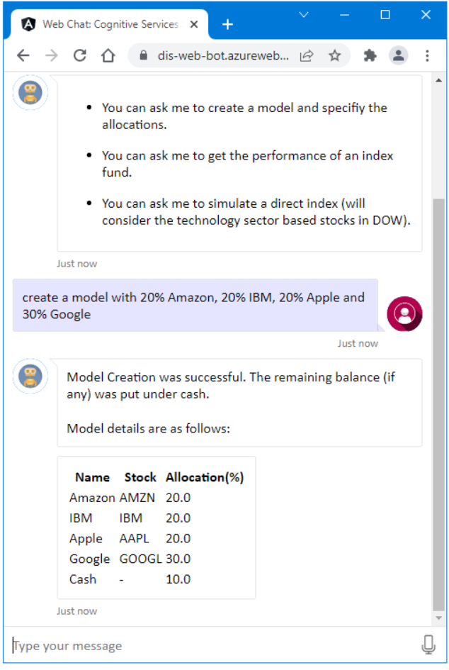
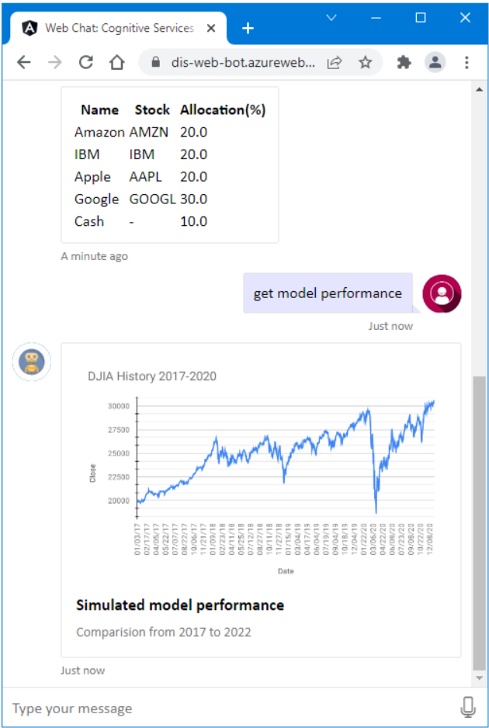
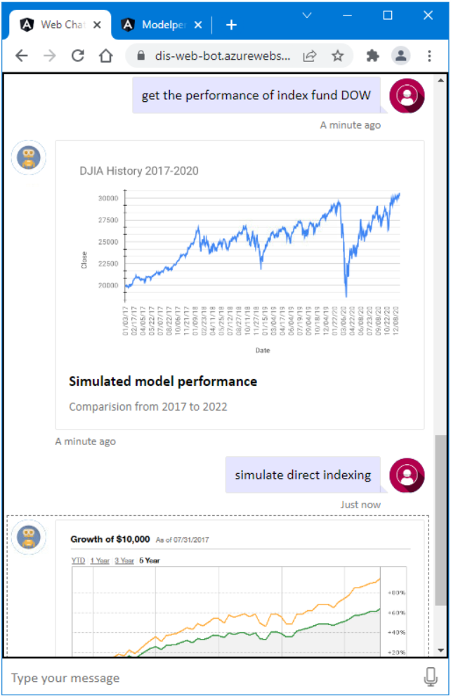
Proposed State

Slide 5
Demo

Slide 6
The Vision
Part I:
Simplify custom portfolio/model creation
Get historical performance of a model for analytics
Part II:
Simulate scenarios (i.e. direct indexing) on these models

Slide 7


The What and Why of Index Fund
What is an Index Fund?
Index funds are investment funds that follow a benchmark index, such as the S&P 500 or the Nasdaq 100.
When you put money in an index fund, that cash is then used to invest in all the companies that make up the particular index, which gives you a more diverse portfolio than if you were buying individual stocks
Advantages of Index Fund
Low cost (because they are not actively managed)
Requires little financial knowledge
Convenience
Provides diversification
Disadvantages of Index Fund
No choice in index composition
It cannot beat the market (by definition).

Slide 8
ELI5
Hmm. I still don’t understand this.
Think of index fund like buying a mixed cheese platter for a party
Rather than having to buy 20 different cheeses you can buy a prepared platter that already has them all.
But remember you cannot choose the types of cheese because everything comes pre-selected for you

Slide 9
The What and Why of Direct Indexing
What is Direct Indexing?
Direct indexing is an approach to index investing that involves buying the individual stocks that make up an index, in the same weights as the index.
Advantages of Direct Indexing
Improved tax efficiency thanks to tax loss harvesting
Portfolio customization
Disadvantages of Direct Indexing
Makes sense only for taxable accounts

Slide 10
Direct Indexing on Dow 30
# | Company | Symbol | DOW 30 Weight | DI Calculated Weight
1 | UnitedHealth Group Incorporated | UNH | 10.22478
2 | Goldman Sachs Group Inc. | GS | 6.315438
3 | Home Depot Inc. | HD | 5.747416
4 | Microsoft Corporation | MSFT | 5.370458 | 19.01319
5 | Amgen Inc. | AMGN | 4.823113
6 | McDonald's Corporation | MCD | 4.806457
7 | Caterpillar Inc. | CAT | 4.401739
8 | Visa Inc. Class A | V | 4.081066
9 | Honeywell International Inc. | HON | 3.677114
10 | Salesforce Inc. | CRM | 3.580242
11 | Travelers Companies Inc. | TRV | 3.545973
12 | American Express Company | AXP | 3.531806
13 | Boeing Company | BA | 3.443166
14 | Johnson & Johnson | JNJ | 3.401239
15 | Chevron Corporation | CVX | 3.329064
16 | Apple Inc. | AAPL | 3.160208 | 10.51077
17 | Procter & Gamble Company | PG | 3.006859
18 | Walmart Inc. | WMT | 2.984269
19 | 3M Company | MMM | 2.798565
20 | NIKE Inc. Class B | NKE | 2.520011
21 | JPMorgan Chase & Co. | JPM | 2.459322
22 | Walt Disney Company | DIS | 2.446112
23 | International Business Machines Corporation | IBM | 2.415481 | 8.14143
24 | Merck & Co. Inc. | MRK | 1.64778
25 | Dow Inc. | DOW | 1.26125
26 | Coca-Cola Company | KO | 1.233681
27 | Verizon Communications Inc. | VZ | 1.022133
28 | Cisco Systems Inc. | CSCO | 0.978483
29 | Intel Corporation | INTC | 0.892907 | 3.011883
30 | Walgreens Boots Alliance Inc | WBA | 0.851937

Slide 11
Demo

Slide 12

Architecture
Azure Web-Chat
Azure Direct Line Channel
Azure Speech Services
REST Api
Azure Bot Controller
REST Api
Spring Boot (java) app
Azure Blob Service
Azure Web Application

Slide 13
Q & A

