Slide 1


Credit Risk Prediction Classification Project
GROUP MEMBER
ARYAN VAKHARIA
D.BHARATH
A.VASUDEV
K.MANIKANTA
A.AAKASH
AURORA’S DEGREE AND P.G. COLLEGE ​
(B.SC. COMPUTER SCIENCE & DATA SCIENCE)​

Slide 2
Content | Slide Numbers
Project Background/Introduction | 3
Objective | 4
Data | 5
Data Cleaning | 6
Exploratory Data Analysis (EDA) | 7
Dummy Variable | 13
Machine Learning Algorithms | 14
Conclusion | 25
Appendix | 27

Slide 3
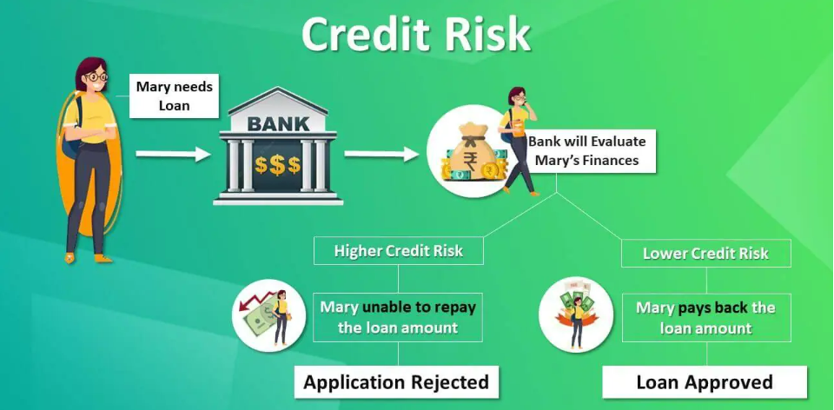
Project Background/Introduction
Credit risk prediction is crucial for financial institutions to assess the likelihood of borrowers defaulting on their loans. This section will explore the importance and challenges of credit risk prediction.

Slide 4
Objective:
4
Credit Risk Drivers
Probability Of Default
Loss Given Default
Exposure At Default
Determines a borrower's ability to meet their debt obligations and the lender's aim when advancing credit.

Slide 5
Data:
Structured and Unstructured Data
Credit risk prediction involves leveraging both structured data, such as financial statements, and unstructured data, such as customer behavior patterns.
External Data Sources
Additional data sources like credit bureaus and economic indicators complement internal data to enhance the accuracy of credit risk prediction models.
Big Data Processing
Dealing with large volumes of data requires efficient processing techniques, such as distributed computing or cloud-based solutions.

Slide 6
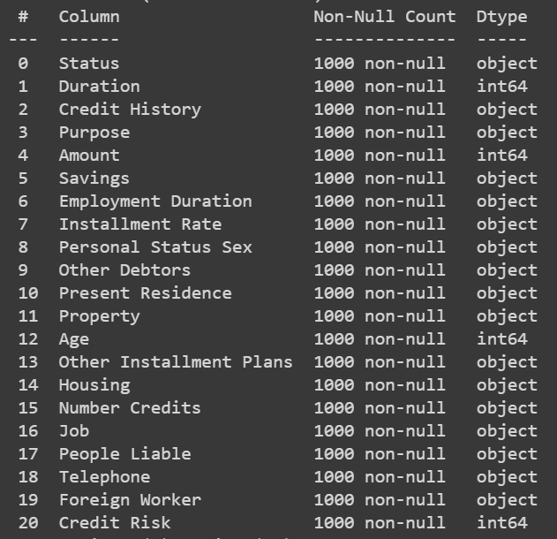
Data Cleaning:
Removal of unwanted observations​
Fixing Structural errors​
Managing Unwanted outliers​
Handling missing data​

Slide 7
Exploratory Data Analysis (EDA)
7
In EDA we find Heat map , Distribution polt , Box plot , Scatter plots , Pair plots and at last we have credit risk prediction Classification using EDA.

Slide 8
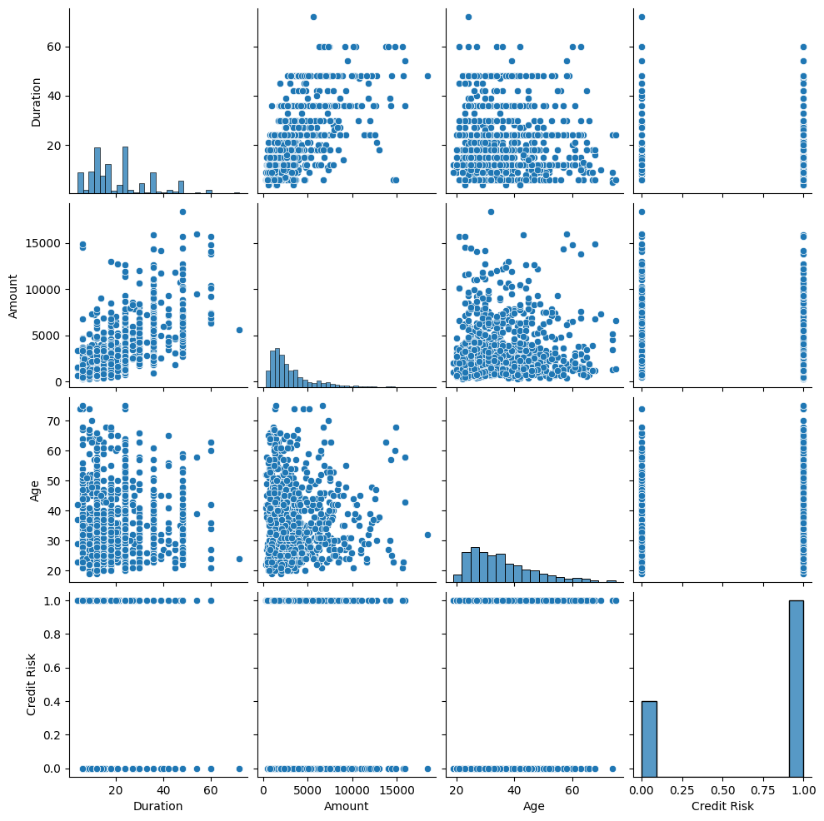
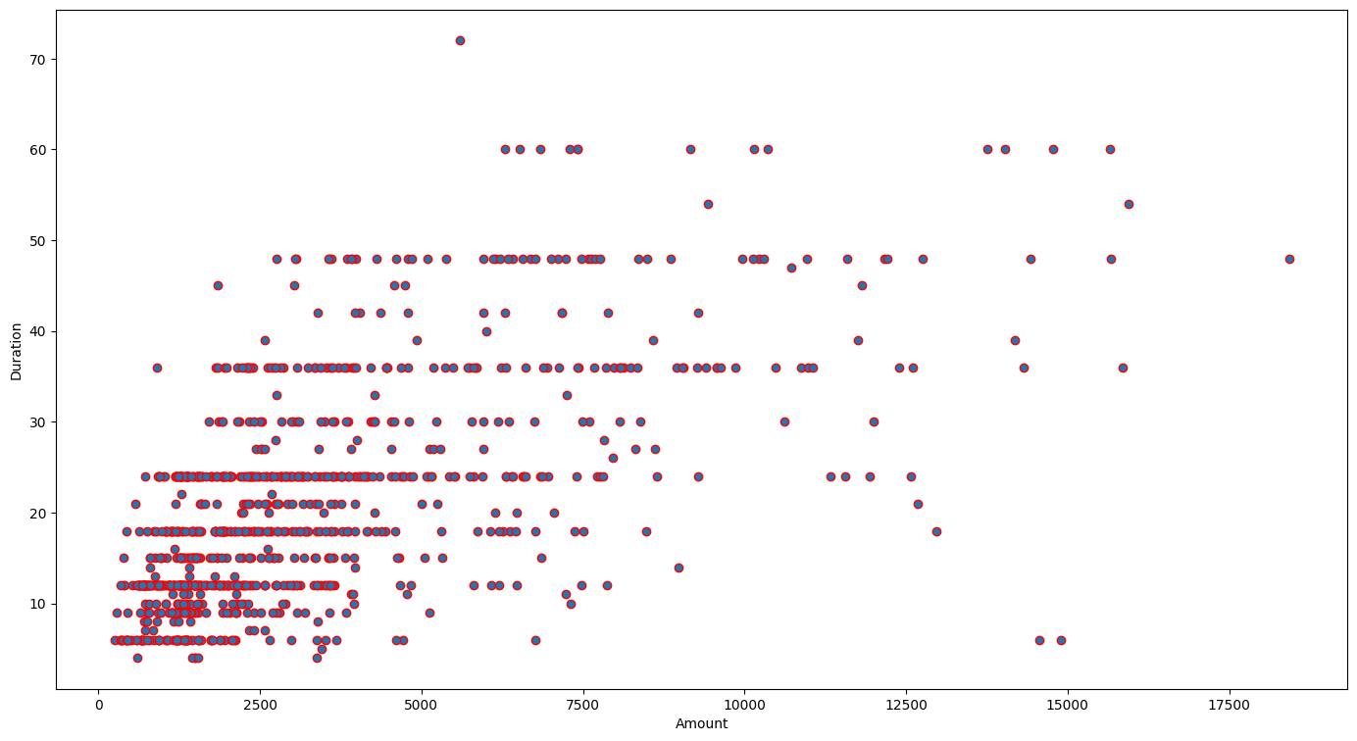
Pair plot
Scatter Plot of Duration and Amount

Slide 9
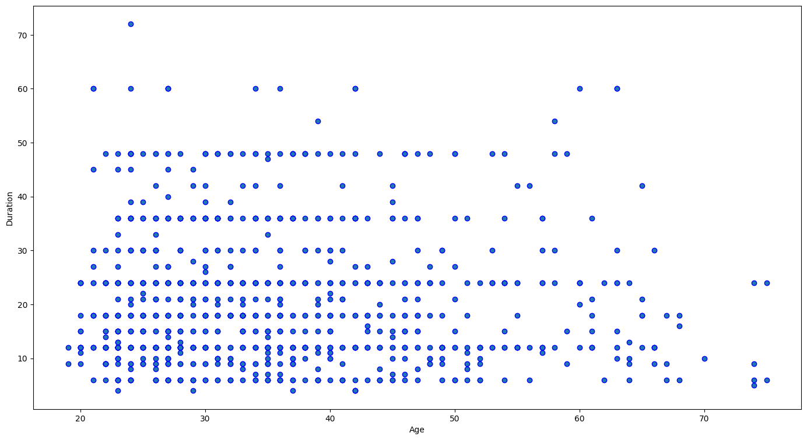
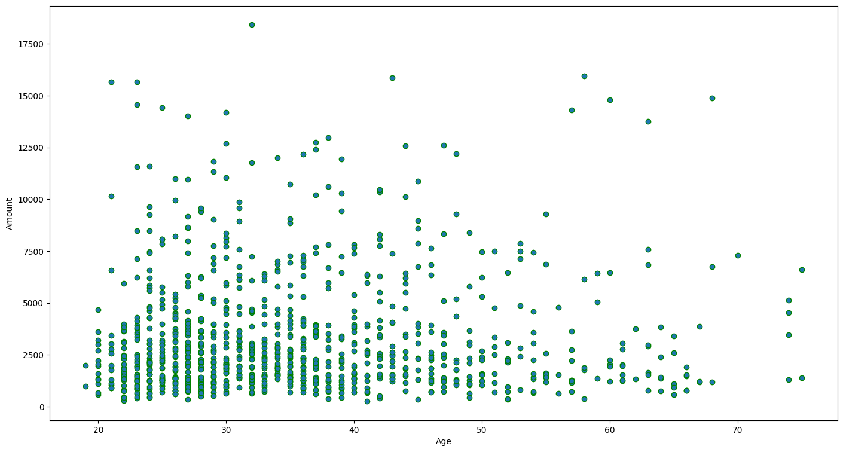
Scatter Plot of Duration and Age
Scatter Plot of Amount and Age

Slide 10
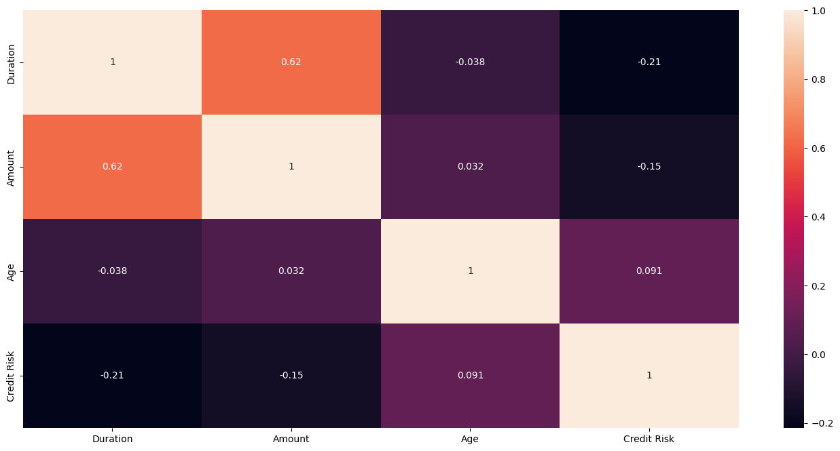
HEAT MAP:

Slide 11
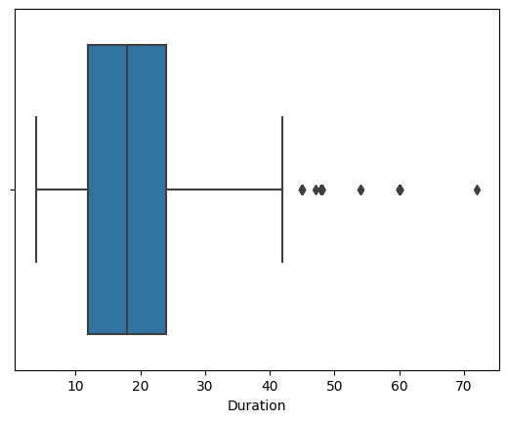
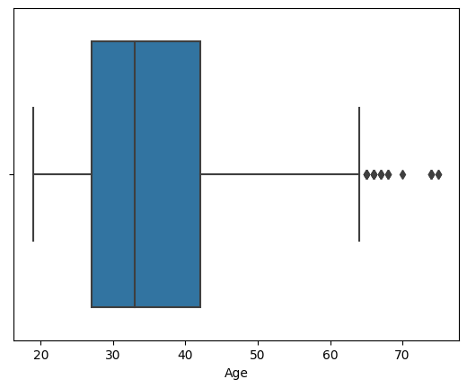
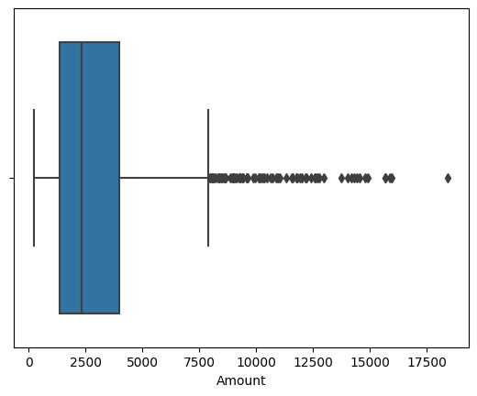
Box plot
Duration plot
Age plot
Amount plot

Slide 12
Interpretation from pair plot and heat map
Age is highly positively correlated with the target variable.
Duration is highly negatively correlated with the target variable.
Duration has a strong correlation with Credit Risk.
Duration and Amount are negatively correlated with the target variable (Credit Risk).
Age is positively correlated with the target variable (Credit Risk).

Slide 13
Applying Dummy Variable
Dummy variables are used in statistical analysis, particularly in regression analysis, to handle categorical data or factors.
Categorical data represents categories, groups, or labels, rather than numerical values.
These variables need to be converted into a format that can be used in regression models, and this is where dummy variables come into play.
Purpose_car (new) | Purpose _furniture/equipment | Purpose_ repairs
Purpose_car (used) | Purpose_others | Purpose_retraining
Purpose_domestic appliances | Purpose_radio/television | Purpose_vacation

Slide 14
Machine Learning Algorithms
Logistic regression
1
Logistic regression aims to solve classification problems. It does this by predicting categorical outcomes, unlike linear regression that predicts a continuous outcome
2
Decision tree
A decision tree is a non-parametric supervised learning algorithm, which is utilized for both classification and regression tasks.
Random forest
3
Random forest is a commonly-used machine learning algorithm, which combines the output of multiple decision trees to reach a single result.
4
K-Nearest neighbour
The k-nearest neighbors , also known as KNN , is a non-parametric, supervised learning classifier, which uses proximity to make classifications or predictions about the grouping of an individual data point.

Slide 15
Ridge Logistic Regression
5
Ridge Regression adds a penalty term proportional to the square of the coefficients
6
K-Means Clustering
k-means clustering tries to group similar kinds of items in form of clusters.
XG Boost
7
XG Boost, which stands for Extreme Gradient Boosting, is a scalable, distributed gradient-boosted decision tree (GBDT) machine learning library
8
Support Vector Machine
A support vector machine (SVM) is a type of supervised learning algorithm used in machine learning to solve classification and regression tasks

Slide 16
Logistic regression
Train test ratio | Accuracy
65-35 | 71.14%
70-30 | 70%
70-25 | 70%
80-20 | 70.5%

Slide 17
Decision tree
Train test ratio | Accuracy
65-35 | 66.7%
70-30 | 66%
70-25 | 68%
80-20 | 67%

Slide 18
Random forest
Train test ratio | Accuracy
65-35 | 70.28%
70-30 | 70.33%
70-25 | 72.4%
80-20 | 74.5%

Slide 19
K – Nearest Neighbour (KNN)
Train test ratio | Accuracy
65-35 | 66.86%
70-30 | 66.86%
70-25 | 66%
80-20 | 66%

Slide 20
Ridge Logistic Regression
Train test ratio | Accuracy
65-35 | 66.86%
70-30 | 67%
70-25 | 66%
80-20 | 66%

Slide 21
K – Means Clustering
Train test ratio | Accuracy
65-35 | 66.86%
70-30 | 66.33%
70-25 | 66%
80-20 | 66%

Slide 22
XG Boost
Train test ratio | Accuracy
65-35 | 69.71%
70-30 | 68.67%
70-25 | 73.2%
80-20 | 71.5%

Slide 23
Support Vector Machine(SVM)
Train test ratio | Accuracy
65-35 | 70.29%
70-30 | 69.67%
70-25 | 69.6%
80-20 | 69.5%

Slide 24
A comparison between the implemented models
MODEL | ACCURACY
Logistic regression | 71.14%
Decision tree | 68%
Random forest | 74.5%
K – Nearest Neighbour (KNN) (65-30) | 66.86%
K – Nearest Neighbour (KNN) (70-30) | 66.86%
Ridge Logistic Regression | 67%
K – Means Clustering | 66.86%
XG Boost | 73.2%
Support Vector Machine(SVM) | 70.29%

Slide 25
Conclusion
Eight machine learning algorithms were used for the Concrete Strength Prediction dataset: Logistic Regression, Decision Tree, Random Forest, K – Nearest Neighbour (KNN), Ridge Logistic Regression, K – Means Clustering, XG Boost, and Support Vector Machine (SVM).
After conducting various analyses and implementing different algorithms, we discovered that the Random Forest Regression Algorithm yielded the best results. Specifically, when using an 80-20 train-test ratio, we obtained a Accuracy of 74.5%, which is the Highest Accuracy value compared to all the other errors we encountered.
After analyzing the Credit Risk dataset, we can conclude that the Random Forest Regression Algorithm is the most effective model.

Slide 26
APPENDIX:
27

Slide 27

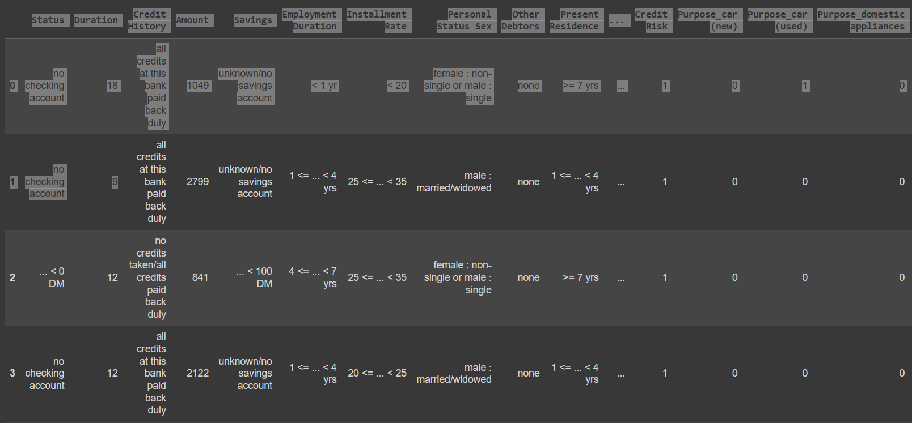
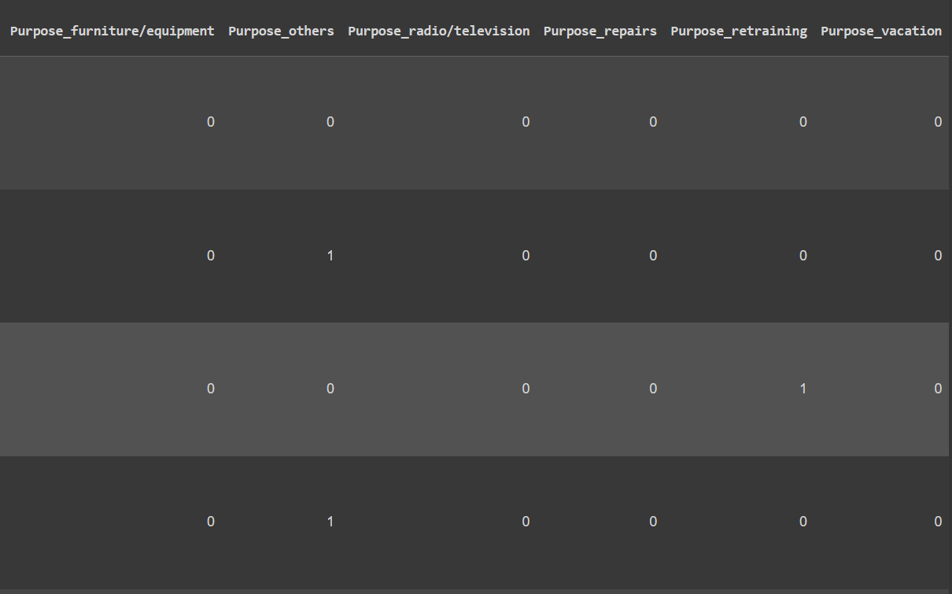
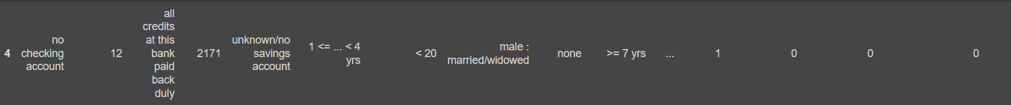
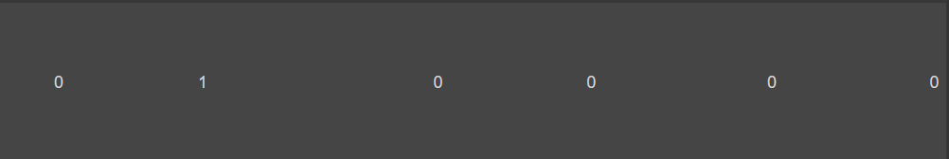
Applying Dummy Variable

Slide 28
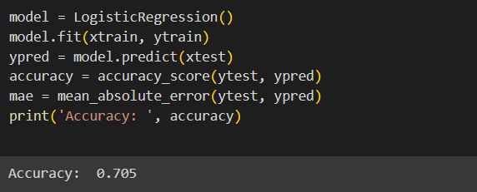

Logistic Regression

Slide 29
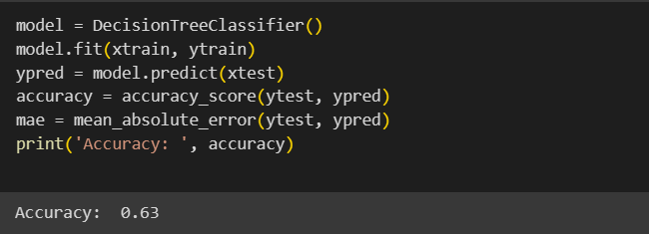
Decision Tree

Slide 30
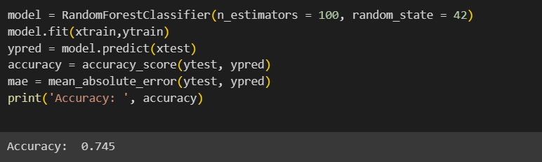
Random Forest

Slide 31
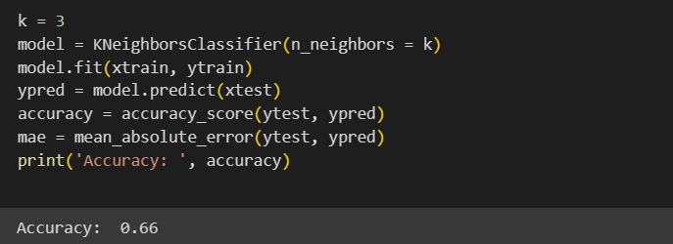
K-Nearest Neighbour (KNN)

Slide 32
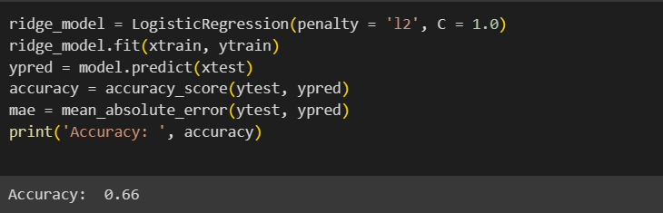
Ridge Logistic Regression

Slide 33
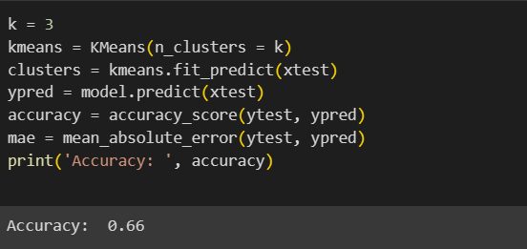
K-Means Clustering

Slide 34
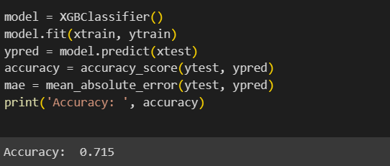
XG Boost

Slide 35
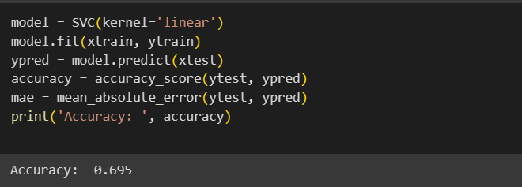
Support Vector Machine (SVM)

Slide 36

THANK YOU
26
from Group 2
ARYAN VAKHARIA
D.BHARATH
A.VASUDEV
K.MANIKANTA
A.AAKASH

