Slide 1

Rental Radiance USA
Denoting the dataset's potential to shed light on the apartment rental market in the USA using Machine Learning Techniques
DATS 6101
Chinmay,Erica,Zac,Bharath

Slide 2
Introduction
Data:Apartment rental pricing dataset (Source: UCI)
About the Data:
This dataset contains 10,000 observations with comprehensive details about US apartment rentals. It includes attributes like amenities, bedrooms, pricing, location, and more. Partially cleaned, it's a valuable resource for real estate research, enabling various data analysis tasks and insights into US apartment rental dynamics. Ideal for further analysis.
Objective:
Data Manipulation
Perform in-depth Exploratory Data Analysis (EDA) on the provided dataset
Identifying Key Variables
Statistical Inferences
Model Building

Slide 3
Dataset overview
Numerical | Categorical
Bathroom | ID
Bedrooms | State
Price | Amenities
Longitude | Has_Photo
Latitude | Title
Time | Pets Allowed
 | Price Type
 | City Name
 | Address
 | Source
Dimensions of data:
10,000 rows, 23 columns
Unique Identifier: ID
Column name | No. of. missing values
Bathroom | 80
Bedrooms | 53
Square_feet | 46
States | 203

Slide 4
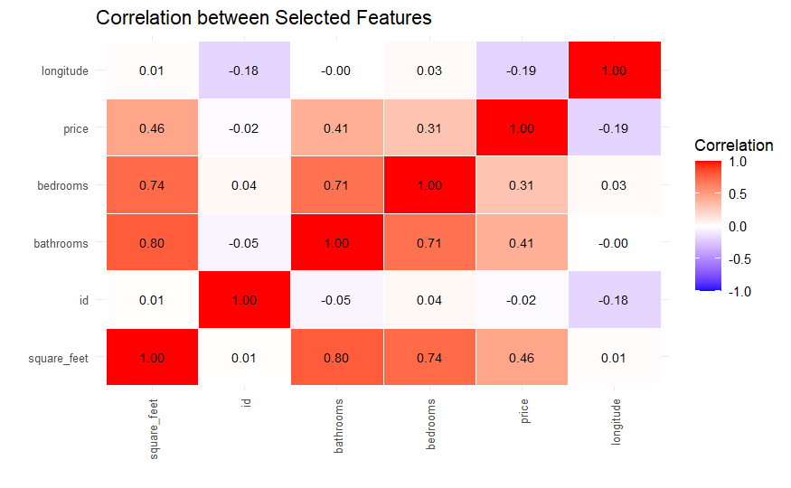
Correlation Between Features

Slide 5
Descriptive Statistics for Rental Prices
Statistic | Value | Description
Minimum | $200 | The lowest rental price.
First Quartile | $934 | 25% of the rental prices are below this value.
Median | $1250 | The middle value in the dataset.
Mean | $1434 | The average rental price.
Third Quartile | $1665 | 75% of the rental prices are below this value.
Maximum | $52,500 | The highest rental price.
Interquartile Range (IQR) | $731 | The range between the first and third quartiles.
Skewness | 18.42 | Indicates a highly right-skewed distribution. Extreme values are on the higher end.
Kurtosis | 904.22 | Indicates a distribution with heavy tails and a sharp peak. Heavy presence of extreme values.

Slide 6
Smart Question 1: How can advanced machine learning techniques, enhance our predictive accuracy in understanding urban rental market trends, and what are the potential implications of improved predictive analytics on real estate investment strategies?
Primary Objective: To Build Advanced Machine Learning Models to predict the rental price of the apartments.
Deeper Insight: The question aims to explore the unique strengths and insights these regression techniques offer in real-world real estate analytics.

Slide 7
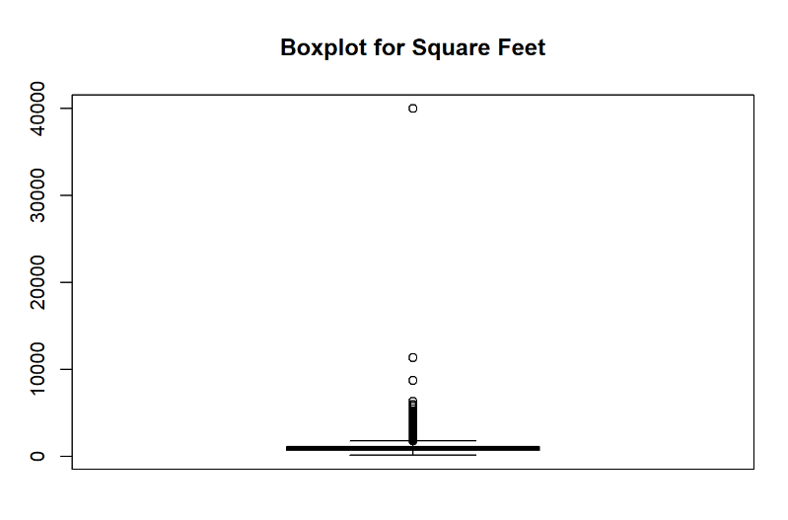
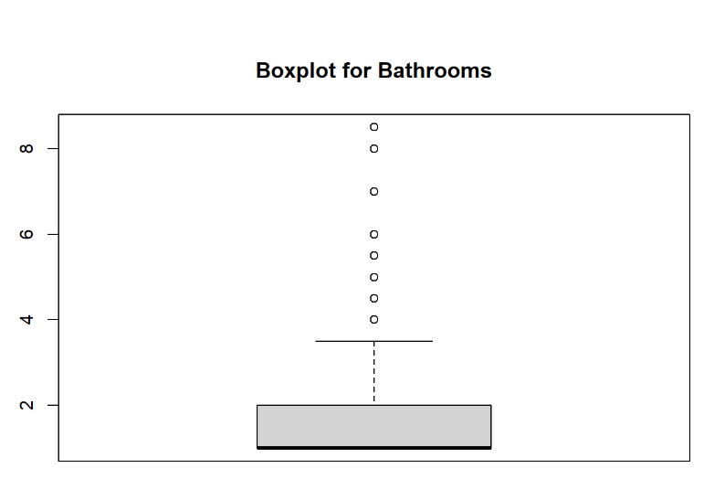
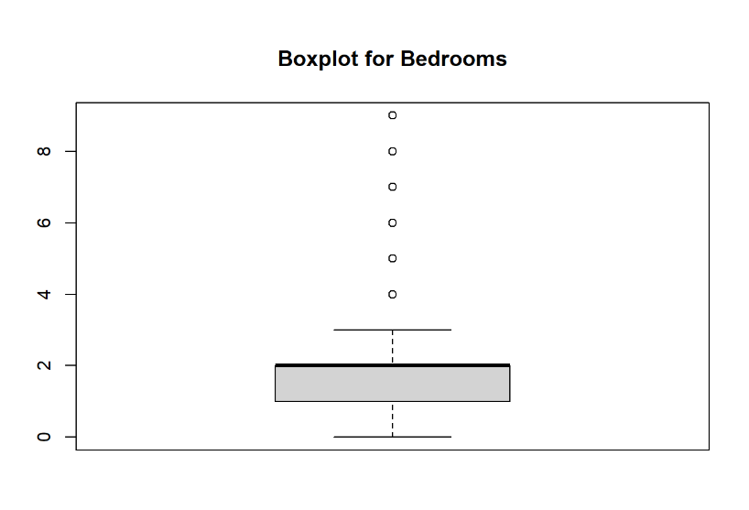
Data Visualization

Slide 8
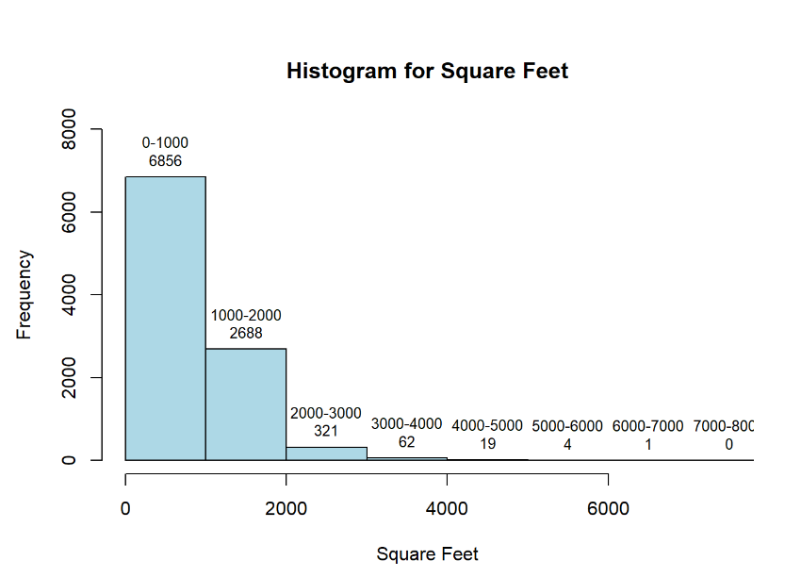
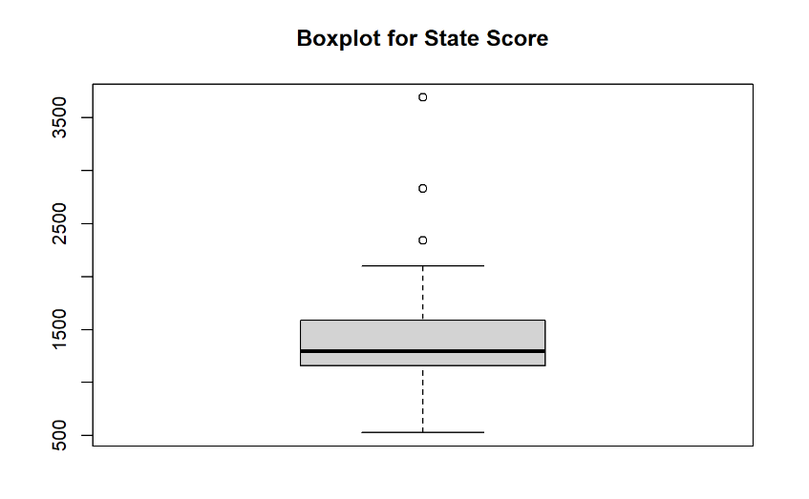
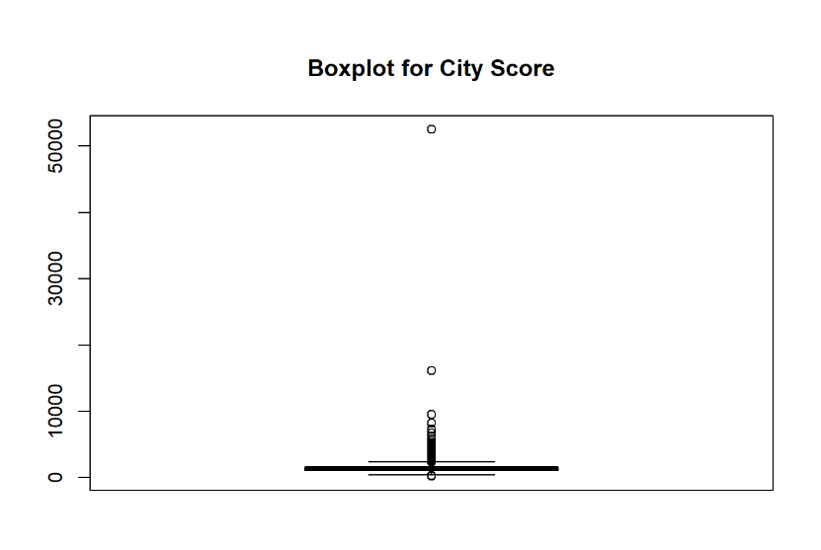
Cleaned Data Visualization

Slide 9
Feature Engineering: City score and State Score
Calculation of City Score:
Objective: To represent the average rental price in each city.
Method:
Step 1: Calculate the average rental price for each city.
Step 2: Assign this average as a new feature, city_score, for each listing.
Step 3: Merge city_score back into the dataset, keyed on city name.
Calculation of State Score:
Objective: To represent the broader regional trends in rental prices.
Method:
Step 1: Compute the average rental price for each state.
Step 2: Create a new feature, state_score, representing this average.
Step 3: Integrate state_score into the main dataset, based on state.
Need for City Score and State Score:
Capturing Geographic Influence: These scores quantify the influence of city and state on rental prices, which is crucial in a diverse and geographically varied market.
Enhancing Model's Predictive Power: Including these scores helps the model to understand and predict rental prices based on location-specific trends.
Dealing with High Cardinality: Especially useful for high cardinality categorical data (like city names), transforming them into a meaningful numerical format.

Slide 10
Application of Lasso Regression: Accuracy: 62.7%
Evaluating the Model:
Generating Predictions: "Used predict() to generate predictions on the test set, applying a carefully chosen lambda value."
R-squared Calculation: "Calculated R-squared value (lasso_r2) to measure the model's predictive power: 1 - sum((test_target - lasso_predictions)^2) / sum((test_target - mean(test_target))^2)."
Results: "Obtained an R-squared value of 0.627, indicating a strong ability to predict rental prices."
Insights and Conclusion:
Interpreting the Results: "The R-squared value of 0.627 implies our model explains 62.7% of the variance in rental prices, a significant indicator of its predictive accuracy."
Strengths of Lasso Regression: "Particularly effective in this context for its feature selection, highlighting the most influential factors in rental pricing."
Model Application: "Lasso Regression's ability to simplify complex datasets makes it highly suitable for real estate market analysis."

Slide 11
Application of Ridge Regression: Accuracy: 63.33%
Model Building and Parameters:
Implementation using glmnet:
Code Snippet: ridge_model <- glmnet(as.matrix(train_features), train_target, alpha = 0)
Parameter - Alpha: Set to 0 for Ridge Regression, focusing on L2 regularization.
Rationale for Parameters:
L2 Regularization: Chosen to manage multicollinearity in our feature-rich dataset.
Regularization Strength: Fine-tuned to balance bias and variance, optimizing predictive accuracy.
Model Evaluation:
Generating Predictions: Using the predict() function with a specific lambda value for test set predictions.
R-squared Calculation: ridge_r2 <- 1 - sum((test_target - ridge_predictions)^2) / sum((test_target - mean(test_target))^2)
Results: Present the obtained R-squared value (e.g., 0.633) to illustrate the model's performance.
Significance of Results:
Interpretation: An R-squared value of 0.633 implies that 63.3% of the variability in rental prices is explained by the model.

Slide 12
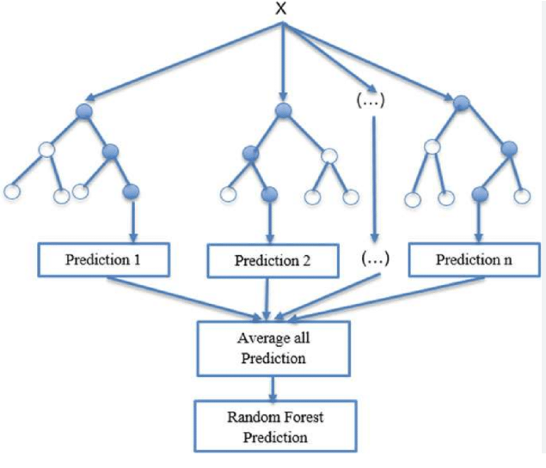
Random Forest Regressor: 76.7%
Introduction: Random Forest, an ensemble learning technique, combines multiple decision trees to improve predictive accuracy and control overfitting.
Relevance to Our Dataset: Ideal for handling the complexities of urban rental market data, given its capability to manage large datasets and capture non-linear relationships.library(randomForest)
rf_mtio<- predict(rf_model, test_fea
Parameter Explanation: Utilized 500 trees (ntree = 500) for a balanced approach between accuracy and computational efficiency.
Key Features of Random Forest:
Handling Overfitting: Reduces overfitting common in decision trees by averaging the results of multiple trees.
Feature Selection: Innately performs feature selection, highlighting significant predictors in the dataset.
Robustness to Noise: Its ensemble nature makes it less sensitive to noise, enhancing model reliability.

Slide 13
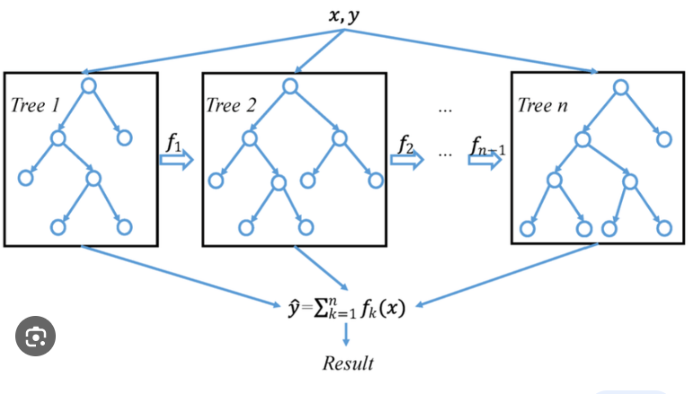
Application of XG-Boost Regressor: 77.4%
Introduction to XGBoost:
Overview: XGBoost, short for Extreme Gradient Boosting, is an advanced ensemble machine learning algorithm known for its speed and performance.
Context: In the urban rental market analysis, XGBoost is employed to capture complex patterns and relationships in the data.
Key Features of XGBoost:
Regularization: Helps in reducing overfitting, a significant advantage over traditional boosting methods.
Handling Missing Values: Automatically manages missing data, providing a robust approach to incomplete datasets."
Computational Efficiency: Optimized for speed and resource usage, making it highly efficient for large datasets.

Slide 14
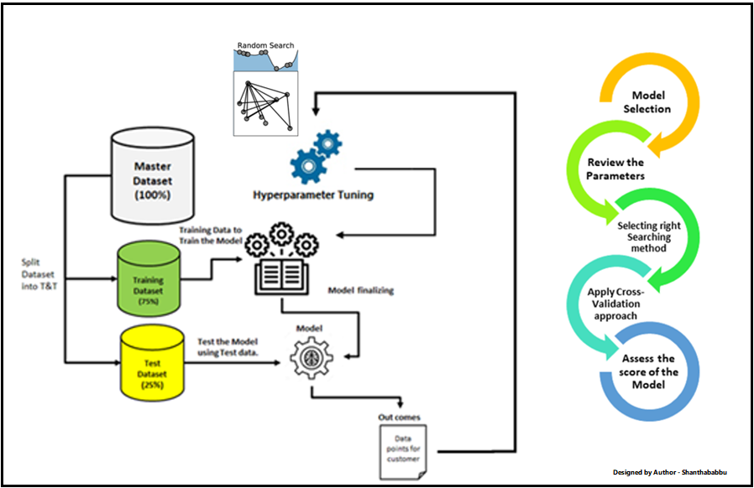
Hyperparameter Tuning: XG-Boost : Best Results: 79.99%
Tuning Process and Parameters:
Optimizing Key Parameters:
"Adjusted critical parameters including eta, max_depth, gamma, colsample_bytree, min_child_weight, and subsample."
"These parameters control aspects like learning rate, tree complexity, and regularization, crucial for model performance."
Model Training:
"Trained the XGBoost model using the best parameters obtained from the tuning process."
Performance Evaluation:
Improvement in R-squared:
"Significant enhancement in the model's R-squared value post-tuning, indicating a substantial increase in its ability to predict rental prices accurately."
Impact of Tuning:
Enhanced Model Accuracy:
The tuning process led to a notably higher R-squared value, reflecting a more accurate and reliable model."
Strategic Model Optimization:
The systematic approach in tuning ensured that the model is well-suited for complex patterns in the rental market data.

Slide 15
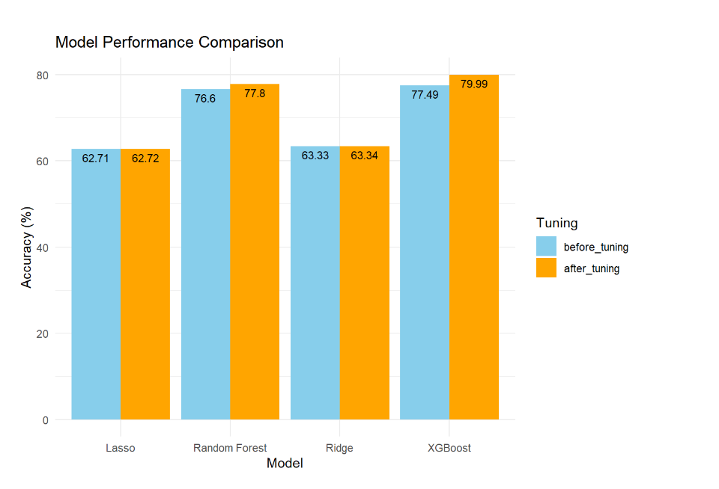
Final Comparison of all models

Slide 16
LASSO Regression to Determine Price
Can the application of LASSO regression, with an optimal regularization parameter, on a dataset of housing features, demonstrate a statistically significant improvement in predictive accuracy (measured by a specific evaluation metric, e.g., Mean Absolute Error) compared to traditional linear regression models, while also providing a parsimonious model with a reduced number of important predictor variables?

Slide 17
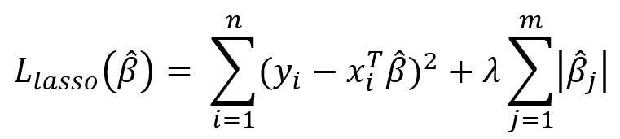
Why LASSO Regression
Effective Feature Selection: Efficiently identifies key predictors in complex real estate data, enhancing model relevance and simplicity.
Multicollinearity Management: Addresses multicollinearity by shrinking less important coefficients, improving model stability.
Improved Interpretability: Simplified understanding of influential factors in rental pricing, aiding in decision-making.
Overfitting Prevention: Regularization parameter in LASSO helps avoid overfitting, ensuring better generalization on new data.
Versatile and Efficient: Suitable for diverse data types, making it ideal for varied real estate datasets; computationally efficient for large-scale analysis.

Slide 18
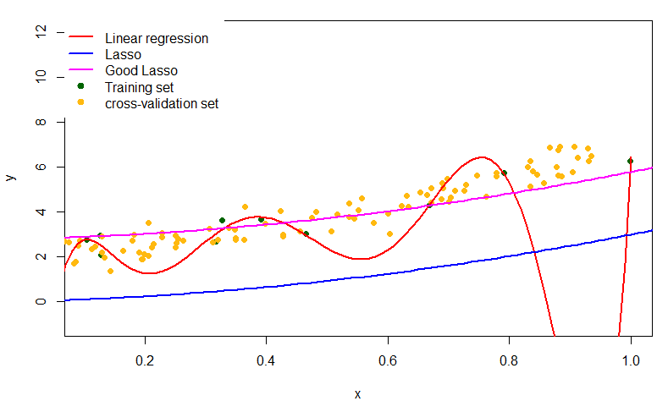
How It Works
LASSO Objective:
Minimize prediction errors.
Key Features:
Selects important predictors automatically.
Controls model complexity to prevent overfitting.
Lagrangian Multiplier (λ):
Balances feature selection and prediction accuracy.
Optimization:
Solves LASSO using iterative techniques.
Cross-Validation:
Helps choose the optimal λ for the trade-off.

Slide 19
Results of the Raw Lasso
Raw LASSO Regression: Initial Assessment
Raw LASSO regression yields an RMSE of 1002.642 and an MAE of 587.9911.
The average price in our dataset stands at $1485.45.
Assessment:
Raw LASSO regression exhibits significant room for improvement.
It produces a sizable error of approximately ⅔ of the average price.
Comparison:
We benchmarked Raw LASSO against a basic regression model (price = sqft(x) + b).
The basic regression model achieved a lower RMSE of 990, outperforming Raw LASSO.
Next Steps:
Let's refine our model to enhance its predictive accuracy and reduce error.

Slide 20
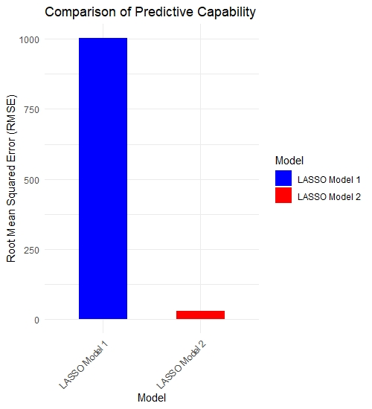
Refinement of the LASSO Model
Refinements to the Lasso model:
Feature Scaling: Standardized all numeric features for equal contribution in the model.
Polynomial Features: Added polynomial transformations to capture complex, non-linear relationships.
Robust Data Preprocessing: Ensured no missing values post-transformation for a more robust dataset.
Increased Model Complexity: Enhanced model complexity to better fit and explain data patterns.
Optimized Data for Training: Utilized a more informative dataset, leading to potentially better predictions.

Slide 21
Results
Effective Data Preprocessing: Proper handling of missing values and standardization of features ensured a clean and consistent dataset, enhancing model accuracy.
Introduction of Polynomial Features: Incorporating polynomial features allowed the model to capture complex, non-linear relationships, providing a more nuanced understanding of housing prices.
Optimal Regularization: The use of cross-validation to find the optimal lambda in LASSO regression helped in selecting the most relevant features while avoiding overfitting, striking a balance between model complexity and predictive power.
Model's Adaptability: LASSO's ability to penalize less important features effectively reduced model complexity without compromising on performance, leading to a more robust and accurate model.
Significant RMSE Reduction: The refinement steps led to a drastic reduction in RMSE, from 1002.642 to 29.22755, indicating a substantial increase in the model's predictive accuracy. This can also indicate the presence of overfitting. This was tested for with a comparison of train_data RMSE and test_data RMSE and the RMSE decreased transitioning from the training data to the test data. Overfitting is still possible however.

Slide 22
Smart Question:
Apartment Market Segmentation Using K-means
Smart Question:
How can the apartment market be segmented based on price and geographical location?
Exploring apartment market segmentation
Utilizing K-means clustering
Market segmentation based on price and geographical location

Slide 23
Smart Question:
Apartment Market Segmentation Using K-means
Data Preprocessing
Data cleansing: Removing NA, NaN, Inf values
Feature conversion: Numeric transformation
Standardization: Equal weighting for clustering
K-means Clustering Implementation
Optimal cluster selection: Three market tiers
Algorithm application: Clustering based on price and location
Seed setting: Reproducibility of results

Slide 24
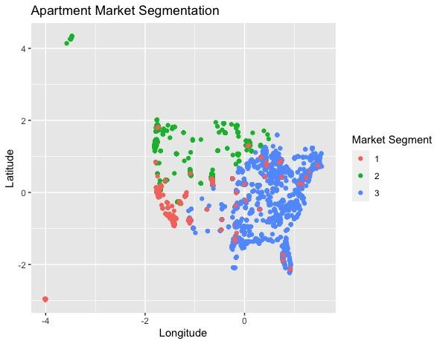
Geographical Cluster Visualization
Apartment Market Segmentation
Urban cluster: High prices, high density
Suburban cluster: Moderate prices, moderate density
Rural cluster: Lower prices, low density

Slide 25
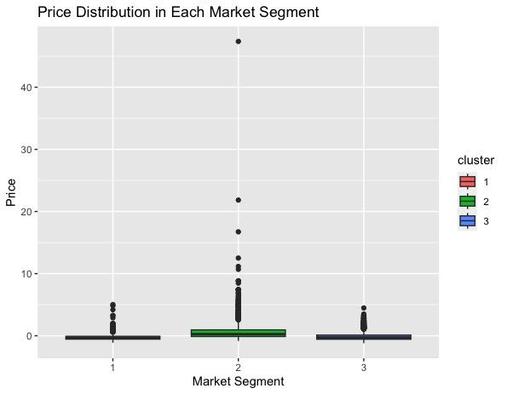
Price Distribution Boxplot
Price Distribution in Each Market Segment
Diverse price range in urban cluster
Concentrated price distribution in suburban cluster
Narrow price range in rural cluster

Slide 26
Why Choose K-means Clustering & Conclusion
Why Choose K-means Clustering Method
Unsupervised learning: Ideal for unlabeled data
Scalability: Efficient with large datasets
Simplicity: Easy to implement and interpret
Adaptability: Good performance on spherical clusters
Conclusion:
Effective market segmentation via K-means clustering
Data-driven identification of three distinct clusters
Insights into price and density patterns by location
Basis for data-centric strategy development

Slide 27
Smart Question: Can we classify apartments into various categories (e.g., luxury, budget) based on their features?
Objective: Introduce the goal of the analysis, which is to classify apartments into 'Luxury', 'Budget', and 'Standard' categories based on rental prices and other features in the dataset.
Importance: Emphasize why this classification is valuable – for instance, it could be useful for real estate market analysis, targeted marketing strategies, or customer segmentation.

Slide 28
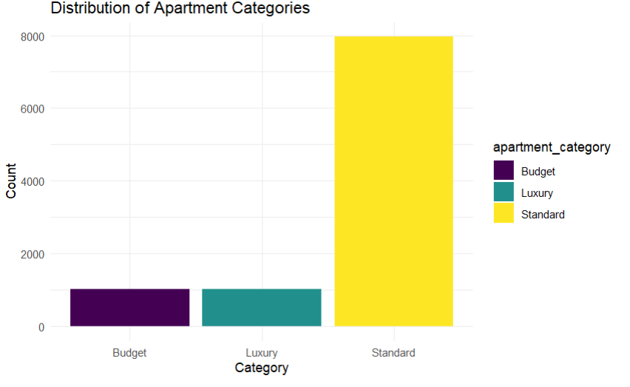
Distribution of Apartment Categories
Notes:
Observation: This bar plot illustrates the count of apartments in each of the three categories - 'Budget', 'Standard', and 'Luxury', based on price quantiles.
Interpretation:
The height of each bar represents the number of apartments in each category.
This plot helps in understanding how apartments are distributed across these defined categories.
You can assess if there's a balance or a significant skew towards one of the categories, which could be important for market analysis or business strategy.

Slide 29
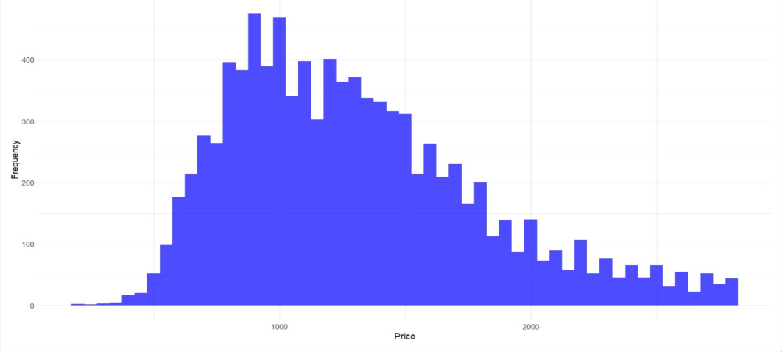
Distribution of Price with Frequency
Notes:
Observation: This histogram shows the frequency distribution of rental prices in the dataset.
Interpretation:
You can observe the concentration of rental prices, identifying the most common price ranges.
The spread of the histogram indicates the range of prices, from the lowest to the highest.
Look for any skewness (left or right) in the distribution, which could indicate a predominance of either lower or higher rental prices.

Slide 30
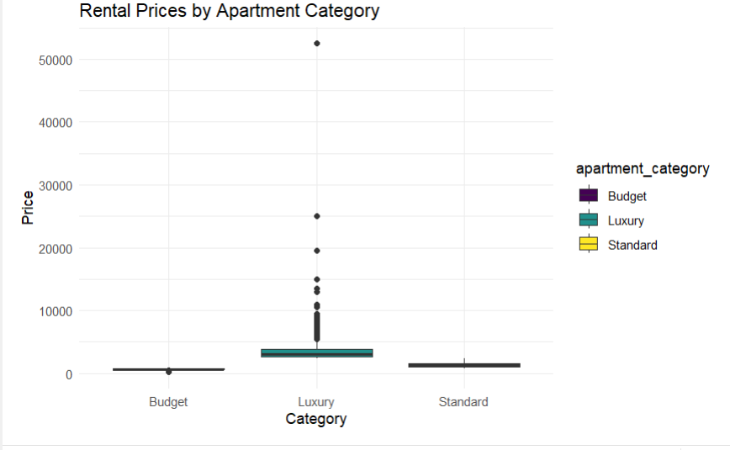
Rental Price by Apartment Category
Notes:
Observation: The boxplot displays the distribution of prices within each apartment category.
Interpretation:
Each box shows the interquartile range (IQR) of prices in the category, with the median price indicated by a line within the box.
The 'whiskers' extend to show the full range of prices, excluding outliers.
Any points outside of the whiskers are considered outliers, representing apartments with unusually high or low prices for their category.
This plot is crucial for understanding how prices vary within each category and identifying categories with greater price variability.

Slide 31
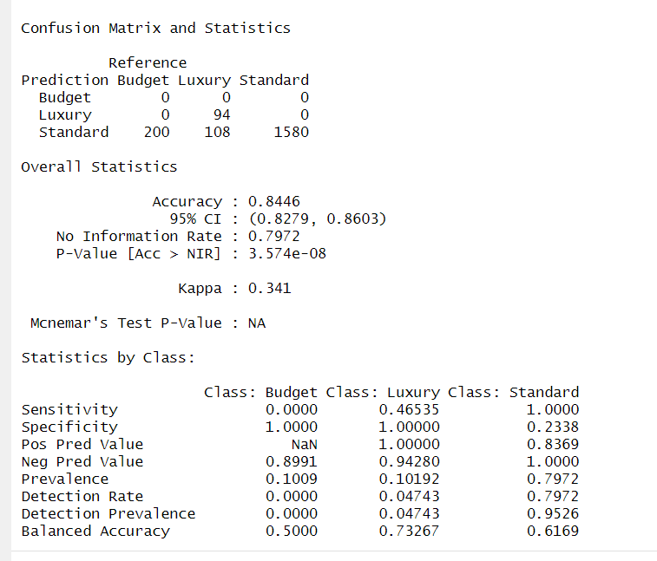
Model Training and Prediction:
Train the Random Forest model on the preprocessed training set.
Predict the apartment categories on the testing set.
Train the Random Forest model on the preprocessed training set.
Predict the apartment categories on the testing set.
Use the confusion matrix to evaluate the model's performance.
Compute classification metrics like accuracy, precision, recall, and F1-score.

Slide 32
Outcome
The model is highly effective in identifying 'Luxury' and 'Standard' apartments, but it fails to identify 'Budget' apartments.
The high class imbalance (most apartments being 'Standard') is influencing the model's performance, making it biased towards predicting the 'Standard' category.
Budget: The model did not correctly identify any 'Budget' apartments (0 true positives). All 'Budget' predictions were false (200 false negatives).
Luxury: Out of the 202 apartments actually categorized as 'Luxury', the model correctly identified 89 (specificity: 100%), but it failed to identify 113 (false negatives).
Standard: The model performed well in identifying 'Standard' apartments, with all 1580 predicted correctly (sensitivity: 100%).

Slide 33





Q&A?
Thank You!

