Slide 1
Portfolio
Student portfolio

Slide 2
About me :
Name : M. Narayani
Department : Bsc.Computer science
College : Valliammai Women’s College of Arts and science
Email : narayanim65@gmail.com
Phone no : 9043038023

Slide 3
Table of the contents
Self introduction
Academic information
Skills
Soft skills
Extracurricular activities
Personal Details
Conclusion

Slide 4
Self introduction
My name is Narayani second year Bsc. Computer science student with a passion for programming problem solving and web developing, I below in contributed to the IT industry by creating a efficient code nd user

Slide 5
Academic information :
Passed SSLC in (2021-2022)with 70%
Passed HSLC in (2023-2024)with 78%
Bachelor’s of degree in (2024-2027)in valliammai Women’s college of Arts and science

Slide 6
Skills :
I known the programming languages : python, c++
Web development : HTML, CSS, JavaScript

Slide 7
Soft skills :
Presentation and Communication
Problem solving
Time management

Slide 8
Achievement :
Received merit schorlship For scoring above 80 % in all semester

Slide 9
Personal Details :
Im born in 28th February in 2007
Father name : Manikandan
Mother name : Selvi
Language known : Tamil and English
Hobbies : playing games, Reading stories, Hearing song

Slide 10
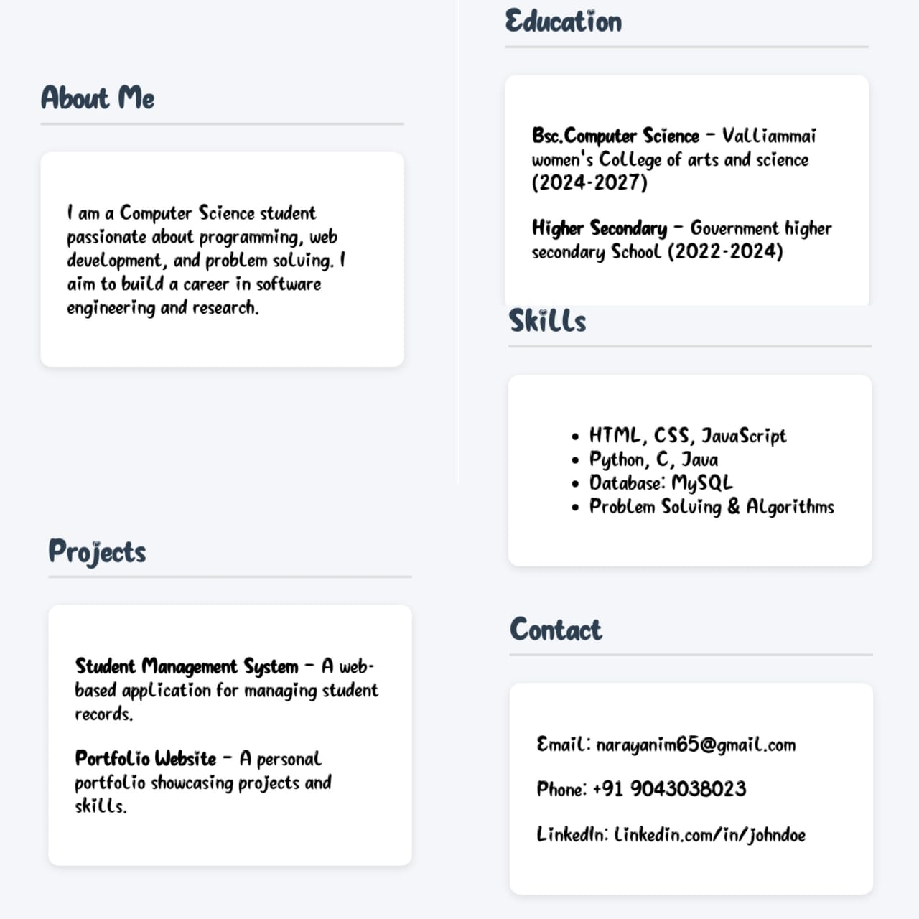

Slide 11
Githup :
https://github.com/narayanim65-arch/HTML-BASIC-1WEEK

Slide 12
Conclusion :
I am enthusiastic to learn strong communication skills. I am confident that my skill project and dedication help and achieve my aim.

Slide 13
End of the presentation
Thank you

