Slide 1

React

Slide 2
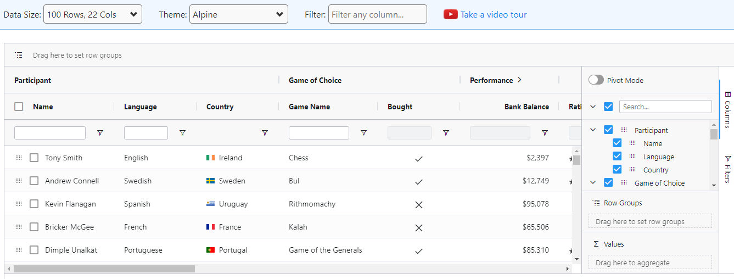
AG Grid in React
AG Grid is the industry standard for React Enterprise Applications
https://www.ag-grid.com/react-data-grid/getting-started/
Installation
npm install --save ag-grid-community ag-grid-react

Slide 3
AG Grid in React - basic
How to create
Include styles
rowData
DolumnDefs
DefaultColDef
checkboxSelection
Sortable
Editable
Filter

Slide 4
AG Grid in React - basic
import React from 'react';
import { AgGridReact } from 'ag-grid-react';
import 'ag-grid-community/dist/styles/ag-grid.css';
import 'ag-grid-community/dist/styles/ag-theme-alpine.css';
import { Autowired } from 'ag-grid-community';
const Aggrid = () =>{
const data =[
{name:'Bharathi' , age:32},
{name:'Max' , age:30},
{name:'John' , age:35},
{name:'Abraham' , age:40},
{name:'Arnault' , age:72},
{name:'Forbes' , age:59},
{name:'Jeff Bezos' , age:50},
{name:'Franck' , age:52}
];
const columns = [
{
headerName:"Name", field:'name',checkboxSelection:true
},
{
headerName:"age", field:'age'
}
]
const defaultColDef = {
sortable:true,editable:true,filter:true
}
return(
<>
<p>Ag Grid</p>
<div className="ag-theme-alpine" style={{height: 400, width: 600}}>
<AgGridReact rowData={data} columnDefs={columns} defaultColDef={defaultColDef} />
</div>
</>
)
}
export default Aggrid;
import React from 'react';
import logo from './logo.svg';
import './App.css';
import Aggrid from './Aggrid';
function App() {
return (
<div className="App">
<Aggrid />
</div>
);
}
export default App;

Slide 5
AG Grid in React -Export
import React from 'react';
import { AgGridReact } from 'ag-grid-react';
import 'ag-grid-community/dist/styles/ag-grid.css';
import 'ag-grid-community/dist/styles/ag-theme-alpine.css';
import { Autowired } from 'ag-grid-community';
const Aggrid = () =>{
const data =[
{name:'Bharathi' , age:32},
{name:'Max' , age:30},
{name:'John' , age:35},
{name:'Abraham' , age:40},
{name:'Arnault' , age:72},
{name:'Forbes' , age:59},
{name:'Jeff Bezos' , age:50},
{name:'Franck' , age:52}
];
const columns = [
{
headerName:"Name", field:'name',checkboxSelection:true
},
{
headerName:"age", field:'age'
}
]
const defaultColDef = {
sortable:true,editable:true,filter:true,floatingFilter:true,flex:1
}
let gridAPi:any;
const onReady = (params:any) =>{
gridAPi = params.api;
}
const exportData = () => {
gridAPi.exportDataAsCsv();
}
return(
<>
<p>Ag Grid</p>
<button onClick={exportData}>Export</button>
<div className="ag-theme-alpine" style={{height: 400}}>
<AgGridReact rowData={data} columnDefs={columns} defaultColDef={defaultColDef} onGridReady={onReady}/>
</div>
</>
)
}
export default Aggrid;

Slide 6
AG Grid in React –Event handler and style
import React from 'react';
import { AgGridReact } from 'ag-grid-react';
import 'ag-grid-community/dist/styles/ag-grid.css';
import 'ag-grid-community/dist/styles/ag-theme-alpine.css';
import { Autowired } from 'ag-grid-community';
import Newbutton from './Newbutton';
const Actionbutton = () =>{
const data =[
{id:1,name:'Bharathi' , age:32},
{id:2,name:'Max' , age:30},
{id:3,name:'John' , age:35},
{id:4,name:'Abraham' , age:40}
];
const columns = [
{
headerName:"Id", field:'id',checkboxSelection:true
},
{
headerName:"Name", field:'name'
},
{
headerName:"age", field:'age',cellStyle:(params:any)=>(params.value > 40 ? {borderLeft:"4px green solid"}:{borderLeft:"4px red solid"})
},
{
headerName:"Action", field:'id',cellRendererFramework:(params:any)=><div><Newbutton params={params} /></div>
}
]
const defaultColDef = {
sortable:true,editable:true,filter:true,floatingFilter:true,flex:1
}
let gridAPi:any;
const onReady = (params:any) =>{
gridAPi = params.api;
}
const exportData = () => {
gridAPi.exportDataAsCsv();
}
return(
<>
<p>Ag Grid</p>
<button onClick={exportData}>Export</button>
<div className="ag-theme-alpine" style={{height: 400}}>
<AgGridReact rowData={data} columnDefs={columns} defaultColDef={defaultColDef} onGridReady={onReady}/>
</div>
</>
)
}
export default Actionbutton;

Slide 7
AG Grid in React –From Rest Api
import React from 'react';
import { AgGridReact } from 'ag-grid-react';
import 'ag-grid-community/dist/styles/ag-grid.css';
import 'ag-grid-community/dist/styles/ag-theme-alpine.css';
import { Autowired } from 'ag-grid-community';
const Restapi = () =>{
const columns = [
{
headerName:"Id", field:'id',checkboxSelection:true,cellStyle:(params:any)=>({Width:50})
},
{
headerName:"PostId", field:'postId',cellStyle:(params:any)=>({Width:50})
},
{
headerName:"Name", field:'name',cellStyle:(params:any)=>({Width:200})
},
{
headerName:"E-Mail", field:'email',cellStyle:(params:any)=>({Width:200})
},
{
headerName:"Body", field:'body',cellStyle:(params:any)=>({Width:500})
}
]
const defaultColDef = {
sortable:true,editable:true,filter:true,floatingFilter:true,flex:1
}
let gridAPi:any;
const onReady = (params:any) =>{
fetch("https://jsonplaceholder.typicode.com/comments")
.then(resp=>resp.json()
.then(resp=>params.api.applyTransaction({add:resp})));
gridAPi = params.api;
}
const exportData = () => {
gridAPi.exportDataAsCsv();
}
return(
<>
<p>Ag Grid</p>
<button onClick={exportData}>Export</button>
<div className="ag-theme-alpine" style={{height: 400}}>
<AgGridReact columnDefs={columns} defaultColDef={defaultColDef} onGridReady={onReady}/>
</div>
</>
)
}
export default Restapi;

Slide 8
AG Grid in React –From Rest Api
import React from 'react';
import { AgGridReact } from 'ag-grid-react';
import 'ag-grid-community/dist/styles/ag-grid.css';
import 'ag-grid-community/dist/styles/ag-theme-alpine.css';
import { Autowired } from 'ag-grid-community';
const Restapi = () =>{
const columns = [
{
headerName:"Id", field:'id',checkboxSelection:true,cellStyle:(params:any)=>({Width:50})
},
{
headerName:"PostId", field:'postId',cellStyle:(params:any)=>({Width:50})
},
{
headerName:"Name", field:'name',cellStyle:(params:any)=>({Width:200})
},
{
headerName:"E-Mail", field:'email',cellStyle:(params:any)=>({Width:200})
},
{
headerName:"Body", field:'body',cellStyle:(params:any)=>({Width:500})
}
]
const defaultColDef = {
sortable:true,editable:true,filter:true,floatingFilter:true,flex:1
}
let gridAPi:any;
const onReady = (params:any) =>{
fetch("https://jsonplaceholder.typicode.com/comments")
.then(resp=>resp.json()
.then(resp=>params.api.applyTransaction({add:resp})));
gridAPi = params.api;
}
const exportData = () => {
gridAPi.exportDataAsCsv();
}
return(
<>
<p>Ag Grid</p>
<button onClick={exportData}>Export</button>
<div className="ag-theme-alpine" style={{height: 400}}>
<AgGridReact columnDefs={columns} defaultColDef={defaultColDef} onGridReady={onReady}/>
</div>
</>
)
}
export default Restapi;

Slide 9
AG Grid in React –Pagination
import React from 'react';
import { AgGridReact } from 'ag-grid-react';
import 'ag-grid-community/dist/styles/ag-grid.css';
import 'ag-grid-community/dist/styles/ag-theme-alpine.css';
import { Autowired } from 'ag-grid-community';
const Restapi = () =>{
const columns = [
{
headerName:"Id", field:'id',checkboxSelection:true,headerCheckboxSelection:true,cellStyle:(params:any)=>({Width:50})
},
{
headerName:"PostId", field:'postId',cellStyle:(params:any)=>({Width:50})
},
{
headerName:"Name", field:'name',cellStyle:(params:any)=>({Width:200})
},
{
headerName:"E-Mail", field:'email',cellStyle:(params:any)=>({Width:200})
},
{
headerName:"Body", field:'body',cellStyle:(params:any)=>({Width:500})
}
]
const defaultColDef = {
sortable:true,editable:true,filter:true,floatingFilter:true,flex:1
}
let gridAPi:any;
const onReady = (params:any) =>{
fetch("https://jsonplaceholder.typicode.com/comments")
.then(resp=>resp.json()
.then(resp=>
params.api.applyTransaction({add:resp})
));
gridAPi = params.api;
}
const exportData = () => {
gridAPi.exportDataAsCsv();
}
/* const rowSelectionType = 'single'; */
const rowSelectionType = 'multiple';
const OnChangeData = (event:any) =>{
console.log(event.api.getSelectedRows());
}
const isRowSelectable = (node:any) =>{
return true;
}
return(
<>
<p>Ag Grid</p>
<button onClick={exportData}>Export</button>
<div className="ag-theme-alpine" style={{height: 550}}>
<AgGridReact columnDefs={columns} defaultColDef={defaultColDef} onGridReady={onReady}
rowSelection={rowSelectionType}
onSelectionChanged={OnChangeData}
rowMultiSelectWithClick={true}
isRowSelectable={isRowSelectable}
pagination = {true}
paginationPageSize={25}
paginationAutoPageSize={true} />
</div>
</>
)
}
export default Restapi;

