Slide 1

React

Slide 2
Initial & mounting phase
Initial phase
After creating component - we will create props and state value initial stage
- getDefaultProps() – this will invoke before the creation
- getInitialState() – this will invoke before the creation
Mounting phase
After initialization of the components is completed, then the component is
mounted on the DOM and rendered for the first time in the webpage.
ComponentWillMount()
- this will be invoked before the component is mounted on the DOM.
- whenever we are change the initial value using setState()
the component will not re-render
componentDidMount()
- This will be invoked after the components is mounted on the DOM the first time
- This is user for DOM querying operations.

Slide 3
updating & Unmounting phase
updating phase
- Based on the user events such as onclick.
- componentWillUpdate()
- this function will invoke before component is re-render
- After the updating of state or pops and before render() function execute
- componentDidUpdate()
- this function will invoke After component is re-render
- render()
- shouldComponentUpdate()
- this function like conditional update , if the value is Ok the re-render process will work
else re-render process will stop.
Unmounting phase
- componentWillUnmount()
- this function invoked before a components is destroyed and unmounted permanently.

Slide 4
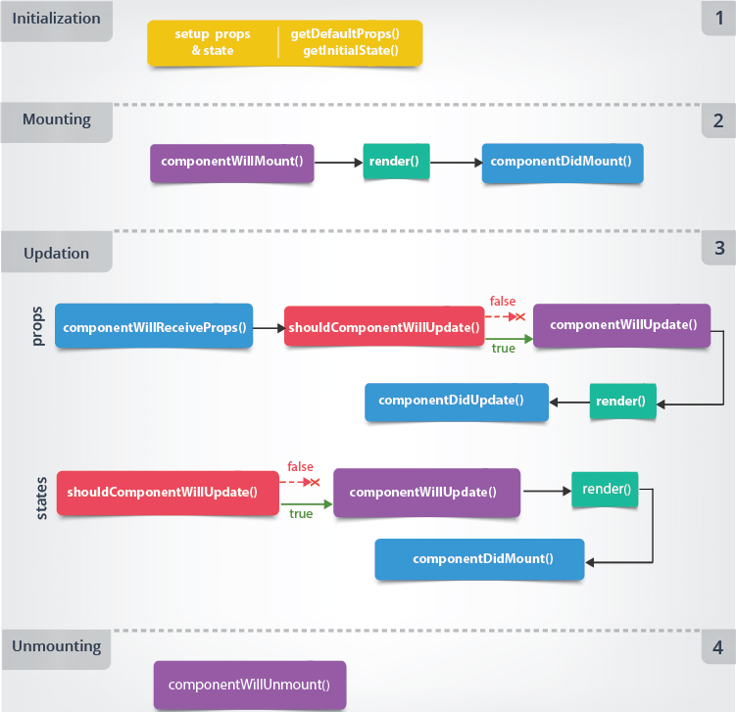
React Lifecycle

Slide 5
React Lifecycle
import React from 'react';
import ReactDOM from 'react-dom';
class Lifecycle extends React.Component{
constructor(){
super();
this.state = {name:"Name",value:"Sarun" };
}
componentWillMount(){
this.setState({value:"Ramanathan" });
}
render(){
return <div> <h1><div>{this.state.name} </div>
<div>{this.state.value}</div></h1>
<button type="button" onClick={this.ChangeValue}> press </button>
<button type="button" onClick={this.DeleteValue}> Delete </button>
<div id="confirmMessage"></div>
</div>;
}
ChangeValue = () =>{
this.setState({value:"ChangeValue => Manoharan" })
}
componentDidMount(){
setTimeout(()=>{this.setState({value:"Bharathi" })},5000);
}
componentWillUpdate(){
alert("componentWillMountUpdate");
}
componentDidUpdate(){
document.getElementById('confirmMessage') .innerHTML="New vaule udpate succsessfully "+ this.state.value;
}
shouldComponentUpdate(){
return true;
}
DeleteValue = ()=>{
this.setState({name:false,value:false});
}
componentWillUnmount(){
alert("componentWillUnmount");
}
}
ReactDOM.render(<Lifecycle />,document.getElementById('root'));

Slide 6
Event Handling
- This keyword in normal function and arrow function
Event Handling
- Event is an action that will be triggered as result of the user / system action.
- mouse click, loading of the web page, windows resizes
- React event are name using camelCase,
- In React need to user JSX format
- onClick={changeValue}
- Possible way of Event Handing
- Using event method in class component.
- Using bind keywork in event.
- passing arguments to event using arrow function.
- passing argument to evening using bind.
Event list
https://reactjs.org/docs/events.html

Slide 7
Event Handling
import React from 'react';
import ReactDOM from 'react-dom';
class Eventbind extends React.Component{
constructor(){
super();
this.state = {msg:"Test"};
}
/* clickEvent(){
this.setState({msg:"thanks"});
}*/
clickEvent = (a,b) => {
this.setState({msg:a + b});
}
/* () anonymous & bind */
render(){
return (
<div>
<h1>{this.state.msg}</h1>
<button onClick={()=>this.clickEvent("This is "," test message")} > Anonymous </button>
<button onClick={this.clickEvent.bind(this,"This is "," Message from bind")} > Bind </button>
</div>
)
}
}
ReactDOM.render(<Eventbind />,document.getElementById('root'));

Slide 8
React style : Sass
React Sass
- Style sheet
- inline
- external style sheet
- module stylesheet
- Sass - Syntactically StylesSheet
- Sass reduce repetitions of css
- variable, nested rules, import, inheritance, built-in function
- npm install node-sass
- ".scss"
- $variablename:value;
- Transpiling

Slide 9
React style : Sass
import React from 'react';
import ReactDOM from 'react-dom';
import './test.scss';
class SassExample extends React.Component{
render(){
return <div>
<h1>Test 1 </h1>
<h2>Test 1 </h2>
<h3>Test 1 </h3>
</div>
}
}
ReactDOM.render(<SassExample />,document.getElementById('root'));}
Index.scss
$colorh2:red;
h1{
color:$colorh2;
}
h2{
font:{
size:72px;
family:sans-serif;
}
$colorh2:yellow;
color:$colorh2
}

