Slide 1
AI-Driven Export Market Decision Support System
for Indian Exporters Using Public Trade and Macroeconomic Data
Final Presentation
Pavithra Bharathi
Mentor: Vikas
Notes:
Student name - 2 marks
Mentor’s name - 2 marks
Topic name - 2 marks
-> automated grading

Slide 2
Executive Summary
Objective
Develop decision-support system to identify and prioritize high-potential country–commodity export opportunities for Indian exporters.
Why it matters
Public trade and economic data are fragmented; market size alone does not reveal a defensible opportunity.
Data
TradeStat + UN Comtrade + World Bank; 6,040 analytical rows and 231 final country–commodity opportunities.
Best result
Random Forest achieved RMSE 0.6299 and R² 0.9224 on the log target — 41.79% lower RMSE than Linear Regression.
Business use
EMAS turns six market dimensions into prioritized, explainable recommendations for export market selection.

Slide 3
Gap Analysis
From fragmented information to integrated market screening
LITERATURE
UNRESOLVED GAP
• Market selection is consistently treated as a multi-criteria problem, not a market-size ranking.
• Export-potential research combines supply, demand, market access, competition, and product structure.
• Machine learning can capture nonlinear trade patterns beyond an interpretable linear baseline.
Fragmented public sources
TradeStat, UN Comtrade and World Bank provide complementary signals but not one integrated prioritization mechanism.
Single-metric screening is weak
High import demand can still be unattractive when India already has high share or supplier concentration is unfavorable.
Need for explainability
Exporters need a shortlist plus the reasons behind each recommendation, not a black-box prediction alone.
PROJECT RESPONSE → Predict demand + quantify competition + integrate six dimensions into the Export Market Attractiveness Score (EMAS).
3

Slide 4
Research Questions, Hypotheses & Tests
All inferential tests evaluated at α = .05
H₀₁: Export-demand distributions do not differ significantly across commodity groups.
H₁₁: At least one commodity group has a significantly different export-demand distribution.
RQ1
1
Do export-value distributions differ across commodity groups?
Kruskal–Wallis
Key result
H = 415.8915, p < .001
Decision
Reject H₀
RQ2
2
Which macroeconomic factors significantly influence export demand?
Standardized OLS + HC3
H₀₂: Macroeconomic factors are not significantly associated with export demand.
H₁₂: At least one macroeconomic factor is significantly associated with export demand.
Key result
GDP, Population, GDP/capita significant
Decision
Reject H₀
H₀₃: Competition and India market-share indicators are
not significantly associated with export opportunity.
H₁₃: At least one competition or India market-share indicator is significantly associated with export opportunity.
RQ3
3
How do supplier competition and India market share change opportunity?
Market share + HHI screening
Key result
Competition / India-share indicator(s) significantly associated with export opportunity
Decision
Reject H₀
H₀₄: Machine-learning models do not improve predictive performance relative to Linear Regression.
H₁₄: At least one machine-learning model improves predictive performance relative to Linear Regression.
RQ4
4
Can ML improve prediction over Linear Regression?
Out-of-time LR / RF / XGB
Key result
RF RMSE 0.6299 vs LR 1.0821
Decision
Reject H₀
4

Slide 5
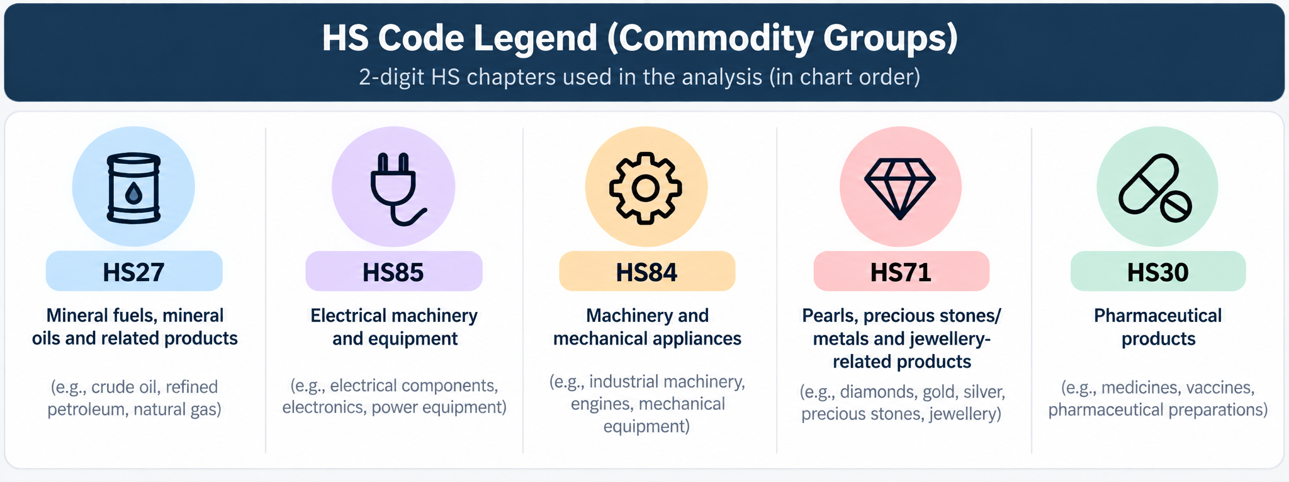
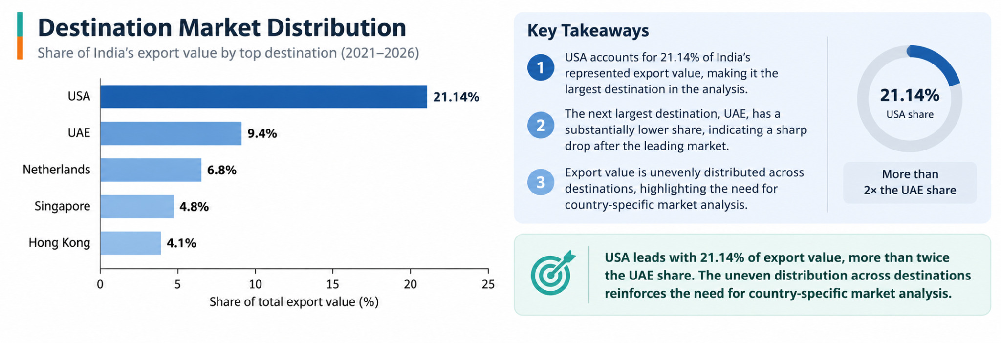
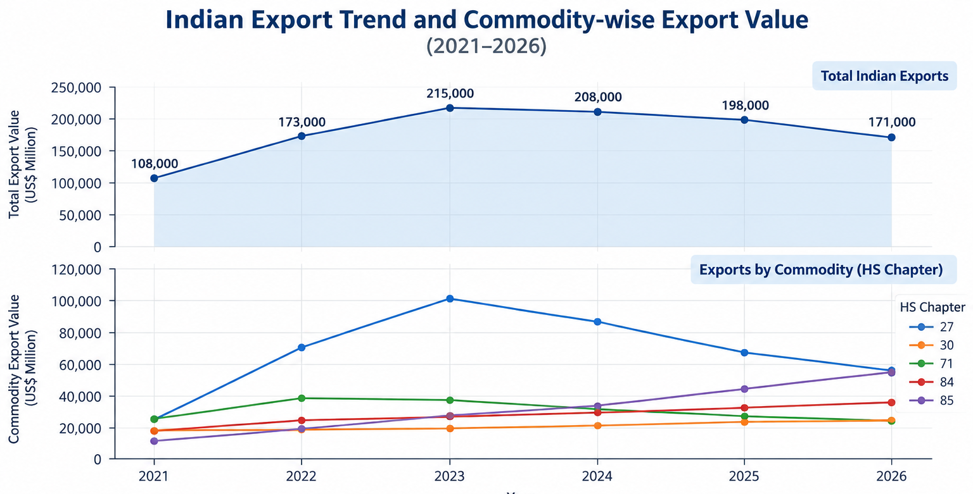
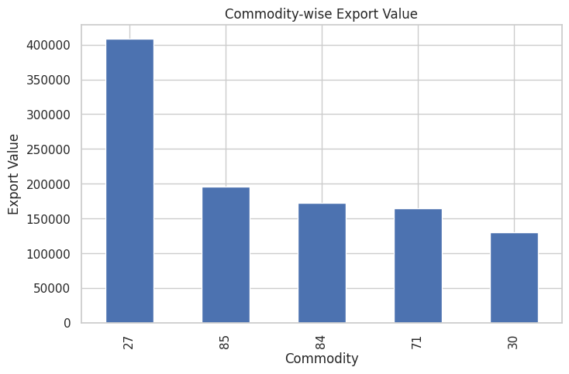
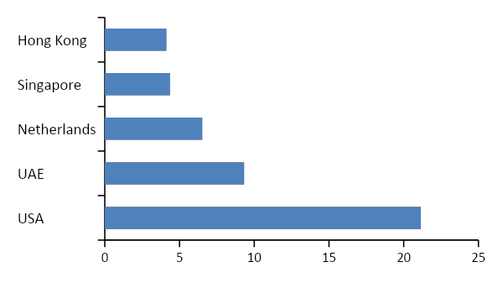
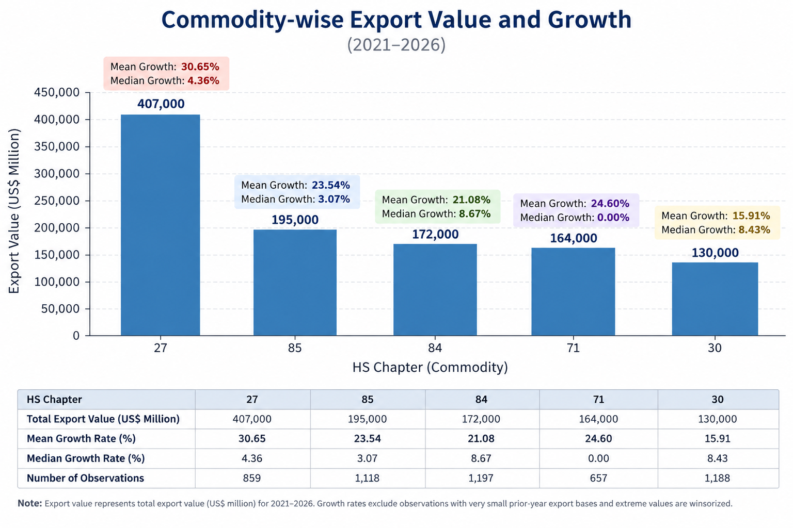
Data Description and EDA
TRADESTAT
UN COMTRADE
WORLD BANK
29 files
100K rows
2,125 rows
India exports, prior value, growth
Import demand, India share, suppliers, HHI
GDP, GDP/capita, population, macro data
Destination concentration
USA contributes 21.14% — more than twice UAE. Diversification matters.
Time pattern
Export value increased strongly through 2023 before moderating. driven partly by the HS27 (Mineral Fuels & Oils) surge during the 2022–23 global energy-price shock. Export values moderated thereafter. 2026
Product heterogeneity
Export performance differs substantially across HS groups: HS27 leads in export value, while HS84 and HS30 show stronger typical growth based on median growth rates.
EDA insight: USA accounts for 21.14% of export value; exports peak in 2023; strong product heterogeneity supports commodity-specific analysis. 2026 has data till July

Slide 6
Architecture diagram/Workflow
1
2
3
4
5
6
Sources
Prepare
Analyze
Predict
Score
Use
TradeStat
Comtrade
World Bank
Clean
Harmonize
Align years
EDA
Tests
HHI
LR
RF
XGBoost
6 EMAS
Dimensions
Sensitivity
Ranks
Tiers
Shortlist
Legend: sources → preprocessing → statistical analysis → machine learning → EMAS decision layer → business-ready output.

Slide 7
Model Building
Statistical analysis, competition screening and machine learning combine to support the final EMAS decision layer.
RQ
RESEARCH QUESTION
APPROACH / MODEL
PURPOSE
KEY FEATURES / SETTINGS
OUTPUT USED IN EMAS
Do export-value
distributions differ across
commodity groups?
Exploratory Data Analysis
+
Kruskal–Wallis Test
Test whether export value
differs significantly across
commodity (HS chapter) groups.
• Log-transformed export demand (log1p)
• Non-parametric test across 24 HS chapters
Demand heterogeneity and need
for commodity-specific analysis.
RQ1
Which macroeconomic
factors significantly
influence export demand?
Multiple Linear Regression
(Standardized)
+
HC3 Robust Standard Errors
Identify which macroeconomic
variables significantly drive
export demand.
• GDP, Population, GDP/capita
• GDP Growth, Trade Openness,
Inflation, Exchange Rate
• Robust inference (HC3)
Economic Strength dimension
and insight on key drivers.
RQ2
How do supplier competition
and India market share
change opportunity?
Descriptive Analysis
+
Opportunity Screening
(Market Share + HHI)
Find high import-demand markets
where India share is low and
supplier concentration is favorable.
• India Market Share (%)
• Number of Suppliers
• Herfindahl–Hirschman Index (HHI)
• Opportunity thresholds
India Opportunity and Competition
dimensions; opportunity shortlist.
RQ3
Can ML improve prediction
of export demand over
Linear Regression?
Machine Learning Models
Linear Regression (Baseline)
Random Forest
XGBoost
Predict future export demand and
test whether ML provides better
out-of-time performance.
• Target: log1p(Export_Current)
• Historical export + macro variables, year, country & commodity
• Train ≤ 2024; Test = 2025
Predicted demand (RF) feeds
Export Performance dimension
of EMAS.
RQ4
DATA SOURCES
TradeStat 6,040 • UN Comtrade 100,000 • World Bank 2,125
VALIDATION DESIGN
Train ≤ 2024: 3,979 • Test 2025: 1,006
PRIMARY MODEL-SELECTION METRIC
RMSE (log); also report MAE (log) and R² (log)

Slide 8
Results
RQ1
RQ2
RQ3
RQ4
H = 415.8915
R² = .233
45 markets
RF Test R² = .9224
p < .001 • Reject H₀
GDP, Population & GDP/capita significant
Opportunity-screening candidates
Test RMSE = .6299 • Reject H₀
Export demand differs significantly
across countries and commodities.
Economic factors significantly
influence export demand.
High-potential markets identified
for India’s exports.
ML models outperform the
linear baseline.
RQ4 VALIDATION SPLIT
RQ4 TRAIN vs TEST PERFORMANCE (LOG SCALE)
INTERPRETATION
TRAIN
TEST
Model
Train
MAE
Test
MAE
Train
RMSE
Test
RMSE
Train
R²
Test
R²
• RF shows a train–test gap, indicating some overfitting.
≤ 2024
3,979 rows
2025
1,006 rows
Linear
Regression
0.7767
0.8036
1.0627
1.0821
0.7749
0.7710
• Despite the gap, RF retains strong out-of-time generalization.
Random Forest
0.1702
0.3181
0.3386
0.6299
0.9771
0.9224
Out-of-time validation using
a temporal split.
• XGBoost is close, but RF remains the best test performer.
XGBoost
0.2305
0.3267
0.3648
0.6602
0.9735
0.9148
Train–test performance is compared to assess generalization and potential overfitting.
• Linear Regression is stable but weaker than nonlinear models.
Random Forest: lowest Test RMSE (.6299) and highest Test R² (.9224).
Integrated decision output: 231 country–commodity opportunities ranked by EMAS • 13 Priority opportunities • #1 China–HS85 = 87.103

Slide 9
Implementation and User Benefit
Select
1
Choose an HS chapter or destination.
Rank
2
Review EMAS score, rank and recommendation tier.
Explain
3
Inspect demand, India share, competition and economic-strength components.
Stress-test
4
Check robustness under alternative weight scenarios.
Act
5
Shortlist 2–3 markets for tariff, logistics, pricing, distributor and regulatory due diligence.
• Target users — Indian exporters, export-promotion teams and analysts conducting first-stage international market screening.
• Select a commodity or destination and review EMAS score, rank, recommendation tier and robustness.
• Inspect component scores to understand demand, economic strength, India opportunity and supplier competition behind each rank.
• Use Priority and Strong tiers to focus expensive tariff, distributor, logistics, pricing and regulatory due diligence on fewer markets.
• Deployment path — reproducible Python/GitHub workflow today; CSV/Excel output can feed a future Power BI or Streamlit dashboard.

Slide 10
Conclusion
CORE FINDING
BUSINESS OUTPUT
TOP MARKET
Multidimensional
13 Priority
China–HS85
Opportunity cannot be judged by market size or growth alone.
Consensus opportunities remain robust across all five scenarios.
Highest final EMAS score: 87.103.
Limitations & future work
• Limitations: historical dependence, judgment-based weights, and omitted tariffs, logistics, political risk, pricing and firm readiness.
• Future work: add trade agreements and market-entry costs, expand detailed HS coverage and time history and include tarrifs, and automate data refresh.

Slide 11
Bibliography
• Andersen, P. H., & Strandskov, J. (1998). International market selection: A cognitive mapping perspective. Journal of Global Marketing, 11(3), 65–84.
• Decreux, Y., & Spies, J. (2016). Export potential assessments: A methodology to identify export opportunities for developing countries. International Trade Centre.
• Gaston-Breton, C., & Martin Martin, O. (2011). International market selection and segmentation: A two-stage model. International Marketing Review, 28(3), 267–290.
• Rhoades, S. A. (1993). The Herfindahl-Hirschman Index. Federal Reserve Bulletin, 79, 188–189.
• Batarseh, F. A., Gopinath, M., Nalluru, G., & Beckman, J. (2019). Application of machine learning in forecasting international trade trends. arXiv:1910.03112.
• Department of Commerce, Government of India. (2026). TradeStat. | United Nations Statistics Division. (2026). UN Comtrade Database. | World Bank. (2026). World Development Indicators.

Slide 12
Appendix

Slide 13
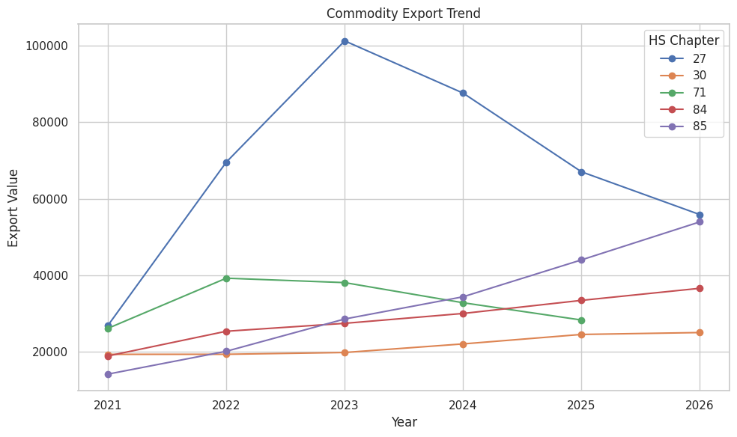
Appendix: HS27 Export Value Spike — 2022–2023
HS27 shows a pronounced spike around 2022–23, consistent with the global energy-price shock and higher Indian refined-petroleum export earnings. As energy prices normalized, the export value subsequently declined.
The spike is in export value, not necessarily export volume. HS27 is highly price-sensitive, so the global energy-price shock materially increased the dollar value of petroleum exports.

