Slide 1

ProjectWork1(19CS702) – Review 1
Security Posture Evaluation and Threat Intelligence Analysis using Python
Submitted by:
Akash A (212221040010)
Bharathi priyan T (212221040028)
Dhinesh Kumar T (212221040041)
2021-2025 Batch
TEAM NO:137
Under the guidance of:
Thilagavathy S
Associate Professor,
Department of CSE
DEPARTMENT OF COMPUTER SCIENCE AND ENGINEERING
SAVEETHA ENGINEERING COLLEGE
(Autonomous Institution – UGC, Govt. of India)
(Affiliated to Anna University, Approved by AICTE - Accredited by NBA & NAAC – ‘A’ Grade - ISO 9001:2015 Certified)
Saveetha Nagar, Thandalam, Chennai-602 105, TamilNadu, INDIA.

Slide 2
Abstract
In the contemporary digital environment, protecting sensitive information from unauthorized access and data breaches is crucial. As cyber threats become increasingly sophisticated, the demand for effective monitoring and analysis of system behavior intensifies. This project seeks to develop a comprehensive solution for the detection and analysis of suspicious files and processes within computer systems, focusing on identifying potential data transmissions to unauthorized entities. Ultimately, this initiative seeks not only to mitigate risks associated with data breaches but also to empower users with the tools needed to maintain the integrity and confidentiality of their sensitive information in an increasingly complex cyber threat landscape. Through rigorous analysis and proactive detection capabilities, the proposed solution will contribute significantly to safeguarding critical data against evolving cyber threats.

Slide 3
Agenda
Introduction
Statement of the Problem
Purpose of your project
Proposed Methodology
Expected results and its Implications
Literature review
Summary and Outcome
Project Plan
Conclusion
References

Slide 4
Introduction
In today’s digital landscape, the safeguarding of sensitive information is of utmost importance as individuals and organizations face an ever-increasing array of cyber threats. With the rise of sophisticated hacking techniques, traditional security measures often prove inadequate in preventing unauthorized access and data breaches. These incidents can have severe repercussions, including financial loss and damage to reputation, highlighting the urgent need for enhanced security protocols.
This project aims to address these challenges by developing a comprehensive solution for detecting and analyzing suspicious files and processes on computer systems. By employing advanced behavioral analysis and anomaly detection techniques, the solution will identify potential data transmissions to unauthorized entities. Ultimately, this initiative seeks to empower users and organizations to better protect their sensitive information and strengthen their defenses against the evolving landscape of cyber threats.

Slide 5
Statement of the Problem
The growing complexity and sophistication of cyber threats pose a significant risk to sensitive information, making unauthorized access and data breaches increasingly common. Traditional security measures often fail to adequately monitor and analyze system behavior, leaving organizations vulnerable to data theft and loss. This problem necessitates the development of advanced solutions capable of detecting and analyzing suspicious files and processes that may indicate unauthorized data transmissions, ensuring robust protection against evolving cyber threats.
Real-Time Threat Detection: Employing advanced machine learning algorithms to monitor system behavior and identify suspicious files and processes as they emerge.
Automated Alerts: Automatically generating notifications for cybersecurity teams when potential threats are detected, providing critical information such as threat type and affected system components.
Integration and Precision: Ensuring high accuracy in threat identification while seamlessly integrating with existing cybersecurity frameworks to enhance overall system security.

Slide 6
Purpose of the project
1. Platform Specificity: Target Operating System: The project is focused on Windows systems, leveraging Windows-specific libraries and tools to gather and analyze process and network data.
This includes using libraries like psutil for process monitoring and network details, and integrating with Windows Management Instrumentation (WMI) for process information.
2. Technological Stack: Programming Language: Python is used for scripting and
implementing the various components of the project. The choice of Python enables flexibility and ease of integration with external APIs and libraries.
3 .Data Collection and Analysis:Data Sources: The project collects data from system processes and network connections. This involves querying the system for active processes and their associated network activities.
4. Verification Mechanism:Threat Intelligence APIs: The project integrates with VirusTotal and AbuseIPDB to verify the reputation of suspicious IP addresses. This external verification helps in assessing the credibility of the detected threats and
provides additional context for decision-making.

Slide 7
Proposed Methodology
Methodology for - Evaluation and Threat Intelligence Analysis
1. Setting Up the Environment
2. Running the Scripts
3. Interpreting the Output

Slide 8
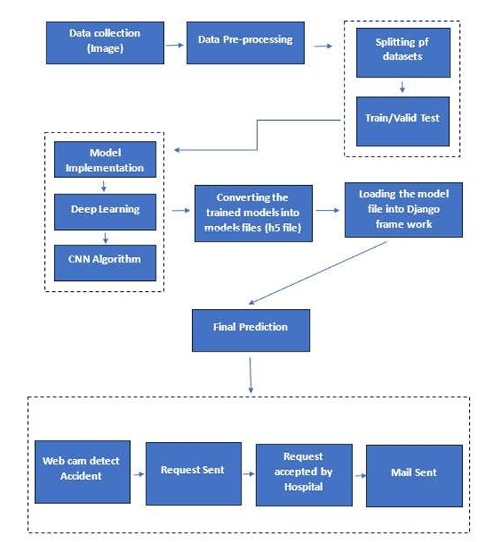
Architecture

Slide 9
Expected Results and Implications
What can be accomplished?
Data Collected.
Interpretation of Network Activity
Identified Suspicious Processes and File.

Slide 10
Literature Review-Reference Paper 1
Stouffer, K., Falco, J., & Scarfone, K. (2011). Guide to Industrial Control Systems (ICS) Security. National Institute of Standards and Technology (NIST).
This NIST guide provides a detailed framework for securing Industrial Control Systems (ICS), which are integral to critical infrastructure sectors like energy, water, and manufacturing. The document emphasizes the need for a layered defense approach, often referred to as "defense in depth." It covers essential strategies like network segmentation, which limits the exposure of sensitive components, and the implementation of robust access control mechanisms to prevent unauthorized access. Incident detection and response are highlighted as key components of maintaining system security, especially in environments where real-time operations are critical. The guide also addresses the growing challenge of integrating legacy systems with modern IT infrastructure, stressing the importance of security posture evaluation in such complex systems. By following the guidelines set forth in this paper, organizations can better manage risks associated with ICS vulnerabilities, protecting both physical and cyber assets from sophisticated cyber-attacks.

Slide 11

Feng, H., Qiu, M., Hu, X., & Khan, I. (2020). A Comprehensive Study on Cyber Threat Intelligence in Cybersecurity. IEEE Access, 8, 29839-29850.
This paper offers a comprehensive overview of the role that Cyber Threat Intelligence (CTI) plays in modern cybersecurity efforts. The authors discuss the evolution of CTI, noting that it has become increasingly vital as cyber threats have grown more advanced and persistent. The paper categorizes CTI into several types: strategic intelligence, which focuses on long-term trends and attacker motives; operational intelligence, which addresses current threat actors and their tactics; and tactical intelligence, which provides detailed information on specific vulnerabilities and exploits. The study also explores the integration of CTI with security information and event management (SIEM) systems to provide real-time alerts on potential threats. The use of machine learning and data analytics is examined, showing how these technologies can enhance the ability to correlate CTI with network behavior, thus improving the detection of zero-day vulnerabilities and advanced persistent threats (APTs). This paper is significant for organizations seeking to improve their threat intelligence capabilities and strengthen their security posture by adopting proactive, intelligence-driven defenses.

Slide 12
Literature Review-Reference Paper 3
Sommer, R., & Paxson, V. (2010). Outside the Closed World: On Using Machine Learning for Network Intrusion Detection. IEEE Symposium on Security and Privacy.
This seminal paper investigates the use of machine learning (ML) in network intrusion detection systems (NIDS). Traditional NIDS rely on signature-based detection, which matches network traffic against known attack patterns. However, this approach often fails to detect new or previously unseen attacks. The authors propose using ML techniques to identify anomalies in network traffic that may indicate malicious activity. By training ML models on normal network behavior, the system can learn to flag deviations as potentially harmful. A key contribution of the paper is its focus on the practical challenges of using ML in real-world environments. The authors point out that while ML-based systems have the potential to detect zero-day attacks, they are prone to high false-positive rates, which can overwhelm security teams with irrelevant alerts. The paper also emphasizes the importance of high-quality training data, noting that poorly curated datasets can lead to ineffective models. This work is crucial for understanding how advanced algorithms can be applied to enhance network security and highlights the need for continual model training and refinement to maintain an effective defense.

Slide 13
Literature Review-Reference Paper 4
Shackleford, D. (2016). The Critical Role of Threat Intelligence in Cyber Defense. SANS Institute.
This report by the SANS Institute underscores the growing importance of threat intelligence (TI) in modern cyber defense strategies. Shackleford highlights how TI can transform security operations by providing context to security incidents, enabling faster and more informed responses to threats. The paper outlines the various stages of the threat intelligence lifecycle, which include data collection, processing, analysis, and dissemination. It also differentiates between different types of threat intelligence—strategic, operational, and tactical—and explains how each type plays a role in defending against cyber attacks. Case studies in the report demonstrate how organizations that integrate TI into their security operations are able to detect threats earlier, often before they can cause significant damage. The paper also emphasizes the need for organizations to continually update and enrich their threat intelligence databases with new information about emerging threats. One key takeaway is that effective TI not only improves threat detection but also enhances an organization's overall security posture by enabling proactive defense measures. Organizations that leverage TI are better equipped to anticipate and mitigate potential attacks, thus reducing their exposure to both known and unknown threats.

Slide 14
Literature Review-Reference Paper 5
Sadeghi, A. R., Wachsmann, C., & Waidner, M. (2015). Security and Privacy Challenges in Industrial Internet of Things. ACM International Conference on Design Automation (DAC).
This paper explores the security and privacy challenges posed by the Industrial Internet of Things (IIoT), a growing area where traditional industrial systems are being integrated with advanced sensors, connectivity, and data analytics. The authors discuss how IIoT introduces new attack surfaces due to the interconnected nature of devices, many of which were not originally designed with cybersecurity in mind. The paper highlights specific vulnerabilities in IIoT environments, such as insecure communication protocols, weak authentication mechanisms, and a lack of encryption in data transmissions. These vulnerabilities can lead to significant risks, including data breaches, industrial sabotage, and disruption of critical services. To address these challenges, the authors propose a multi-layered security framework that includes strong access controls, secure firmware updates, and anomaly detection systems tailored to industrial environments. They also discuss the need for privacy-preserving techniques, given the large amount of sensitive operational data that IIoT devices often generate.

Slide 15
Literature Review- Summary
Title: "Guide to Industrial Control Systems (ICS) Security“
Authors: Stouffer, K., Falco, J., & Scarfone, K.
Published: National Institute of Standards and Technology (NIST), 2011
Summary: This comprehensive guide outlines best practices for securing Industrial Control Systems (ICS), which are vital for critical infrastructures like power grids and water treatment facilities. The document emphasizes a multi-layered security approach, integrating strategies like network segmentation, access controls, and incident response plans. It provides insights on risk management in ICS environments, balancing legacy systems with modern cybersecurity needs.
Outcome: The guide underscores the need for regular security posture evaluation and proactive risk mitigation to prevent cyber-attacks on critical infrastructure. However, it identifies challenges such as the complexity of ICS environments and the difficulty in securing legacy systems without compromising operational efficiency.

Slide 16
Literature Review- Summary
Title: "A Comprehensive Study on Cyber Threat Intelligence in Cybersecurity“
Authors: Feng, H., Qiu, M., Hu, X., & Khan, I.
Published: IEEE Access, 2020
Summary: This paper explores the growing significance of Cyber Threat Intelligence (CTI) in enhancing cybersecurity strategies. The authors analyze various CTI sources, ranging from open-source data to proprietary threat feeds, and discuss their integration into systems for real-time monitoring. The paper also reviews the role of machine learning and data analytics in identifying and preventing sophisticated cyber-attacks, focusing on the detection of anomalies in network traffic.
Outcome: The study demonstrates how the integration of CTI with real-time analytics can strengthen threat detection capabilities, enabling faster responses to cyber-attacks. However, the authors also highlight challenges such as ensuring the accuracy of threat intelligence data and the high resource requirements for effective CTI deployment.

Slide 17
Literature Review- Summary
Title: "Outside the Closed World: On Using Machine Learning for Network Intrusion Detection“
Authors: Sommer, R., & Paxson, V.
Published: IEEE Symposium on Security and Privacy, 2010
Summary: This paper evaluates the application of machine learning techniques for network intrusion detection. It focuses on the limitations of traditional signature-based detection systems and proposes the use of machine learning models to detect anomalies in network traffic. The authors emphasize the importance of high-quality data for training models and the challenges of managing false positives in real-world applications.
Outcome: The study illustrates the potential of machine learning to detect zero-day threats, improving the overall security posture of organizations. However, it also discusses the limitations, such as high false-positive rates and the need for continuous model updates to stay effective against evolving threats.

Slide 18
Literature Review - Summary
Title: "The Critical Role of Threat Intelligence in Cyber Defense“
Author: Shackleford, D.
Published: SANS Institute, 2016
Summary: This report explores how integrating threat intelligence (TI) into cybersecurity operations can enhance an organization's ability to detect and respond to cyber threats. It describes various types of TI, such as tactical, operational, and strategic, and provides case studies demonstrating how organizations have successfully leveraged TI to anticipate and mitigate attacks before they occur.
Outcome: The paper concludes that using TI significantly improves an organization's defensive capabilities, allowing for proactive threat detection and response. However, it identifies barriers such as the need for continuous intelligence updates and the integration of TI into existing security infrastructures.

Slide 19
Outcome of the LR - Scope of the project
The literature survey reveals several key findings and insights relevant to the development of an intelligent accident detection system:
1. Real-Time Alerts: Implement a system to notify administrators in real-time when suspicious activities are detected. This would enable quicker responses to potential threats.
2. Enhanced Detection Criteria: Develop more sophisticated criteria for detecting
suspicious processes based on behavioral analysis. This could include monitoring for unusual system resource usage, unexpected file modifications, or irregular process
interactions.
3. Comprehensive System Monitoring: Expand the project to cover additional aspects of system security, such as file system changes, registry modifications, and other indicators of compromise.
4. Automated Responses: Introduce automated actions in response to detected threats, such as blocking malicious IP addresses, terminating suspicious processes, or quarantining affected files.
Overall, By implementing these improvements and future enhancements, the project can provide more robust protection against potential security threats and contribute to a more comprehensive security posture.

Slide 20
Project Plan
WBS NUMBER | TASK TITLE | TASK OWNER | START DATE | DUE DATE
1 | Project Conception and Initiation
1.1 | Project Charter |  | 02/09/24 | 02/09/24
1.1.1 | Project Charter Revisions |  | 03/09/24 | 03/09/24
2 | Project Definition and Planning
2.1 | Scope and Goal Setting |  | 04/09/24 | 04/09/24
2.2 | Literature Review |  | 04/09/24 | 04/09/24
2.3 | Gant Chart Preparation |  | 04/09/24 | 04/09/24

Slide 21
Project Plan
WBS NUMBER | TASK TITLE | TASK OWNER | START DATE | DUE DATE
3 | Project Conception and Executoin
3.1 | Project design
3.2 | Collection of Data
3.2.1 | Project Coding module1
3.2.2 | Project Coding module2
3.2.3 | Project Integration
3.2.4 | Project Build and Execution
4 | Project Testing
4.1 | Project Testing
4.2 | Project Delivery

Slide 22
Conclusion
Key conclusions from the project are:
1. Real-Time Accident Detection: Leveraging advanced computer vision and deep learning technologies enables the accurate and timely identification of traffic accidents as they occur. This real-time detection is essential for initiating swift emergency responses and mitigating the impact of accidents.
2. Enhanced Emergency Response: The automated notification system ensures that emergency services receive immediate alerts with detailed information about the accident's severity and location. This capability is crucial for reducing response times, allowing for quicker medical intervention and potentially saving lives.
3. Integration and Accuracy: The project emphasizes the importance of integrating the accident detection system with existing emergency response frameworks. Ensuring high accuracy in detection and seamless communication between systems is vital for the overall effectiveness of the emergency response process.
4. Impact on Road Safety: By improving the speed and efficiency of accident detection and response, the system has the potential to significantly enhance road safety. Reduced response times can lead to better outcomes for accident victims, thereby lowering the rate of fatalities and severe injuries.

Slide 23
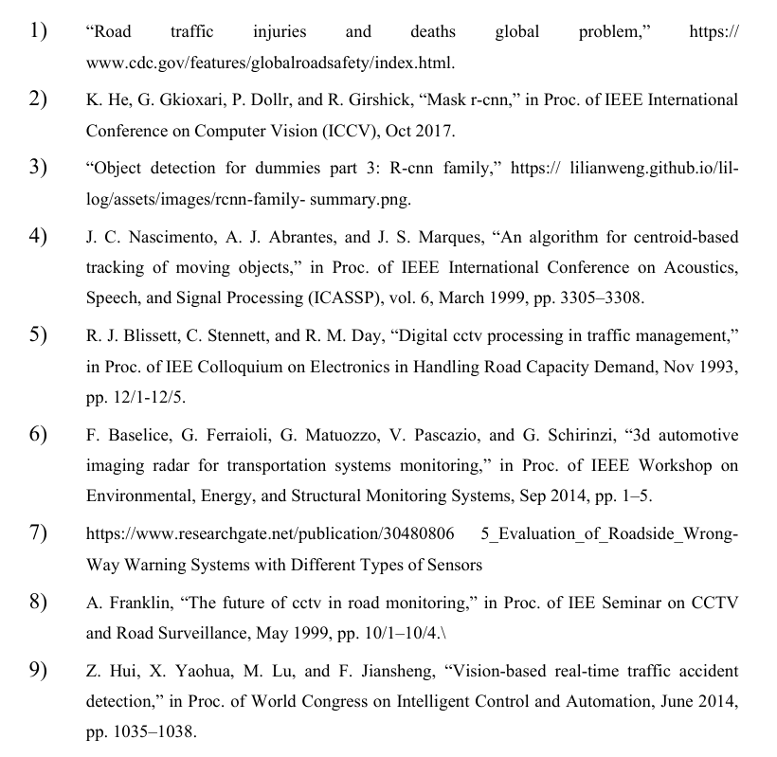
References

