Slide 1
Digital Portfolio
STUDENT NAME: R Bharathi raja
REGISTER NO AND NMID: asanm40324134031802521013
DEPARTMENT: Bsc computer science 2nd year
COLLEGE: COLLEGE/ UNIVERSITY Pspt arts and science Puthur sirkazhi mayiladuthurai

Slide 2
PROJECT TITLE
HealthMate – For a health tracking or appointment app

Slide 3


AGENDA
Problem Statement
Project Overview
End Users
Tools and Technologies
Portfolio design and Layout
Features and Functionality
Results and Screenshots
Conclusion
Github Link
3/21/2024 Annual Review

Slide 4

PROBLEM STATEMENT
Clearly define the problem your project aims to solve. Describe the pain points or challenges faced by the target audience and why a solution is necessary

Slide 5

PROJECT OVERVIEW
Provide a high-level summary of
the project, including its
purpose, goals, and scope.
Briefly explain what the project
does and how it addresses the
problem stated above.

Slide 6

WHO ARE THE END USERS?
Identify the primary users of your project. Describe their needs and how your solution benefits them.

Slide 7

TOOLS AND TECHNIQUES
List all tools, frameworks
languages, databases, libraries,
and platforms used in the
development of your project.
Example:
Frontend: HTML, CSS
JavaScript, React
Backend: Node.js, Express
Database: MongoDB
Version Control: Git, GitHub
Others: Figma(for Ul design)
Postman (API testing)

Slide 8
POTFOLIO DESIGN AND LAYOUT
Explain the design approach for the project. Include color
schemes, layout structure
responsiveness, typography, and
UI/UX principles applied.
8

Slide 9
FEATURES AND FUNCTIONALITY
List and describe the key
features of your project. Include functionality from both user and admin perspectives (if
applicable)
Example:
User authentication
Profile creation
Real-time chat
Dashboard analytics
Admin controls

Slide 10
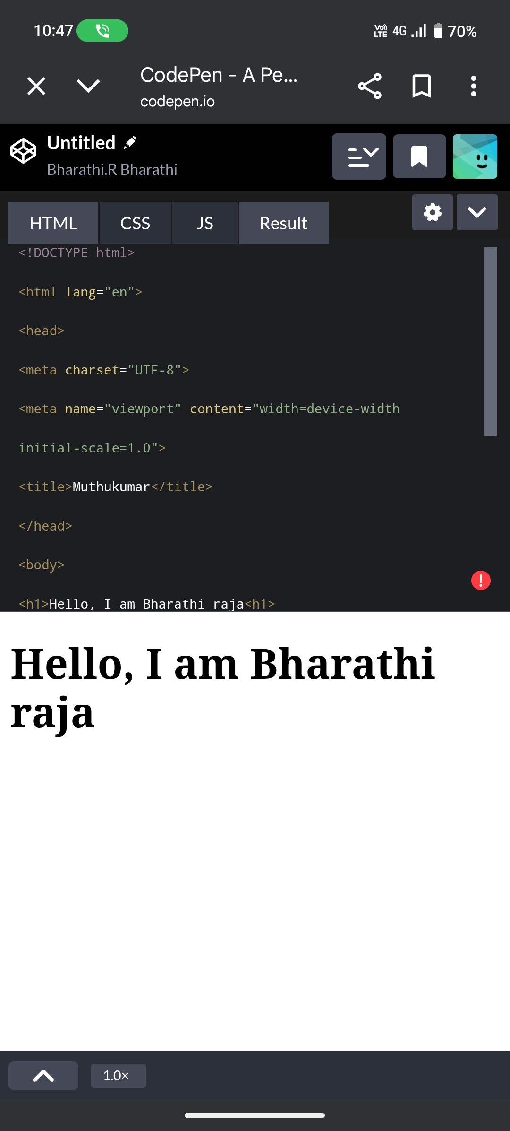
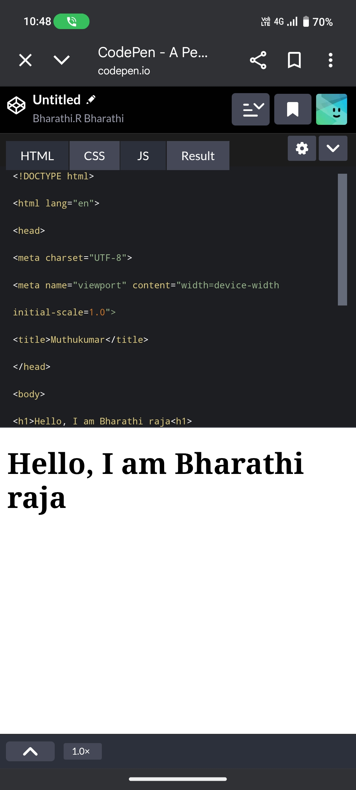

RESULTS AND SCREENSHOTS
3/21/2024 Annual Review
10

Slide 11
CONCLUSION
Summarize the project
outcomes, challenges faced, lessons learned, and potential future enhancements
11

