Slide 1



StockdataReport
View in Power BI
Last data refresh:
5/8/2023 11:18:36 AM UTC
Downloaded at:
5/8/2023 12:43:32 PM UTC

Slide 2
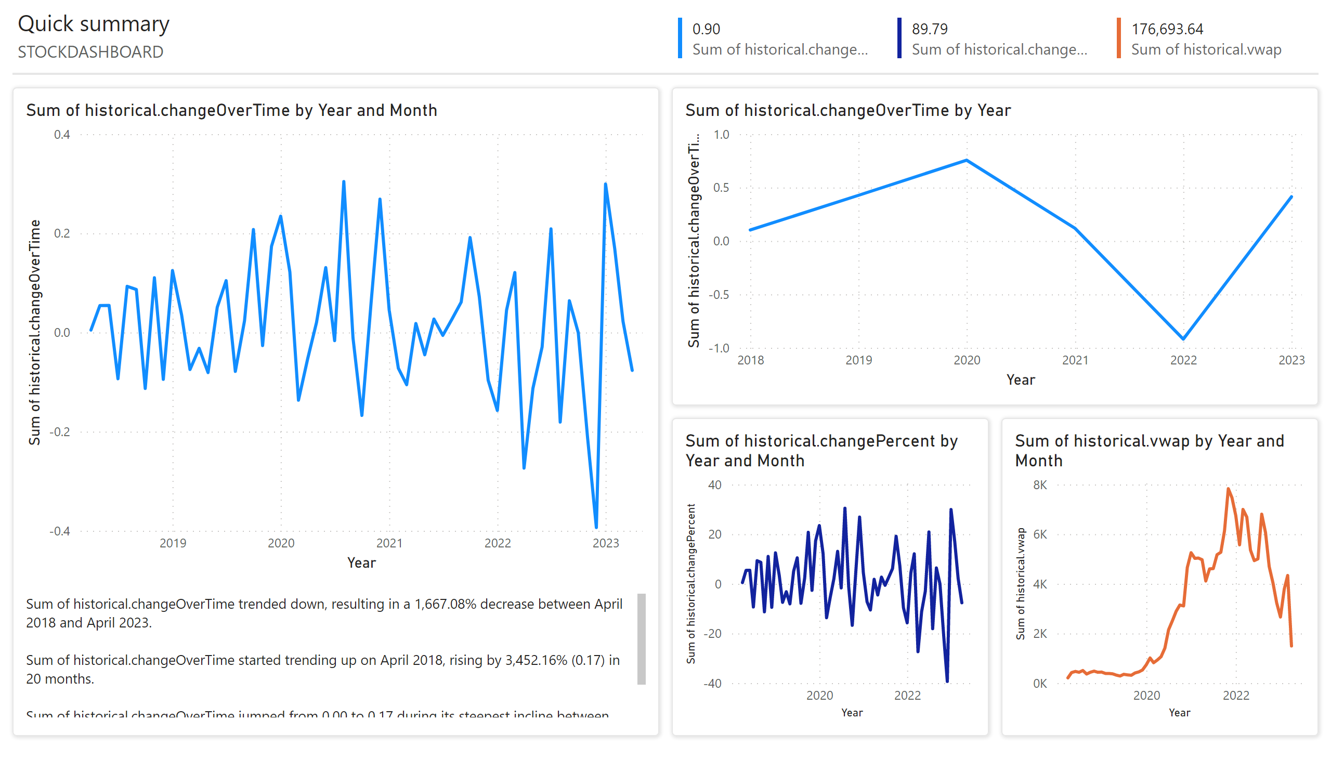
Page 1
Notes:
lineChart
No alt text provided
lineChart
No alt text provided
lineChart
No alt text provided
lineChart
No alt text provided
shape
No alt text provided
textbox
No alt text provided
shape
No alt text provided
shape
No alt text provided
shape
No alt text provided
textbox
No alt text provided
textbox
No alt text provided
multiRowCard
No alt text provided
multiRowCard
No alt text provided
multiRowCard
No alt text provided
shape
No alt text provided

