Slide 1

Department of Computer Science and Engineering VIGNAN’S LARA INSTITUTE OF TECHNOLOGY & SCIENCE Project Review on
Prediction of Mileage Per Gallon with ML and using
User Interface
Under The Esteemed Guidance of
Dr. K.Venkateswara Rao, Ph.D
Professor & HOD
Department of CSE
Presented By
Batch No: C1
S.Bharathi (18FE1A05D5)
Sk.Nasreen Sulthana (18FE1A05D0)
S.Bhargavi (18FE1A05D7)
Sri Venkata Avinash T (18FE1A05E8)
1

Slide 2

CONTENTS
Abstract
Introduction
Literature Survey
Existing System
Proposed System
Software/Hardware Requirements
Algorithms Implemented
Expected Outcome
Actual Outcome
Results
Conclusion

Slide 3

ABSTRACT
Now a days there is a huge competition in the automobile industries and every leading company want to provide their customers with the efficient products which meets their requirements. The basic requirement for any automobile starts with MPG, Price, Model etc. Further in the manufacturing of the vehicle or the product one need to check the MPG and it is mostly done manually. However, in this paper a model is implemented with machine learning approach which is used to calculate the fuel efficiency automatically by considering the basic parameters. As all the parameters are not going to affect the final outcome some selected parameters are used like displacement, number of cylinders, horsepower, weight, acceleration etc. The MPG and also termed as fuel efficiency will be calculated using XGBOOST with GridSearchCV and linear regression algorithms and improved accuracy up to 90%.

Slide 4
INTRODUCTION
The automotive industry is extremely competitive, with increasing fuel prices and picky consumers, automobile makers are constantly optimizing their processes to increase fuel efficiency.
In the context of transport, fuel economy is the energy efficiency of a particular vehicle, given as a ratio of distance traveled per unit of fuel consumed.
Fuel efficiency of a vehicle depends on several internal as well as external factors. However, all these factors may not be available for the fuel efficiency analysis.
Hence, the challenge is to model and/or predict the fuel efficiency only with the available data like horse power, no.of cylinders , acceleration and displacement.

Slide 5
LITERATURE SURVEY PAPER-1
Ref No | Title | Description | Methodology/Algorithms | Datasets Used | Performance Metrics | Results
1 | Fuel Consumption Prediction of Fleet Vehicles Using Machine Learning | We Predict the fuel consumption using random forest. To evaluate the RF algorithm random forest package in Rwas used. This predictive model can be fine-tuned using two parameters ntree – the number of trees within the ensembles and mtry – the number of variables randomly sampled for a split. The default value of mtry for regression is p/3, where p is the number of predictors. we consider mtry as 2 and For ntree parameter we considered values of 250, 500, and 750. In the first construction of the RF model all the variables were fed into the model. | Random Forest, Gradient Boosting, Neural Network. | Collected from GPS based tracking devices and precision fuel sensors. | Root Mean Square Error. | RMSE: 0.040459

Slide 6
LITERATURE SURVEY PAPER-1
DRAWBACKS:
Maintaining the GPS tracking and fuel sensors in every vehicle is cost effective.
It is difficult to gather that much amount of data even when a simple damage causes to hardware.
The data related to different influencing factors such as load, traffic, weather etc are not collected through the same device. We need to use different devices for different factors.
With evolvement of big data, powerful analysis tools are required to transform those data in to meaningful insights.

Slide 7
LITERATURE SURVEY PAPER-2
Ref No | Title | Description | Methodology/Algorithms | Datasets Used | Performance Metrics | Results
2 | Vehicle Fuel Consumption Prediction Method Based on Driving Behaviour Data Collected from Smartphones | The best method suitable for this project is Random Forest .First of all, k groups of training sample sets were selected by sampling with replacement. Secondly, m features were randomly selected from n features in each training sample set as splitting nodes, and k decision trees were generated. -e node splitting of each decision tree adopted the principle of minimum mean square error, which minimizes the sum of mean square deviations of two groups of datasets after splitting. Finally, the predicted vehicle fuel consumption was obtained by averaging the predicted value of k decision trees. | Random Forest, Support Vector Machine, Back propagation Neural Network. | Collected from smartphones and on-board diagnostic system(OBD). | Root Mean Square Error. | RMSE:0.783

Slide 8
LITERATURE SURVEY PAPER-2
DRAWBACKS:
The collection of data done only when the smart-phone is connected with the OBD, Because of this there is a lot of null values and unwanted data in the dataset.
Installing OBD and maintaining smartphones to each driver is not possible.
Here they are only considering the driver behaviour as there are lot of reasons which effect the fuel efficiency.
The RMSE vale is 0.7 which show very poor performance.

Slide 9
LITERATURE SURVEY PAPER-3
Ref No | Title | Description | Methodology/Algorithms | Datasets Used | Performance Metrics | Results
3 | Modelling fuel efficiency for heavy duty vehicles in India | The model used in this study follows the way of approximating fuel consumption by calculating the power consumed to overcome rolling resistance, aerodynamic resistance, and power required for acceleration. After this we will find the fuel economy using the formula. FE= total distance covered*ρdisel /(FC*100) | Simulation models | Collected through survey | Fuel Economy. | FE:2.65km/l.

Slide 10
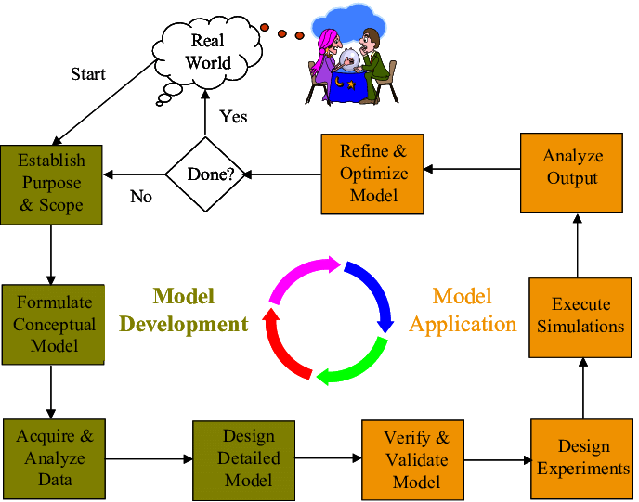
EXISTING SYSTEM
METHODOLOGY:
EXISTING MODEL:
Preparation of database of HDV specifications through surveys
Calculation of fuel economy for HDV models of different category, using the proposed model
Validation of the proposed model
Fuel economy calculation for different HDV models in India
Comparison with international best practices(technology comparison/ segment –vise comparison

Slide 11
EXISTING SYSTEM
The total power required for acceleration P is computed as
p = pr+pa+paa/1000
The formula for calculating fuel consumption
FC = P ηth*ηtrans*LHV
The formula for calculating fuel economy
FE= total distance covered*ρdisel /(FC*100)
The results of the model are validated with the actual test results of fuel efficiency observed for HDVs in India.
The model presents a fuel economy of 2.65km/l for truck and bus.

Slide 12
EXISTING SYSTEM
ADVANTAGES:
We will find the factors effecting the fuel efficiency.
We can increase the fuel efficiency by 36%.
DISADVANTAGES:
The data we collect through survey may not give proper results.
It is difficult to gather that much amount of data through survey.
Here we only know the factors effecting the fuel efficiency but doesn’t know how much it will effect.
This model is only applicable to HDVs to optimize the fuel economy of India.

Slide 13
PROPOSED SYSTEM
Our data set contains NINE attributes mpg, cylinders, displacement, horsepower, weight, acceleration, model of the car, model year, origin.
The model used to calculate cars mpg is:
Comparing XGBoost-using GridSearchCV
Linear Regression
The front-end technologies used for user interface are HTML, CSS
The technology used for back-end is MYSQL.

Slide 14
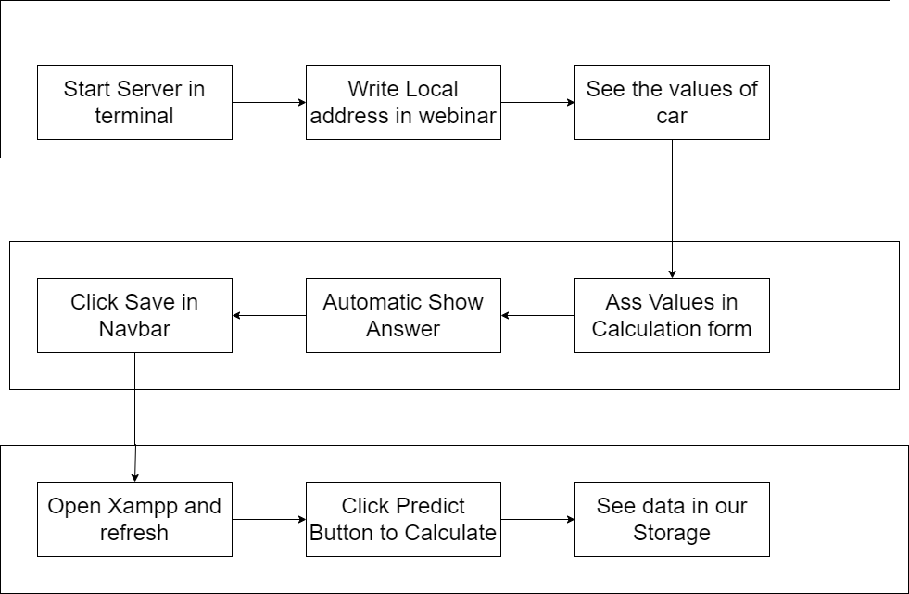
PROPOSED SYSTEM

Slide 15
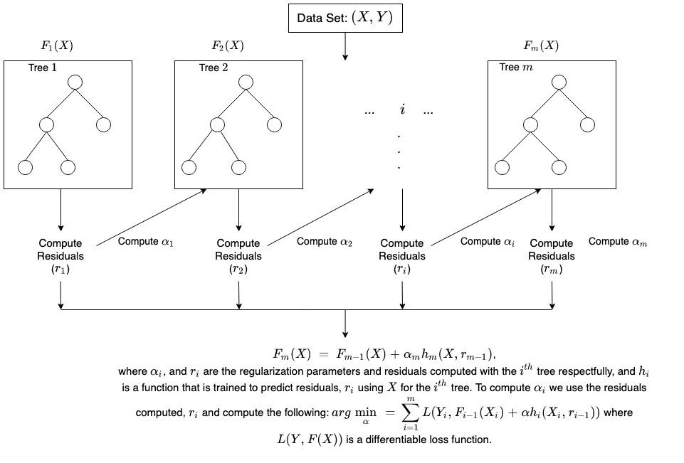
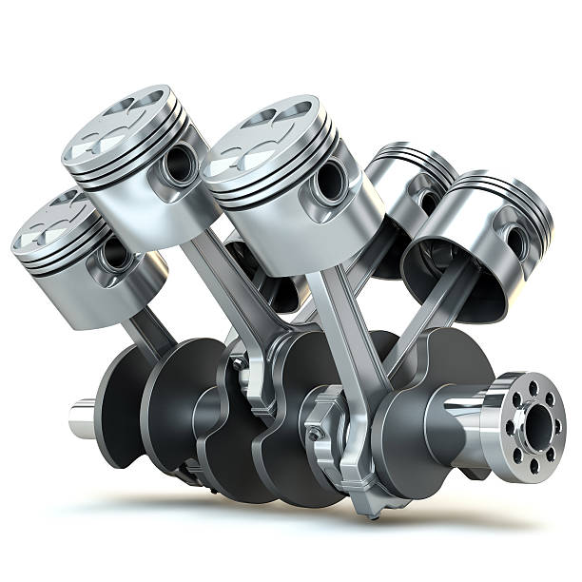


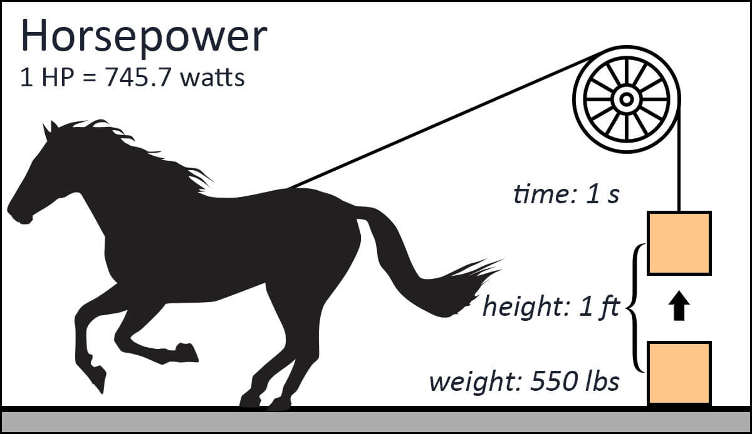
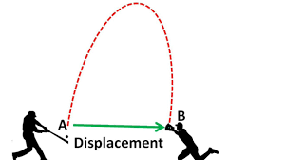

ARCHITECTURE
INPUT
Storing Data in Database
Output
MPG

Slide 16
Hardware/Software Requirements
Hard Requirements:
CPU: Intel i5 processor with minimum 7th generation.
RAM: Minimum of 4GB.
Operating System: Microsoft Windows 10
Software Requirements:
Jupiter Notebook and Visual Studio Code.
Kaggle for dataset.
Tensorflow, keras, pandas, matplotlib, seaborn and sklearn.

Slide 17
FRONT-END
Enter no.of Cylinders:
Enter total displacement:
Enter Horsepower:
Enter Total weight:
Enter Acceleration:
Enter The model year:
Enter the origin no:
SUBMIT
SUBMIT

Slide 18
ALGORITHM
Hyper-parameters
Train data
Model Training
Train evaluation matrices
Data
Test data
Model
Test evaluation matrices

Slide 19
ALGORITHM
Hyper-Parameter Tuning:
Hyperparameters control the over-fitting and under-fitting of the model. Optimal hyperparameters often differ for different datasets. To get the best hyperparameters the following steps are followed:
1. For each proposed hyperparameter setting the model is evaluated.
2. The hyperparameters that give the best model are selected.
Grid SearchCV:
Grid search is the most basic hyperparameter tuning method. With this technique, we simply build a model for each possible combination of all of the hyperparameter values provided, evaluating each model, and selecting the architecture which produces the best results.
Each model would be fit to the training data and evaluated on the validation data.

Slide 20
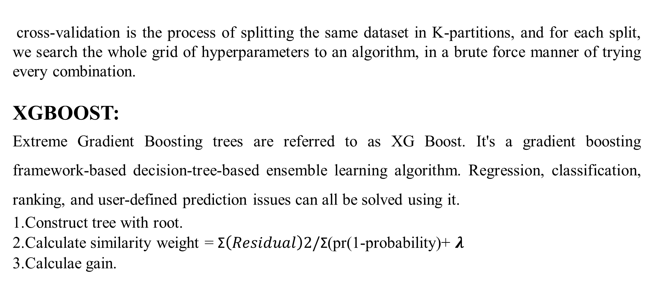
ALGORITHM
cross-validation is the process of splitting the same dataset in K-partitions, and for each split, we search the whole grid of hyperparameters to an algorithm, in a brute force manner of trying every combination.
XGBOOST:
Extreme Gradient Boosting trees are referred to as XG Boost. It's a gradient boosting framework-based decision-tree-based ensemble learning algorithm. Regression, classification, ranking, and user-defined prediction issues can all be solved using it.
1.Construct tree with root.
2.Calculate similarity weight = $\text{Σ}\left(Residual\right)2/\text{Σ}$(pr(1-probability)+ $λ$
3.Calculae gain.

Slide 21
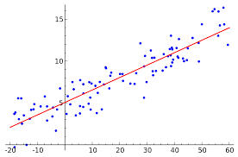
ALGORITHMS
Linear Regression:
It's far a popular gadget learning set of policies used for regression. Linear regression suggests the linear courting between impartial and dependent variable. Consequently, it is termed as linear regression. It manner the price of based totally variable is converting with respect to the unbiased variable. The final results of the linear regression is of numeric kind.

Slide 22
EXPECTED OUTCOME
To build a model that could reliably predict a car’s MPG
Providing an alternate solution to simulations models that are used to predict the fuel efficiency of cars
It can also be useful in detection of anomalous cars by identifying irregular fuel efficiency.
To improve the accuracy and give good results.

Slide 23
ACTUAL OUTCOME
After the comparing the results with different metrics the conclusion is XGBOOST gives better results than Linear Regression with r2-suare of 0.90.
Model | RMSE | MAE | R2-square
XGBOOST | 2.351 | 1.656 | 0.90
Linear Regression | 3.401 | 2.591 | 0.80
Table 1. Comparison of Results

Slide 24
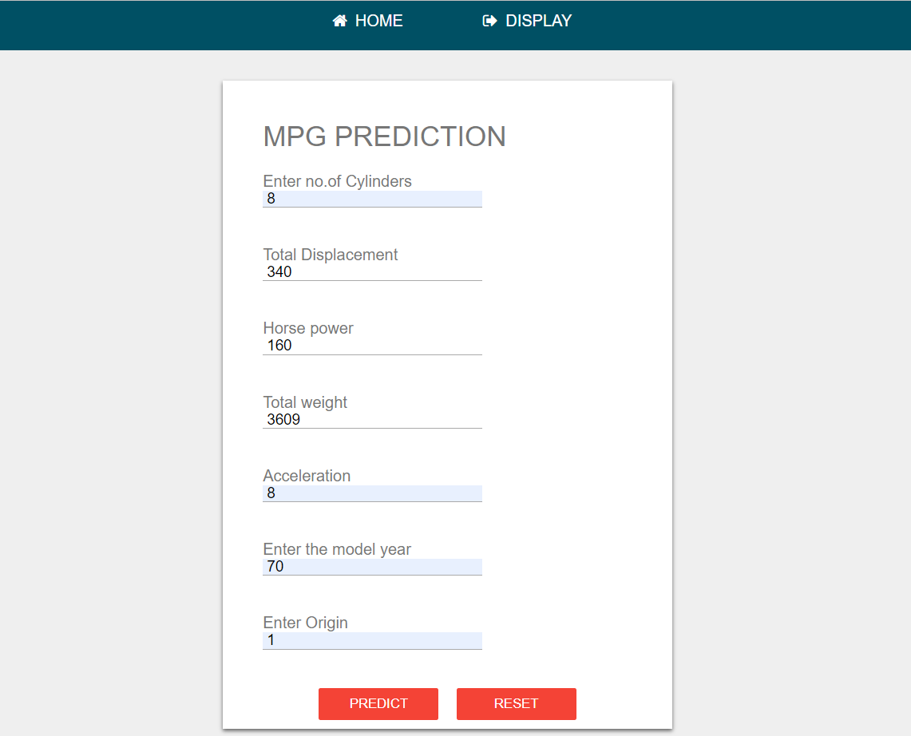
RESULTS

Slide 25
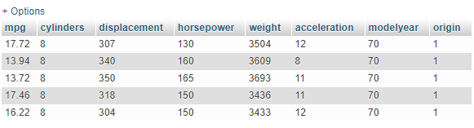
CONCLUSION
CONCLUSION:
On the basis of current crisis everyone understand that how important the fuel efficiency is for a vehicle. A model was developed to calculate fuel efficiency with minimum number of parameters. When compared to the current models, it outperforms them by 90 percent. As already discussed the existing dataset contain some inaccurate data, a new database id added so that our model will perform better and significantly more reliable.

Slide 26
CONCLUSION
Any Queries?
Please Ask…..

Slide 27

CONCLUSION
Thank you

