Slide 1


Docker
January 2019
1

Slide 2
Agenda
Introduction
Definitions
Basic Commands
Docker File
Docker Compose
Using Docker with Selenium
Demo
2
Notes:
Slide Number

Slide 3
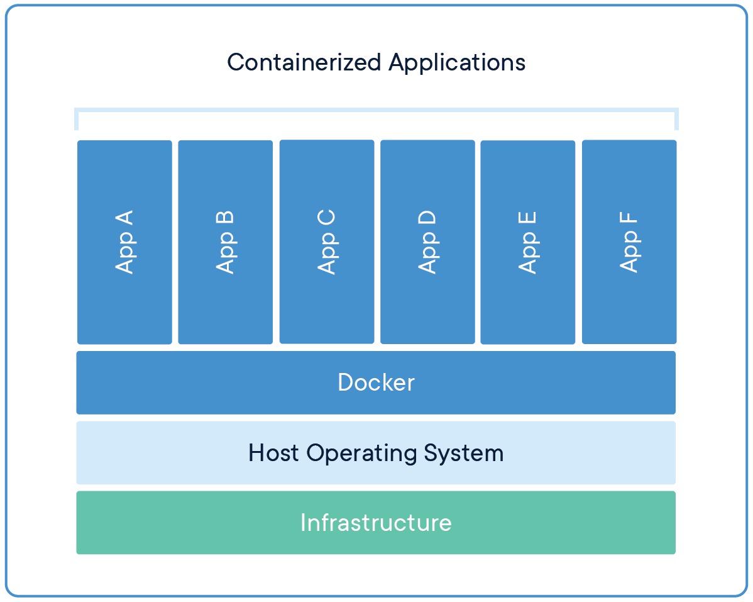
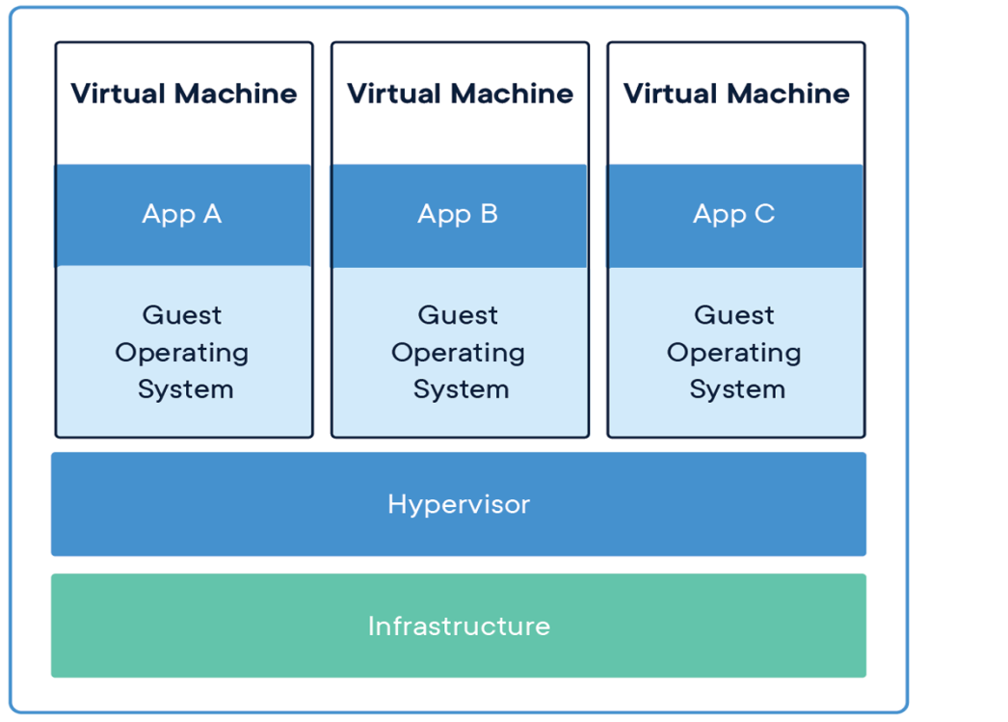
Introduction
Docker is a platform for developers and sysadmins to develop, deploy, and run applications with containers. The use of Linux containers to deploy applications is called containerization.
Wikipedia Definition: Docker is a computer program that performs operating-system-level virtualization, also known as "containerization".
$docker run ubuntu
2
Notes:
Slide Number

Slide 4
Few Definitions
Images - The blueprints of our application which form the basis of containers. We used the docker pull command to download the ubuntu image.
  *Base Images *Child Images *Official Images *User Defines
Containers - Created from Docker images and run the actual application. We create a container using docker run which we did using the ubuntu image that we downloaded.
Docker Daemon - The background service running on the host that manages building, running and distributing Docker containers. The daemon is the process that runs in the operating system to which clients talk to.
Docker Client - The command line tool that allows the user to interact with the daemon.
Docker Hub - A registry of Docker images. You can think of marketplace where all these images are stored.
2
Notes:
Slide Number

Slide 5
Basic Commands
docker --version – version of current installation
docker version – complete info on current installation
docker pull ubuntu – Gets ubuntu image from docker hub to local
docker images – Lists out all the images on the system
docker run ubuntu echo "hello from ubuntu“ – runs the command in a container
docker ps – Lists all running containers
docker ps -a – Lists all containers running or stopped
docker run -it ubuntu bash – Runs bash on the ubuntu container in interactive mode
docker rm – Removes the container
docker start – Starts one or more stopped containers
docker stop – Stops one or more running containers
docker exec -it 4d0d5c2821a8 bash – bash on existing container 4d0d5c2821a8
2
Notes:
Slide Number

Slide 6
Docker File
Docker can build images automatically by reading the instructions from a Dockerfile.
docker build –t myapp:v1 . – Builds an image myapp:v1 from current folder
Dockerfile INSTRUCTIONS
  FROM – base image to be used for our build
  COPY – copy existing files from local system to build image
  RUN – run the command (Used in build time)
  CMD – run the command while building. It is also used as the base command used while initializing the container. Only one CMD to be used in dockerfile
  EXPOSE – ports to be exposed by default
.dockerignore – Similar to gitignore file
FROM nginx:alpine
COPY . /usr/share/nginx/html
RUN echo "run command"
CMD sh
https://docs.docker.com/engine/reference/builder
To export existing container as image
docker export container-name > imagename.tar
2
Notes:
Slide Number

Slide 7
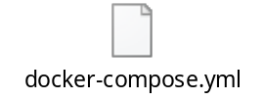
Docker-compose.yml
Compose is a tool for defining and running multi-container Docker applications.
docker-compose up – Compose and starts your entire app
docker-compose stop – Stops the containers
docker-compose down – Stops and removes the containers
Directive | Use
version | Specifies the Compose file syntax version.
services | In Docker a service is the name for a “Container in production”. This section defines the containers that will be started as a part of the Docker Compose instance.
networks | This section is used to configure networking for your application.
volumes | Mounts a linked path on the host machine that can be used by the container.
2
Notes:
Slide Number

Slide 8
Using with Selenium
Run Selenium Hub
  docker run -d -p 4444:4444 --name selenium-hub selenium/hub
Run Selenium Node and link to the Hub
  docker run -d --link selenium-hub:hub selenium/node-chrome
If needed, run the debug node to view the browser in VNC
  docker run –d –P --link selenium-hub:hub selenium/node-chrome-debug
2
Notes:
Slide Number

Slide 9
Demo
2
Notes:
Slide Number

Slide 10
Thank You!
2
Notes:
Slide Number

