Slide 1

Case Study

Slide 2
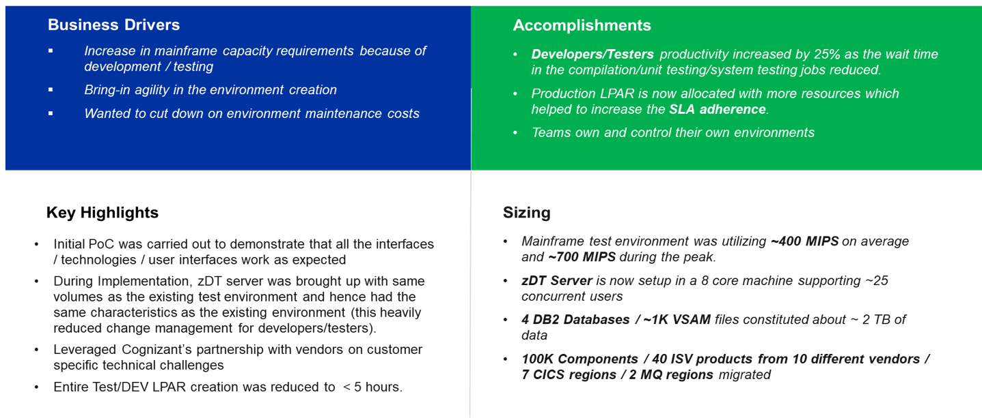

Environment Virtualization for Retail Customer

Slide 3
Thank you

