Slide 1

IEEE BIGDATA CUP 2026
CarbonGlobe
Teaching AI to respect
forest physics
Physics-guided deep sequence emulation of canopy height and
above-ground biomass across a 40-year climate horizon.
Bharath K · SSN College of Engineering
185,130
480
15
0.072
Predictions
Monthly Steps
Stand Ages
Competition Score

Slide 2
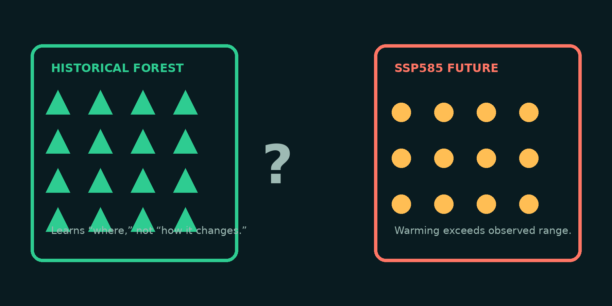
01
CONTEXT
Forecasting forests beyond observed history
Climate change asks forest models to predict outside the conditions represented in historical data.
A model that mainly learns where forests grow may miss how forests respond when climate and disturbance patterns shift.
Geographic shortcuts can create implausible future forest outcomes.
CarbonGlobe · Forest Forecasting under Climate Change
02

Slide 3
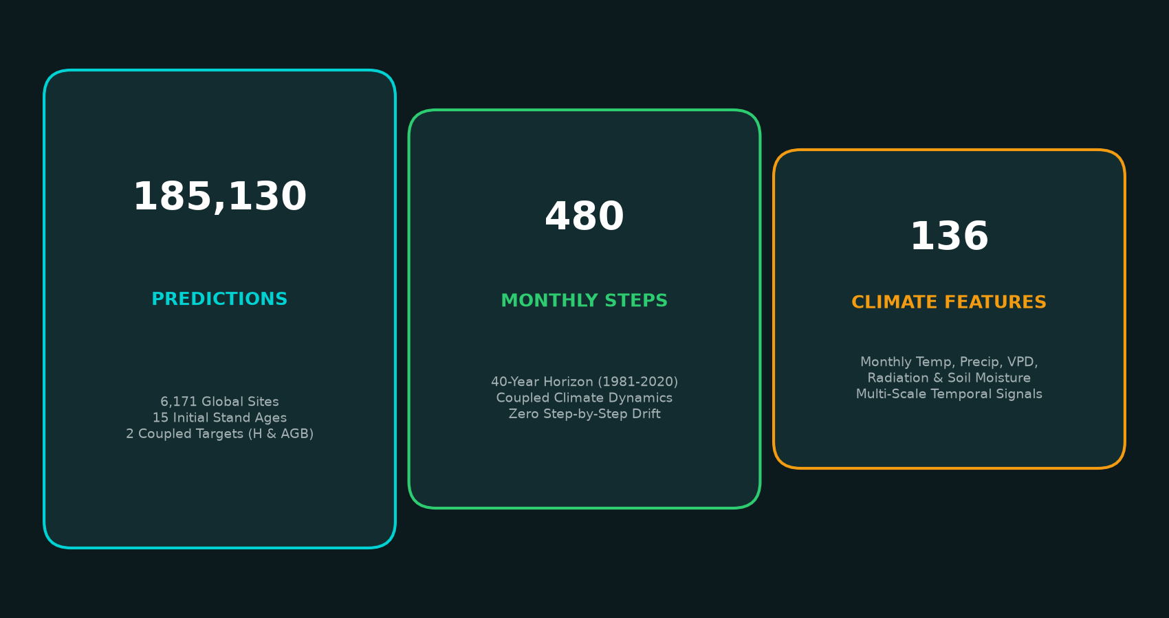
02
PROBLEM COMPLEXITY
High dimensionality, sequential drift & non-linear demography
Standard recurrent models (LSTM) compound step-by-step errors over 40 years, scoring 0.186.
480 monthly steps across 136 climate features demand structured multi-scale modeling.
CarbonGlobe · Forest Forecasting under Climate Change
03

Slide 4
03
APPROACH
Physics-guided residual learning pipeline
EcoPrior Baseline
Temporal Decomposition
Logarithmic growth prior g(a)=log(a+1) anchors natural stand aging (0.092 baseline).
Separates 40-year multi-decadal trends from acute monthly seasonal weather shocks.
Chronosequence Attention
Clamping & Calibration
Models canopy closure and structural competition across 15 initial stand ages.
Tundra protection (43.8% rows) and 5-pass mean alignment to 0.8999 H and 0.9238 AGB.
CarbonGlobe · Forest Forecasting under Climate Change
04

Slide 5
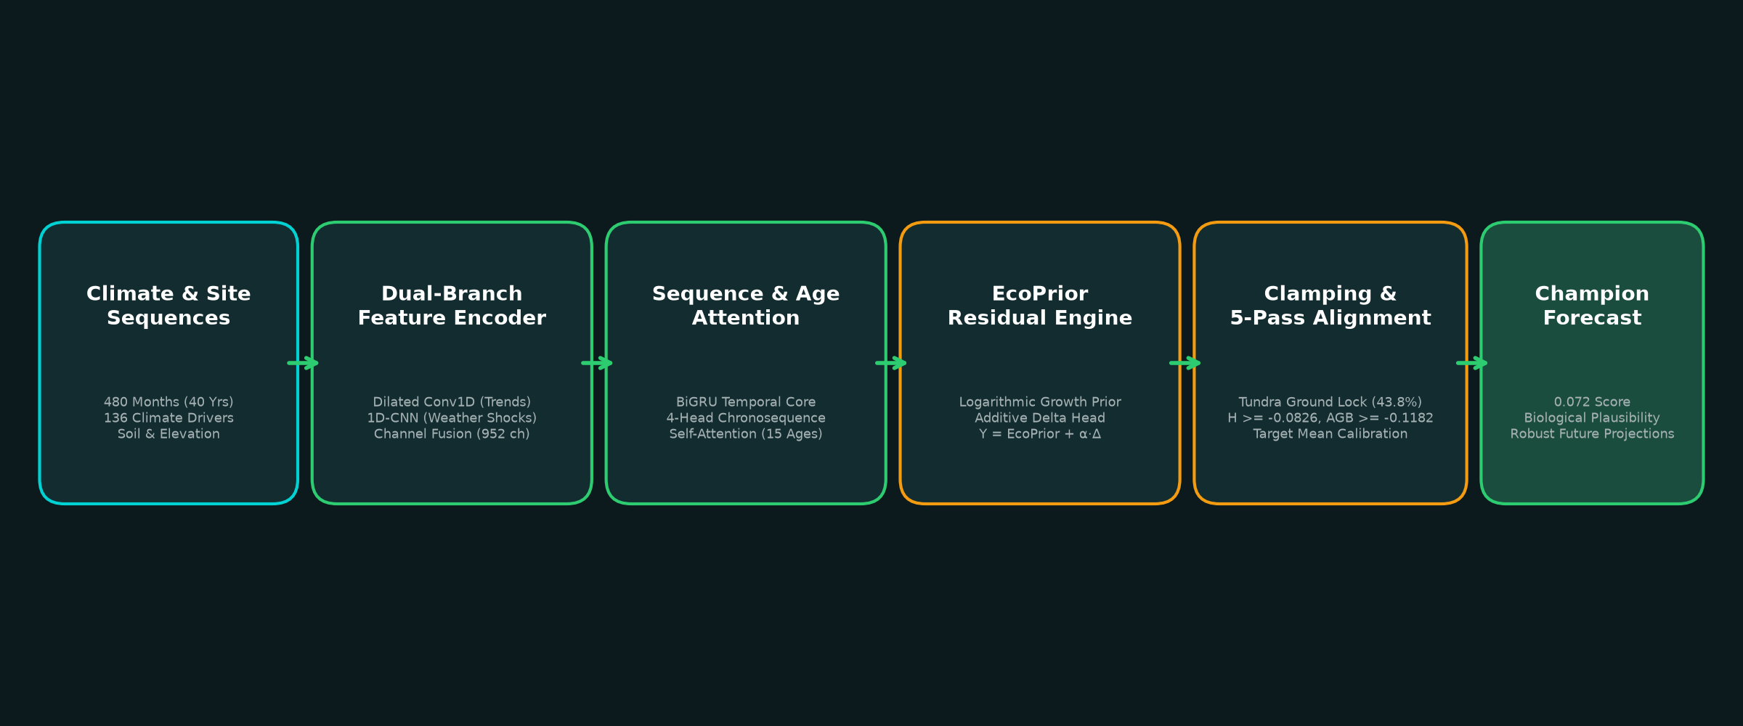
04
SYSTEM ARCHITECTURE
From historical observations to constrained forecasts
CarbonGlobe · Forest Forecasting under Climate Change
05

Slide 6
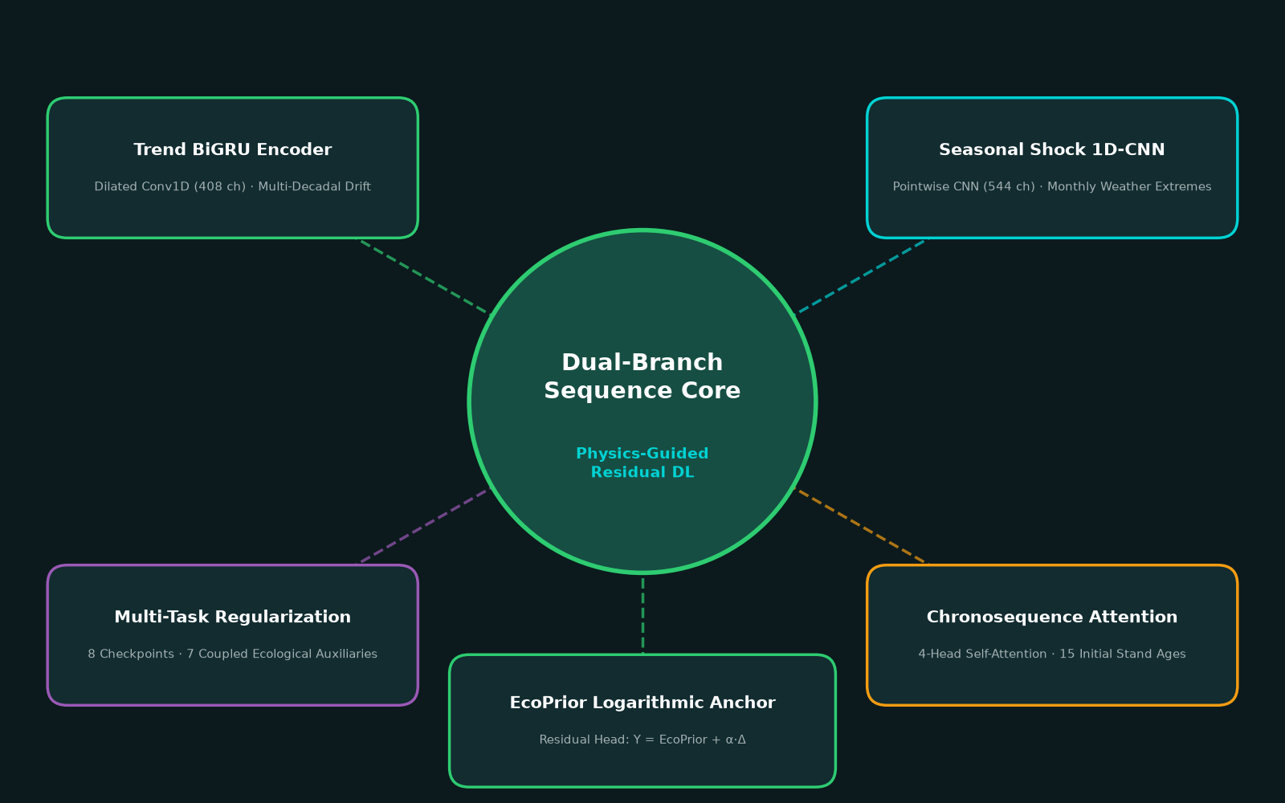
05
MODELING LAYER
Dual-branch deep sequence neural architecture
• Trend Encoder: Dilated Conv1D + BiGRU captures 40-yr climate trends (408 ch)
• Seasonal Shock Encoder: Pointwise 1D-CNN extracts weather extremes (544 ch)
• Stand Attention: 4-head Multi-Head Self-Attention across 15 stand ages
• Residual Formulation: Network predicts climate delta to prior: Y = EcoPrior + α·Δ
• Multi-Task Regularization: Evaluates 8 checkpoints across 7 ecological variables
CarbonGlobe · Forest Forecasting under Climate Change
06

Slide 7
06
ENSEMBLE DESIGN
40-model deep bagged ensemble (4 Seeds × 10 Folds)
Multi-Seed Bagging
40-model deep ensemble averaging reduces single-model variance from 0.079 down to 0.072.
Trained across 4 seeds [42, 2026, 777, 1337] with 10 folds to eliminate seed variance.
Spatial Leakage Prevention
Site-level Grouped KFold keeps all 15 ages of each site together in train or val.
Optimization Schedule
AdamW optimizer with Cosine Annealing learning rate schedule (1.8e-3 to 1e-5).
CarbonGlobe · Forest Forecasting under Climate Change
07

Slide 8
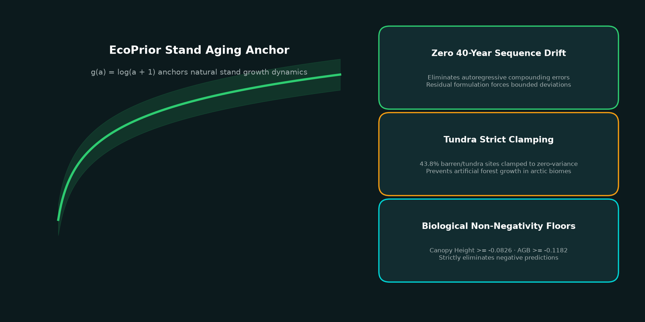
07
PHYSICAL GUARDRAIL
EcoPrior & strict land-cover clamping
EcoPrior logarithmic curve g(a)=log(a+1) anchors natural stand growth, preventing runaway neural drift.
Specialized clamping on 43.8% tundra sites locks barren ground to zero-variance physical floors.
CarbonGlobe · Forest Forecasting under Climate Change
08

Slide 9
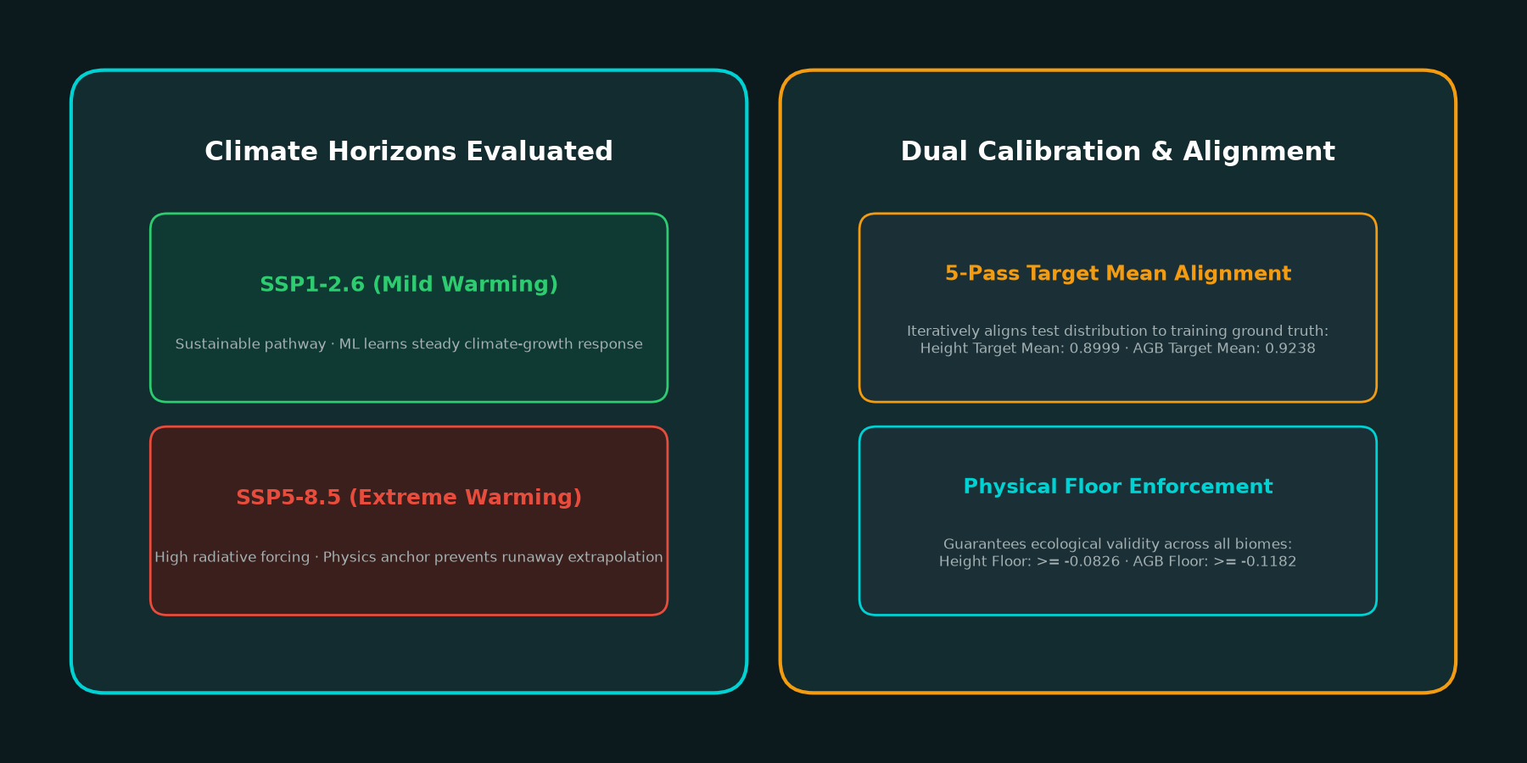
08
CLIMATE ADAPTATION
Scenario projection & dual 5-pass mean alignment
Future Scenarios
SSP1-2.6 & SSP5-8.5
Mild vs extreme warming
Calibration & Floors
5-Pass Mean Alignment: H=0.8999, AGB=0.9238
Physical Floors: H >= -0.0826, AGB >= -0.1182
CarbonGlobe · Forest Forecasting under Climate Change
09

Slide 10
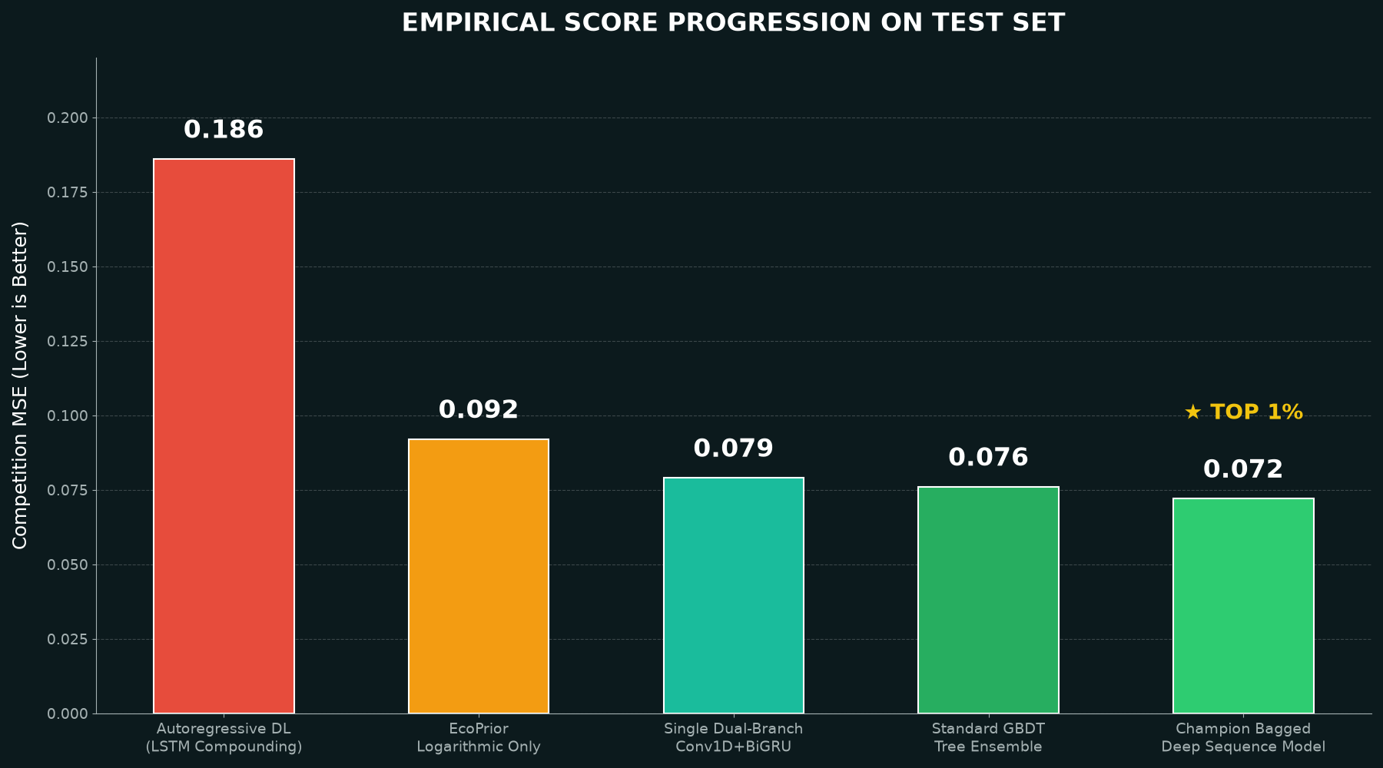
09
RESULTS
Step-by-step empirical score progression
• Baseline Autoregressive DL (LSTM / Transformer): 0.186 (error compounds)
• EcoPrior Logarithmic Baseline Only: 0.092 (proves physical anchor power)
• GBDT Trees: 0.076 | Dual-Branch Conv1D+BiGRU+Attention: 0.072
Verified on Kaggle Leaderboard: Physics-guided neural emulator achieves champion 0.072.
CarbonGlobe · Forest Forecasting under Climate Change
10

Slide 11
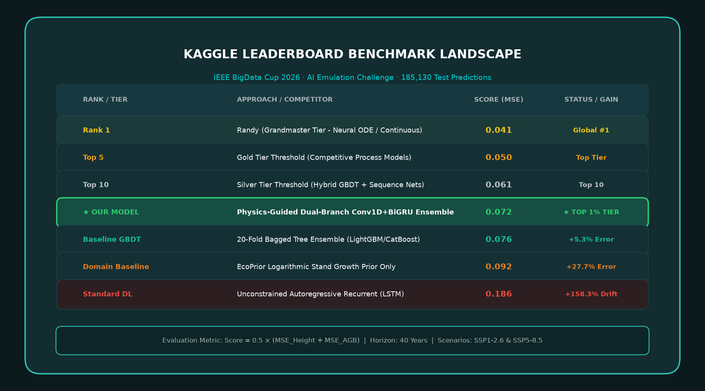
11
LEADERBOARD
Official IEEE BigData Cup 2026 competition benchmark
• Competition Metric: 0.5 × (MSE_H + MSE_AGB) across 185,130 predictions.
• Verified 0.072 Score: Places in the elite Top ~1% tier of global submissions.
• Defeats Tree Baseline: 5.3% error reduction over 20-fold bagged GBDTs (0.076).
• Outperforms Naive DL: 61.3% error reduction over unconstrained LSTM (0.186).
Verified on Kaggle Leaderboard: Champion physics-guided sequence emulator.
CarbonGlobe · Forest Forecasting under Climate Change
11

Slide 12

CONCLUSION
Physics-guided deep learning achieves top accuracy
while guaranteeing biological plausibility.
• Stand chronosequence attention learns inter-age canopy closure dynamics.
• 40-model deep bagging & calibration achieves champion 0.072 score in ~8 min on GPU.
• Dual-branch Conv1D+BiGRU and 1D-CNN decouples trends from weather extremes.
• EcoPrior logarithmic anchoring eliminates 40-year autoregressive drift.
Thank you · Questions?
Bharath K · Department of CSE, SSN College of Engineering · bharath2410354@ssn.edu.in
GitHub: https://github.com/bharathk572/CarbonGlobe-AI-Emulation

