Slide 1

Syracuse University Chatbot
Team:
Bharath Karumudi
Haixin Chang
CSE 682 – Software Engineering
Professor: Dr. Mehmet Kaya
Mar 25, 2019
College of Engineering and Computer Science

Slide 2
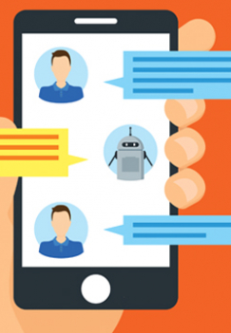
Project
Goal – To develop a Chatbot for the Syracuse University students to interact with the bot to get the desired information.
Advantage – A student will be able to find the desired information immediately with ease and in one place.

Slide 3
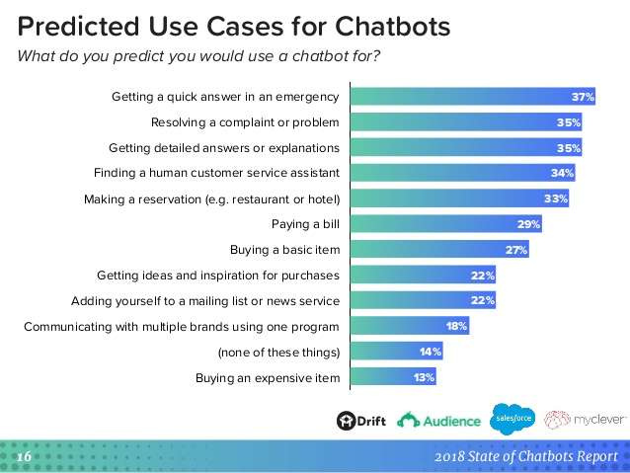
Different Use Case predictions for Chatbots
Notes:
Reference: https://www.drift.com/blog/chatbots-report/

Slide 4

Use Cases
The Syracuse Chatbot allows the students to get the information:
Student profile
Class Enrollment
Schedules for classes and exams
Term fee

Slide 5
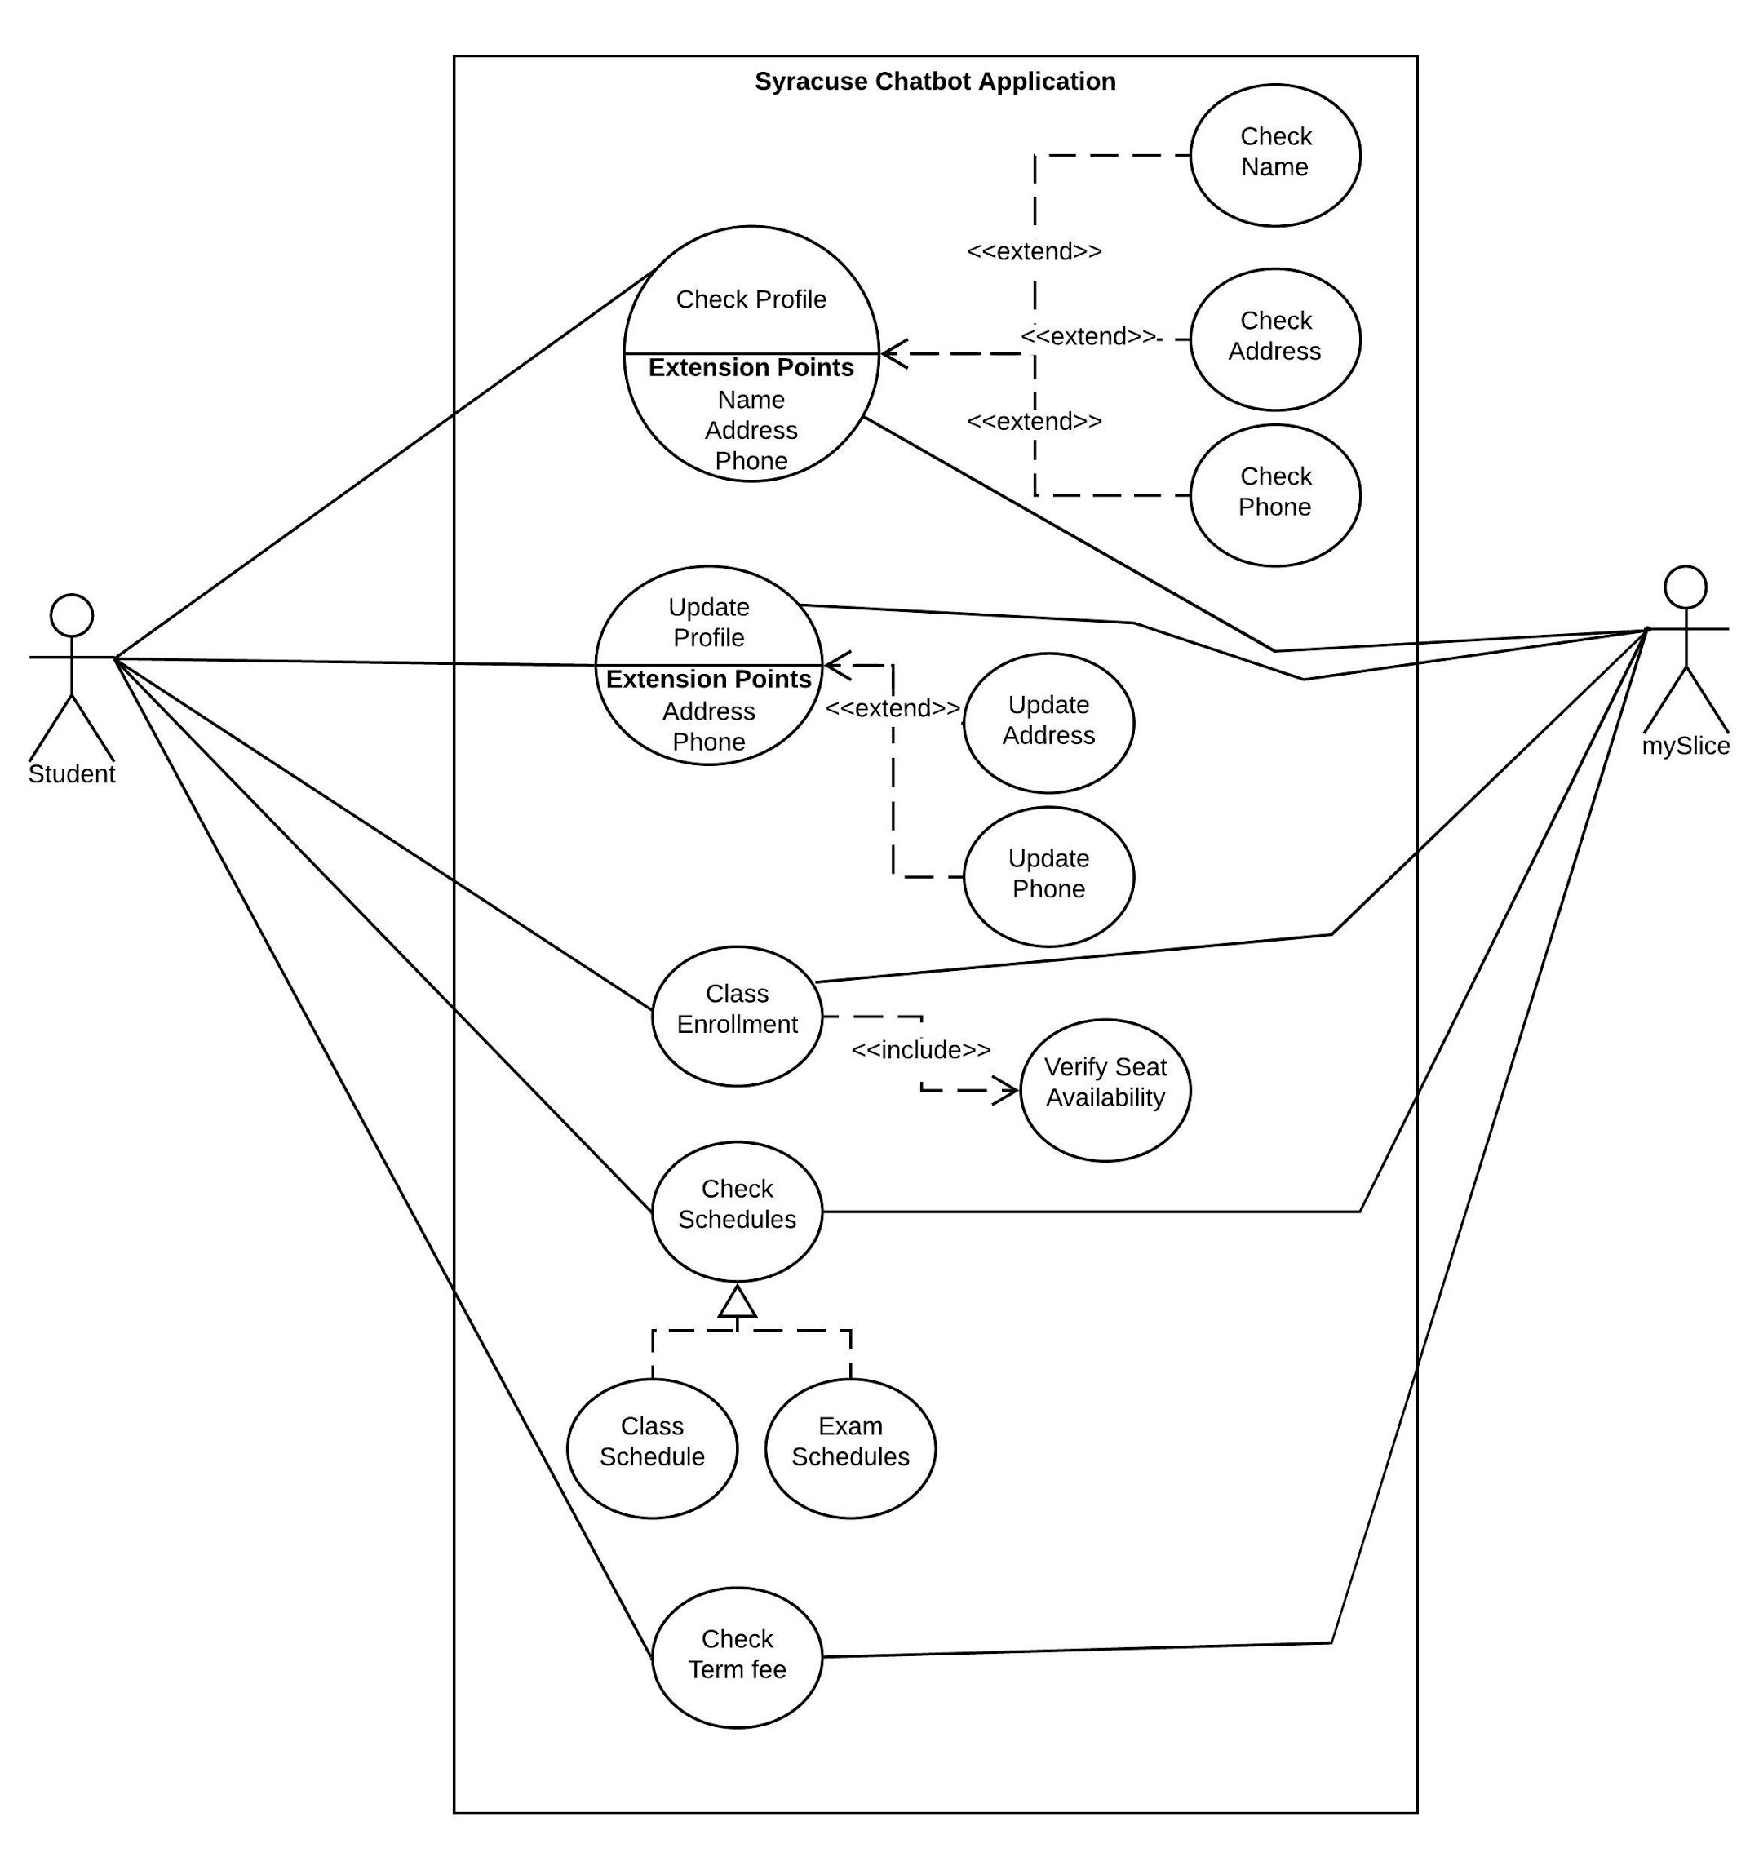
Use Case Diagram
Student profile
Class Enrollment
Schedules for classes and exams
Term fee
Notes:
The Syracuse Chatbot allows the students to get the information:
Student profile
Class Enrollment
Schedules for classes and exams
Term fee

Slide 6
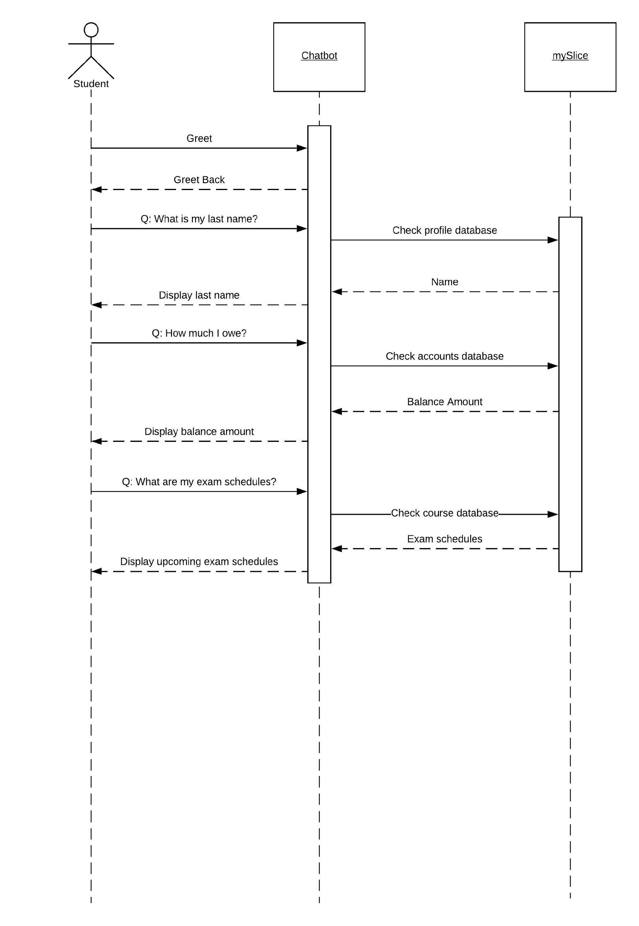
Sequence Diagram

Slide 7
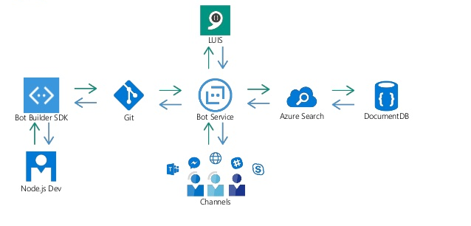
System Architecture Diagram

Slide 8
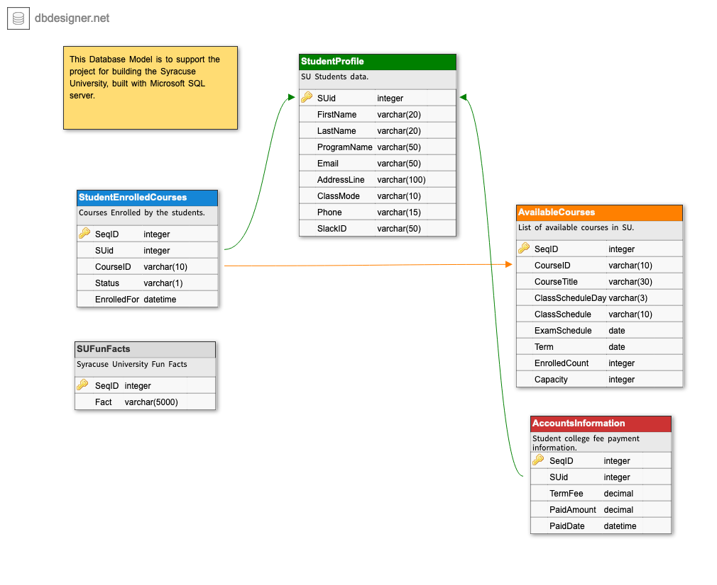
Database design

Slide 9
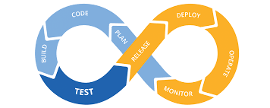


Approach
Leveraging the Microsoft Language Understanding Intelligent Service (LUIS) AI – A machine learning-based service to build natural language into bots that continuously improve.
The application will be completely cloud based with continuous integration and deployment enabled using GitHub as code base and develops in Node.js
Uses Azure structured databases and cloud native services for availability with a response time of at most one second.

Slide 10


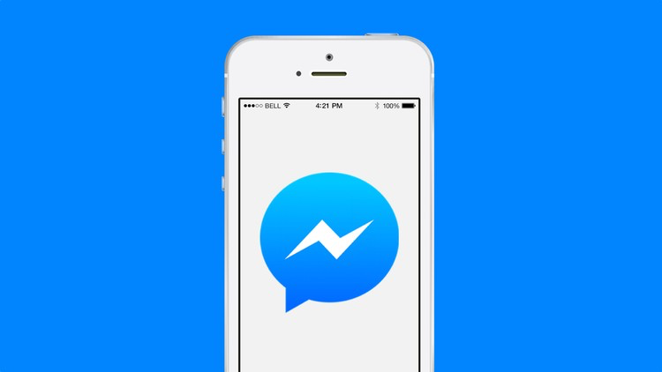
Application Integration
The bot will be available in three channels
Web based: URL
Slack Channels
Facebook Messenger: Facebook’s is reviewing.

Slide 11
Functional User Requirements Shall be able to:
Check his/her profile details such as Name, Email, phone number, address on the records.
Update his/her phone number and Address details.
Check for the availability of classes.
Enroll for the classes.
Check term fee and balance.
Check his/her class schedules.
Check his/her exam schedules.
Use Chatbot from Web, Facebook messenger and Slack.

Slide 12
Functional System Requirements
If the user greets the bot, it shall greet back with a fun fact about SU.
If the user asks to check the profile, it shall show only user’s first name, last name, email, address and phone.
If the user asks to update either address or phone, it shall update MySlice and return a confirmation.
If the user asks to enroll for a course, it shall first check the spot availability. If available, enroll the user; if not, display no seats are available message.
If the user asks the bot to provide the term fee details, it shall check MySlice and display the balance due. If nothing is due, it shall display No payment is required.
If the user asks for the class schedules, it shall return the his upcoming class schedules.
If the user asks for the upcoming exam schedules, it shall check a user’s enrolled courses and return the upcoming exam schedules.
It should be integrated with Slack and Facebook messenger.
A standalone web-based application shall be available.

Slide 13
Non-Functional Requirements Shall be able to:
Response time
Respond to users’ request within one second.
Learning
Be easy to use. Normally a user should be able to learn within 30 minutes.
Language
Support only in standard English (input questions and output answers)
System load
Handle concurrent users with no limit.
Computer Language
Develop in node.js.
Hosting
Host in Azure.
Availability
Be available all the time. Scheduled maintenance is acceptable.
Open source
Maintain a code base in GitHub.
Automation
Use Continuous Integration and Continuous deployment.

Slide 14

Live Demonstration

Slide 15
Future Releases
Scheduling the appointments with Professors and Student Advisors.
Submitting the assignments through bots.
Integrating Orange Alert system to alert Syracuse Students and Staff.
Paying the term fee and other balances.
Booking the conference rooms.
Displaying the grades and GPAs.
Sending the notifications like grade availability, course access.
Submitting the course surveys.
Shopping the text books from University library.
Placing an order in University Cafeteria for a coffee or any other food.
Providing general information like Address and other knowledge base information using QnA maker.
Integrating with University services over APIs.
Integrating with Voice Assistants like Alexa, Cortana, Siri and Google Home.

Slide 16
Thank you !

