Slide 1

Syracuse University Chatbot
Team:
Bharath Karumudi
Haixin Chang
CSE 682 – Software Engineering
Professor: Dr. Mehmet Kaya
Feb 18, 2019
College of Engineering and Computer Science

Slide 2
Project
Goal – To develop a Chatbot for the Syracuse University students to interact with the bot to get the desired information.
Advantage – A student will be able to find the desired information immediately with ease and in one place.

Slide 3
Different Use Case predictions for Chatbots
Notes:
Reference: https://www.drift.com/blog/chatbots-report/

Slide 4
Approach
Leveraging the Microsoft Language Understanding Intelligent Service (LUIS) AI – A machine learning-based service to build natural language into bots that continuously improve.
The application will be completely cloud based with continuous integration and deployment enabled using GitHub as code base and develops in Node.js
Uses Azure structured databases and cloud native services for availability with a response time of at most one second.

Slide 5
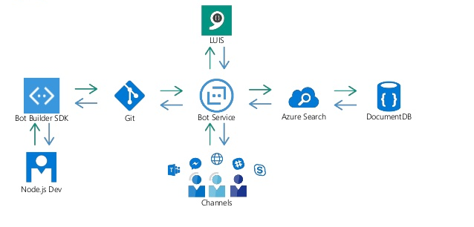
System Architecture Diagram

Slide 6
Use Cases
The Syracuse Chatbot allows the students to get the information:
Student profile
Class Enrollment
Schedules for classes and exams
Term fee

Slide 7
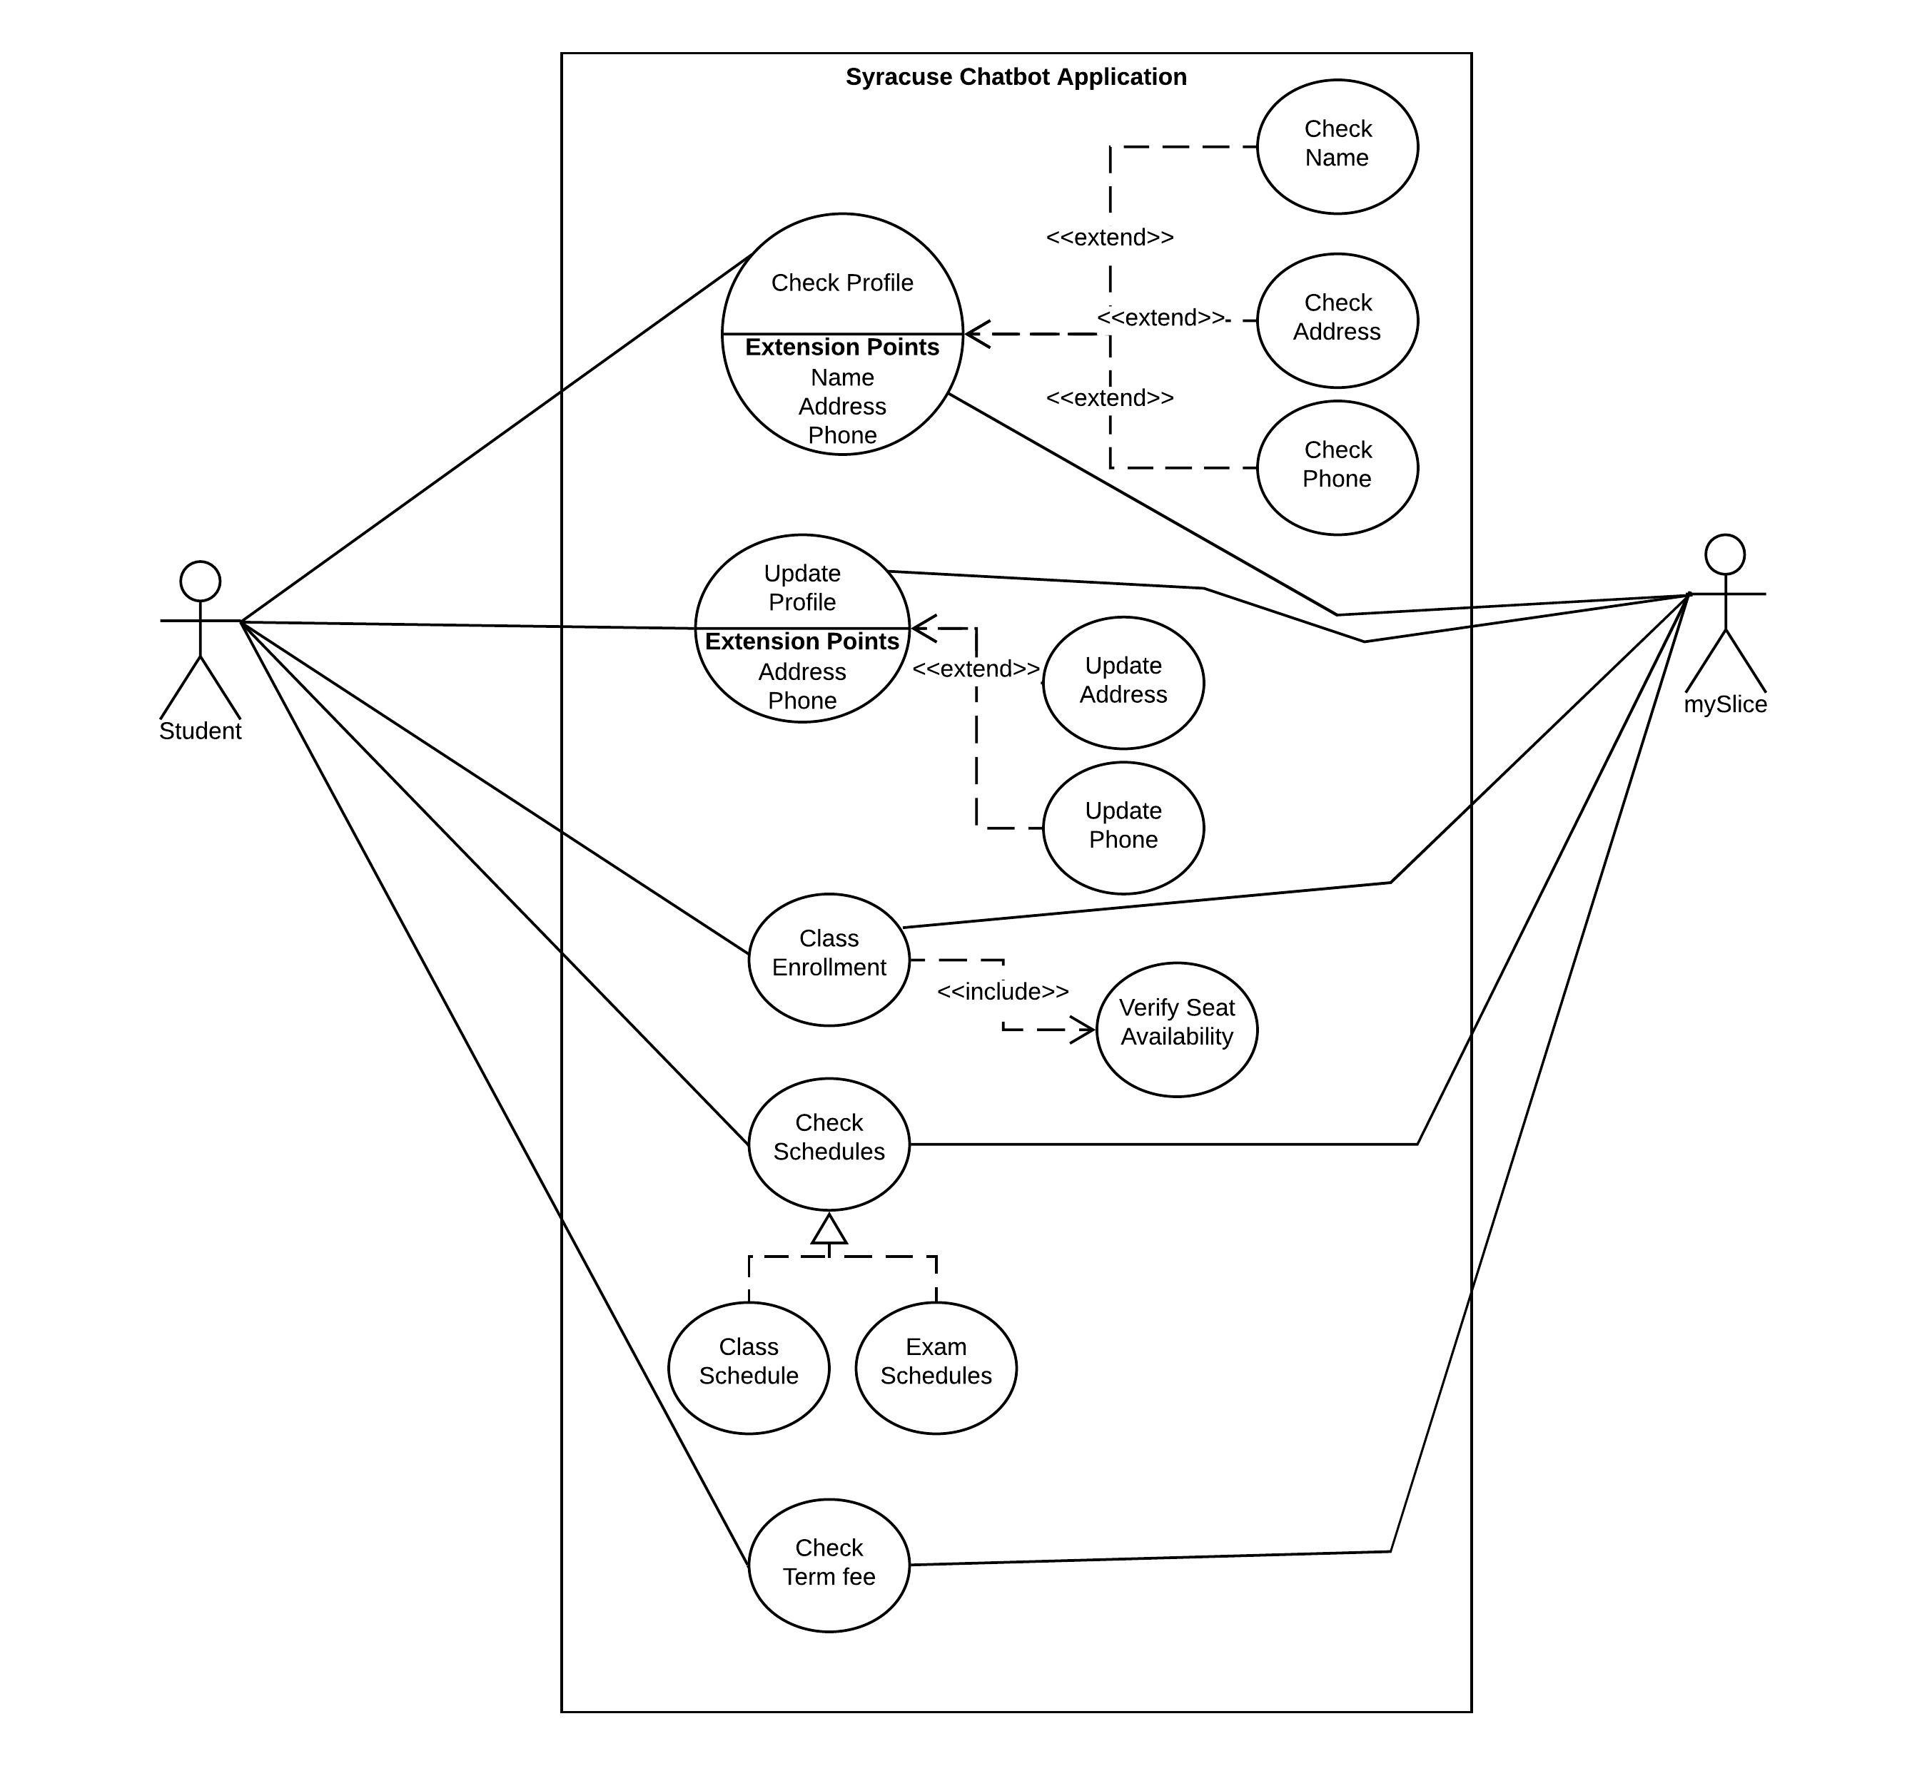
Use Case Diagram
Student profile
Class Enrollment
Schedules for classes and exams
Term fee
Notes:
The Syracuse Chatbot allows the students to get the information:
Student profile
Class Enrollment
Schedules for classes and exams
Term fee

Slide 8
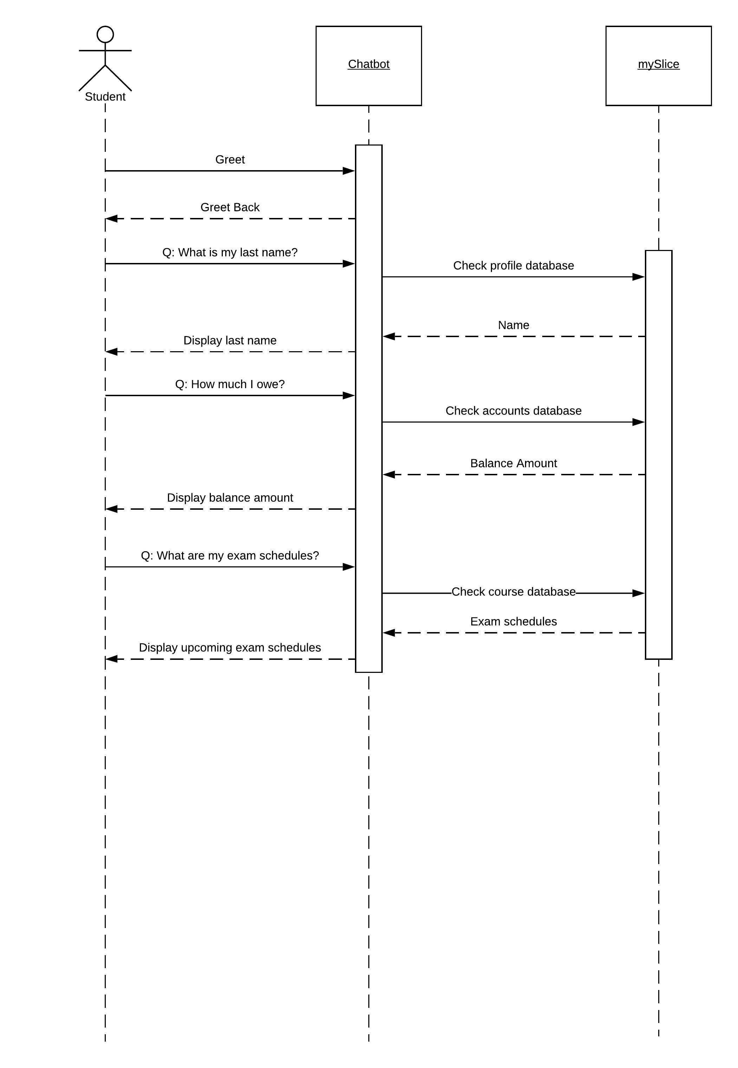
Sequence Diagram

Slide 9
Application Integration
The bot will be available in three channels
Web based
Slack Channels
Facebook Messenger

Slide 10
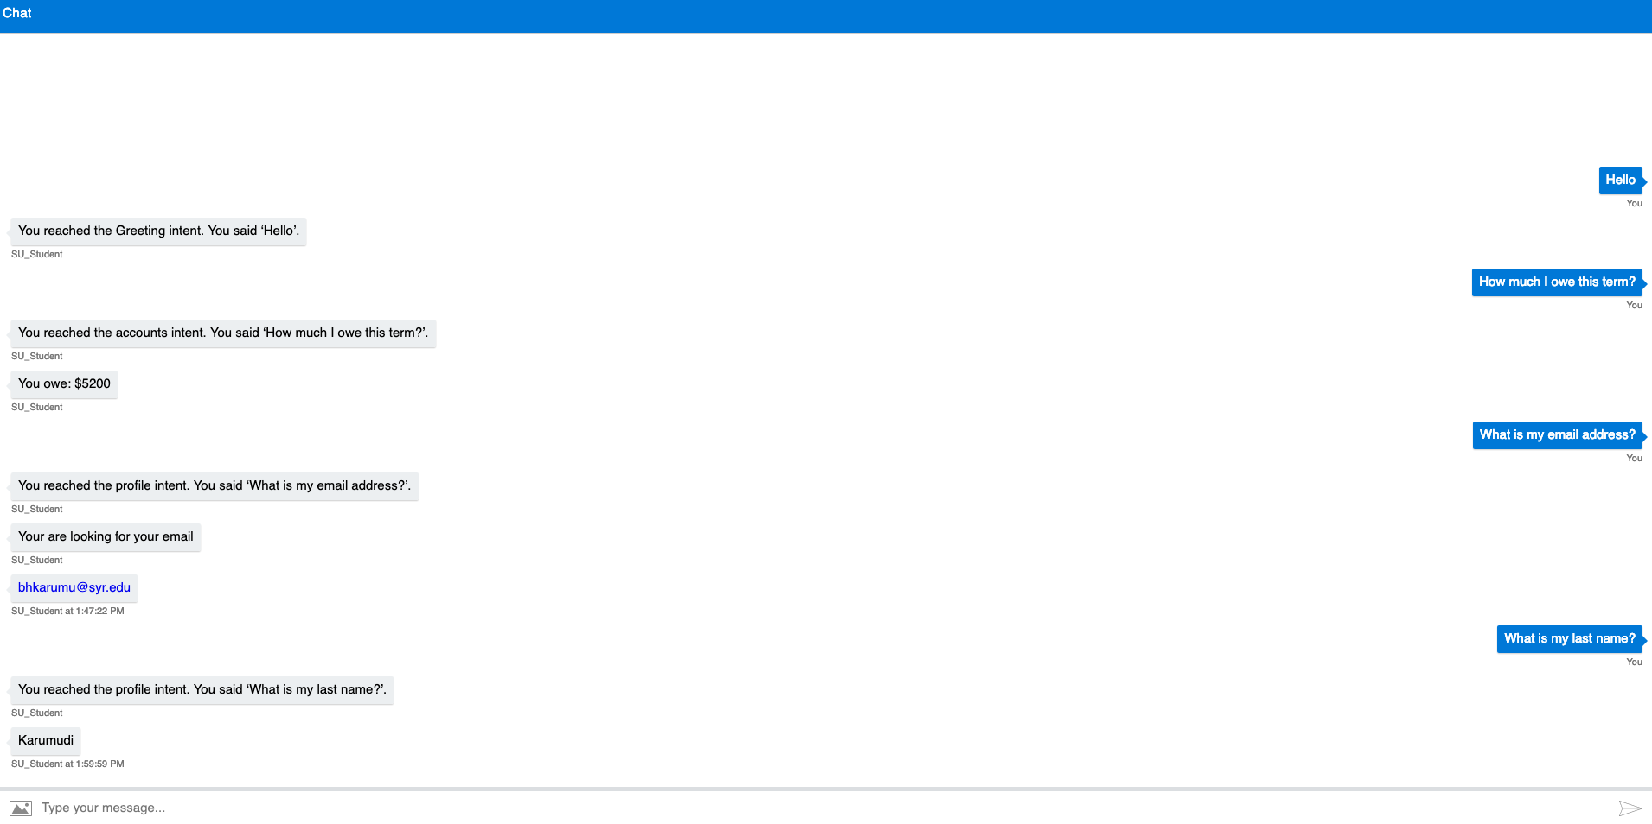
Prototype

Slide 11
Thank you!

Slide 12
Backup Slides

