Slide 1

Syracuse University Chatbot
Bharath Karumudi
Haixin Chang
Feb 18, 2019

Slide 2
Introduction
Chatbot is a web-hosted AI application, developed based on the current bot technology. This application acts an intermediate media between users and databases. A user can interact with Chatbot via simple English sentences to request and/or update information from certain databases.
Notes:
Explain the current bot technology(history and current usage???) and LUIS AI

Slide 3
Introduction (continued…)
These English sentences are converted into machine-friendly queries by LUIS AI to query databases; then returning the answer in a natural language sentence

Slide 4
Introduction (continued…)
Chatbot is demonstrated by having Web based API, and sample web, mobile interfaces (through Slack and Facebook messengers).

Slide 5
Introduction (continued…)
Integrated systems: Slack/Facebook messengers, Azure, Databases, LUIS AI

Slide 6
Introduction (continued…)
The Chatbot provides Syracuse students a quick and easy way to have their questions answered.

Slide 7
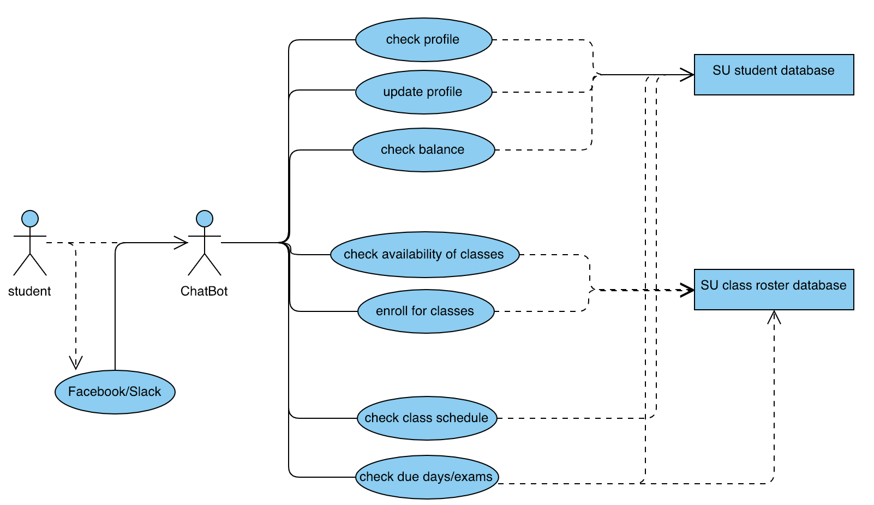
User Requirements: Chatbot shall be able to:
Through SU student database:
Check a user’s profile
Update a user’s profile
Check term fee and balance
Through SU class roster database:
Check the availability of classes
Enroll for classes
Through both databases:
Check class schedule on a particular day
Check upcoming due days and exam schedules

Slide 8
User Requirements: Chatbot shall be able to: (continued…)
Use Chatbot from Facebook messenger and Slack.

Slide 9
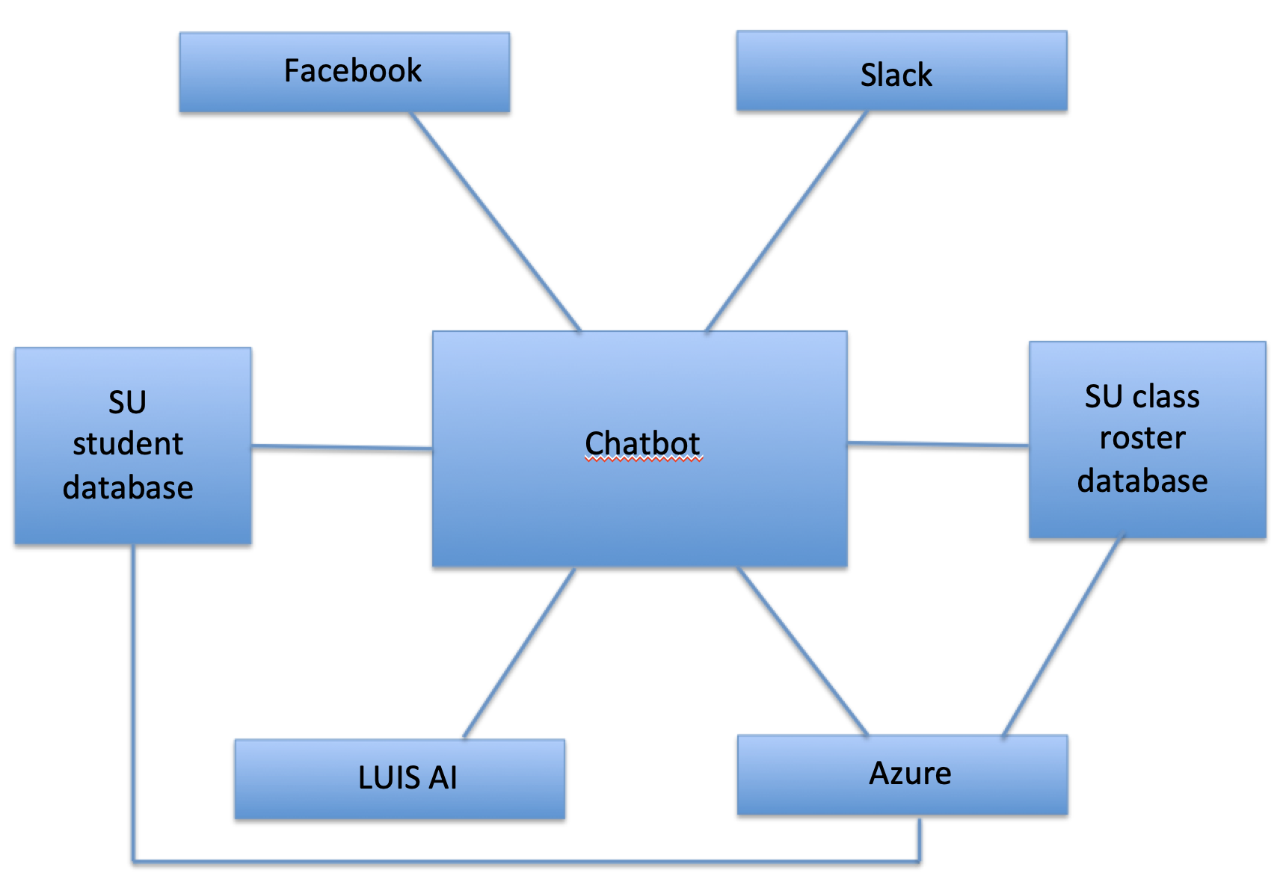
System Requirements:
Web-based application, hosted on Azure
Databases (hosted on Azure)
Translations between English (users’ requests and return results) and queries are handled by LUIS AI
Shall send greeting massages or a random Syracuse fun fact or a University alert upon start
Shall be able to handle any number of users’ requests at the same time
Can be accessed through both Facebook messenger and Slack
Notes:
which has the same basic information as Myslice, including student’s profile, class information; contains university’s class roster and class availability etc.

Slide 10
Non-functional requirements: the Chatbot shall:
Respond to users’ request within 10 MS
Validate a user’s ID against the SU ID each time it is being used
Protect user’s password and any sensitive information by encrypting data before storing it database
Be easy to use. Normally a user should be able to learn within 3 hours
Answer limited questions (not every topic can be answered)
Currently only support questions in standard English

Slide 11
Thank you!

