Slide 1

project on COMPANY INFORMATION
Presented by, G.VANISRI(124E1A0552)

Slide 2
Abstract
Company information website gives the description about IT companies present in our country.
This Website contain information like company logo, portfolio ,CEO’s ,location etc.,
Existing system of this project is manually they search about company.
Proposed system is using HTML, bootstrap,CSS ,PSQL databases to reduce time and burden.

Slide 3
Introduction
The main theme of this project is provide awareness about the profile of IT companies present in our country.
It will give all the details like company established year, capital, employability CEO’s in present and previous, location of company and recent projects etc.,
In this application infrastructure like it has company logo, description about companies in our country.

Slide 4
Existing system
There are many companies are providing their profiles individually on their own websites.
There is huge data, it is difficult to analysis exact data in peak stage before attending the interview.
Disadvantages:
Time taken process
Hard to search a particular company profiles individually.

Slide 5
Proposed system
We are going to provide all companies information in one website, which is helpful to students or user's to know about particular information about the company.
Advantages:
It gives the indetail information about IT company.
The intention of this website is to make user to face an interview with full company profile.
It takes less time.

Slide 6
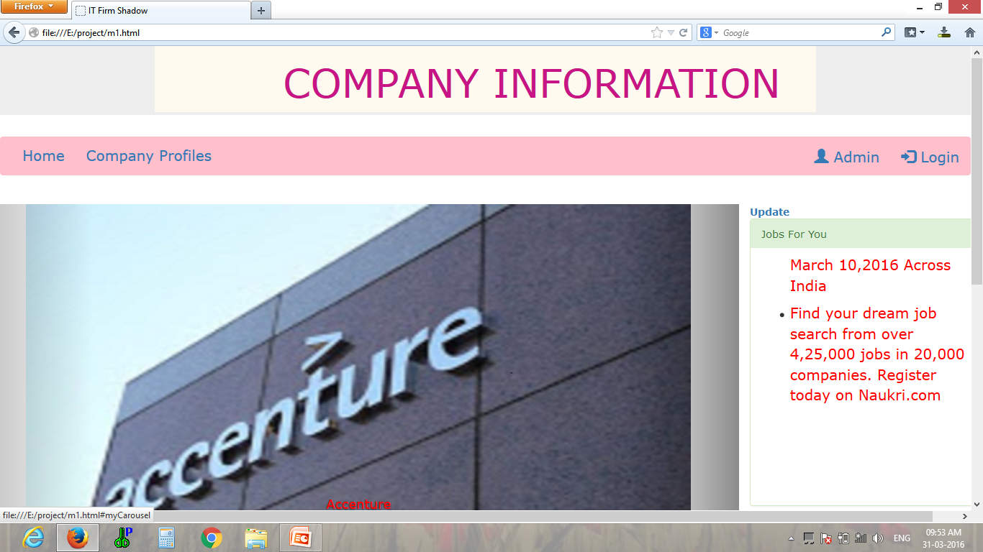

Slide 7
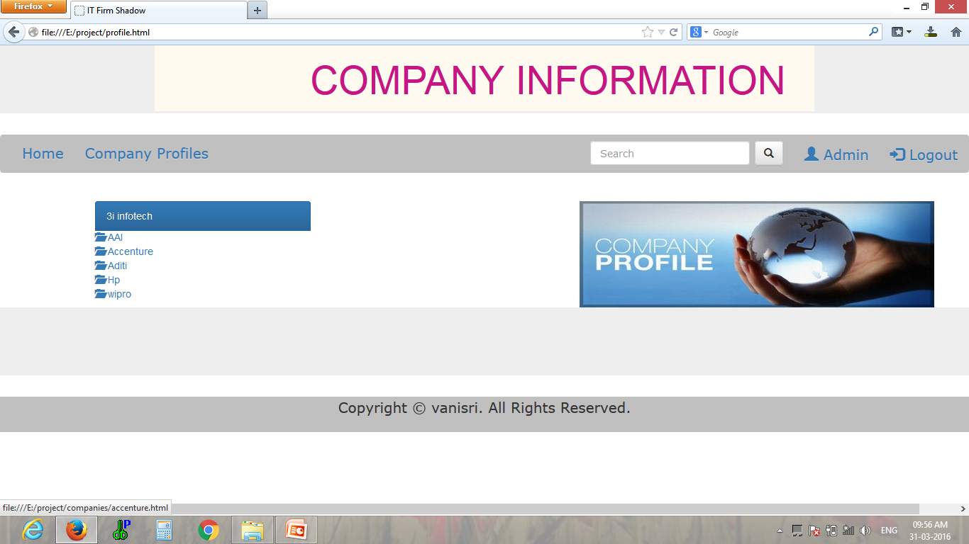

Slide 8
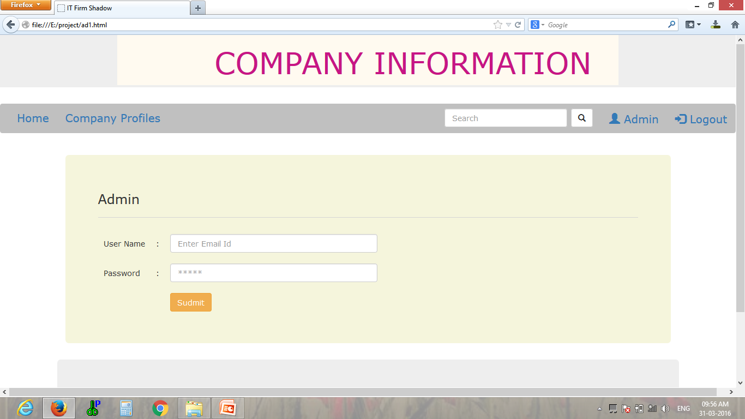

Slide 9
Techologies
FRONT END :
HTML
CSS
JAVA Script(for validations)
Bootstrap
BACK END :
PHP
JAVA Script
PSQL Database

Slide 10
Conclusion
By using this website time is reduced, easy to know about the It company profile.The main intention of this application is to make users face an interview with full company profile.

Slide 11
.
THANK YOU

