Slide 1

PROJECT ON COLLEGE TRANSPORTATION SYSTEM
DEPARTMENT OF COMPUTER SCIENCE & ENGINEERING
PRESENTED BY
P.Bharath Khan 124E1A0505
R.Bhavani Sree 124E1A0508
H. Shilpa 124E1A0544
UNDER THE GUIDANCE OF R.Theja 124E1A0549
Mr.E.Murali, M.Tech. P. Kavitha 124E1A0523

Slide 2
CONTENTS
Abstract
Existing System
Proposed System
Software and Hardware Technologies
System architecture
Modules
Uml diagrams
Conclusion

Slide 3
ABSTRACT
College transportation system is a website which is used to gives the complete details about the students and faculties who travel in the college bus.
By using this website department heads can easily identify who paid the bus fee and who did not paid.
In this website bus details are also be maintained like bus number, bus driver, the cost spent for the bus, bus employee details, bus routes

Slide 4
EXISTING SYSTEM
In previous days the student fee payment details are collected from college account section.
Some times few students fee payment details are not updated in to system

Slide 5
DISADVANTAGES OF EXISTING SYSTEM
Existing system doesn’t provide the notifications to each and every student.
Existing system provide notifications in notice board for only two or three days.

Slide 6
PROPOSED SYSTEM
By using these proposed system enter the student details(roll number , branch ,etc.) we get total fee payment information.

Slide 7
ADVANTAGES OF PROPOSED SYSTEM
Easy to know the student fee payment details.
Maintainance cost is reduced.

Slide 8
SOFTWARE REQUIRMENTS
FRONT END:
1. HTML
2. JAVA SCRIPT
3. BOOTSRTAP
BACK END :
1.PHP
DATABASE :
1.MY SQL

Slide 9
HARDWARE REQUIRMENTS
RAM: 2GB
HARDDISK: 40 GB

Slide 10
SYSTEM ARCHITECTURE
User should register to pay fee.
All the user details will be stored in data base
At the database consists of routes and the bus fee details.
It also consists of paid details of user and also pending details.

Slide 11
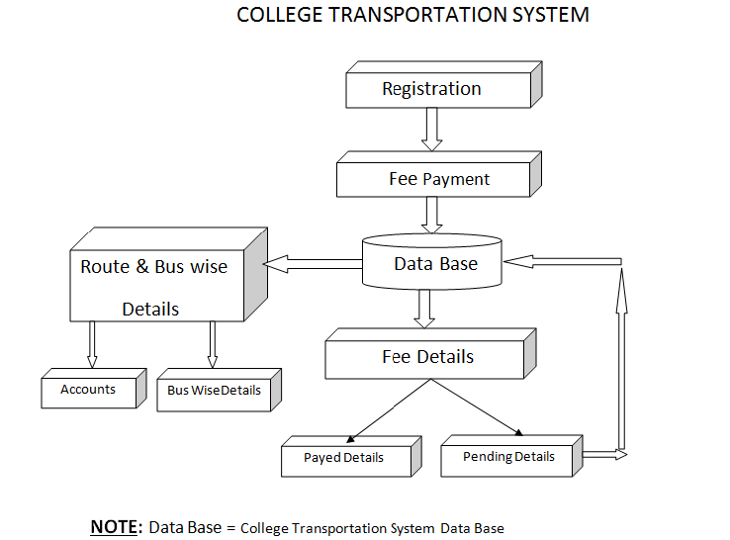

Slide 12
MODULES
User
Admin
Database

Slide 13
USER
Basically there are users and staff who have rights to know information about the bus details.
Students and staff must have pre-registration into this website so authenticated users can become the member .

Slide 14
ADMIN
The total rights and all the information can see by admin only.
The admin goes through check the fee details that which is paid by the users.
Based on fee paid details admin divide the list who are fee paid and pending .

Slide 15
DATABASE
By using data base store information related to students and staff.
Retrieve data related to user fee paid and pending details by using database.

Slide 16
UML DIAGRAMS
Class diagram
Use case diagram
Activity diagram
Sequence diagram
State chart diagram

Slide 17
CLASS DIAGRAM
The class diagram is the important entity in object-oriented analysis and design.
The class diagram can be used to show the attributes and the operations of a class and also the constraints that apply to the way the objects are connected.
Class diagram shows a set of classes,interfaces, and collaborations and their relationships.

Slide 18
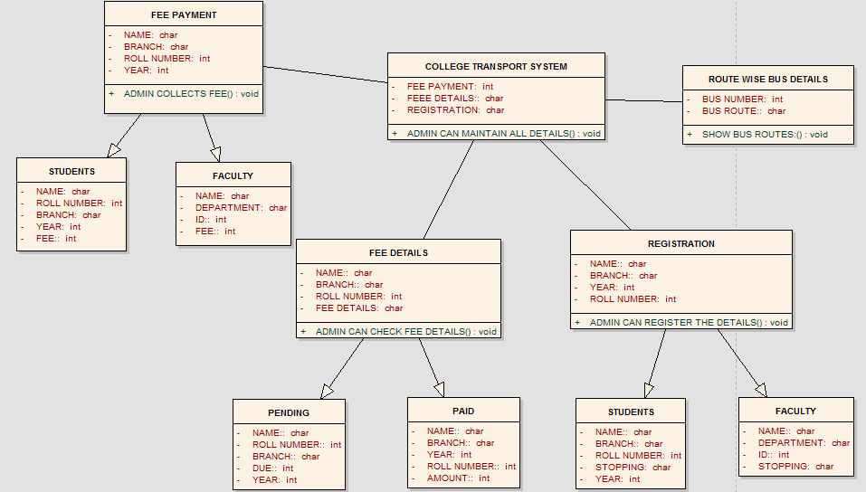

Slide 19
USE CASE DIAGRAM
The use case diagram is a visualization of use-cases,i.e., the interaction between the system and users.
Use case diagrams shows a set of use cases and actors(a special kind of class) and their relationships.
Use case diagrams address the static use case view of a system these diagrams are important in organizing and modeling the behaviors of a system.

Slide 20
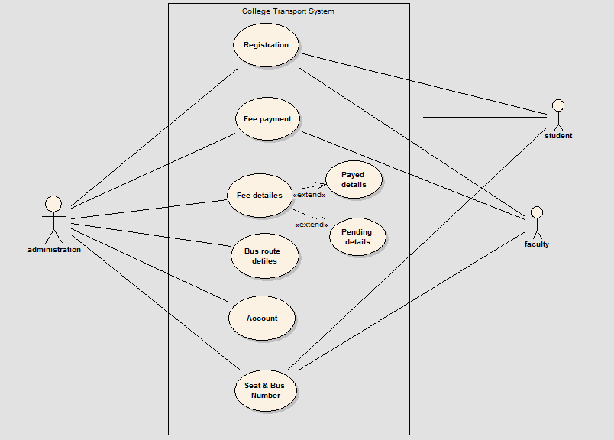

Slide 21
ACTIVITY DIAGRAM
The basic usage of activity diagram is similar to other four UML diagrams.
The specific usage is to model the control how from one activity to another. This control flow does not include messages.
The activity diagram is suitable for modeling the activity flow of the system.

Slide 22
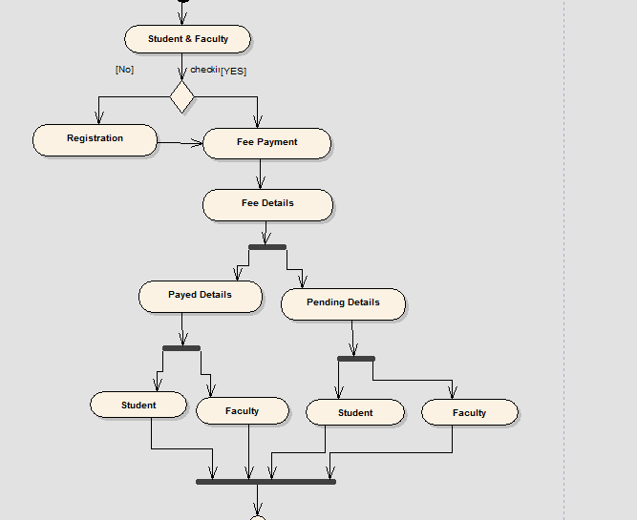

Slide 23
SEQUENCE DIAGRAM
The sequence diagram displays the overall flow of control in an object-oriented program.
The sequence diagram commonly contain:
1)Objects.
2)Links.
3)Messages.
4)Respond time.
5)The vertical “lifelines” represents objects of interest.

Slide 24
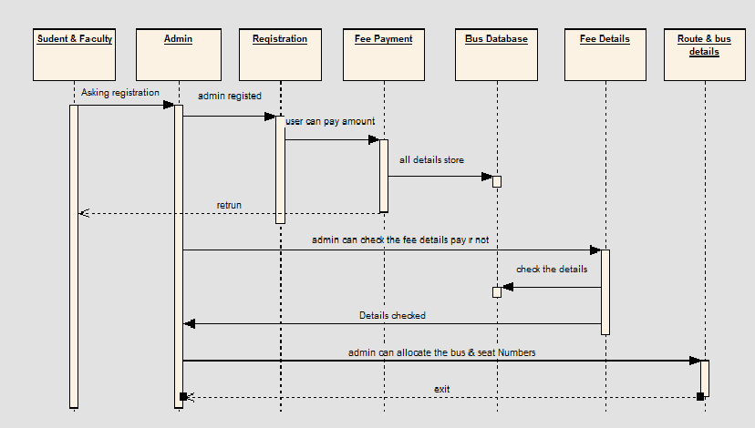

Slide 25
STATE CHART DIAGRAM
State chart diagram is used to model dynamic nature of a system. They define different states of an object during its lifetime.
State chart diagram describes the flow of control from one state to another state.

Slide 26
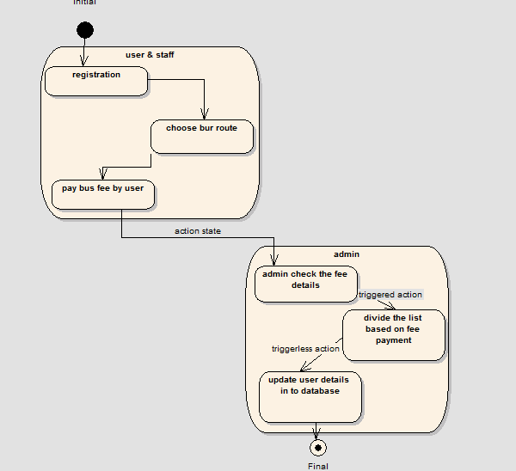

Slide 27
CONCLUSION
The basic idea behind this project is to overcome all the problems in offline system and to increase the efficient use of technologies to maintain large databases.

Slide 28
THANK YOU

