Slide 1


Slide 2
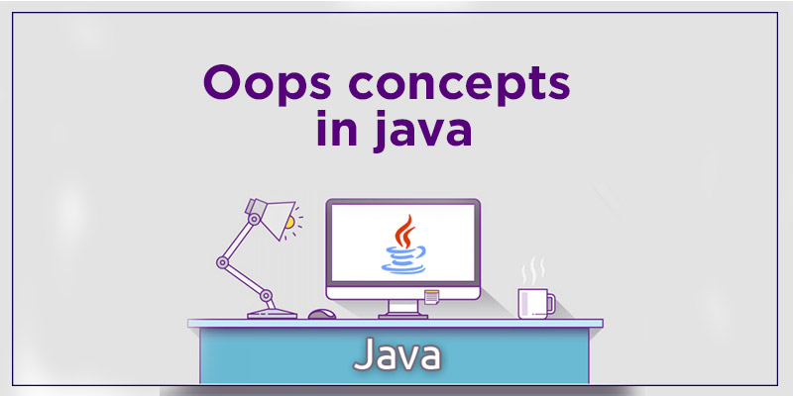
Presented By :
BHARATH K N

Slide 3


Slide 4



Java :
Java is a object oriented programming language which is used to develop java software’s.
Designed by :
In the year 1995
Logo
Current Stable Version
JAVA SE 18
(Released 2months ago)
Currently Owned By :

Slide 5
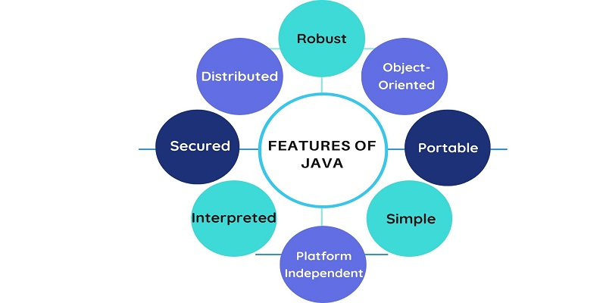
Features of java

Slide 6
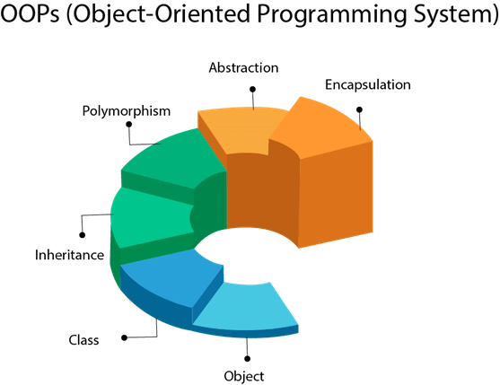
What is Oops?

Slide 7
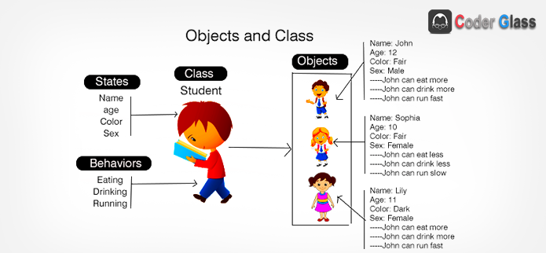
Class and Object
Class : Class is a blueprint or a template to create object.
Object : It is a real time entity which has both state and behaviour.

Slide 8
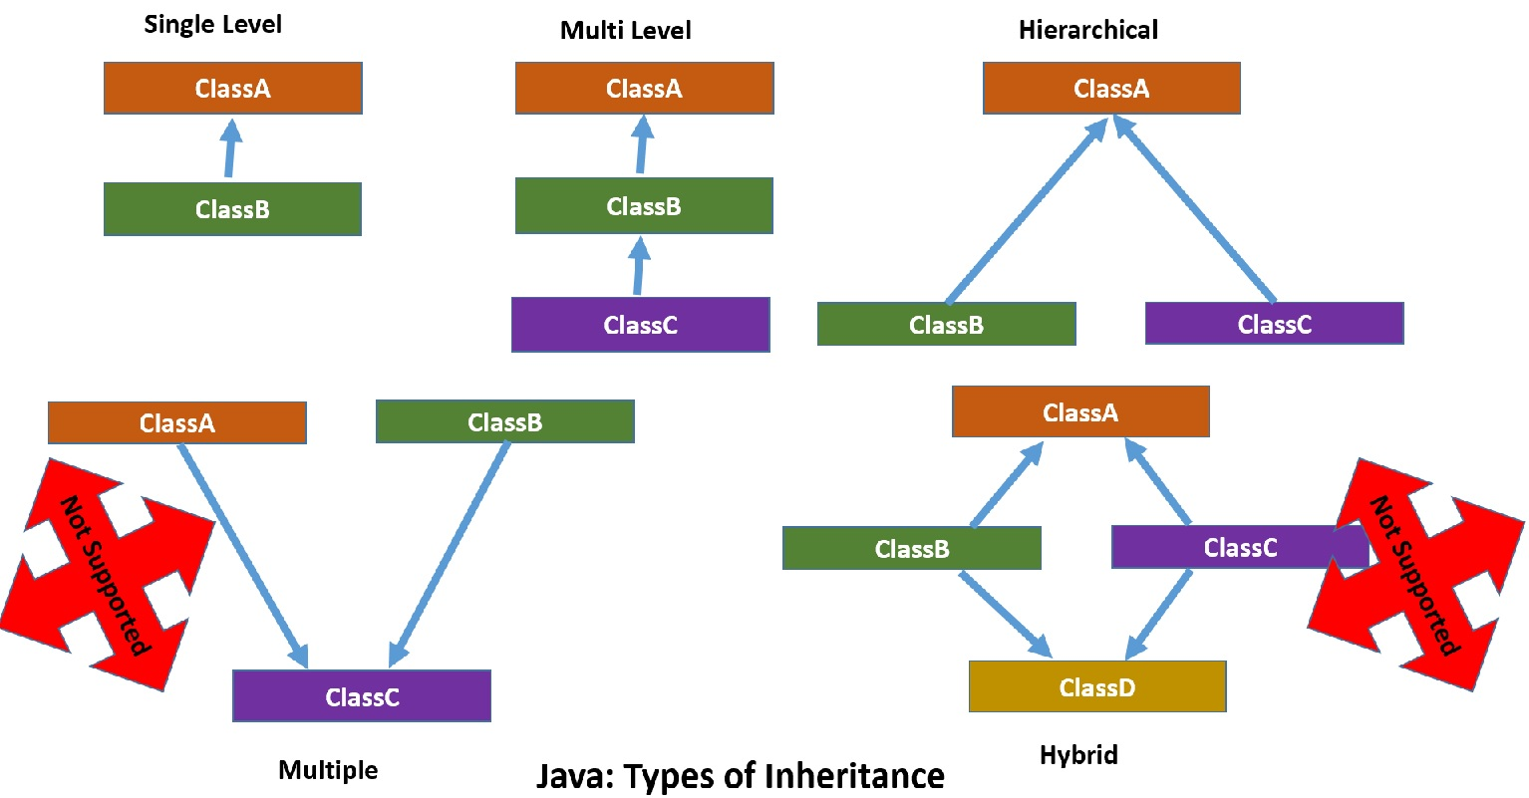
Inheritance
The process of inheriting the properties from one class to another class is called as Inheritance

Slide 9
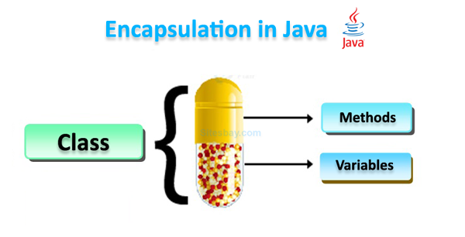
Encapsulation
Encapsulation refers to the bundling of fields and methods inside a single class. It prevents outer classes from accessing and changing fields and methods of a class.

Slide 10
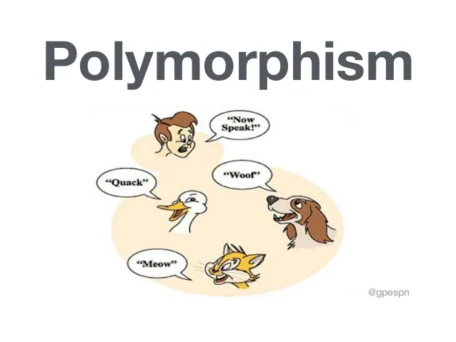
Polymorphism
Poly = Many
Morphism = forms
An Object showing different behaviour at different stages is called as polymorphism.

Slide 11
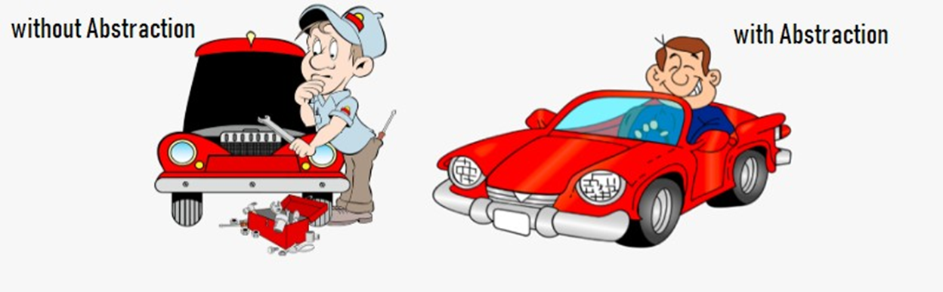
Abstraction
Hiding the complexity of the system and exposing only the required functionality to the end user is called as Abstraction

Slide 12
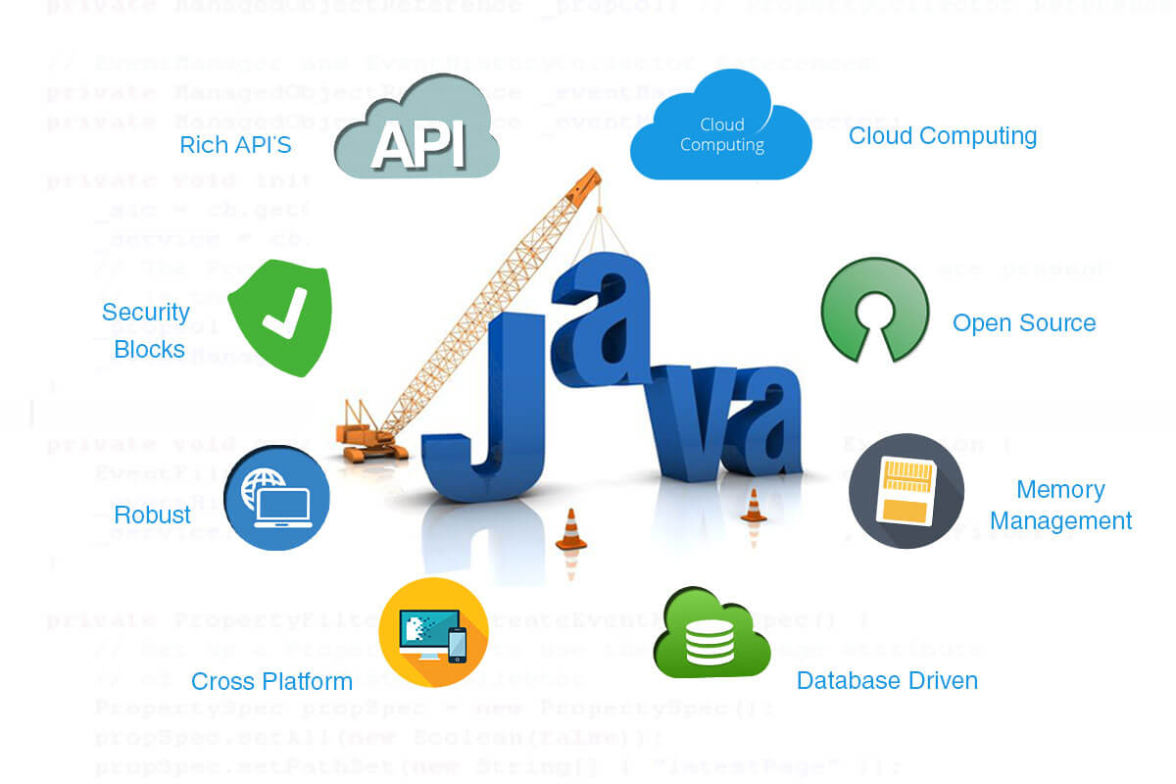
Advantages of Java

Slide 13



Interesting facts about java

Slide 14
