Slide 1
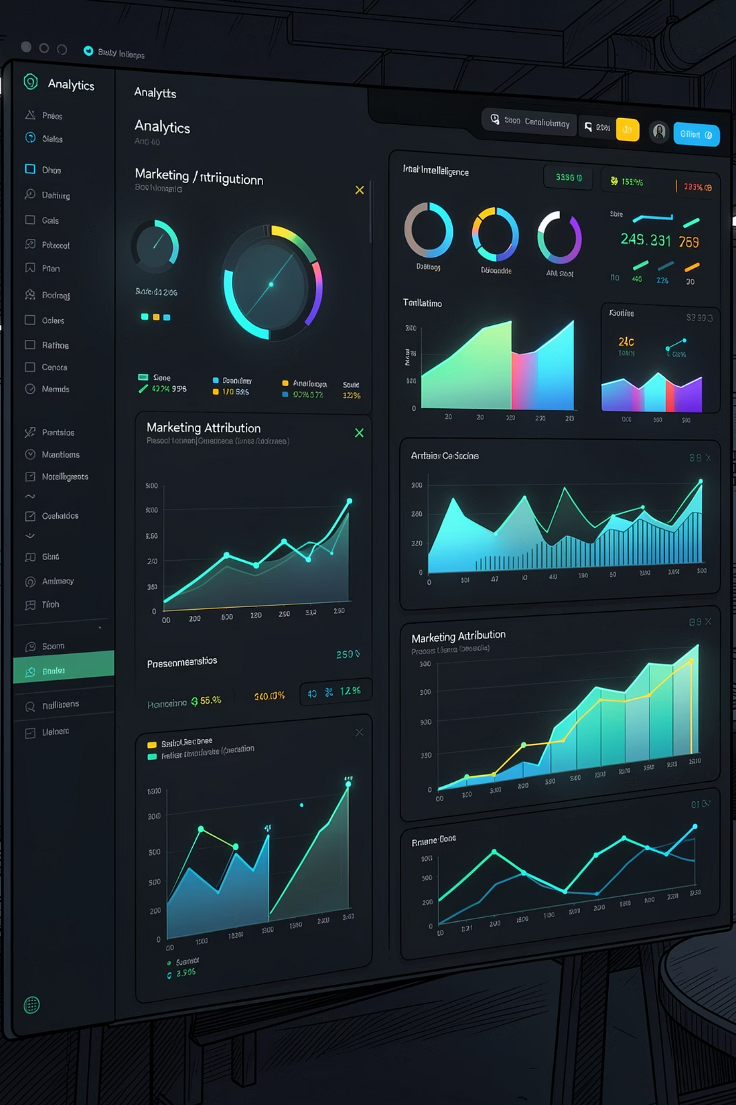
NEXUS CONSUMER BRANDS | Q1 2026
ROI Lens: Attribution Truth
Advanced Marketing Attribution & Budget Refinement Strategy — moving from last-click lies to attribution truth. Powered by Ai Palette Consumer Intelligence.

Slide 2

Why Last-Click Attribution Is Destroying ROI
₹100 Crore deployed across 5 channels. 47,796 interactions tracked. The attribution model? Last-Click — giving 100% credit to the final touchpoint and ignoring the entire customer journey.
The Signal Problem
The Business Cost
YouTube touched 49% of all buyers but received only 7% of credit. Marketplace was massively overfunded on false signals.
Suboptimal budget allocation. Millions wasted on overrated channels. High-performers starved of investment.
The Scale
10 brands. 5 channels. 47,796 consumer interactions — all evaluated through a fundamentally broken lens.

Slide 3
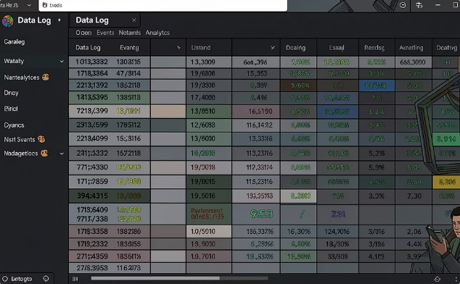

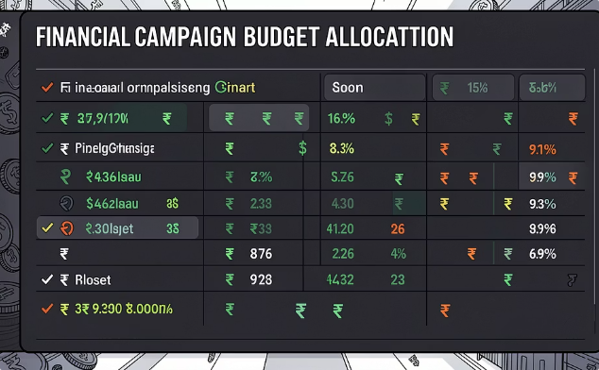
The Data Foundation
Three datasets formed the analytical backbone of this study — spanning the full consumer journey, audience intelligence, and financial spend across all 10 brands.
touchpoints.csv — The Journey Log
user_profiles.csv — Persona Intelligence
campaign_spend.csv — The Financial Layer
47,796 consumer interactions across 5 channels. Events tracked: Impression, Click, Add-to-Cart, and Purchase.
88,163 user profiles across 4 segments: Fitness Enthusiast, Budget Parent, Premium Gourmet, and Gen-Z Trendseeker — spanning Tier 1, 2, and 3 cities.
50 campaigns across 10 brands. CPC and CPM pricing models. ₹100 Crore total budget deployed last quarter.

Slide 4
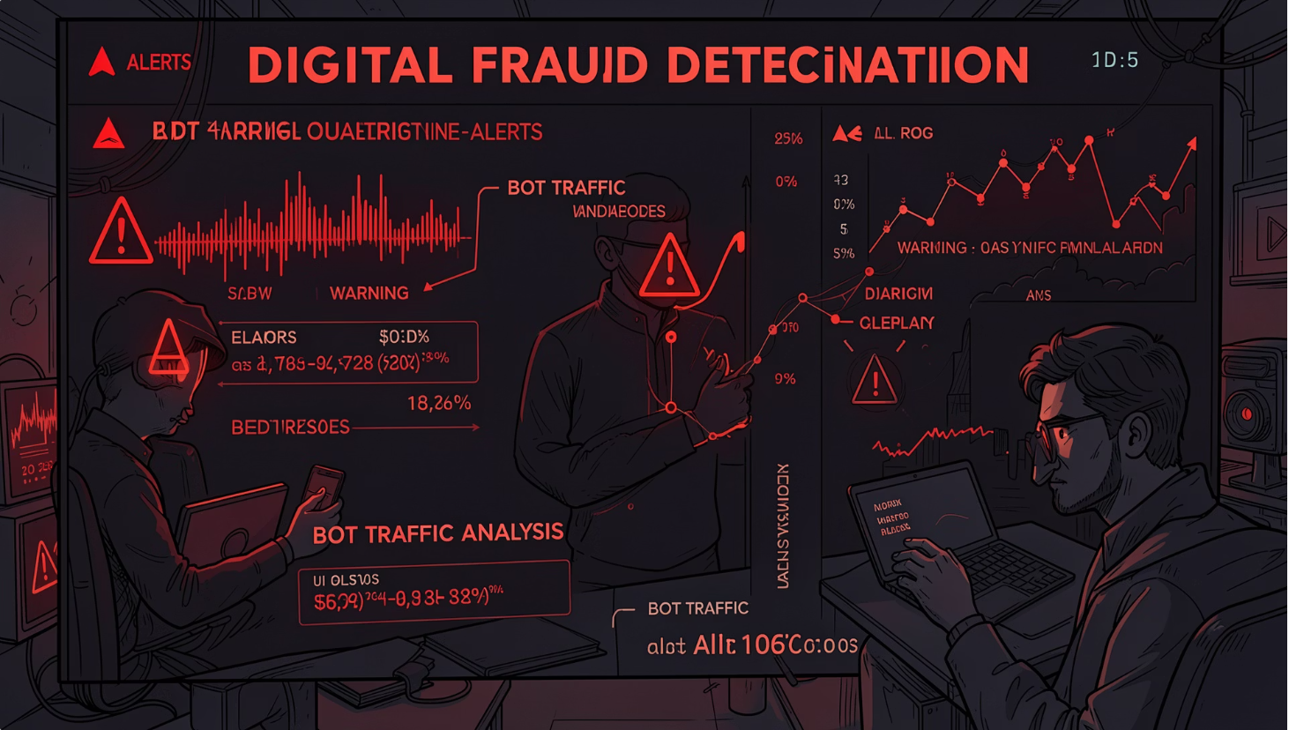

46% of Traffic Was Fake — We Found It
Detection Method
Analyzed time gaps between consecutive user events. Real humans cannot interact faster than 2 seconds. All sub-2-second click patterns were flagged as bot activity.
All further analysis performed on clean data only. Last-click was making decisions on corrupted signals.
47,796
21,992
25,804
Total raw interactions
Fraudulent interactions removed
Clean interactions retained

Slide 5
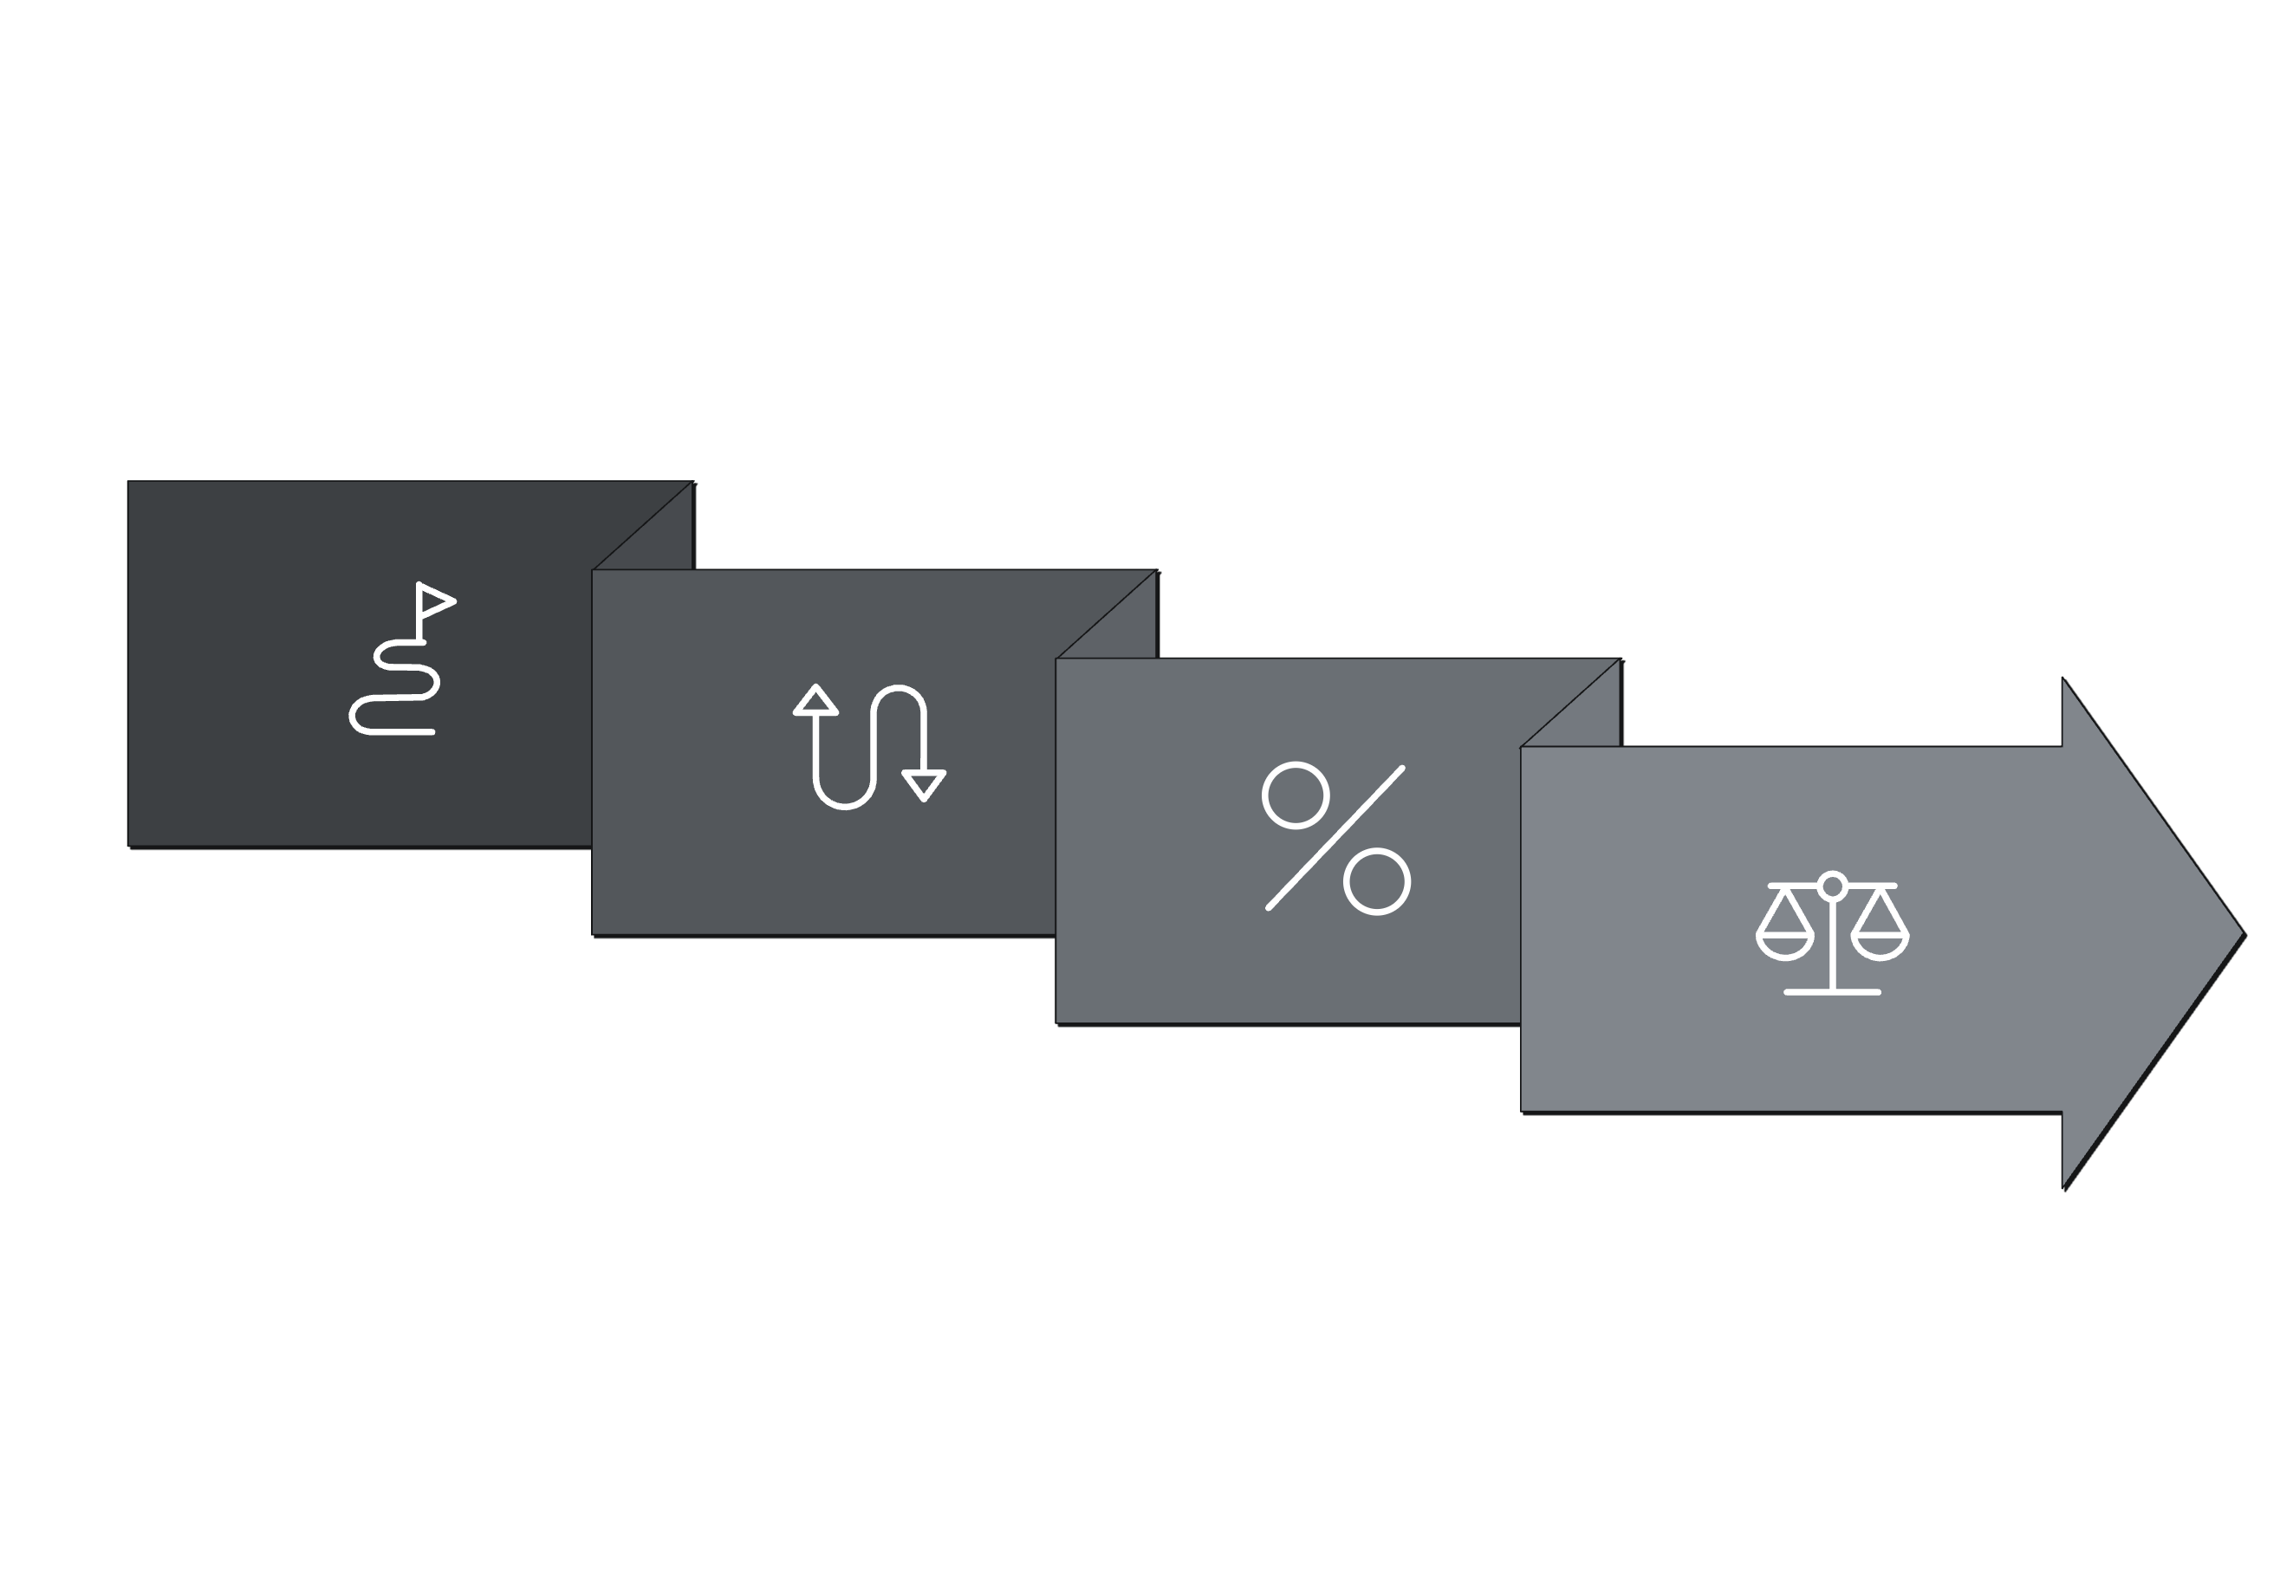
Introducing Markov Chain Attribution
Unlike last-click, Markov Chain models the probability of moving between channels
— asking: "If we remove this channel, how many purchases do we lose?"
That loss equals the channel's true contribution.
Count Transitions
Assign Credits
Build Journeys
Compute Removal
Every channel gets fair credit for its role in the journey — not just the final step before purchase.

Slide 6
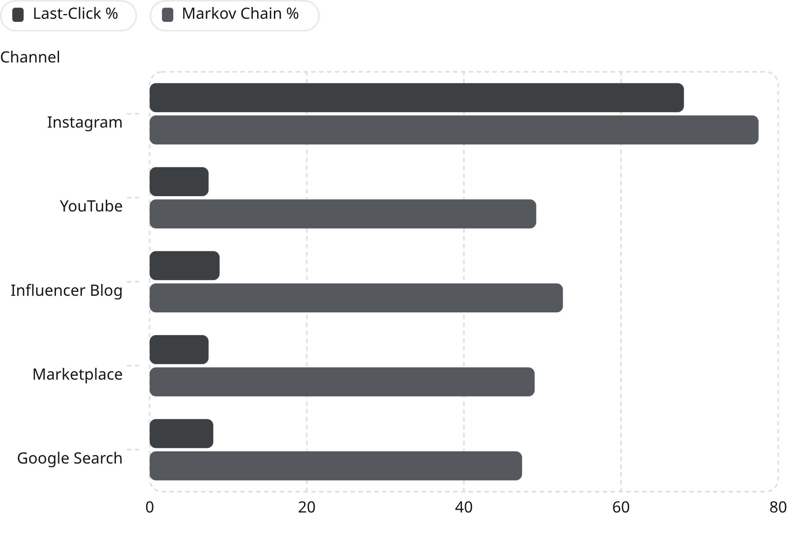
The Channels Are Not What You Think
Channel Roles Identified
Instagram — Primary Converter
Final touchpoint king. Closes purchases.
YouTube — Top-of-Funnel Primer
Starts journeys. Was credited for only 7.5% of buyers despite touching 49%.
Influencer Blog — Mid-Funnel Nurture
Builds consideration. Massively undervalued.
Marketplace — Bottom-Funnel
Most expensive per true conversion. Overfunded.

Slide 7
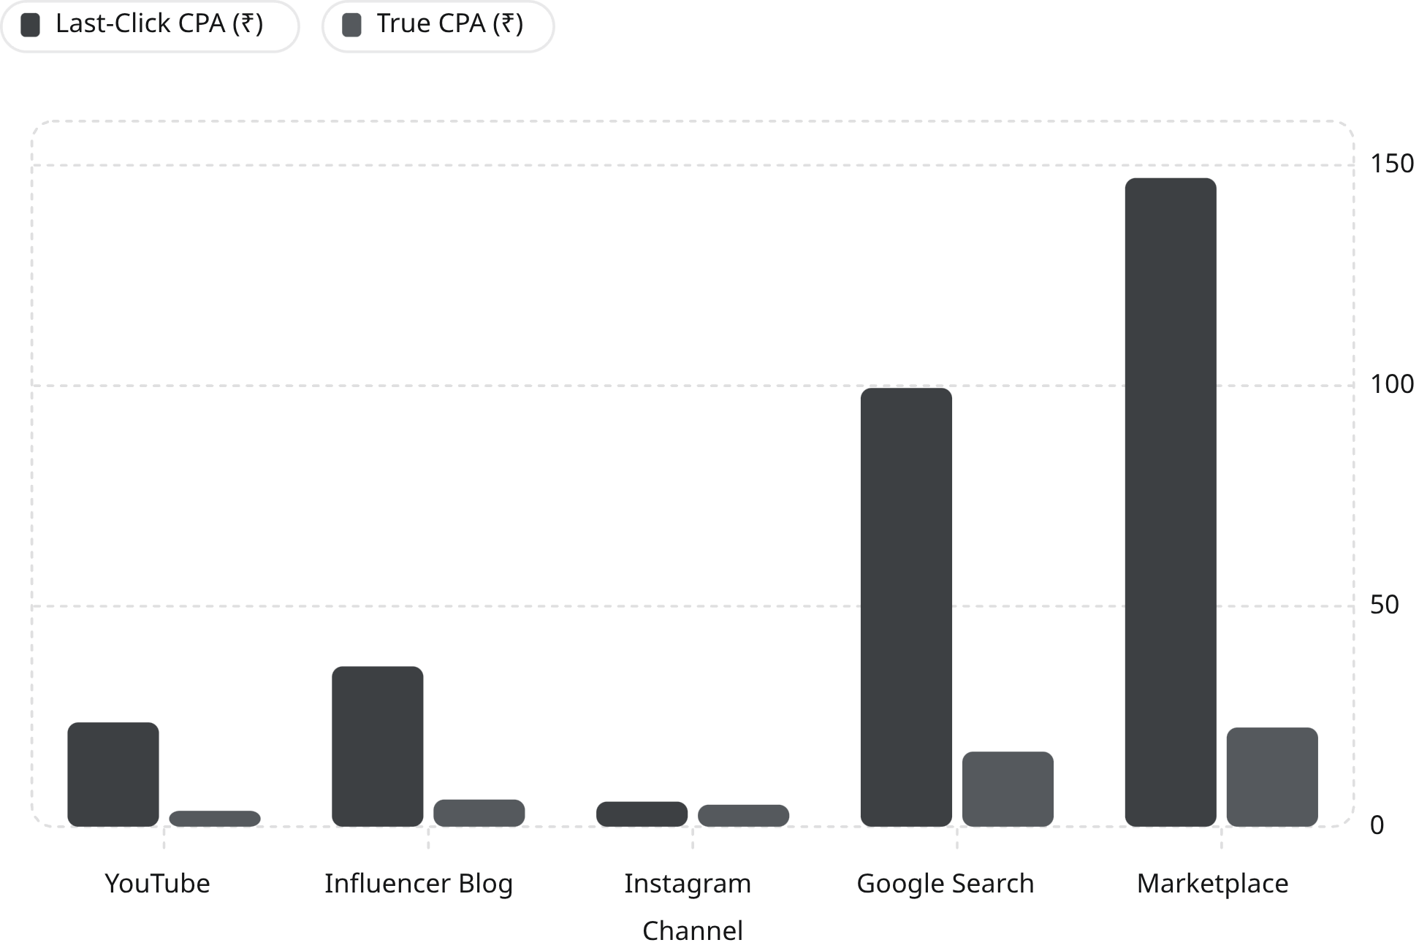

The Real Cost of Every Purchase
The Delta Is Staggering
YouTube and Influencer Blog were massively undervalued — doing heavy lifting early in the journey but receiving near-zero credit.
Marketplace appeared cheap on last-click but is actually the most expensive channel per true conversion at ₹22.49 CPA.
YouTube
Marketplace
6.5x cheaper than last-click suggested
6.5x more expensive than it appeared

Slide 8
The ₹100 Crore Reallocation Strategy
Budget allocated inversely proportional to True CPA — lower CPA means more budget, more conversions. Each of 10 brands receives ₹10 Crore.
Channel
True CPA (₹)
Recommended Budget
Budget %
YouTube ↑
3.60
₹3.73 Crore
37.3%
Instagram
4.98
₹2.70 Crore
27.0%
Influencer Blog ↑
6.15
₹2.18 Crore
21.8%
Google Search ↓
17.01
₹0.79 Crore
7.9%
Marketplace ↓
22.49
₹0.60 Crore
6.0%
Actions: Scale YouTube and Influencer Blog significantly. Cut Google Search by ~50% and Marketplace by ~40%. Add frequency cap on Marketplace to combat ad fatigue.

Slide 9
Executive Decision Summary
⚠ Defund Immediately
Operational Changes
Heavy Marketplace campaigns — True CPA ₹22.49, overbudgeted
Standalone Google Search campaigns — True CPA ₹17.01
Any campaign targeting bot-heavy segments
Add frequency cap on Marketplace (ad fatigue detected)
Implement bot traffic filter on all future campaigns
Retire last-click attribution permanently
Expected Impact
✅ Scale These Channels
YouTube — Cheapest true CPA at ₹3.60, starts journeys
Influencer Blog — Strong mid-funnel at ₹6.15 true CPA
Instagram — Keep strong; it closes purchases
+35–40%
~46%
More conversions on same ₹100Cr budget
Fraudulent traffic waste eliminated

Slide 10
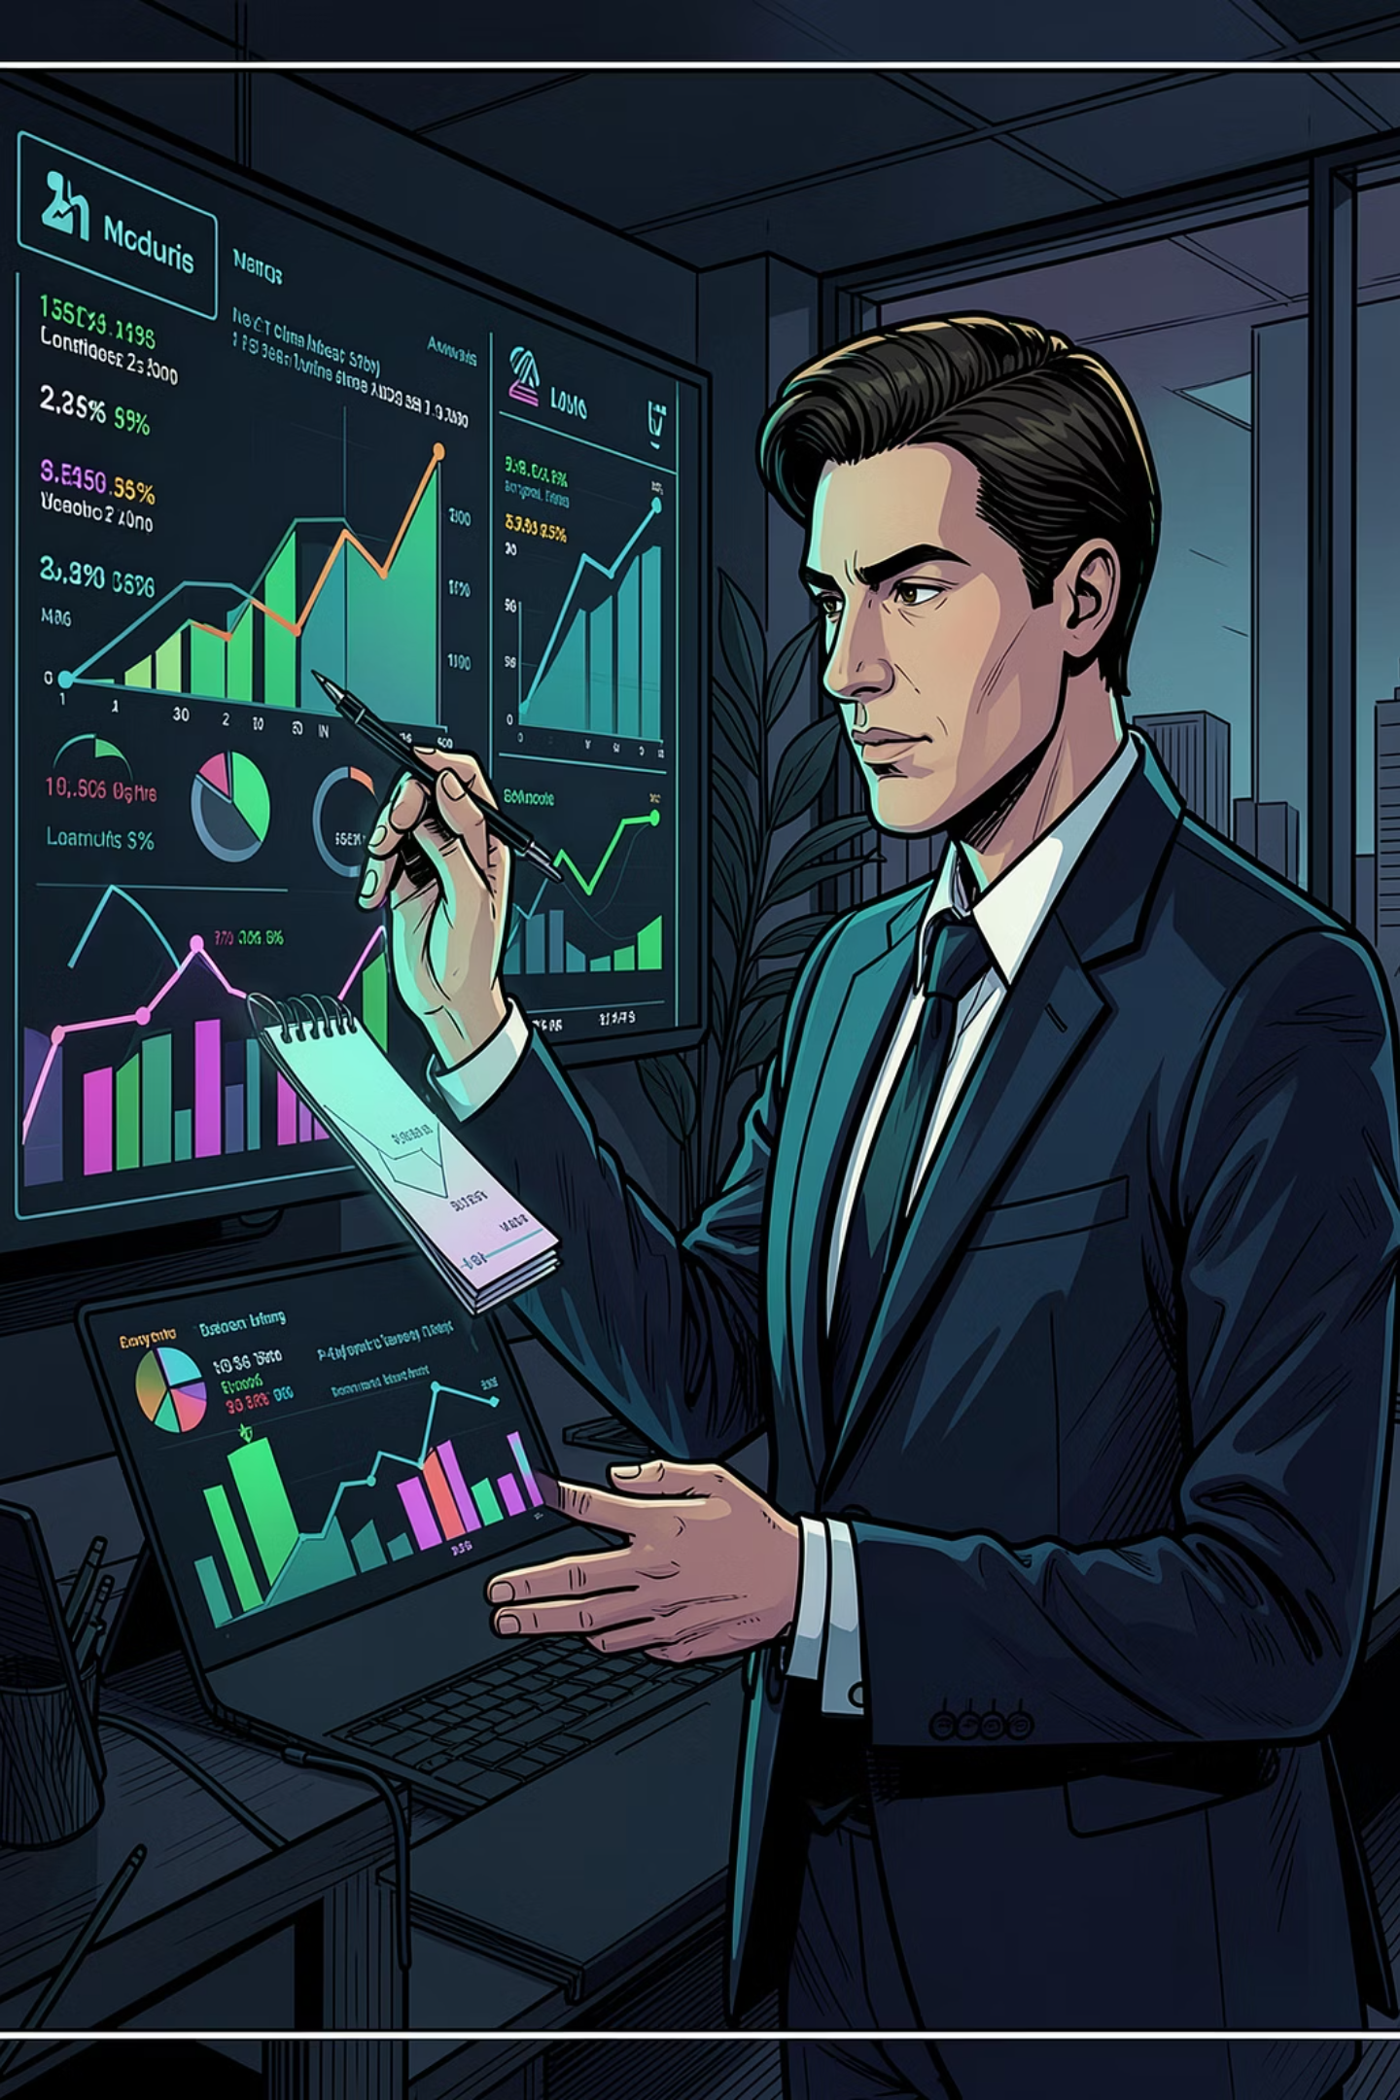

The Attribution Revolution Starts Now
The data is clear. The methodology is proven. The ROI case is undeniable. It's time to stop rewarding the last click and start investing in the entire journey.
01
Deploy Markov Chain Attribution
Replace last-click across all 10 brands immediately.
02
Implement Bot Detection at Scale
Filter fraudulent traffic before any budget decision.
03
Execute the Reallocation
Shift spend toward YouTube and Influencer Blog. Cap Marketplace.
04
Measure True ROI
Track conversion lift, CPA delta, and journey attribution monthly.
Tool Used: ROI Lens (Markov Chain Attribution Framework) | Data Partner: Ai Palette Consumer Intelligence

