Slide 1
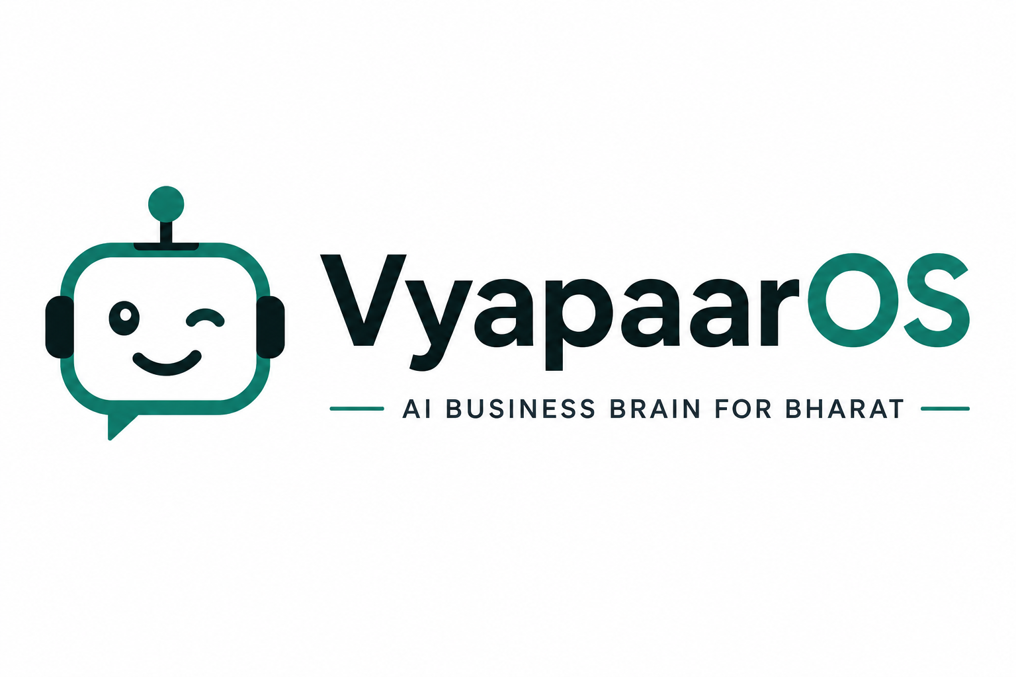
Impact & Future Scope
One AI employee that runs the entire back office of Bharat's businesses.
BUSINESS BRAIN
BHARAT-FIRST AI
63M MSMEs
MSME Prototype · Next.js 16 · React 19

Slide 2

SECTION A
IMPACT
What the Business Brain changes for India's small businesses

Slide 3
THE GAP
The Problem We Solve
A
Fragmented reality
Why ERPs failed
▸ 63 million MSMEs in India run on WhatsApp, UPI, paper bills, notebooks & spreadsheets
▸ Orders, payments, inventory and invoices live in separate places — no single view of the business
▸ Built for corporates, priced for enterprises, require training — ignored by small owners
▸ The accounting gap leaves ₹70L+ crore of MSME commerce informal & invisible
VyapaarOS — AI Business Brain for Bharat
03

Slide 4
THE ANSWER
What We Built
A
Business Brain
Working AI employees
▸ Ask in plain language (Kannada + English): cash flow, GST, profit, receivables — answered instantly
▸ One connected view of orders, inventory, payments, invoices, suppliers and GST
▸ AI Auditor — caught a ₹28,500 duplicate supplier payment; flags missing GST & unusual refunds
▸ Autopilot — AI CFO, Procurement Manager and Auditor run in the background, explain every call
VyapaarOS — AI Business Brain for Bharat
04

Slide 5
OWNER'S TIME
Impact on the Owner's Time
A
Before
After
▸ 3+ hours every day on manual bookkeeping and reconciliation
▸ 156 UPI payments reconciled by hand; paper bills filed away; follow-ups forgotten
▸ Business answers in seconds — "what's my cash position?"
▸ Payments auto-reconciled (2.1 hrs avg settlement), bills processed, reminders sent automatically
VyapaarOS — AI Business Brain for Bharat
05

Slide 6
OWNER'S MONEY
Impact on Money: Recovered & Protected
A
Cash recovered
Margins protected
▸ ₹28,500 duplicate payout to a supplier detected and reclaimed in one audit
▸ ₹84,200 in overdue receivables (3 customers, 15+ days) surfaced for structured follow-up
▸ 3.2% rice margin erosion caught early → pricing recommendation (₹66/kg) with 6% elasticity model
▸ GST liability (₹39,294) estimated proactively — no surprise tax bills
▸ Digital Twin simulates purchases & hires before committing money (2.3x ROI call)
VyapaarOS — AI Business Brain for Bharat
06

Slide 7
DECISIONS
From Human-Led to AI-Assisted Decisions
A
Explainable intelligence
Proactive, not reactive
▸ Every recommendation shows the 'why' — owners trust and act on it
▸ Restock alerts fire before stockout, not after (safety limits on every SKU)
▸ Digital Twin: "Buy 500 kg of rice?" → 45-day stock coverage analysis first
▸ Owner becomes a reviewer who approves, instead of a clerk who records
VyapaarOS — AI Business Brain for Bharat
07

Slide 8
BHARAT
Broader Societal Impact
A
Inclusive by design
Formalizing the informal
▸ Bharat-first prompts: Kannada + English; 10+ Indian languages planned
▸ Sector-agnostic — rice, ghee, saffron, sarees, handicrafts, ayurveda
▸ Clean records → GST compliance, better credit access, working-capital loans
▸ Empowers mom-and-pop shops to compete with modern retail and chains
▸ Not another dashboard to maintain — an AI employee you can talk to
VyapaarOS — AI Business Brain for Bharat
08

Slide 9
MEASURABLE
Impact KPIs
A
Efficiency
Money
▸ 90%+ reduction in manual bookkeeping effort
▸ Reconciliation down from days to ~2 hours
▸ 8–12% margin protection via pricing intelligence
▸ ₹28,500 recovered in a single audit pass
▸ New branch launch: minutes via DNA cloning (was weeks)
VyapaarOS — AI Business Brain for Bharat
09

Slide 10
SECTION B
FUTURE SCOPE
From prototype to the AI employee every Bharat business deserves

Slide 11
FROM → TO
Prototype to Production
B
Today
Target
▸ In-memory data & mock API — demo branch only
▸ Rule-based chat (Kannada + English prompts)
▸ Single branch, single owner
▸ Persistent, multi-tenant, authenticated cloud platform
▸ Real LLM natural-language brain + voice
▸ Millions of branches, franchise-ready
VyapaarOS — AI Business Brain for Bharat
11

Slide 12
DATA
Real Integrations (The Data Layer)
B
Financial rails
Communication & documents
▸ Banking — auto-import statements via Account Aggregators
▸ UPI — instant settlement reconciliation (PhonePe, GPay, Razorpay)
▸ GST — live GSTN filing & auto-prepared returns
▸ WhatsApp Business API — orders, invoices & reminders in chat
▸ OCR — read paper bills, invoices and screenshots automatically
▸ Accounting sync — Tally / Zoho / QuickBooks or replace them
VyapaarOS — AI Business Brain for Bharat
12

Slide 13
AI ROADMAP
AI Capability Roadmap
B
Smarter brain
Human-native
▸ LLM-powered natural language (replaces rule-based mock)
▸ Predictive analytics — demand, cash flow, stockouts
▸ Anomaly detection at scale — fraud, theft, leakage signals
▸ Voice interface in Hindi, Kannada, Tamil, Telugu, Marathi
▸ Camera → purchase order → ledger (image intelligence)
▸ A personalized AI agent that learns your business over months
VyapaarOS — AI Business Brain for Bharat
13

Slide 14
PRODUCT
Product Expansion
B
Commerce
Operations
▸ Supplier price comparison marketplace + group buying power
▸ Credit scoring — turn business data into loan eligibility
▸ Mobile-first app with offline mode for rural connectivity
▸ Multi-branch empire mode via Business DNA cloning
▸ Thermal billing, QR invoicing, POS hardware support
▸ Compliance hub — filings, licenses, expiry reminders
VyapaarOS — AI Business Brain for Bharat
14

Slide 15
GO TO MARKET
Commercialization & Scale
B
Model
Reach
▸ Freemium → ₹999–₹1,999 / month per branch
▸ WhatsApp-first onboarding — zero training needed
▸ Revenue: subscriptions + transaction fees + credit marketplace
▸ Target: 63M MSMEs → 10M+ active users in 5 years
▸ Partnerships: banks, NBFCs, GST networks, FMCG distributors
▸ Pilot: first 100 shops on live integrations in 12 months
VyapaarOS — AI Business Brain for Bharat
15

Slide 16
SUMMARY
Future Scope at a Glance
B
Today
Tomorrow
▸ Mock AI (rule-based)
▸ In-memory data
▸ Single demo branch
▸ English / Kannada
▸ Real LLM + voice AI in 10+ languages
▸ Cloud + real bank / UPI / GST / WhatsApp
▸ Millions of branches
▸ Autopilot — AI runs it, owner approves
VyapaarOS — AI Business Brain for Bharat
16

Slide 17
VyapaarOS is not an ERP.
It is the AI employee every Bharat business deserves.
Next 12 months:
1
Production data layer — persistence + auth + multi-branch
2
WhatsApp & bank integrations — first 100 pilot shops
3
Real LLM natural-language Business Brain
4
Mobile app with offline mode
Made for Bharat · 63,000,000 businesses · Built with React 19 & Next.js 16

