Slide 1
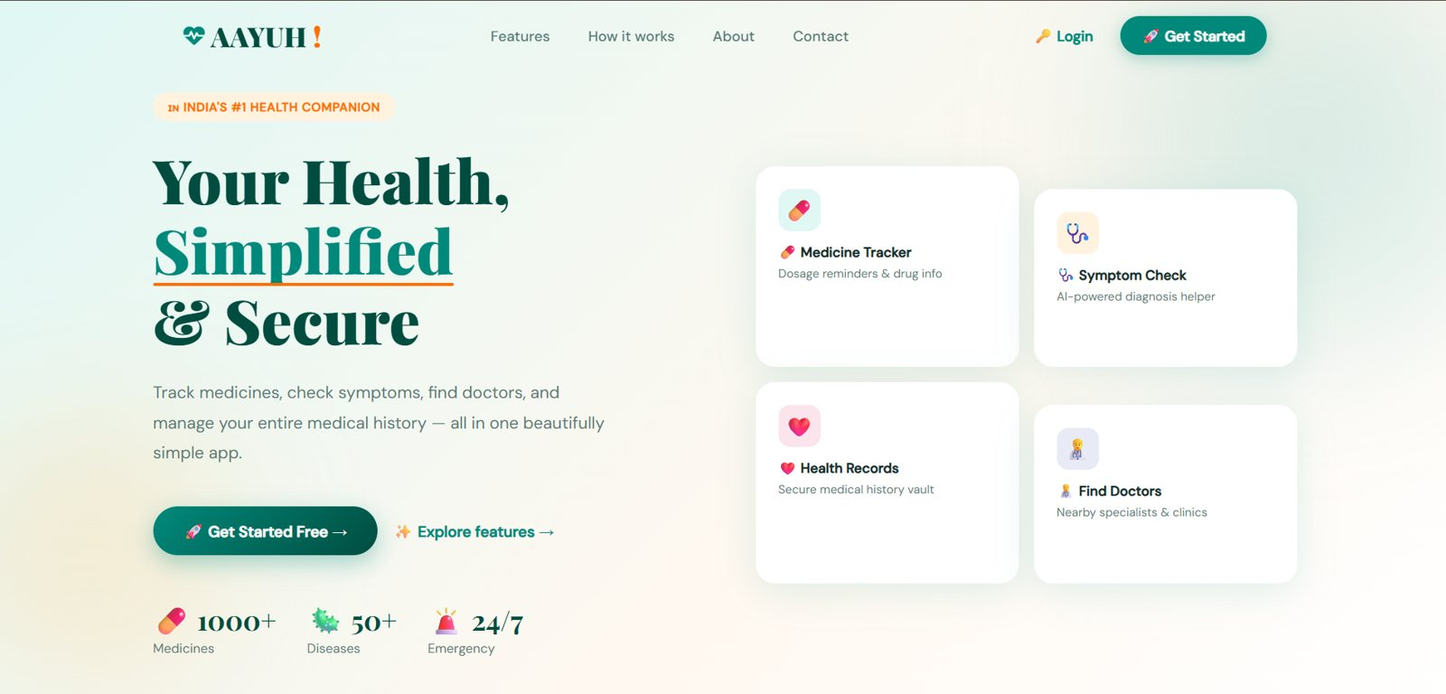
FULL-STACK AI HEALTH COMPANION · PROJECT CASE STUDY
AAYUH – AI-Powered Health Companion
Medicine info, ML symptom checker, health chatbot, medical records and emergency access as a website, PWA and Android app.
P. Bharath Kumar · Student ID: 2400030010
Project type: Full-stack web + Android app with an ML service
Live: aayuh.vercel.app
GitHub: bharathkumar1904/AAYUH- · aayuh-proxy · aayuh-ml
Notes:
Explain the business purpose: a single health companion app for Indian users, with an ML symptom engine behind it.

Slide 2
Problem statement and objectives
Health information is scattered
Medicines, symptoms, records and doctors live in different apps and websites.
Medicine tracker
FDA label data + AI summary
Symptom checker
ML model + triage rules
Health chatbot
Medical-only AI assistant
Disease lookup
Wikipedia + AI tips
Medicine labels are hard to read
Patients need plain-language usage, dosage and side effects.
→
Medical history
Upload and filter reports
Emergency SOS
Quick-dial contacts
Searching symptoms causes anxiety
Generic web search gives no structure or urgency guidance.
Find doctors
Map of nearby care
Health trackers
Steps, heart rate, BP
Records are lost on paper
Reports and prescriptions need one secure place.
Pharmacy
Browse and add to cart
Android app
Same code via Capacitor
Emergencies need speed
Numbers and nearby care must be a tap away.
Notes:
Problem to solution. All ten items exist in the repository.

Slide 3
System architecture
User
Browser, PWA or Android app
1 Frontend
Static HTML, CSS, JS on Vercel
2 Proxy (API)
Node.js http server on Render
3 ML service
FastAPI + scikit-learn, Docker
→
→
→
4 DATA AND EXTERNAL SERVICES
Firebase
Auth, Firestore, Storage (browser direct)
Supabase
Pharmacy products table
Groq LLM
Reached only through the proxy
Public APIs
FDA, Wikipedia, OpenStreetMap, ipapi
→
→
→
5 Deployment: Vercel (web) · Render (proxy) · Docker image (ML) · Capacitor APK with Capgo OTA. Symptom path: page → proxy /predict → ML → result; if it fails → proxy /chat → Groq.
Notes:
Walk left to right, then explain the external services.

Slide 4
Technology stack
Frontend
HTML5, CSS3, vanilla JavaScript, Leaflet maps, pdf.js, Web App Manifest, Service Worker
Backend
Node.js http server (dotenv only) as an API proxy; FastAPI + Uvicorn + Pydantic for ML
Machine learning
Python 3.11, scikit-learn MultinomialNB, pandas, NumPy, joblib
AI (LLM)
Groq Cloud chat completions, called only via the proxy
Auth and database
Firebase Auth, Firestore, Storage; Supabase (pharmacy products)
Mobile
Capacitor 8 (Android), Capgo live updates
External APIs
openFDA drug labels, Wikipedia, OpenStreetMap Nominatim, ipapi.co
Deployment
Vercel, Render, Docker
Not used
React, Angular, Tailwind, MongoDB, TensorFlow, deep learning
Notes:
Every item comes from package.json, requirements.txt or script tags.

Slide 5
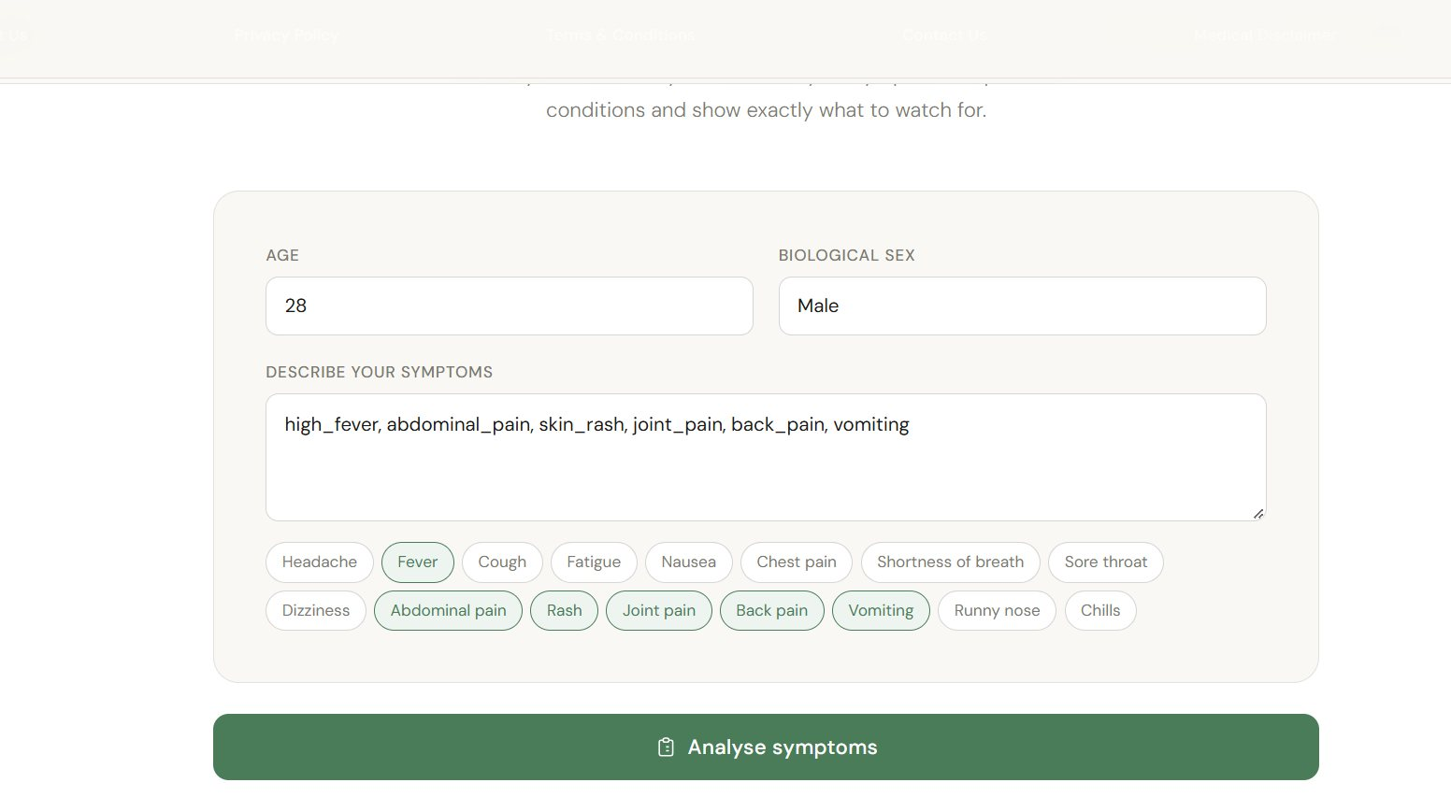
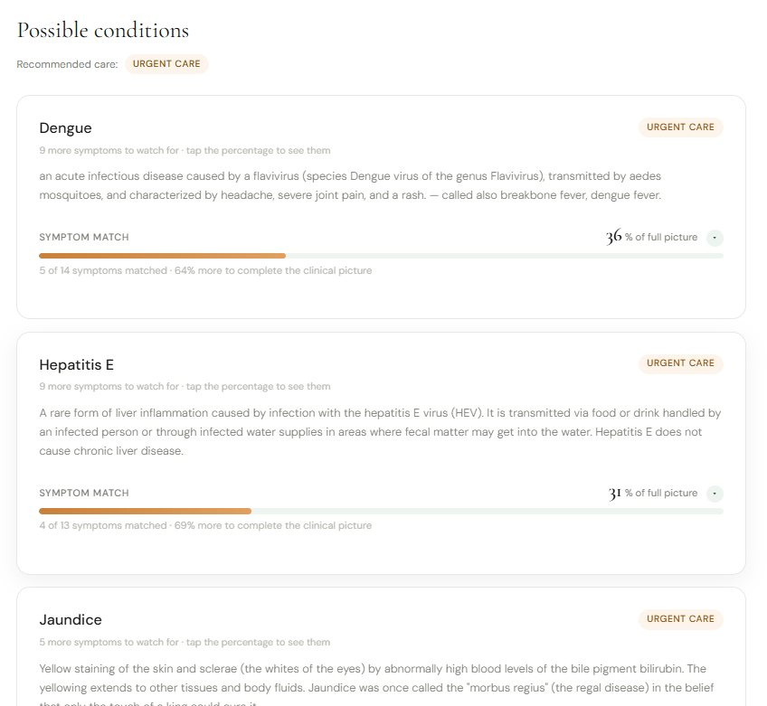
Symptom checker: end to end
Flow
Normalize symptoms → proxy /predict → ML model → top 5 conditions with match % and triage level → render.
Fallback
If nothing matches or the ML service fails, the proxy /chat asks the LLM for safe general guidance.
Honest limit
Age and sex are collected but not sent to the model.
Input: age, sex, symptoms
Results
Input
Age, sex, symptoms
Normalize
Aliases to snake_case
Proxy /predict
Relay to FastAPI
Model + triage
Top 5 + match %
Render or fallback
LLM if no match
→
→
→
→
Output is a symptom match score, not a diagnosis; every result page carries a medical disclaimer.
Notes:
Core feature: explain the fallback chain.

Slide 6
ML engine
Data
4,920 rows → 304 unique after removing duplicates (94% were copies). 41 diseases, 132 symptoms.
Features
Binary symptom vector multiplied by a severity weight (128 of 132 symptoms have one).
Model
MultinomialNB, alpha = 10, fast and probabilistic on small data.
Measured accuracy
94.4% on training rows, 92.9% (39 of 42) on the provided test file. Test set is tiny, so this is not clinical validation.
Triage rules
5 emergency and 2 urgent red-flag rules run before the model result.
Serving
FastAPI /predict, /triage, /symptoms, /health in a Docker image.
Notes:
Numbers were reproduced locally from the repo data.

Slide 7
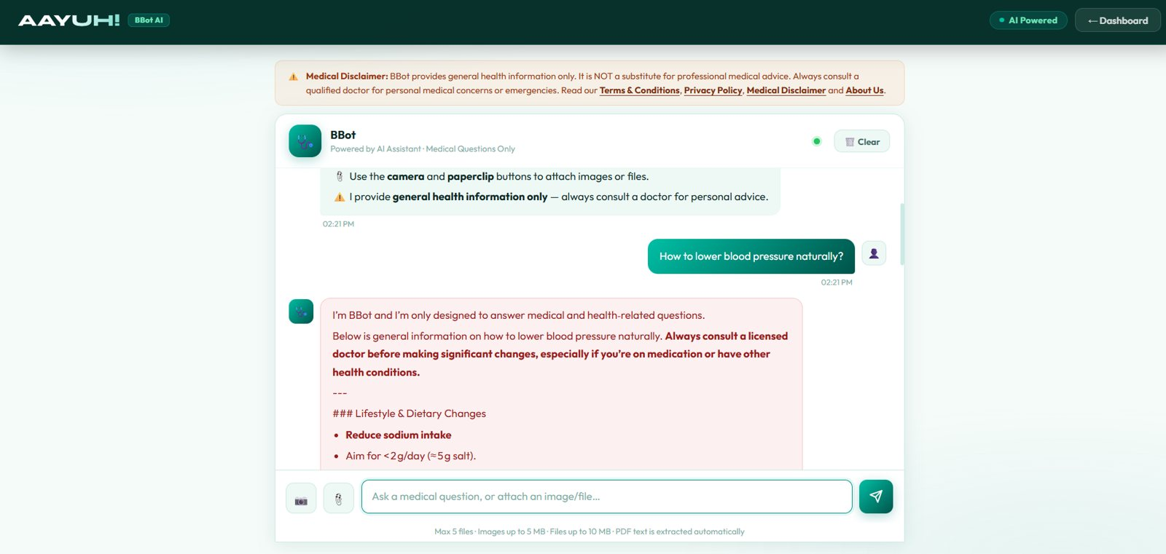
AI features and guardrails
BBot chatbot
System prompt limits topics to health and adds a disclaimer; keeps last 20 messages; extracts PDF text.
Medicine finder
openFDA label + LLM JSON summary; Indian brand names mapped to generics.
BBot answers medical questions only
Limit
Attached images are not analysed. Only the file names are sent to the model.
Find doctors
LLM suggests places on a Leaflet map. Names and coordinates are not verified.
Notes:
Be upfront that Find Doctors is LLM generated.

Slide 8
Data, authentication and security
Store | Used for
Firebase Auth | Email/password login, LOCAL persistence
Firestore | users, medical_history, emergencyContacts, userSettings
Firebase Storage | Report files at reports/{uid}/...
Supabase | Pharmacy products, admin access log
localStorage | Profile cache, steps, chat history
Done well
Groq key stays on the server; disclaimers; cookie banner; per-user storage paths.
Fix before interview
Hard-coded pharmacy admin password in client code; open /chat endpoint with no rate limit; Firestore rules are not in the repo.
Notes:
Security gaps are listed in detail in deck 06.

Slide 9
Technical challenges and solutions
Challenge | Problem → Implementation → Result
Hiding the LLM key | Browser calls would expose it → Node proxy holds GROQ_API_KEY → keys never ship to the client
Duplicate-heavy dataset | 94% of rows were copies → drop_duplicates before training → 304 unique rows
Misleading probabilities | Raw percentages confuse users → show matched/profile symptom match + remaining symptoms
Safety | A model can miss emergencies → rule-based red-flag triage runs first → emergency or urgent labels
Free-tier sleep | Idle servers add delay → keep-alive ping every 14 min and /health endpoint
Service failure | ML or unknown symptoms → fall back to LLM with a no-diagnosis prompt → user always gets guidance
One codebase, 3 platforms | Web, PWA, Android → Capacitor wraps the same files; Capgo OTA updates
Multi-file reports | Several files per visit → shared group_id across Firestore docs + resumable uploads
Notes:
Problem, implementation, result. No invented metrics.

Slide 10
Interview questions and future work
Frontend
1 Why multi-page vanilla JS? 2 How does the PWA work? 3 How is auth enforced on pages? 4 How is it responsive?
Backend and ML
5 Why a proxy? 6 Why Naive Bayes? 7 How is triage decided? 8 How do you handle ML downtime?
Data
9 Firestore schema? 10 How are reports stored? 11 Why Firebase and Supabase?
Security
12 Where are secrets? 13 What would you fix first? 14 How is health data protected? 15 How do you limit AI risk?
Future: Firestore rules and tests, rate limiting, doctor data from OpenStreetMap, age/sex-aware model, reminders, multilingual UI, CI/CD
Thank You Live Demo | GitHub
Notes:
Full answers are in the Q&A deck.

