Slide 1
AAYUH · INTERVIEW DEEP-DIVE
Frontend, PWA and Android
A multi-page vanilla JavaScript app packaged as website, PWA and Android app
Frontend architecture and page map
PWA and service worker
Auth guards and navigation
Device sensors: steps and heart rate
Screens tour
Honest improvements
P. Bharath Kumar · Student ID 2400030010 · aayuh.vercel.app · github.com/bharathkumar1904/AAYUH-
Notes:
Cover. Say what this deck covers and that every detail comes from the repository.

Slide 2
Frontend architecture
Multi-page static app
21 HTML pages at the repo root (22 in www/). No framework, no bundler, no build step.
Self-contained pages
Each page carries its own CSS and JavaScript, plus its own Firebase setup where needed. Shared: style.css, script.js, backbutton.js.
Biggest pages
Blog 1,724 lines, dashboard 1,614, pharmacy 1,011, profile 897, medicines 762, symptoms 746.
Libraries by CDN
Firebase SDK, Supabase JS v2, Leaflet maps, pdf.js, Google Fonts.
Why this approach
Fast to build, works as static hosting, and Capacitor can wrap the same files into an Android app.
Trade-off
Repeated code across pages and no shared components. A framework would reduce duplication.
Notes:
Explain the pragmatic choice and its cost.

Slide 3
Page map
Page | Purpose | Data source
index / home / register | Landing, login, sign up | Firebase Auth
dashboard | Quick access, trackers, daily tips | Firestore, sensors
symptoms | Symptom checker | Proxy: ML, then LLM
medicines | Medicine information | openFDA + LLM
disease | Disease lookup | Wikipedia + LLM
ChatBot | BBot health assistant | LLM via proxy
medical history | Report vault | Firestore + Storage
Emergency | SOS contacts | Firestore
Find Doctors | Map of nearby care | Nominatim + LLM + Leaflet
pharmacy | Product browse and cart | Supabase
Notes:
Know which backend each page talks to.

Slide 4
PWA and offline
manifest.json
display: standalone
theme_color: #00796B
orientation: portrait
service-worker.js
cache: aayuh-cache-v1
strategy: cache-first
files: index, home, dashboard,
manifest, 2 icons
Installable
Web App Manifest makes the site installable with a standalone window.
Registration
script.js registers the worker and handles an update message (skipWaiting).
Limit
Only 6 files are pre-cached, so most pages need the network. Deeper offline support is future work.
Say: "The PWA basics are in place; full offline mode is an improvement, not a claim."
Notes:
Be precise about what offline means here.

Slide 5
Auth guards and navigation
Login
Firebase signInWithEmailAndPassword with LOCAL persistence, so sessions survive restarts. Password reset by email.
Page guard
Protected pages call onAuthStateChanged and redirect to index.html when no user is signed in.
Admin view
Dashboard shows an admin list only when the ID token has the claim role = admin.
Android back button
backbutton.js and an exit dialog use the Capacitor App plugin to exit cleanly.
Consent
A cookie banner and legal pages (privacy, terms, disclaimer) are included.
Caveat
Client-side guards are only UX. Real protection must come from Firebase security rules.
Notes:
Guards hide pages; rules protect data.

Slide 6
Device sensors on the dashboard
Steps
devicemotion accelerometer; iOS permission prompt
Heart rate
Rear camera, red-channel variance (PPG)
Blood pressure
Manual entry or estimate from HR
Sync
localStorage + Firestore users/{uid}.health
→
→
→
Daily reset
Steps reset at midnight; a goal can be set and is saved to the profile.
Test button
A +10 test button simulates steps on desktop so the logic can be demonstrated.
Safety wording
The page states camera estimation is not medically accurate and advises a certified BP cuff.
Notes:
Sensors are approximations; the disclaimers matter.

Slide 7
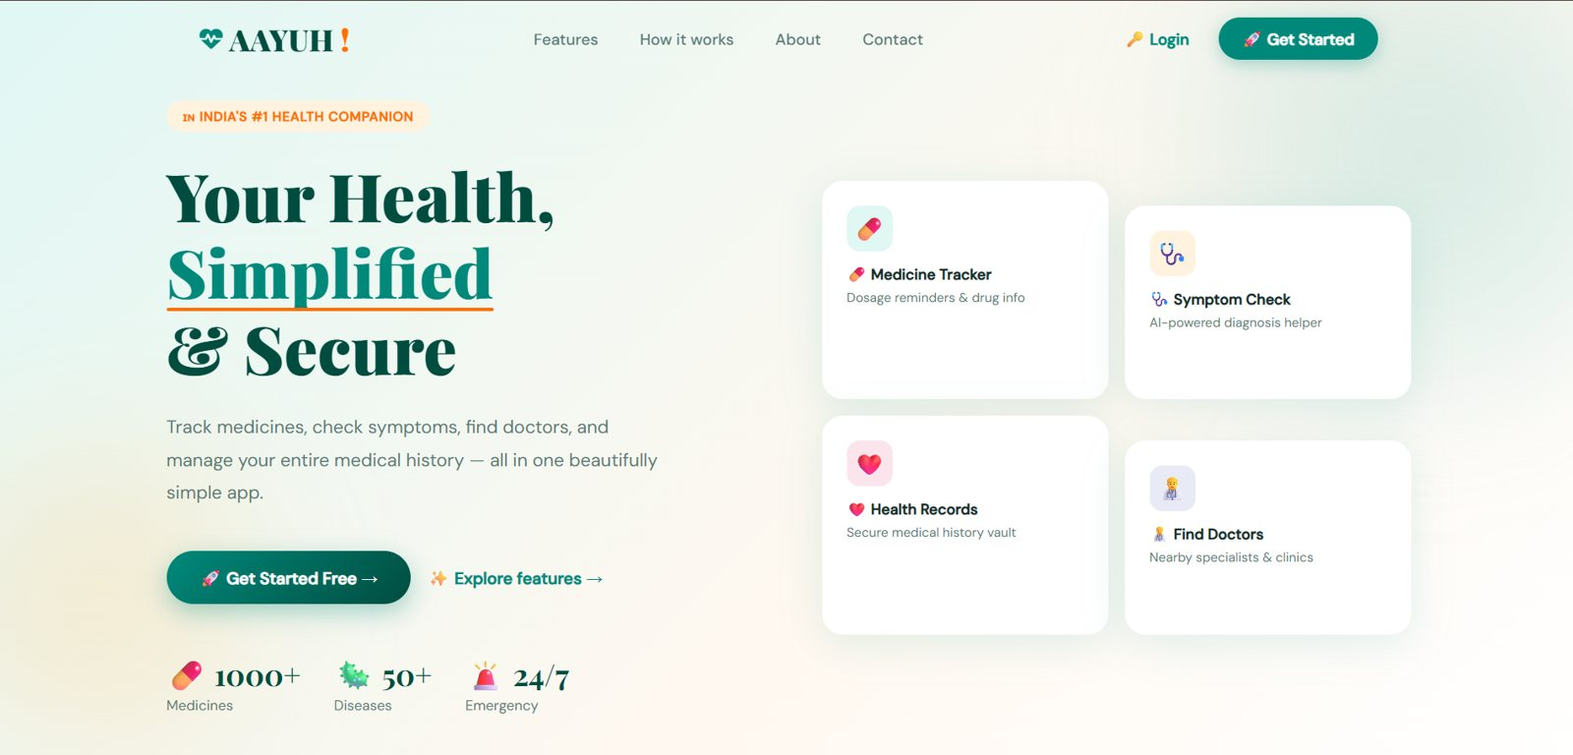
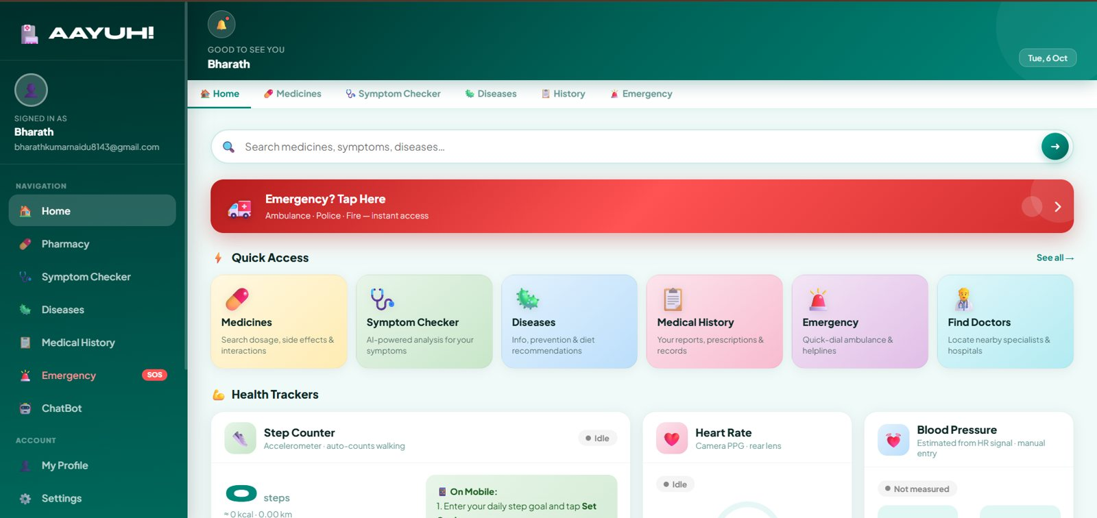
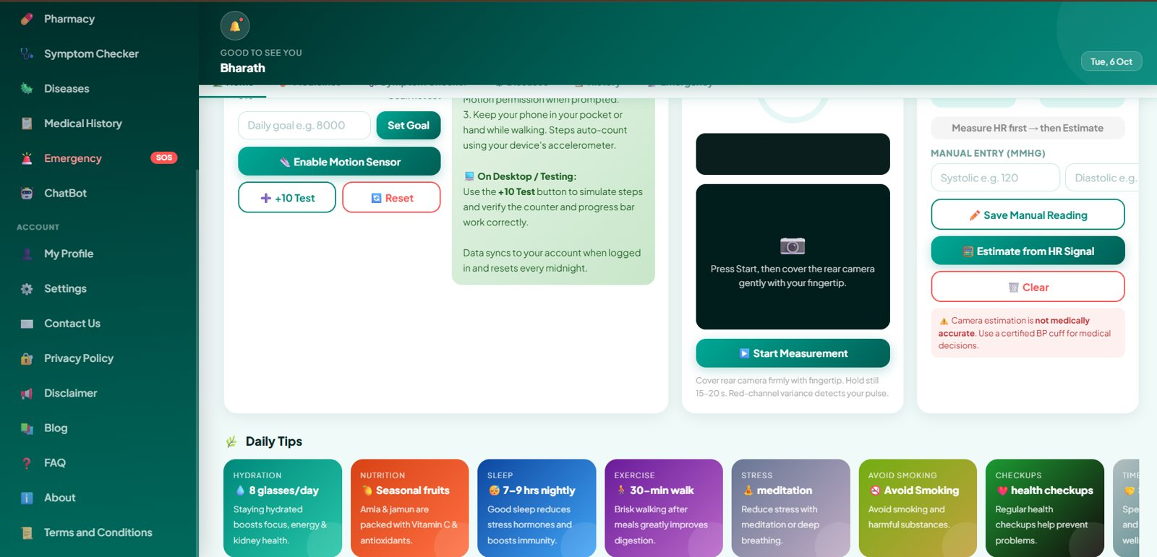
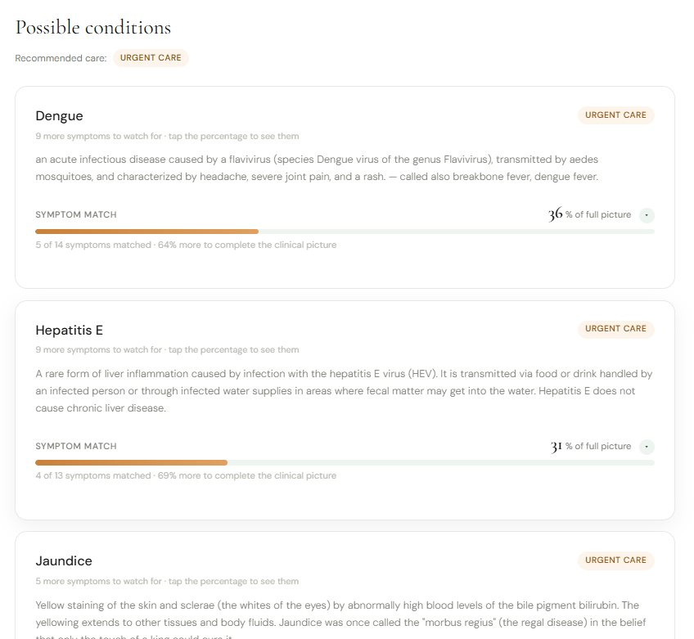
Screens tour
Landing
Dashboard
Notes:
Use for a live demo.

Slide 8
Honest improvements
Duplicate folders
Root and www/ copies of pages have drifted apart. Use one source and copy at build time.
Mixed Firebase SDKs
Some pages use v9 compat and others v10 modular. Standardize on one.
Escape dynamic HTML
symptoms.html has escapeHtml; other pages build HTML strings directly. Apply escaping everywhere.
Shared components
Move repeated header, auth and styles into shared modules or adopt a framework.
Offline depth
Cache more pages and add an offline fallback page.
Tests
Add Playwright flows for login, symptom check and history upload.
Notes:
Name weaknesses before the interviewer does.

