Slide 1
AAYUH · INTERVIEW DEEP-DIVE
AI and LLM Integration
Where the Groq-hosted LLM is used, how prompts are guarded, and what can go wrong
AI feature map
Request path and the model question
BBot chatbot
Medicine finder
Prompt patterns
Risks and mitigations
P. Bharath Kumar · Student ID 2400030010 · aayuh.vercel.app · github.com/bharathkumar1904/AAYUH-
Notes:
Cover. Say what this deck covers and that every detail comes from the repository.

Slide 2
AI feature map
Feature | What the LLM does | Guardrail in the code
BBot chatbot | Answers health questions, reads PDF text | System prompt: medical topics only, always advise a doctor
Medicine finder | Turns a drug name into usage, dosage, timing, side effects (JSON) | Low temperature, FDA label as backup, disclaimer
Symptom fallback | Plain guidance when the ML model has no match | Rules: no diagnosis, no medicine names or doses
Disease lookup | Prevention, diet and warning tips beside Wikipedia text | Educational-only banner on the page
Find doctors | Suggests clinics, hospitals and pharmacies as JSON for map pins | Only a disclaimer; names and places are not verified
Notes:
Know all five uses.

Slide 3
Request path and the model question
Page
Builds messages, temperature, max_tokens
Proxy /chat
Adds key and model from env
Groq
OpenAI-compatible chat completions
Page
Reads choices[0].message.content
→
→
→
Model mismatch
Pages send llama-3.3-70b-versatile and the README says Llama 3.3-70B, but the proxy ignores the client model and uses GROQ_MODEL (default openai/gpt-oss-20b).
What to say
The server decides the model through an environment variable. Check the value on Render before the interview.
Typical settings
Temperature 0.3 to 0.4; max_tokens from 700 to 1,400 depending on the feature.
Notes:
The server-side model choice is a good design point.

Slide 4
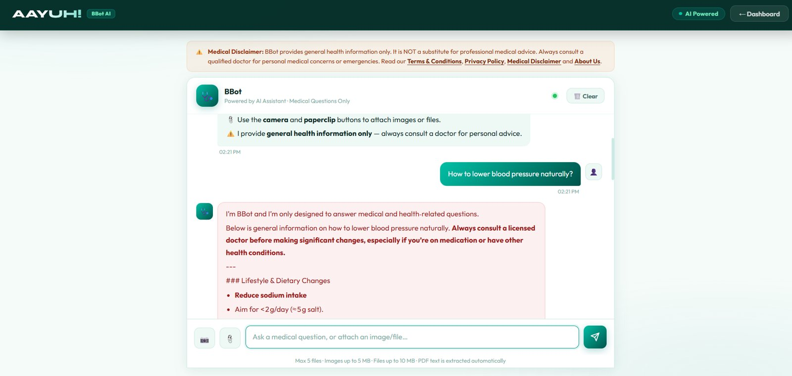
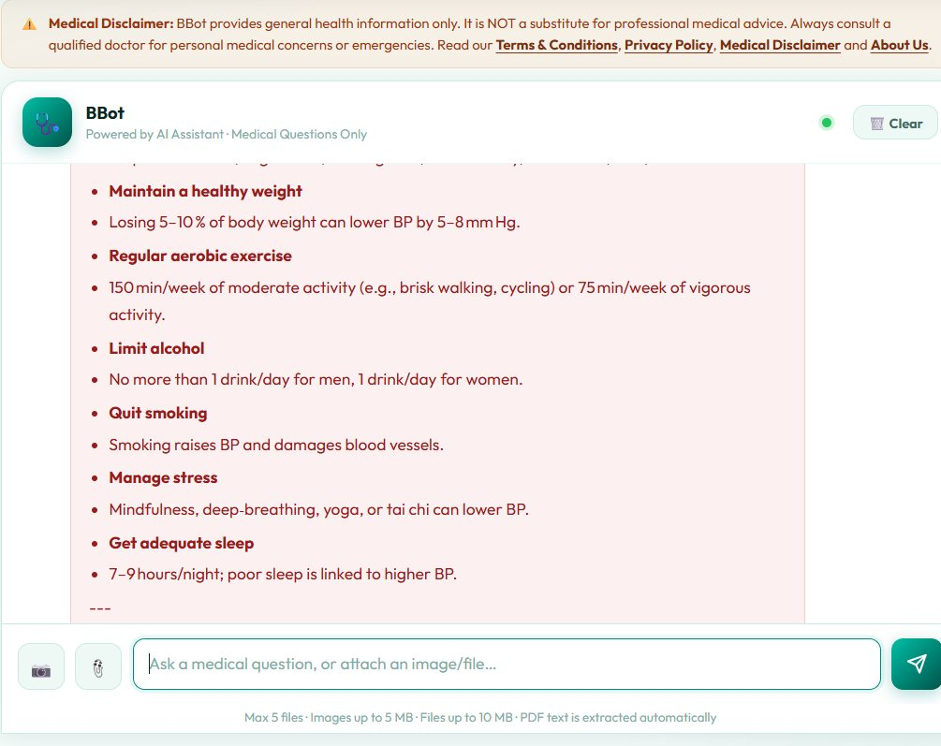
BBot chatbot
System prompt
Only medicine and health topics; off-topic gets a fixed refusal; always remind users to see a licensed doctor.
Memory
Last 20 messages in localStorage (aayuh_bbot_history).
Medical-only assistant with disclaimer
Attachments
Max 5 files; images 5 MB, files 10 MB. PDFs are read with pdf.js (20 pages, 6,000 characters).
Limit
Images are not analysed. Only their file names go into the prompt.
Notes:
Describe the system prompt rules.

Slide 5
Medicine finder
Input
Brand or generic name
Brand map
Dolo 650 to paracetamol
openFDA
Label lookup, 6 s timeout
LLM JSON
Patient-friendly fields
Merge
ai.usage or FDA usage
→
→
→
→
Parallel calls
The FDA request starts first and runs while the LLM is called; the LLM is retried once if it returns nothing.
Fallback order
Use the AI usage text, otherwise the FDA text, otherwise Information not available.
Why a brand map
Indian brand names are not in the US FDA database, so common ones are mapped to generics.
Notes:
FDA data is US labelling, not Indian regulation.

Slide 6
Prompt patterns used
Role + rules
You are a medical information assistant, then numbered rules: do not diagnose, never name doses.
JSON-only output
Medicine and doctor prompts demand a JSON object and no markdown. The page extracts it with a regex and JSON.parse.
Length limits
Prompts cap output (for example under 180 words) and use plain headings.
Low temperature
0.3 to 0.4 for steadier, less creative answers.
Fixed refusal
Off-topic questions get one exact sentence, which the page detects to style it.
Weakness
Regex JSON parsing breaks on odd output. Use a JSON mode or schema validation.
Notes:
Show you know prompts are code.

Slide 7
Risks and mitigations
Risk | Where it shows up | Mitigation
Hallucination | Find doctors can invent names, addresses and coordinates | Use OpenStreetMap Overpass data, show it as unverified
Medical harm | Chat or medicine text read as advice | Disclaimers, no doses, triage rules, red-flag wording
Prompt injection | Text inside an uploaded PDF reaches the prompt | Separate system and user content, filter outputs
Privacy | Symptoms and report text sent to a third-party LLM | Tell users, redact identifiers, review provider terms
Abuse and cost | Open /chat endpoint | Rate limits, app token, model allow-list
Notes:
Responsible AI is a strong interview topic.

Slide 8
Improvements
Ground answers
Retrieval from trusted sources such as MedlinePlus with citations.
Real doctor data
Query OpenStreetMap or a verified directory instead of free-form LLM output.
Output checks
Schema validation and a safety filter on every reply.
Image support
Use a vision-capable model, or remove the image attach button.
Evaluate
Test sets for refusal behaviour and unsafe prompts.
Cost control
Caching common medicine lookups.
Notes:
Prioritise grounding.

