Slide 1
AAYUH · INTERVIEW DEEP-DIVE
Data, Auth and Storage
Firebase for users and records, Supabase for pharmacy, localStorage for caches
Data architecture
Firebase Authentication
Firestore collections
Medical history upload flow
Supabase pharmacy
Rules and improvements
P. Bharath Kumar · Student ID 2400030010 · aayuh.vercel.app · github.com/bharathkumar1904/AAYUH-
Notes:
Cover. Say what this deck covers and that every detail comes from the repository.

Slide 2
Data architecture
Firebase Auth
Email and password accounts, session persistence, password reset.
Firestore
Profiles and health data, report metadata, emergency contacts, user settings.
Firebase Storage
The actual report files under reports/{uid}/.
Supabase
Pharmacy products and an admin access log. Added for the shop page.
localStorage
Profile cache, daily steps, last readings, chat history.
Why two backends
The pharmacy page was built separately. Consolidating on one backend would simplify security.
Notes:
Be honest that two backends is a trade-off.

Slide 3
Firebase Authentication
register.html
password min 6 chars + strength bar
createUserWithEmailAndPassword
home.html (login)
setPersistence(LOCAL)
signInWithEmailAndPassword
sendPasswordResetEmail
protected pages
onAuthStateChanged -> redirect
to index.html if no user
Admin role
The dashboard reads the ID token claims. When role is admin it shows a user list. Setting that claim needs a trusted backend or the Admin SDK.
SDK versions
Pages mix Firebase 9.23 (compat) and 10.x (modular).
Public config
The Firebase web config in pages is public by design; security comes from rules.
Notes:
Public config is normal for Firebase.

Slide 4
Firestore collections
Collection | Key fields | Written by
users/{uid} | name, profile fields, stepGoal, health { steps, heartRate, bp, lastUpdated } | dashboard, profile
medical_history | group_id, user_id, user_email, title, description, doctor, date, file_url, file_path, file_type, timestamp | medical history page
emergencyContacts | userId, name, phone | Emergency page
userSettings/{uid} | preference fields | settings page
Queries filter by user_email or user_id. Using only the uid is safer because emails can change.
Notes:
Know the schema.

Slide 5
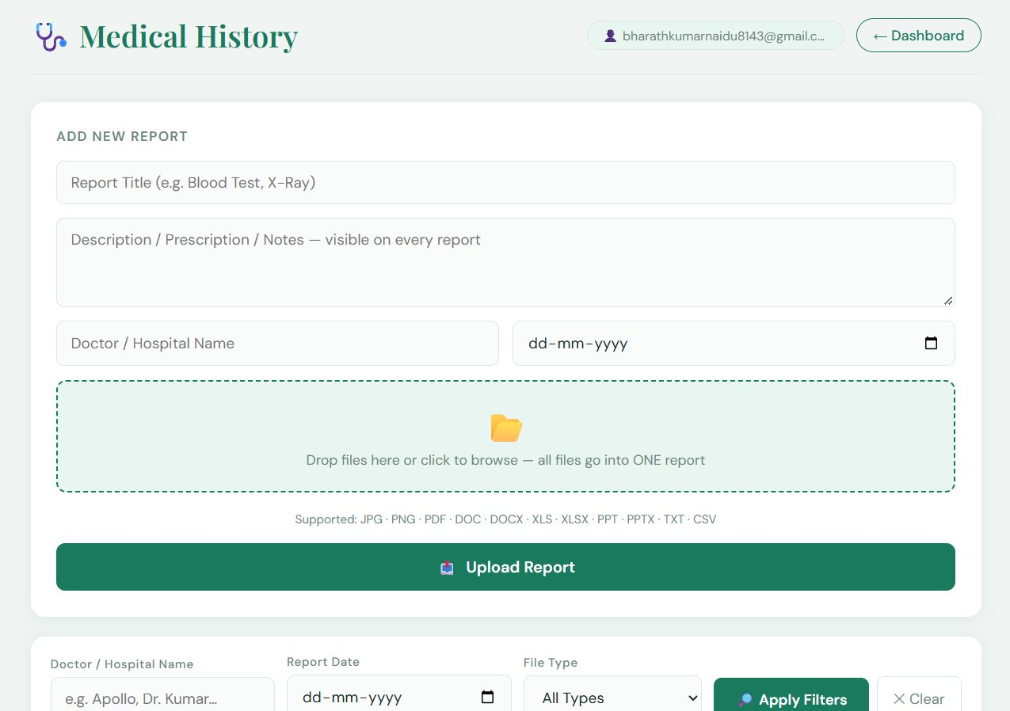
Medical history upload flow
Why group_id
Several files belong to one visit. The list view groups them back into a single report.
Read side
Query by user and order by timestamp; fallback queries exist when an index is missing.
Formats listed
JPG, PNG, PDF, DOC(X), XLS(X), PPT(X), TXT, CSV. No size limit is enforced in the page.
Add report form
Pick files
Drag and drop, many files
group_id
One id for all files
Upload
uploadBytesResumable with progress
URL
getDownloadURL
Save
One Firestore doc per file
→
→
→
→
Notes:
Explain grouping.

Slide 6
Supabase pharmacy
Products
Loads the products table. If it is empty, it inserts 10 seed items.
Shop
Category chips, search, in-memory cart, and Buy buttons that open affiliate links.
Admin access log
Each admin login attempt stores IP, city, country, browser and result using the ipapi.co service.
Serious issue
The admin password is a constant in the page script, so anyone can read it. Replace it with Supabase Auth and row-level policies.
Notes:
This is the first thing to fix.

Slide 7
Rules and improvements
Security rules
Firestore and Storage rules are not in the repository. Add them: users read and write only their own documents and files.
Use uid keys
Replace email-based queries with user_id everywhere.
Limits
Enforce file size and type in Storage rules.
Privacy features
Account deletion, data export and retention rules.
One backend
Move pharmacy products to Firestore or move everything to Supabase.
Backups
Scheduled exports and a restore test.
Notes:
Rules are the real security layer.

