Slide 1
AAYUH · INTERVIEW DEEP-DIVE
Features Walkthrough
A screen-by-screen tour with the code behind each feature
Landing and accounts
Dashboard and trackers
Symptom checker
Disease and medicine information
Medical history and emergency
Chatbot, pharmacy and profile
P. Bharath Kumar · Student ID 2400030010 · aayuh.vercel.app · github.com/bharathkumar1904/AAYUH-
Notes:
Cover. Say what this deck covers and that every detail comes from the repository.

Slide 2
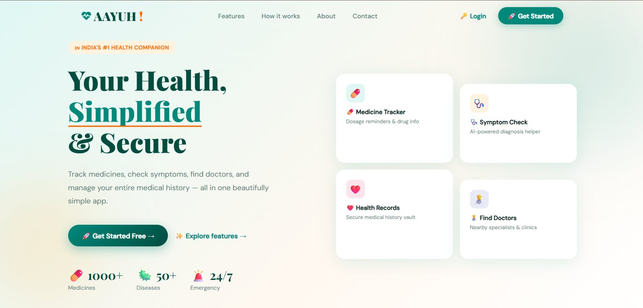
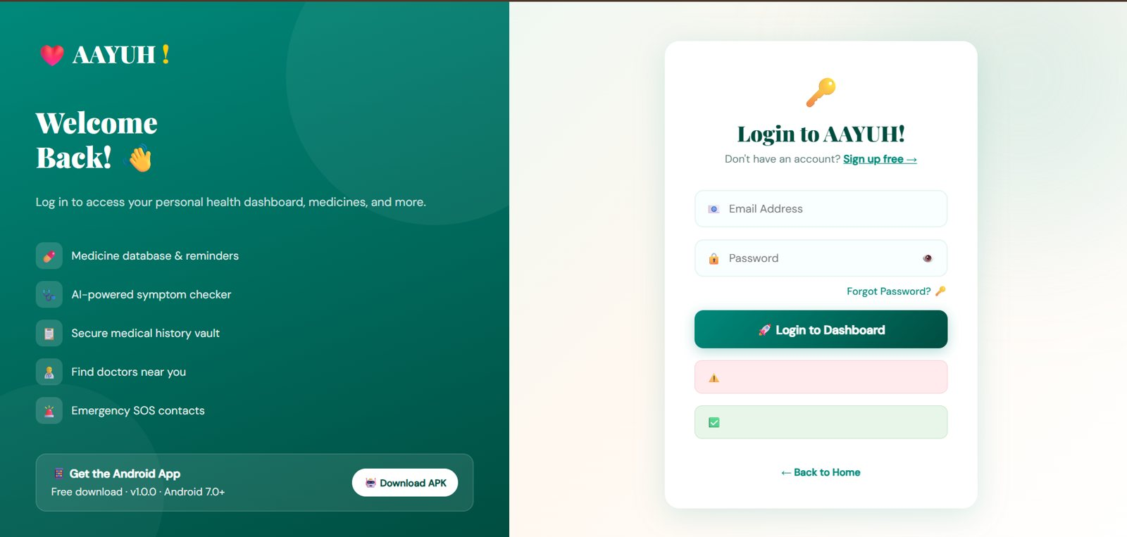
Landing and accounts
Landing page
Login with APK download
Accounts
Email and password via Firebase; sign up checks a 6-character minimum with a strength bar.
Android download
The login page links the APK (v1.0.0, Android 7.0+).
Reset
Forgot password sends a reset email.
Notes:
Start the demo here.

Slide 3
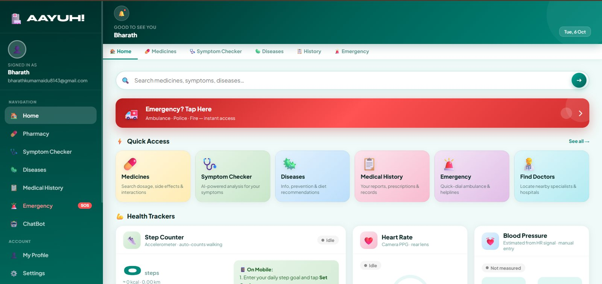
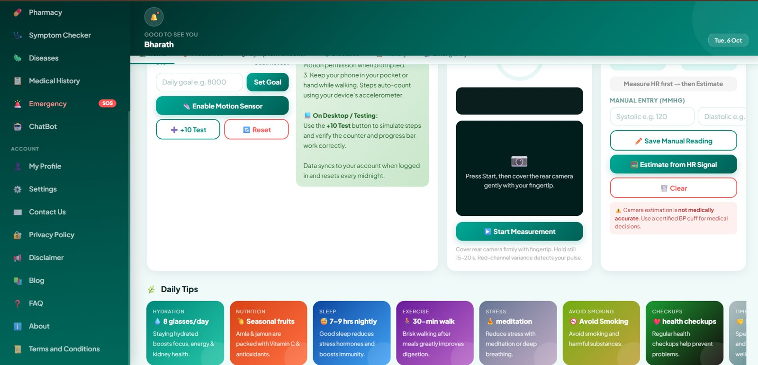
Dashboard and trackers
Quick access and trackers
Steps, heart rate, blood pressure
Quick access
Six tiles: Medicines, Symptom Checker, Diseases, Medical History, Emergency, Find Doctors, plus a red emergency banner.
Trackers
Accelerometer steps, camera heart rate, manual or estimated BP.
Daily tips
Hydration, nutrition, sleep, exercise and more as cards.
Notes:
Mention the accuracy disclaimers.

Slide 4
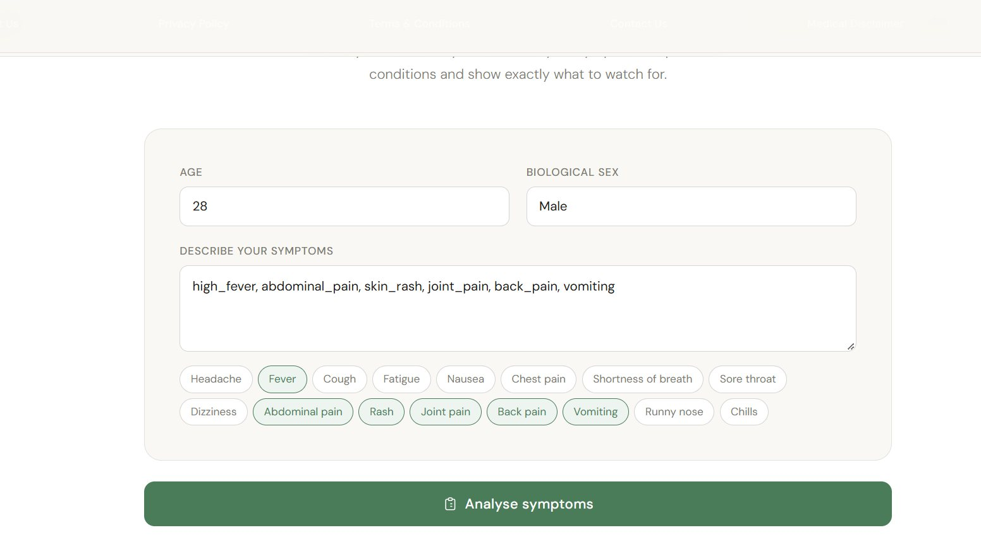
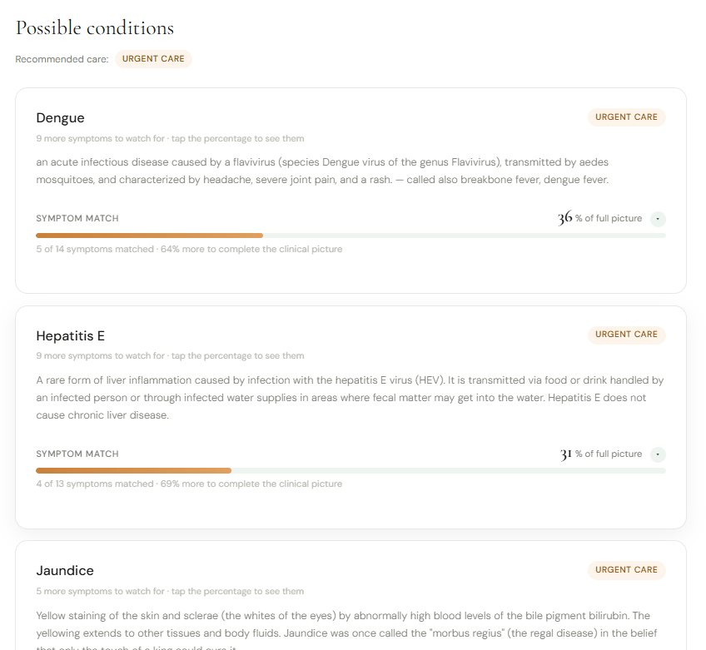
Symptom checker
Describe symptoms or tap chips
Conditions with match % and care level
Input
Age, sex and free text or quick chips.
Output
Up to 5 conditions, symptom match %, remaining symptoms to watch, and a care badge.
Fallback
LLM guidance when the model has no match.
Notes:
This is the signature feature.

Slide 5
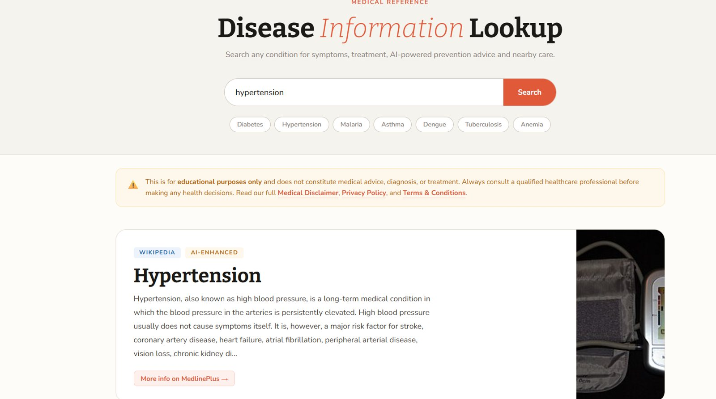
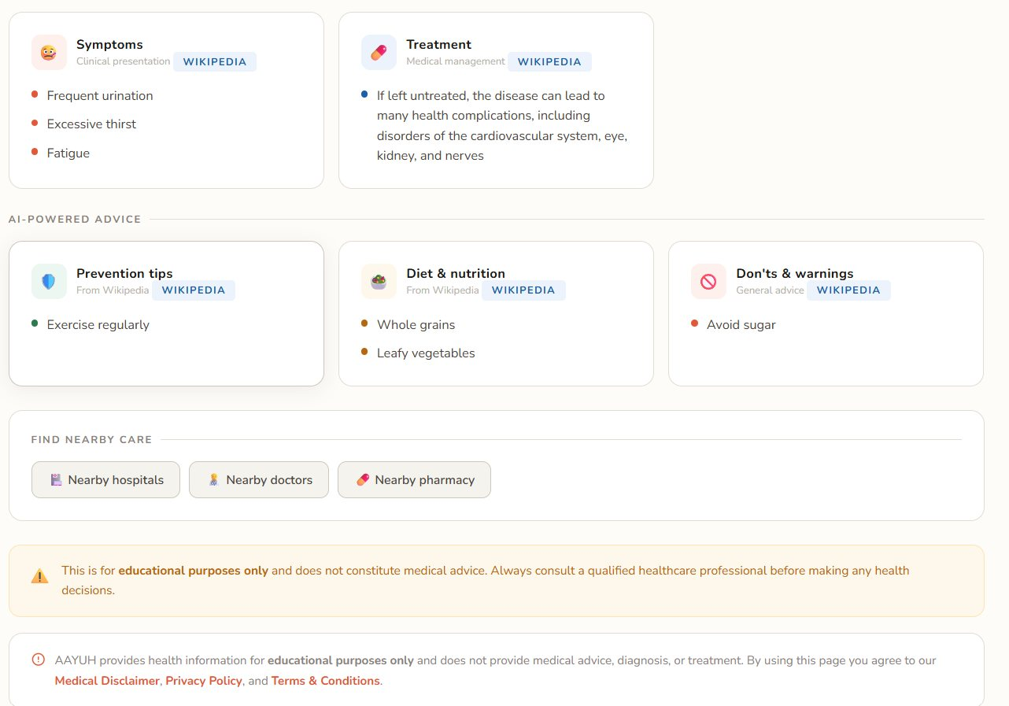
Disease information
Search a condition
Symptoms, treatment, prevention, diet
Source
Wikipedia page summary, plus AI-generated tips under AI-powered advice.
Nearby care
Buttons for hospitals, doctors and pharmacies.
Label issue
AI tips are tagged Wikipedia in the UI. Relabel them as AI-generated.
Notes:
Point out the labelling issue yourself.

Slide 6
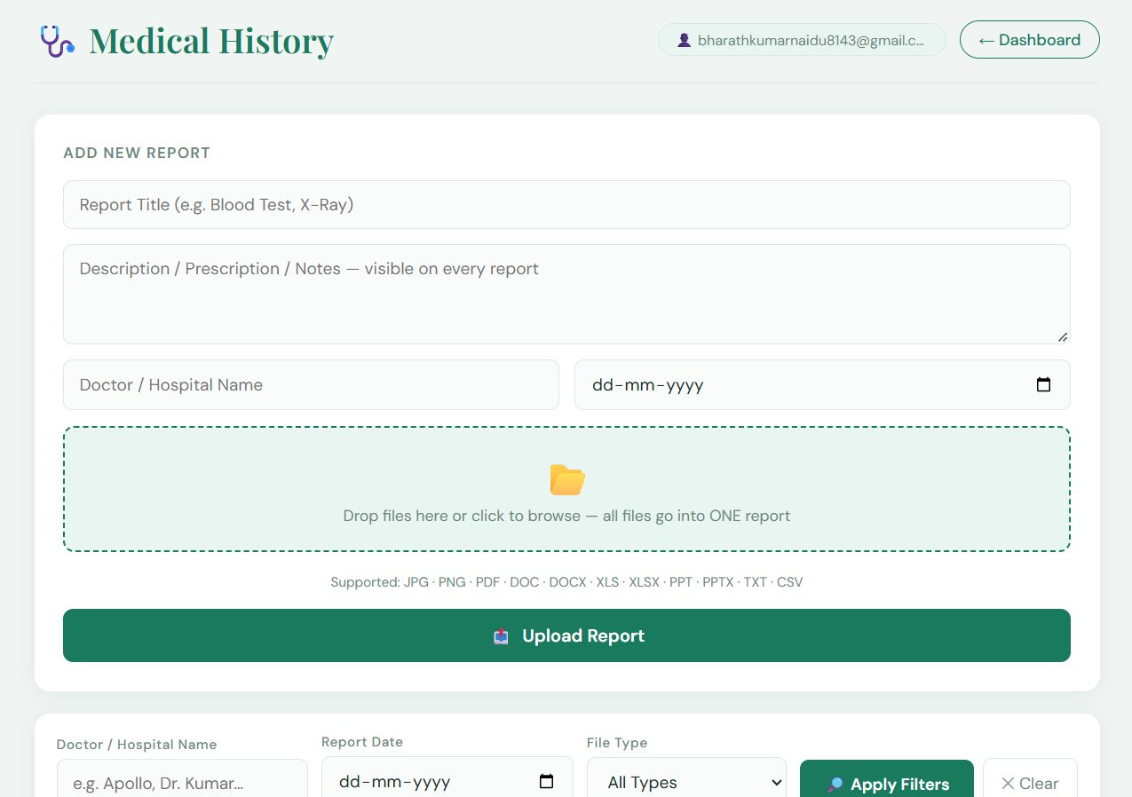
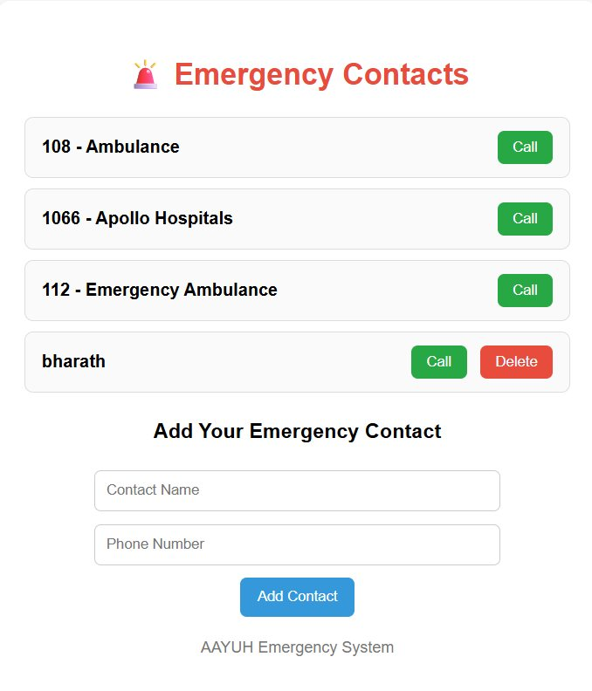
Medical history and emergency
History
Many files become one report; filters by doctor, date and type; files stored in Firebase Storage.
Emergency
Default numbers (108, 1066, 112) plus user contacts with a Call button, stored per user.
Upload reports and filter by doctor, date, type
Emergency contacts
Privacy note: reports are health data, so Firestore and Storage rules must restrict access to the owner.
Notes:
Link to the security deck.

Slide 7
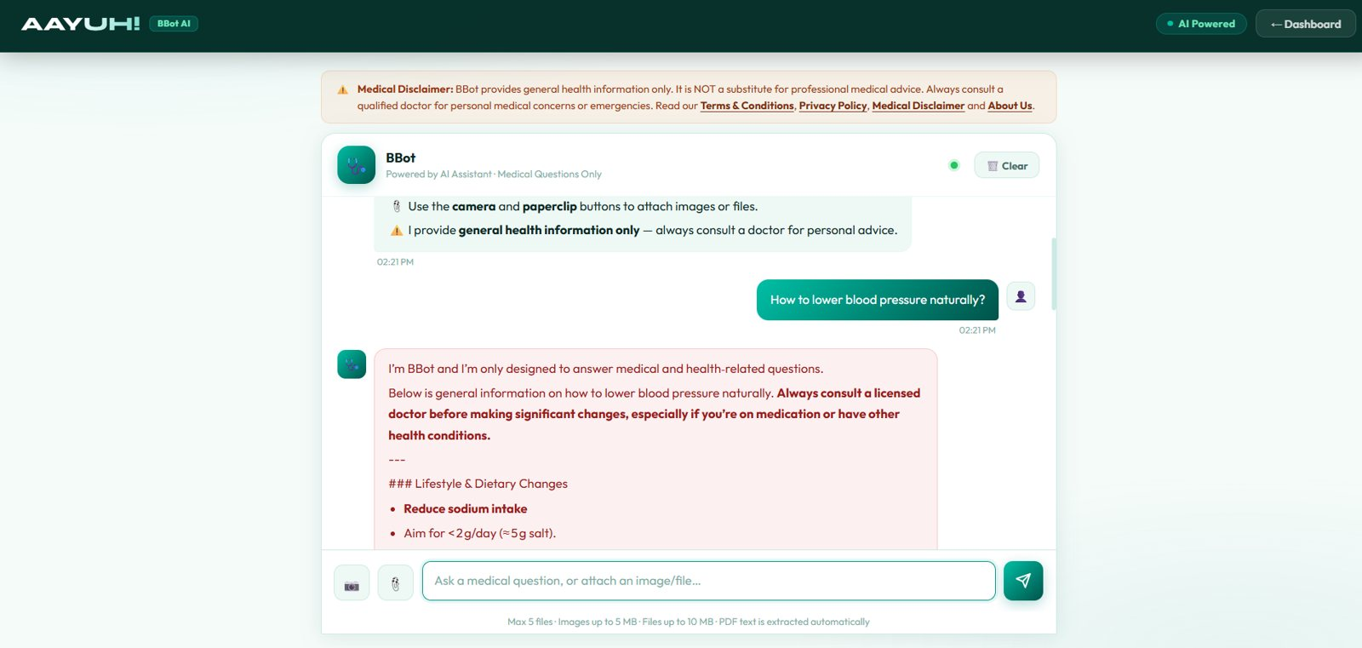
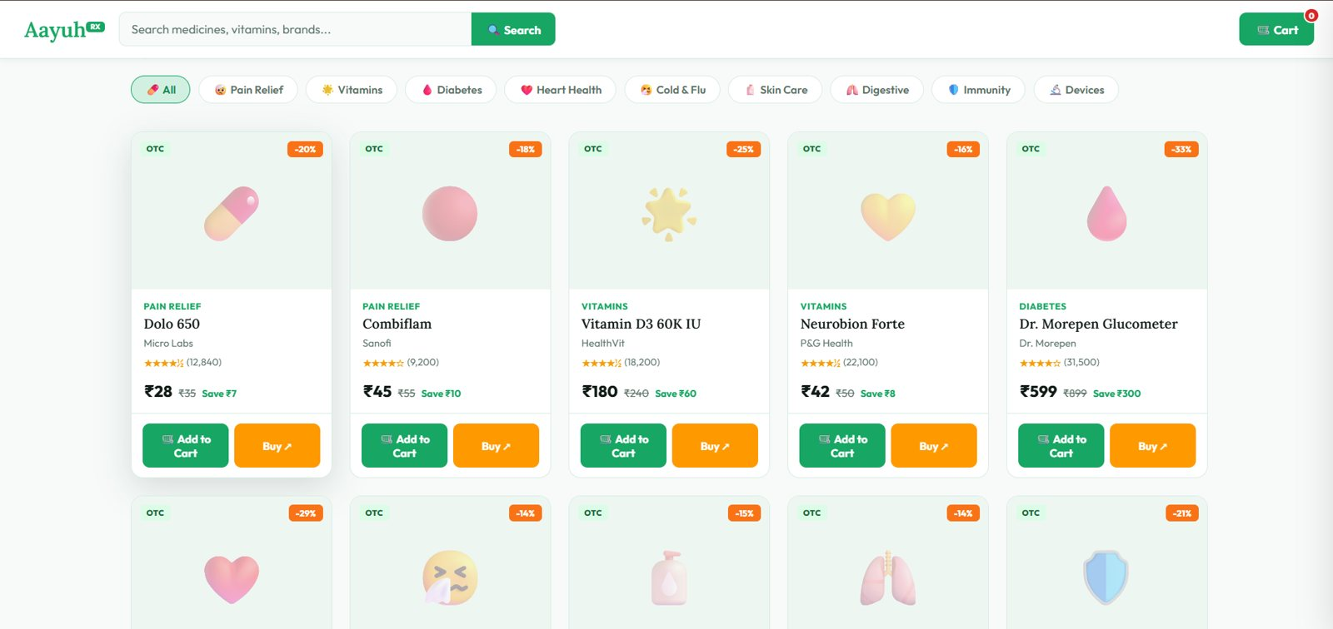
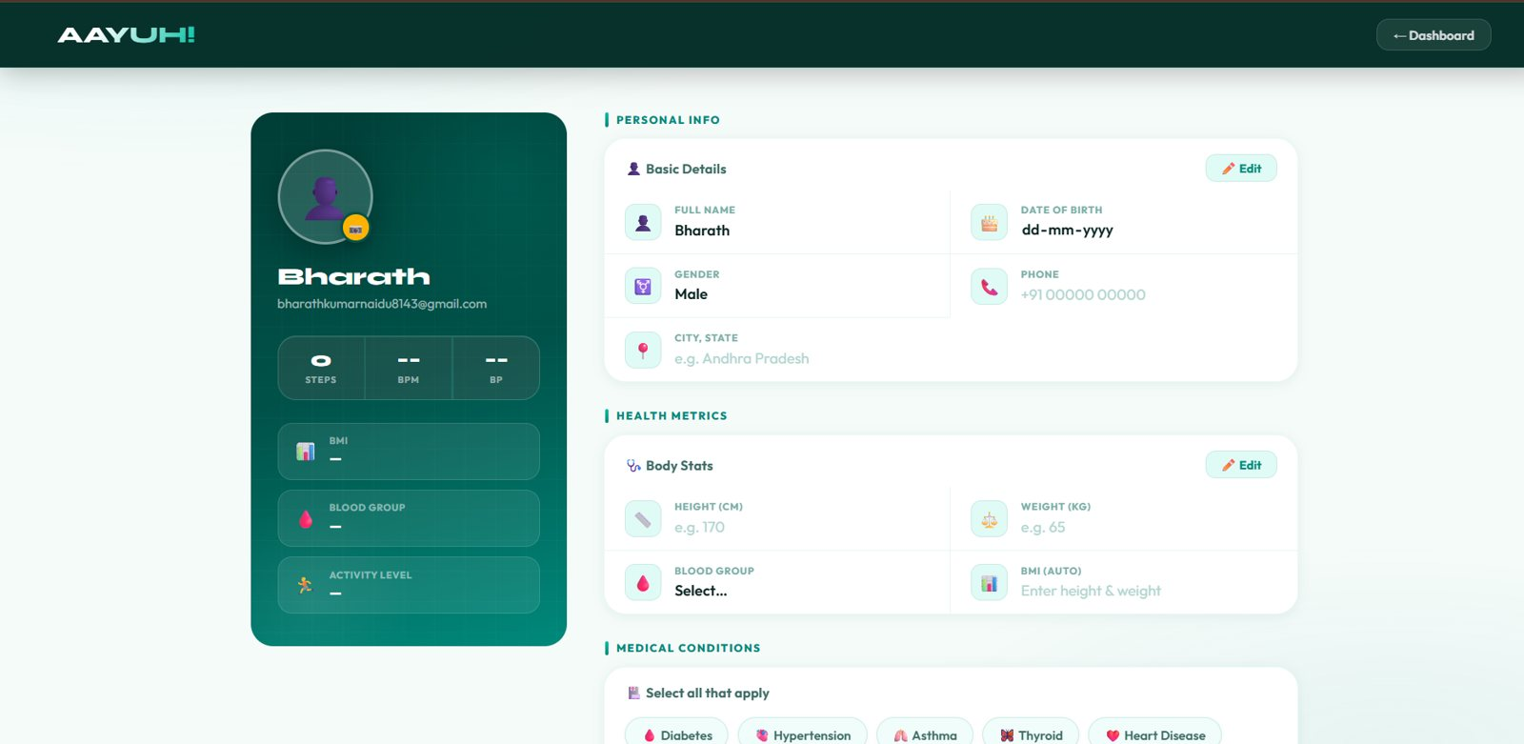
Chatbot, pharmacy and profile
BBot
Aayuh Rx pharmacy
Profile
BBot
Medical-only answers, attach PDFs and files, clear history.
Pharmacy
10 seeded products, categories, cart, buy links. Data in Supabase.
Profile
Basics, height and weight with auto BMI, blood group, conditions, activity level, emergency contacts.
Notes:
Quick tour of the rest.

