Slide 1
SASI ARTS · INTERVIEW DEEP-DIVE
Frontend Architecture
Vanilla JavaScript single-page storefront: state, rendering, UI
Why no framework
Code structure and script order
State management with localStorage
Rendering and data loading pipeline
Responsive design and performance
Honest improvements
P. Bharath Kumar · Student ID 2400030010 · sasi-arts.vercel.app · github.com/bharathkumar1904/sasi-arts
Notes:
Cover. Say what this deck covers and that every detail comes from the repository.

Slide 2
Why a no-framework single-page app
Decision
HTML5, CSS3 and ES6 JavaScript only. No React, no bundler, no build step.
Reasons
Small catalogue with simple interactions. Easy to edit and deploy. Search engines read plain HTML.
Trade-off
DOM updates are manual and app.js is large (1,863 lines). A component framework would scale better.
Script order
config.js → data.js → supabase.js → app.js, each versioned with ?v=34 for cache-busting.
CDN libraries
Razorpay Checkout, EmailJS browser SDK, Font Awesome 6.5, Google Fonts (Playfair Display, Poppins).
How to say it
"I chose the simplest tool that fits the problem, and I can explain exactly when I would move to React."
Notes:
Lead with the reasoning. Interviewers want to hear trade-offs, not framework names.

Slide 3
Code structure
File | Lines | Responsibility
index.html | 797 | Storefront markup: all sections, modals, drawers in one page
css/style.css | 1,584 | All storefront styling, media queries, animations
js/config.js | 43 | Store settings, public keys, categories, tax and API base URL
js/data.js | 47 | Sample products, gallery items and reviews (offline fallback)
js/supabase.js | 307 | REST client for Supabase, storage upload, CRUD helpers
js/app.js | 1,863 | State, rendering, cart, checkout, payment, tracking, forms
admin/index.html + admin/js/admin.js | 1,145 (JS) | Separate admin panel, loaded only on /admin
Notes:
Line counts measured from the repository.

Slide 4
State management with localStorage
// simplified from js/app.js
state = {
cart, wishlist, wkItems,
orders, viewedProducts
}
saveState('cart')
-> localStorage 'sasiCart'
Other keys:
sasiOrders, sasiWKItems,
sasiRecent, sasiWishlist
Single state object
Cart, wishlist, WhatsApp Kart items, orders and recently viewed products live in one place.
Persist on every change
Each mutation calls saveState(key), so a page refresh never loses the cart or customization.
Limits
Per browser, not per user: no cross-device cart. Orders also go to Supabase for the owner.
Interview line: "State is explicit and persisted. The cost is manual re-rendering after each change."
Notes:
Explain saveState and why localStorage was enough.

Slide 5
Rendering and data loading pipeline
Page load
Products from cache or data.js
Fetch DB
loadProductsFromDB() async
Merge
DB wins over samples
Cache
Saved to localStorage
renderAll()
Categories, products, cart, reviews, deal, QR
→
→
→
→
Resilient rendering
Each render function runs inside try/catch, so one failing section cannot blank the page.
Template strings
HTML is built as strings and set with innerHTML. Fast to write, but values must be escaped.
Search and filter
shopSearchProducts matches name and category; category filter and sort are select controls.
Notes:
Walk left to right.

Slide 6
Responsive design and performance
Breakpoints
Media queries at 768, 767, 600 and 480 px. Navigation becomes a hamburger dropdown; multi-column grids collapse to one column.
CSS Grid and Flexbox
Product grids, builder layout, deal banner and forms re-flow without JavaScript.
Lazy loading
Product images use loading="lazy" so off-screen images are not fetched early.
Scroll animations
IntersectionObserver triggers animations only when sections enter the viewport.
No framework bundle
Only small CDN scripts load; there is no large JavaScript bundle to parse.
Caching
Versioned script URLs and a data hash clear stale cached products after changes.
Notes:
No numeric performance claims are made.

Slide 7
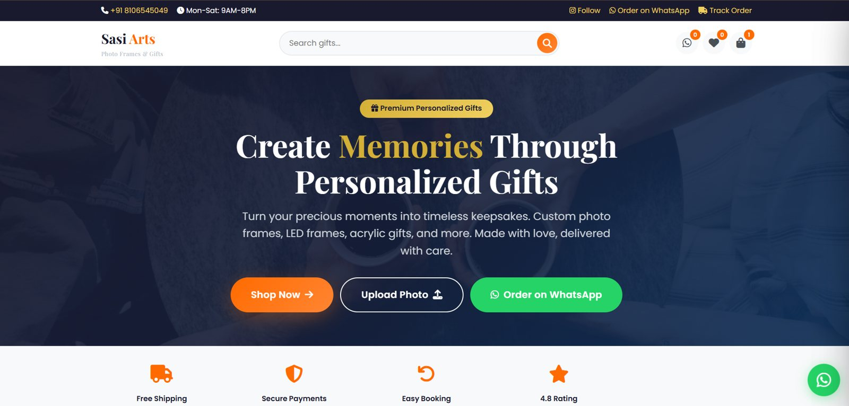
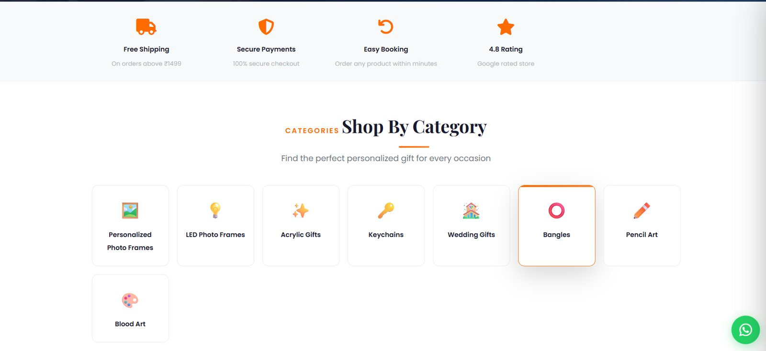
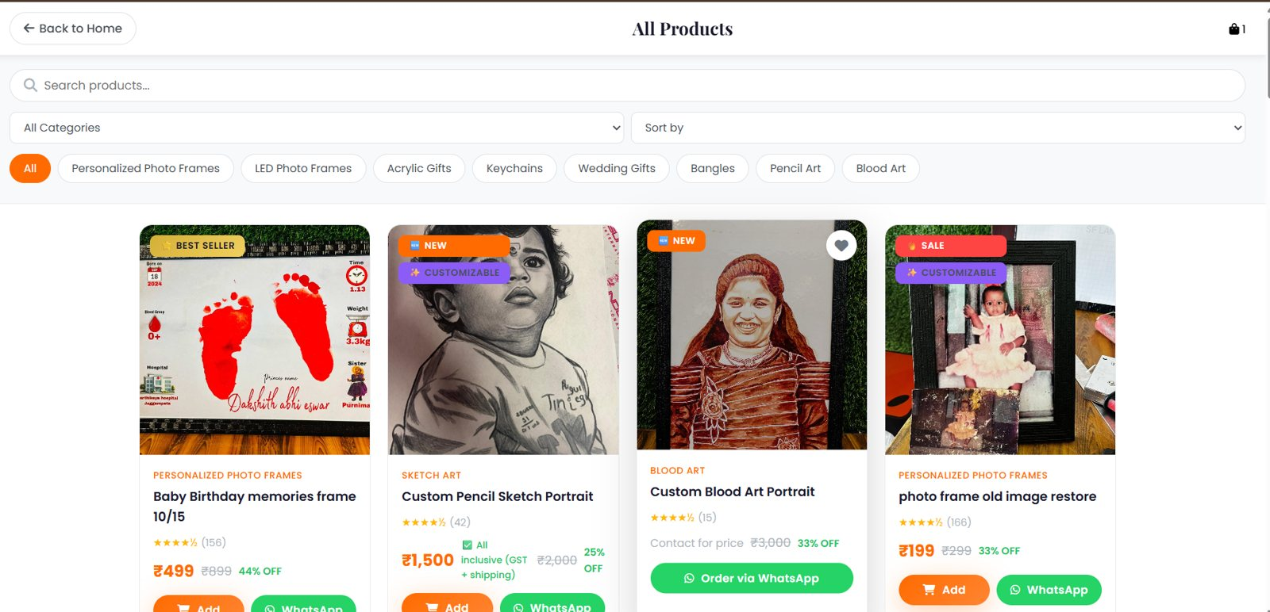
UI tour: real screenshots
Homepage
Categories
Product catalogue
Notes:
Use these to demo while explaining responsiveness.

Slide 8
Honest improvements and talking points
Escape dynamic HTML
Search text and product names reach innerHTML. Use textContent or an escape helper to prevent script injection.
Split app.js into modules
Separate cart, checkout, tracking and rendering into ES modules.
Adopt components when needed
If the catalogue and features grow, move to a component framework with a router.
Accessibility and tests
Add keyboard focus management, aria labels and Playwright end-to-end tests.
Notes:
Naming weaknesses yourself builds credibility.

