Slide 1
SASI ARTS · INTERVIEW DEEP-DIVE
Payments, Razorpay and WhatsApp
Two ordering paths, server-side signature verification, price calculation
Why two ordering paths
Razorpay sequence
HMAC signature verification
Price, GST and shipping
Failure scenarios
WhatsApp ordering flow
Improvements
P. Bharath Kumar · Student ID 2400030010 · sasi-arts.vercel.app · github.com/bharathkumar1904/sasi-arts
Notes:
Cover. Say what this deck covers and that every detail comes from the repository.

Slide 2
Why two ordering paths
Razorpay checkout
For standard priced products. Customers pay by UPI, card or netbanking and the order is created automatically.
WhatsApp ordering
For custom quotes, blood art, sketches and anyone who prefers to talk first. Cart details go into a prefilled message.
Corporate enquiry
A bulk-order form stores company, quantity, budget and GST need in the corporate_orders table.
Notes:
Both paths exist to convert customers who would not complete a normal checkout.

Slide 3
Razorpay sequence
Step | From → To | What happens
1 | Customer → Website | Fills delivery form; pincode triggers /api/shipping for the charge
2 | Website → Backend | POST create with total × 100 paise; server calls Razorpay orders.create
3 | Backend → Website | Returns order_id; Checkout modal opens with the public key id
4 | Customer → Razorpay | Pays with UPI, card or netbanking
5 | Website → Backend | Handler receives payment_id and signature; POST verify
6 | Backend | Recomputes HMAC-SHA256 with the secret; answers verified true or 400
7 | Website → Supabase | If verified: save orders and order_items, keep a local copy
8 | Website | Clear cart, send EmailJS invoice to admin, show Order ID
Notes:
Memorize this sequence.

Slide 4
Signature verification
expected = HMAC_SHA256(
secret = RAZORPAY_KEY_SECRET,
data = razorpay_order_id
+ '|' +
razorpay_payment_id )
if expected === razorpay_signature
-> verified: true
else
-> 400 Invalid payment signature
What it proves
Razorpay signed this order and payment pair with the shared secret. Editing the front-end cannot forge it.
Where the secret lives
Vercel environment variable. The browser only has the public key id.
Honest limit
The order is then saved from the browser. A webhook would confirm payments even if the tab closes.
Notes:
Say "server-side verification is implemented" confidently, and name the webhook as the next step.

Slide 5
Price, GST and shipping
Subtotal
Sum of item totals, including "N for Rs X" offers
+ GST
Flat Rs 23.33 (TAX_AMOUNT)
+ Shipping
Pincode zone charge
= Total
Sent to Razorpay as total × 100
→
→
→
All-inclusive items
If every cart item is marked allInclusive, GST and shipping are set to zero.
GST is flat
The code adds a fixed configured amount, not a percentage. Say this plainly if asked.
Rounding
Server uses Math.round on the paise amount.
Notes:
Do not claim percentage GST.

Slide 6
Failure scenarios
Scenario | Behavior today | Better design
Fake or tampered payment | Verify returns 400; order not saved | Same, plus alert on repeated failures
User closes checkout | "Payment cancelled" toast; cart untouched | Abandoned-cart reminder
Paid but database save fails | Saves order and items separately, keeps local copy; reconcile using payment_id | Razorpay webhook creates the order server-side
Verification request fails | Error toast asking to contact support | Retry with idempotency
Browser total manipulated | Server trusts the amount sent | Recompute total on server
Notes:
Questions 12 and 13 in the bank.

Slide 7
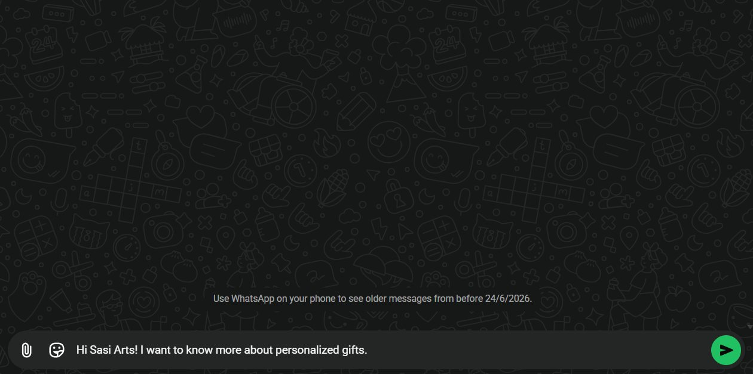
WhatsApp ordering flow
How it works
The app builds a text message (product, size, material, custom text) and opens a wa.me link with encodeURIComponent.
Not an API
No WhatsApp Business API call: it is a click-to-chat link to the shop number in config.js.
WhatsApp order from the live site
Why it helps
Custom quotes and personal assistance without a payment gateway.
Notes:
Explain this is a deep link.

Slide 8
Payment improvements
Webhook
payment.captured creates or confirms the order on the server.
Server pricing
Totals computed from database prices.
Idempotency
Prevent duplicate orders on retries using the Razorpay order id.
Payment status
Store failed and pending states and refund handling.
GST rules
Percentage GST by product category and invoice numbering.
Notifications
Customer email or WhatsApp confirmation, not only admin invoice.
Notes:
Prioritise webhook and server pricing.

