Slide 1
SASI ARTS · INTERVIEW DEEP-DIVE
Features, Customization and Admin
Product walkthrough with real screenshots and the data behind each feature
Feature map
Product customization
How customization data flows
Cart, checkout and tracking
Admin panel
Engagement features
P. Bharath Kumar · Student ID 2400030010 · sasi-arts.vercel.app · github.com/bharathkumar1904/sasi-arts
Notes:
Cover. Say what this deck covers and that every detail comes from the repository.

Slide 2
Feature map
Shop
Catalogue with search, sort and category filter; 22 sample products across the configured categories.
Customize
Photo upload, custom text, size and material in the product modal; a 3-step builder with live preview.
Order
Razorpay checkout or WhatsApp order, with pincode shipping and GST.
Track
Five-step status lookup by Order ID.
Manage
Admin panel with 11 tabs: products, orders, leads, offers, invoices and more.
Grow
Deal countdown, reviews, wishlist, QR codes, gift reminders, corporate enquiry, newsletter.
Notes:
Counts come from the project documentation and schema.

Slide 3
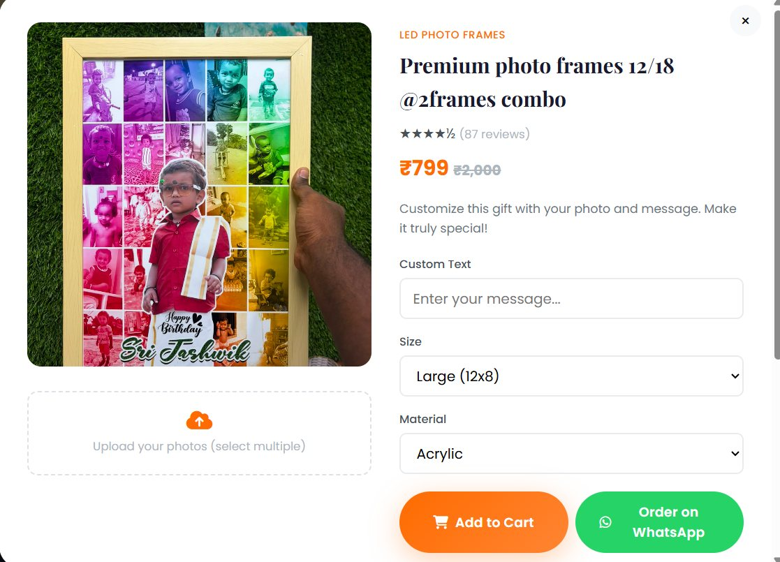
Product customization
Inputs
Photos (drag and drop or picker, multiple), custom text, size and material from product options.
Builder wizard
Category → product → customize, with a font-style selector and live preview.
Validation
Image type and 10 MB limit in the browser; bucket allows only JPEG, PNG, WebP, GIF.
Customize modal on the live site
Notes:
Font selection lives in the builder wizard, not the modal.

Slide 4
How customization data flows
Choose
Product, size, material
Upload
Photo to Supabase Storage
Add to cart
item.customization built
Persist
localStorage sasiCart
Order
order_items.customization (JSONB)
→
→
→
→
customization: {
text: 'Happy Birthday',
size: '8x10',
material: 'Acrylic',
photos: [ storage URLs ]
}
// illustrative values; shape from app.js
Refresh safe
Cart items, including photo URLs, survive a reload.
If upload fails
A local preview is kept and the user sees a message.
Notes:
Answer: where is customization stored.

Slide 5
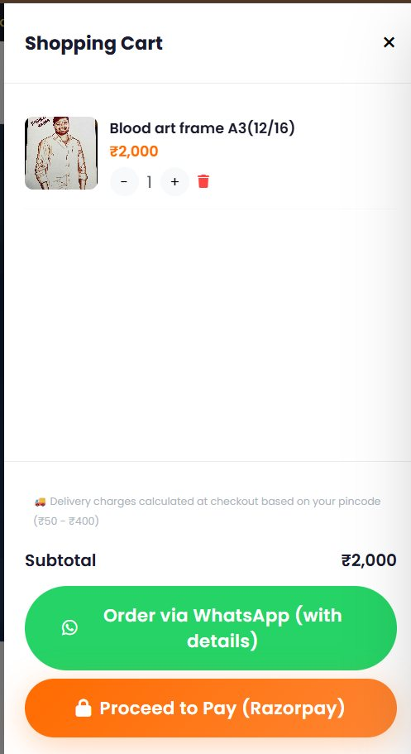
Cart and checkout
Cart
Quantity controls, offer pricing such as "N for Rs X", persisted in localStorage.
Delivery form
Name, phone, address, city, state, pincode. Entering a pincode fetches the shipping charge.
Totals
Subtotal + flat GST + shipping; all-inclusive items skip GST and shipping.
Pay
Razorpay Checkout opens; on verified payment the order is saved.
Cart and delivery
Notes:
Walk the form fields.

Slide 6
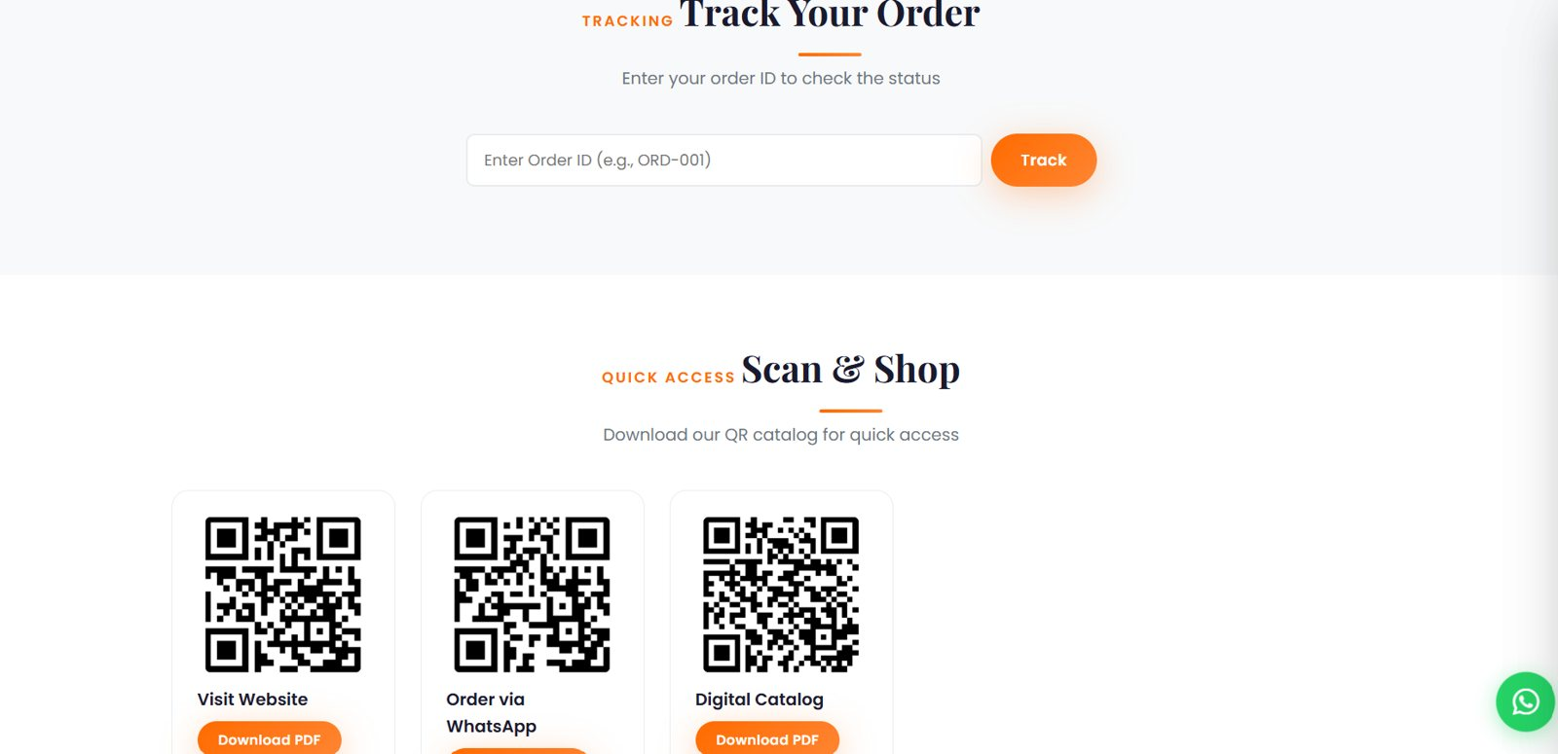
Order tracking
Order ID
ORD- plus the timestamp in base 36, created when payment is verified.
Lookup
Local orders first, then a Supabase query by id.
Statuses
Order Placed, Processing, Production, Shipped, Delivered. Admin updates the value.
Track order by ID (with QR codes)
Notes:
No customer login is needed for tracking.

Slide 7
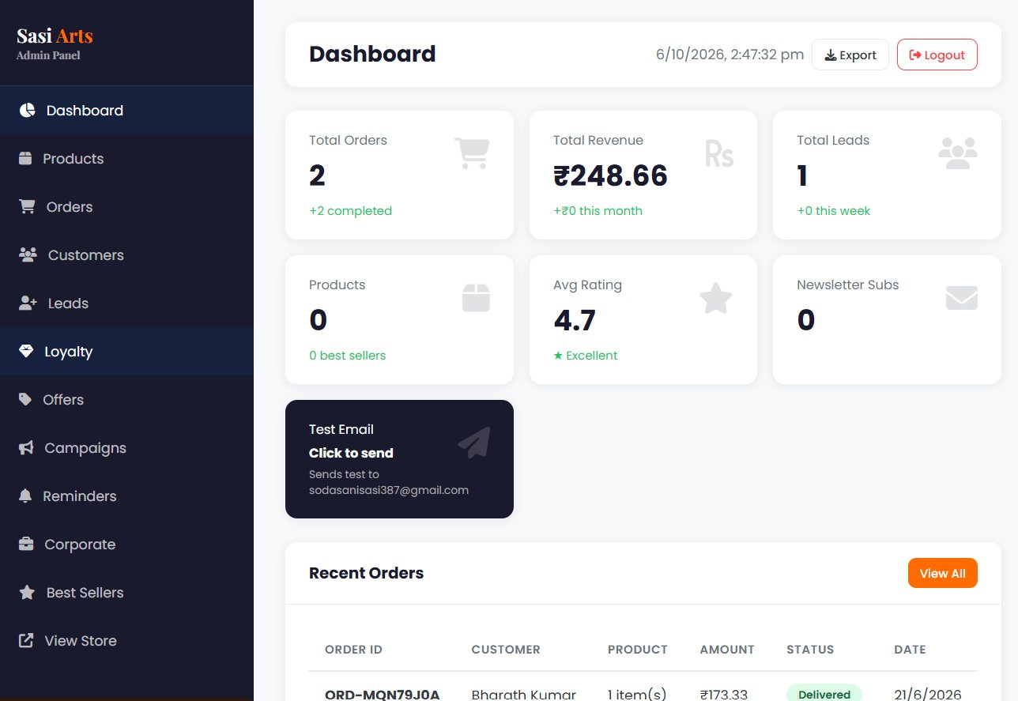
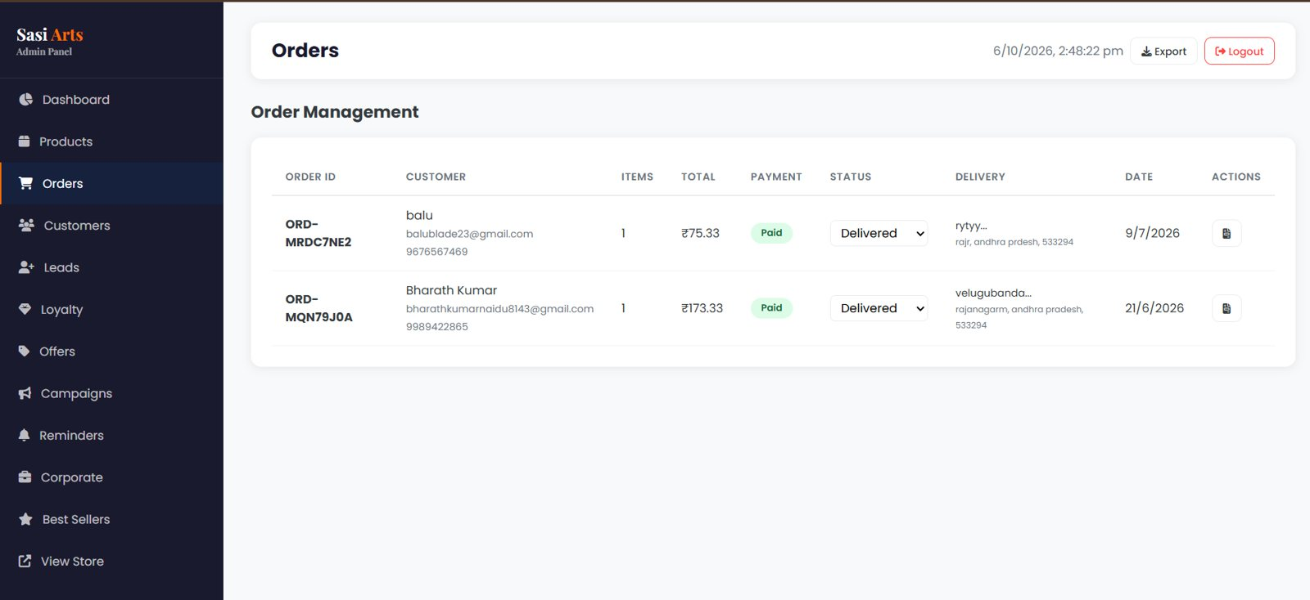
Admin panel
Dashboard
Orders
Access
Separate page behind Supabase Auth.
11 tabs
Dashboard, products, orders, customers, leads, loyalty, offers, campaigns, reminders, corporate, best sellers.
Operations
Product CRUD with image upload, status updates, printable invoices, CSV export.
Notes:
Admin edits update the live catalogue through Supabase.

Slide 8
Engagement and growth features
Today's deal
Offer with countdown loaded from the offers table.
Reviews
Star rating and text saved to the reviews table.
Wishlist
Heart toggle stored in localStorage.
QR codes
Website, WhatsApp and catalog QR codes, drawn by the external api.qrserver.com image service.
Gift reminders
Birthday and anniversary subscriptions saved to Supabase.
Corporate enquiry
Bulk order form with GST option stored for follow-up.
Notes:
These show product thinking beyond checkout.

