Slide 1
FOUNDATIONS OF ARTIFICIAL INTELLIGENCE · CASE STUDY
AI-DRIVEN
MULTI-AGENT
EMERGENCY RESPONSE
H
D
& HOSPITAL COORDINATION SYSTEM
A
Autonomous agents • Classical AI • Dynamic replanning
P
6 autonomous agent types
Presented by: N.BHARATH KUMAR REDDY | CB.SC.U4CSE23734
Academic simulation — not a clinical dispatch system

Slide 2
FOAI / CASE STUDY
01 · MOTIVATION
Problem Statement & Objectives
THE PROBLEM
OUR AI APPROACH
• Road traffic and road closures change during response.
• Nearest hospital may lack ICU capacity or a required specialist.
• Several emergencies can compete for limited ambulances and beds.
• A fixed route or static assignment can become invalid mid-mission.
• Model patients, ambulances, hospitals, doctors and traffic as agents.
• Use search to calculate routes across a weighted city graph.
• Use knowledge rules and utility scores to assess hospital suitability.
• Re-plan when traffic or medical resources change.
GOAL: SAFE, SUITABLE, LOW-COST EMERGENCY RESPONSE
AI-Driven Multi-Agent Emergency Response System
02

Slide 3
FOAI / CASE STUDY
02 · REVIEW FUNDAMENTALS
PEAS Formulation
P · PERFORMANCE
E · ENVIRONMENT
A · ACTUATORS
S · SENSORS
• Minimize response and transport time
• Meet patient resource needs
• Reduce resource conflicts
• 10×10 weighted city grid
• Patients, roads, hospitals, doctors
• Dynamic traffic and resource states
• Dispatch / move ambulance
• Choose route and hospital
• Reserve bed / ICU; re-plan
• Agent location and status
• Road congestion / blockage
• Bed, ICU and specialist availability
PEAS is defined for the agent system; each agent has its own local sensors, actions and goal.
AI-Driven Multi-Agent Emergency Response System
03

Slide 4
FOAI / CASE STUDY
02 · REVIEW FUNDAMENTALS
Environment & Agent Analysis
MULTI-AGENT
DYNAMIC
PARTIALLY OBSERVABLE
• 6 agent types act and communicate
• Traffic and resource counts can change
• Each agent has local knowledge
STOCHASTIC
SEQUENTIAL
COOPERATIVE
• Incidents and availability changes are simulated
• Each action changes later states
• Agents share the goal of resolving emergencies
Patient
Ambulance
Hospital
Doctor
Traffic
Coordinator
Emergency request
Routing & transport
Capacity & admission
Specialty & availability
Road-state updates
Priority & replanning
AI-Driven Multi-Agent Emergency Response System
04

Slide 5
FOAI / CASE STUDY
03 · SEARCH
State-Space Modeling
FORMAL MODEL
ILLUSTRATIVE CITY GRID
• City = weighted graph G = (V, E)
• V: 100 intersections on a 10×10 grid
• E: connected road segments
• State: agent location, target, road costs and traffic
• Action: move to a valid neighbouring cell
• Goal: reach patient / suitable hospital at low cost
A
P
H
Red cells = blocked / high-penalty roads
Teal cells = one illustrative route (not live simulation output)
AI-Driven Multi-Agent Emergency Response System
05

Slide 6
FOAI / CASE STUDY
03 · SEARCH
Search Algorithms & Their Roles
ALGORITHM
TYPE
PROJECT ROLE
TRADE-OFF
STATUS
BFS
Uninformed
Fewest hops on equal-cost edges
Ignores weighted traffic costs
Implemented module
DFS
Uninformed
Exploration / comparison baseline
May take a winding, costly route
Implemented module
UCS
Cost-based
Lowest cumulative road cost
Can expand many nodes
Implemented module
Greedy Best-First
Informed
Fast heuristic-guided direction
May miss the cheapest route
Implemented module
A*
Informed
Core cost-aware routing
Needs a suitable heuristic
Implemented module
A* evaluation: f(n) = g(n) + h(n)
g(n) = cost so far · h(n) = estimated remaining cost
AI-Driven Multi-Agent Emergency Response System
06

Slide 7
FOAI / CASE STUDY
03 · SEARCH
Path Length ≠ Path Cost
PATH LENGTH
PATH COST
• Number of hops / road segments.
• BFS finds a route with the fewest hops when edges are unweighted.
• It does not account for congestion penalties in the weighted city.
• Sum of edge weights and traffic penalties.
• UCS and A* find a minimum-cost route with non-negative costs (A* with an admissible heuristic).
• A slightly longer detour can cost less than a congested direct route.
DIRECT ROUTE
high traffic cost
DETOUR
more hops · lower cost
AI-Driven Multi-Agent Emergency Response System
07

Slide 8
FOAI / CASE STUDY
04 · LOGIC
Knowledge Representation & Reasoning
ASSERTED FACTS
RULE / INFERENCE
EXPLAINABLE RESULT
• patient_requires_icu(P1)
• hospital_has_icu(H2)
• hospital_icu_available(H2)
• doctor_available(D1)
• doctor_specialty(D1, cardiology)
• IF patient needs ICU AND hospital ICU is available
• THEN hospital satisfies ICU requirement
• Forward chaining: facts → derived eligibility
• Backward chaining: query → required facts
• Query: Can H2 treat P1?
• Check ICU requirement
• Check specialist availability
• Result: suitable only if all required constraints hold
Predicate-style facts and inference steps are displayed so the decision can be inspected.
AI-Driven Multi-Agent Emergency Response System
08

Slide 9
FOAI / CASE STUDY
05 · DECISION
Utility-Based Hospital Selection
U(H) = wᵣ·Resource + wₛ·Specialist − wᵈ·Distance − wₜ·Traffic
Weights adapt to emergency severity; critical cases prioritize medical suitability over proximity.
HOSPITAL H1
HOSPITAL H2
HOSPITAL H3
• ICU unavailable
• Distance: 3 km
• REJECTED
• ICU + specialist available
• Distance: 5 km
• SELECTED
• Specialist unavailable
• Distance: 2 km
• REJECTED
Eligibility rules filter out hospitals that cannot meet hard medical requirements; utility ranks the remaining candidates.
AI-Driven Multi-Agent Emergency Response System
09

Slide 10
FOAI / CASE STUDY
05 · DECISION
Dynamic Replanning Under Uncertainty
01
02
03
04
05
06
EMERGENCY
PLAN
EVENT
INVALIDATE
REPLAN
RESUME
Patient request
Select ambulance, route & hospital
ICU full / road blocked
Old plan no longer valid
Re-evaluate + run A*
New route / hospital
SIGNATURE FEATURE
Completed milestones are preserved; only invalid downstream actions are recomputed.
Dynamic events are simulated and controllable through scenario controls.
AI-Driven Multi-Agent Emergency Response System
10

Slide 11
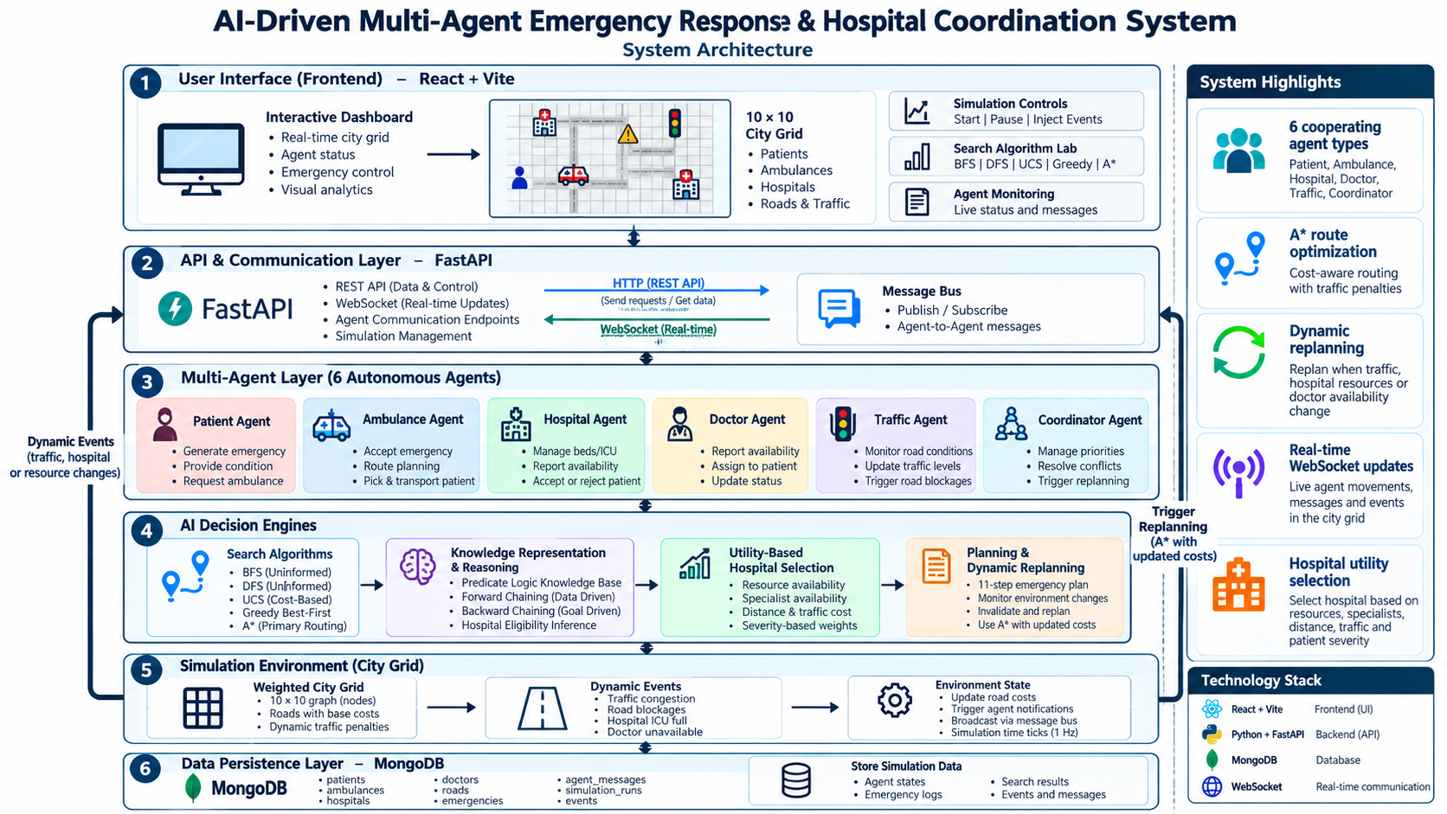

Slide 12
FOAI / CASE STUDY
06 · IMPLEMENTATION
Codebase Structure & Responsibilities
FOAI_Project/
├── backend/
│ ├── agents/ Patient, Ambulance, Hospital, Doctor, Traffic, Coordinator
│ ├── search/ BFS, DFS, UCS, Greedy, A*
│ ├── knowledge/ Facts and rules
│ ├── reasoning/ Forward / backward chaining
│ ├── decision/ Utility-based hospital ranking
│ ├── planning/ Emergency plan and replanning
│ ├── communication/ Async publish / subscribe message bus
│ ├── simulation/ Grid, events and state ticks
│ └── main.py FastAPI entry point
└── frontend/src/
├── pages/ Dashboard, Simulation, Search Lab, KB, Analytics
├── components/ City grid, agent panels, decision explanation
├── services/ REST + WebSocket client
└── styles/ Vanilla CSS
SEPARATION OF CONCERNS
• Agents, search, logic and planning are isolated modules.
REAL-TIME CHANNEL
• WebSocket streams simulation state and agent events.
PERSISTENCE
• MongoDB stores runs, decisions, messages and metrics.
AI-Driven Multi-Agent Emergency Response System
12

Slide 13
FOAI / CASE STUDY
07 · DEMONSTRATION
Overall Execution Flow
1
Incident
2
Triage
3
Eligibility
4
Utility
5
Dispatch
PatientAgent emits SOS
Severity + resource needs
Knowledge rules filter hospitals
Rank suitable hospitals
Coordinator assigns ambulance
6
Search
7
Transit
8
Replan
9
Admission
10
Complete
Calculate route to patient
Move + monitor traffic
React to road/resource changes
Reserve resources + doctor
Record outcome and metrics
An event can invalidate a downstream step and trigger a new plan without restarting completed steps.
AI-Driven Multi-Agent Emergency Response System
13

Slide 14
FOAI / CASE STUDY
08 · TESTING
Testing Scenarios & Validation
01 · Baseline emergency
02 · Parallel emergencies
• End-to-end dispatch, route and admission
• Resource contention and priority
03 · ICU saturation
04 · Road blockage
• Rule-based hospital rejection
• Dynamic A* replanning
05 · Specialist unavailable
06 · Ambulance contention
• Knowledge-based eligibility check
• Priority and reassignment
07 · Compound stress test
• Multiple simultaneous failures
Validation principle: report measurements from actual runs; do not present illustrative metrics as measured results.
AI-Driven Multi-Agent Emergency Response System
14

Slide 15
FOAI / CASE STUDY
08 · TESTING
Live Demo, Limitations & Future Work
DEMO SEQUENCE
LIMITATIONS & FUTURE WORK
• 1. Open Search Lab and compare all five algorithms.
• 2. Inspect facts, rules and derived eligibility in Knowledge Base.
• 3. Run dynamic road-blockage scenario.
• 4. Observe route invalidation, agent messages and replanning.
• 5. Review decision factors and analytics after completion.
• Uses simulated city, traffic and hospital resources.
• Not connected to live emergency services or medical records.
• Decision rules and weights require careful validation.
• Future: larger grids, richer uncertainty models, stronger testing and fairness checks.
AI-Driven Multi-Agent Emergency Response System
15

Slide 16
FOAI / CASE STUDY
KEY TAKEAWAYS
A transparent, explainable
multi-agent AI system
for dynamic emergency coordination
AGENTS
SEARCH
REASONING
ADAPTATION
Autonomous roles + communication
Five strategies + cost-aware routes
Facts, rules, forward/backward chaining
Utility selection + dynamic replanning
Thank You
Questions & Discussion
Academic simulation only · Not a clinical decision or dispatch tool

