Slide 1

RevConnect
Connect Create Engage Grow.
A Modular Console-Based Social Networking System

Slide 2
Agenda
1. Project Overview
2. Problem Statement
3. Objectives
4. Technologies Used
5. System Architecture
6. Core Features
7. Database Design
8. Security Features
9. Logging & Testing
10. Future Enhancements
11. Conclusion

Slide 3
Project Overview
RevConnect is a console-based social media application designed to provide an interactive platform for personal users, creators, and business accounts. The system enables users to register, manage profiles, create and share posts, like and comment on content, build networks through connections and follows, and receive real-time notifications.
The application follows a modular layered architecture, separating UI, service, and data access layers to ensure scalability, maintainability, and future extensibility into a web or mobile-based system.

Slide 4
Problem Statement
Traditional social media platforms are complex and tightly coupled, making them difficult to extend or customize for academic and experimental purposes. There is a need for a modular and scalable social networking system that supports personal users, creators, and business accounts while providing essential social interaction features such as posting, networking, and notifications in a structured and maintainable architecture.

Slide 5
Objectives
To design and develop a console-based social media using java and MySQL.
To implement modular layered architecture separating UI, service and data access layers.
To provide core social networking features.
To support different account types such as personal, business, and creator and managing the private and public access to it.
To make the system scalable and extensible for future web or mobile deployment.

Slide 6
Technologies Used
Java
MySQL
JDBC
Maven
JUnit
Log4j
Git

Slide 7
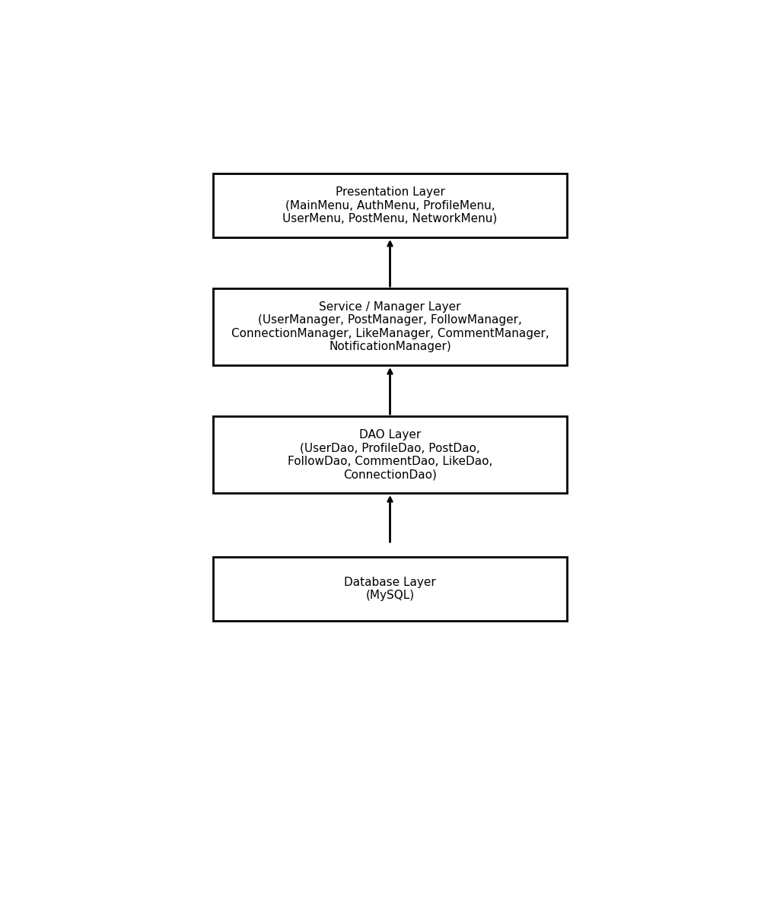
System Architecture
UI Layer
Service/Manager Layer
DAO Layer
Database Layer

Slide 8
Core Features
User Registration & Login
Profile Management
Post Creation
Like, Comment, Share
Feed System

Slide 9
Database Design
RevConnect uses a relational database model implemented using MySQL.
We used proper relationships between the tables with proper constraints.
Database is normalized to reduce redundancy and improve performance
Cascade delete is applied so that related data is removed automatically when a user or post is deleted.

Slide 10
Security Features
Password Validation with minimum requirements
Change Password using username
Forgot Password using security questions
Privacy Settings

Slide 11
Logging & Testing
Logging is implemented using Apache Log4j2.
Important user activities such as login, post creation, follow, and connection requests are logged.
Logs are written to both console and file for monitoring and debugging.
Unit testing is performed using JUnit and Mockito.

Slide 12

Future Enhancements
Web Version
Mobile App
Chat System
Media Uploads

Slide 13

Conclusion
RevConnect successfully demonstrates the design and implementation of a modular console-based social media application using Java and MySQL. The system provides essential social networking features such as authentication, profile management, posting, networking, and notifications while following a clean layered architecture. The project emphasizes scalability, security, and maintainability, making it suitable for future enhancement into a web or mobile-based platform. Overall, RevConnect serves as a strong foundation for understanding real-world application development concepts.

