Slide 1

Digital portfolio
STUDENT NAME: barath B
REGISTER NO AND NMID: 32324u09010& astvu32332324u09010
DEPARTMENT: BCA COLLEGE: Voorhees College/Thiruvalluvar University :

Slide 2
Problem Statement
1. Problem Statement Students often lack a professional medium to present their projects. Resumes alone are not interactive or visually appealing. A digital portfolio bridges this gap by allowing projects, skills, and achievements to be showcased online. It solves the problem of limited visibility for recruiters and potential collaborators.

Slide 3
Project overview
2. Project OverviewDeveloped a responsive personal portfolio using HTML, CSS, and JavaScript.Provides sections like Home, About, Projects, and Contact.Designed to adapt to different devices (desktop, tablet, mobile).Focuses equally on visual design and user-friendly functionality.

Slide 4
End users
3. End Users Students – to highlight academic and personal projects. Recruiters/Employers – quick access to candidate’s skills and contact details. Peers/General audience – learn about the developer’s journey and technical growth

Slide 5
Tool and technologies
4. Tools and TechnologiesHTML5← Content structuring (headings, paragraphs, forms).CSS3 Styling (colors, layouts, media queries for responsiveness).JavaScript (ES6)→ Dynamic behavior (menu toggle, smooth scroll, interactivity).GitHub → Version control, project backup, and live hosting with GitHub Pages.

Slide 6
Portfolio design and layout
5. Portfolio Design and LayoutHeader & Navbar - sticky navigation with acollapsible mobile menu.Hero Section professional intro with name, tagline, and background image.About Section - personal profile, education, and background details.Projects Section grid layout with hover effects showcasing different works.Contact Section - clickable email and phone for instant communication.

Slide 7
Features and functionality
6. Features and FunctionalityFully responsive design adapts to desktop, tablet, and mobile.Interactive navigation menu smooth scrolling and menu toggle.Project showcase with hover effects improves Ul experience.Clickable contact links - direct call or email with a single click.Lightweight and fast-loading website ensures better user engagement.

Slide 8
Result and screenshot
7. Results and ScreenshotsSuccessfully deployed on GitHub Pages.Demonstrated working features like mobile responsiveness and interactive menu.Screenshots show sections (Home, About, Projects, Contact) in both desktop and mobile views

Slide 9
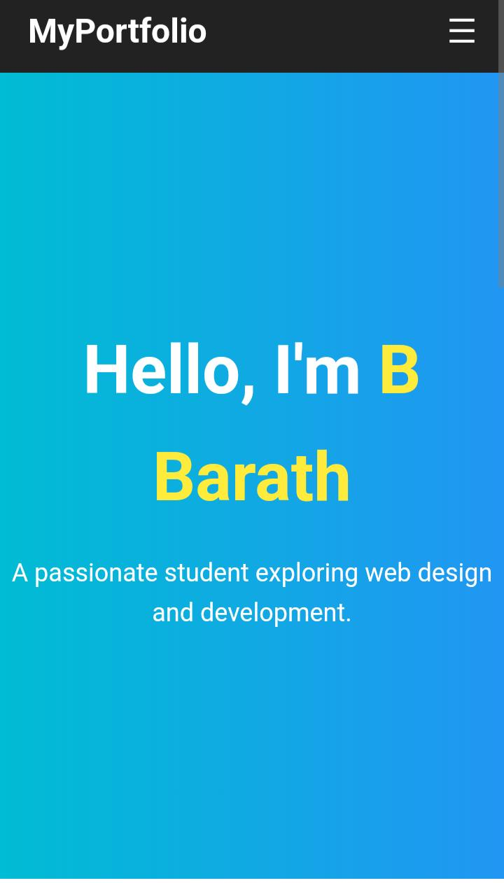

Slide 10
Conclusion
8. ConclusionThe portfolio serves as a digital resume + project showcase.Demonstrates fundamental web technologies (HTML, CSS, JS) effectively.Builds a foundation for adding advanced skills (React, backend, database).Provides a professional online presence for academic and career growth.

