Slide 1

CMR COLLEGE OF ENGINEERING & TECHNOLOGY
Kandlakoya, Medchal, Hyderabad - 501401
Department of Computer Science and Engineering
Civic Issues Reporting System
NAME OF THE STUDENT:
B.AVINASH (22H55A0503)
B.RAHUL SAI KIRAN (22H55A0504)
CH.BHARATH KUMAR(22H55A0505)
Under esteemed guidance of
Ms. B. Gayathri
Asst. Professor of CSE

Slide 2
Outline
Abstract
Introduction
Literature survey
Existed system
- Problems in existed system
Research Objective of Presentation
Problem Definition
Research work
- Proposed system architecture
- Methods
Performance Measure
Results
Output
Conclusion
Future Work

Slide 3
Abstract

Slide 4
ABSTRACT
The Civic Issues Reporting System (CIRS) is a technology-driven platform designed to streamline the reporting, management, and resolution of civic issues in communities.
This system offers an accessible and user-friendly interface for citizens to report various problems, from potholes to public safety concerns.
The Civic Issues Reporting System (CIRS) represents an innovative solution to the challenges faced by modern communities.

Slide 5
INTRODUCTION

Slide 6
Introduction
The Civic Issues Reporting System (CIRS) is a transformative platform designed to address the multifaceted challenges encountered by modern communities.
In an era where technology plays a pivotal role in our daily lives, CIRS harnesses its power to bring about a new paradigm in the way civic issues are reported, managed, and resolved.
This sets the stage for a detailed exploration of CIRS, highlighting its key features and the positive impact it promises to have on community well-being and local governance.

Slide 7
Literature Survey

Slide 8
Existed system
Citizen Reporting Apps by Municipalities: Digital platforms developed and managed by local governments or municipal authorities.
Community Engagement Platforms :Digital tools or online forums designed to facilitate communication, collaboration, and participation among community members, local authorities, and organizations.

Slide 9
Research Objective

Slide 10
Research objective
Assess the Effectiveness of CIRS in Streamlining Civic Issue Reporting.
Examine the User Experience and Accessibility of CIRS Interface.
Evaluate the Impact of CIRS on Civic Issue Management.
Analyze the Diversity and Range of Civic Issues Reported through CIRS.
Security and Privacy.
Assess the Efficiency of Issue Resolution Through CIRS.
Investigate User Satisfaction and Feedback with CIRS.

Slide 11
Problem Definition

Slide 12
Problem Definition
In many communities, the traditional methods of reporting and managing civic issues pose significant challenges, leading to inefficiencies and delayed resolutions.
The absence of a streamlined system often results in a lack of responsiveness and coordination, hindering the overall well-being of the community.
Common problems such as potholes, broken infrastructure, and public safety concerns persist, creating a disconnect between citizens and local authorities.

Slide 13
Research Work

Slide 14
Performance Measure:
Response Time : The time taken from the submission of a civic issue report to the initiation of a response or resolution.
Resolution Time : The duration between the initiation of a response and the successful resolution of a reported civic issue.
Number and Diversity of Reported Issues : The total count of civic issues reported through CIRS and the variety of problems captured, ranging from potholes to public safety concerns.
Notes:
Geolocation

Slide 15
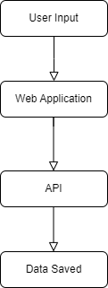
Proposed system architecture
User Problem Entering

Slide 16
Proposed Methods
Case Study Analysis : Select a sample of reported civic issues within a specific community and conduct a detailed case study analysis.
Time-to-Resolution Metrics : Measure the time taken for CIRS to facilitate the resolution of reported civic issues.
Community Engagement Metrics : Develop metrics to assess the level of community engagement facilitated by CIRS.
Image Uploading: Allow users to attach images when reporting issues, providing visual context to aid in issue identification and resolution.
Emergency Reporting: Include a feature dedicated to emergency reporting, allowing users to quickly report urgent or critical situations that require immediate attention.

Slide 17
Result
The analysis of results from the implementation of the Civic Issues Reporting System (CIRS) reveals a significant improvement in the efficiency of civic issue resolution within communities.
The streamlined reporting and management processes, facilitated by the technology-driven platform, contribute to a notable reduction in response and resolution times.
Citizens find the accessible and user-friendly interface intuitive, leading to increased participation in reporting various issues

Slide 18
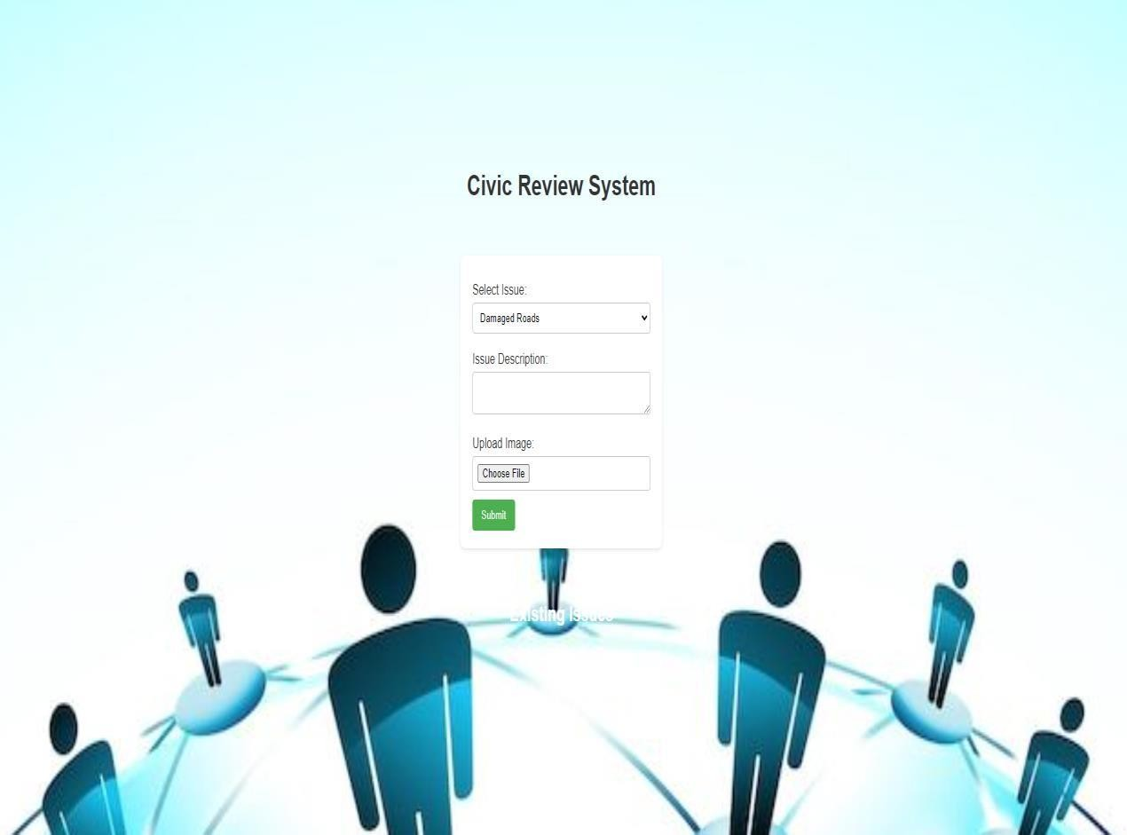
Home Page:

Slide 19
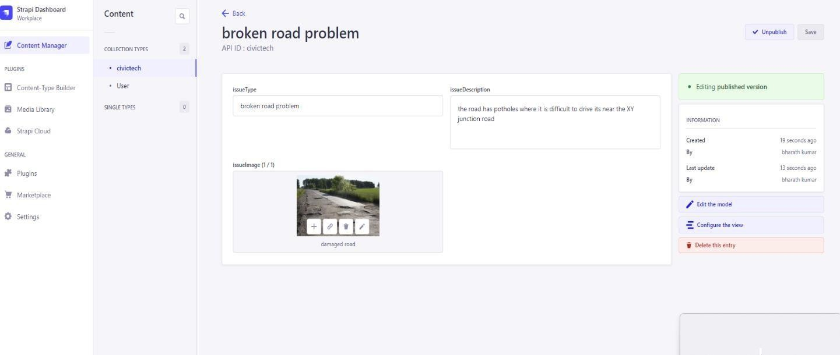
Output:

Slide 20
Conclusion
In conclusion, the Civic Issues Reporting System (CIRS) stands out as an effective and transformative solution for enhancing civic management within communities.
The technology-driven platform has successfully streamlined the reporting, management, and resolution of a diverse range of civic issues.
The accessible and user-friendly interface empowers citizens to actively contribute to the betterment of their neighborhoods, fostering a culture of engagement and shared responsibility.

Slide 21
Future work
Looking ahead, the future work for the Civic Issues Reporting System (CIRS) involves continuous refinement and expansion to further enhance its capabilities.
First and foremost, ongoing user feedback will be crucial in refining the user interface and addressing any emerging usability concerns, ensuring a seamless reporting experience.
Additionally, the integration of advanced data analytics tools will enable a more in-depth analysis of reported issues, identifying patterns and trends for proactive community planning.

Slide 22
References
1.https://www.ichangemycity.com/
2.Achen, Christopher H., and Larry M. Bartels. 2016. Democracy for Realists: Why Elections Do Not Produce Responsive Government. Princeton, NJ: Princeton University Press.
3.Alesina, Alberto, and Eliana La Ferrara. 2000. “Participation in Heterogeneous Communities.” Quarterly Journal of Economics 115(3): 847–904.
4.https://www.researchgate.net/publication/359118551_Smart_Civic_Issue_Reporting_System

Slide 23
Thank You!

