Slide 1

Loan Approval Predictions
BY Bharath Kumar Tanniru(02078210) Poojith Sonti(02080247)

Slide 2
Introduction
Loans play a crucial role in the global economy, facilitating everything from personal purchases like homes and cars to business expansions and government funding. Across the world, loans vary widely in terms of purpose, amount, duration, and interest rates, reflecting different economic conditions, regulatory environments, and credit markets. Financial institutions, including banks, credit unions, and online lenders, offer diverse lending products to meet the varied needs of consumers and businesses. The accessibility and terms of these loans can significantly influence economic growth and financial stability.

Slide 3
Objective
The aim of a project on loan approval prediction using machine learning is to develop a system that can accurately and efficiently determine the likelihood of a loan applicant being approved based on various predictive factors. This project seeks to enhance decision-making processes for financial institutions by automating risk assessment, reducing potential biases, and increasing the speed of loan processing, ultimately making credit more accessible and reliable for eligible applicants.

Slide 4
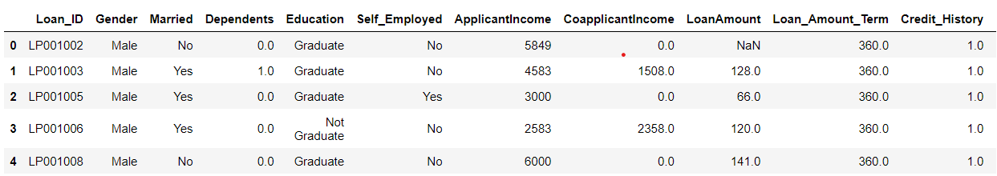
Dataset
We took the dataset from Kaggle.
This is sample of dataset.

Slide 5
Pipeline
Collection of Dataset
Preprocessing
Data Handling
Data Spliting
Prediction
Training the model using RandomForest

Slide 6
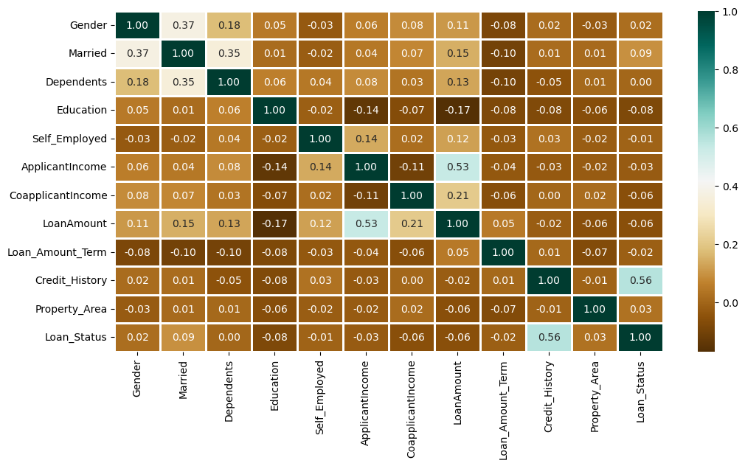
Data Visualization
The heatmap visualizes correlations between various loan-related variables.
Values close to 1 or -1 indicate strong positive or negative relationships, respectively.
The data is used to understand how different applicant attributes might affect loan approval chances.
Correlation Matrix

Slide 7
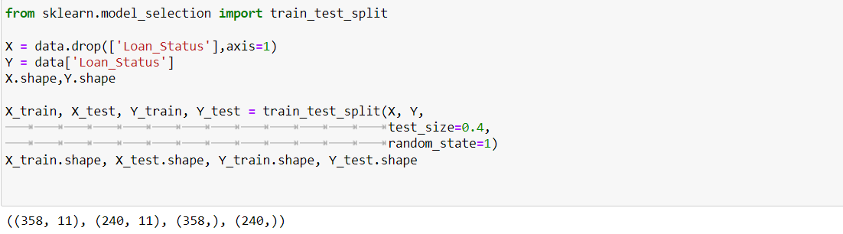
Splitting of Data
We have split Data In to two parts Train set and test set.
For Test set we took data up to 40%.

Slide 8


Accuracy of each Model
For Train set
For Test set

Slide 9
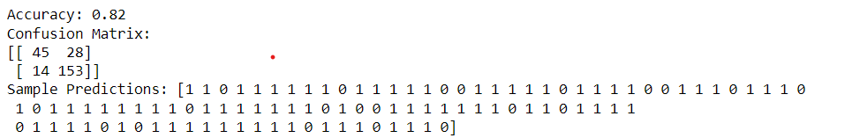
Evaluation
We used Random forest Classifier for predictions due its high accuracy of 82%.
These are the 100 predictions from the test set.
Here 0 indicates that loan is not approved and 1 indicates loan is approved.

Slide 10
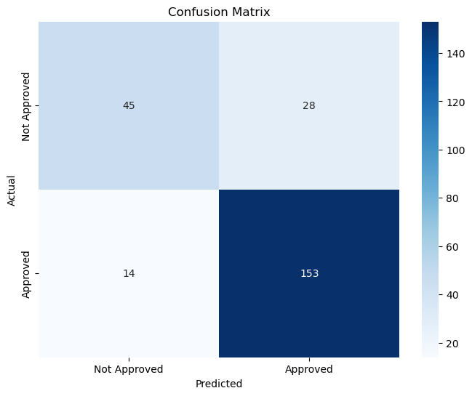
Confusion Matrix
True Negatives (TN): The top-left quadrant (45) shows the number of true negative predictions where the model correctly identified loans that were not approved.
False Positives (FP): The top-right quadrant (28) represents the false positive predictions where the model incorrectly predicted approval for loans that were actually not approved.
False Negatives (FN): The bottom-left quadrant (14) indicates the false negative predictions where the model incorrectly predicted non-approval for loans that were actually approved.
True Positives (TP): The bottom-right quadrant (153) shows the number of true positive predictions where the model correctly predicted loans that were approved.

Slide 11

Thank you

