Slide 1

E-commerce Sales Analysis Using Power BI
by Bharath Madhesh S N

Slide 2
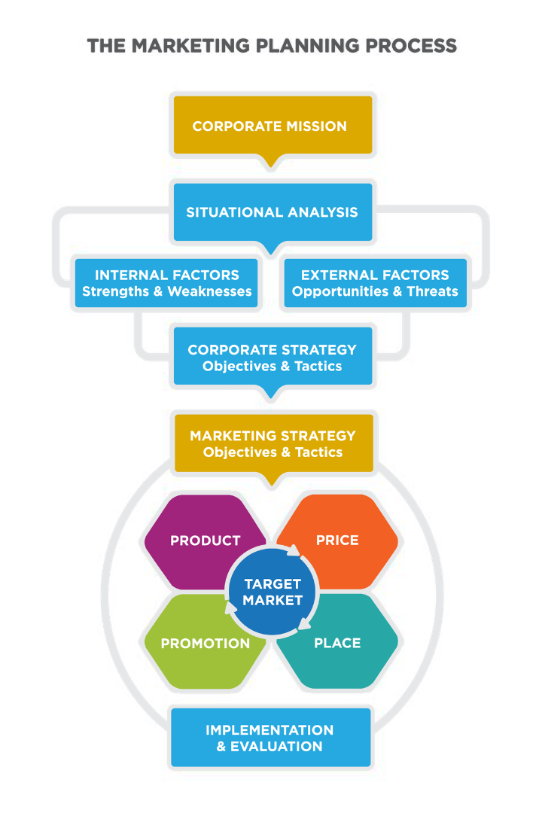
Abstract:
This project focuses on analyzing e-commerce sales data using Power BI, a powerful business analytics tool. The aim is to extract valuable insights from the data to drive informed business decisions and strategies.

Slide 3
Problem Statement
Incomplete Data
Limited Insights
Competitive Pressure
The e-commerce company lacks a comprehensive view of their sales data, hindering their ability to identify trends and make data-driven decisions.
There's a lack of efficient tools to visualize and analyze the sales data, resulting in difficulties for the company to derive meaningful insights.
Rival companies are leveraging data analytics effectively, putting pressure on the e-commerce company to enhance their own analytical capabilities.

Slide 4
Project Overview
Data Collection
Power BI Integration
Dashboard Creation
The project involves gathering sales data from various sources, including online platforms, customer databases, and transaction records.
Utilizing the Power BI tool to integrate, clean, and transform the collected data for comprehensive analysis and visualization.
Developing dynamic and interactive dashboards to present actionable insights derived from the analyzed sales data.

Slide 5
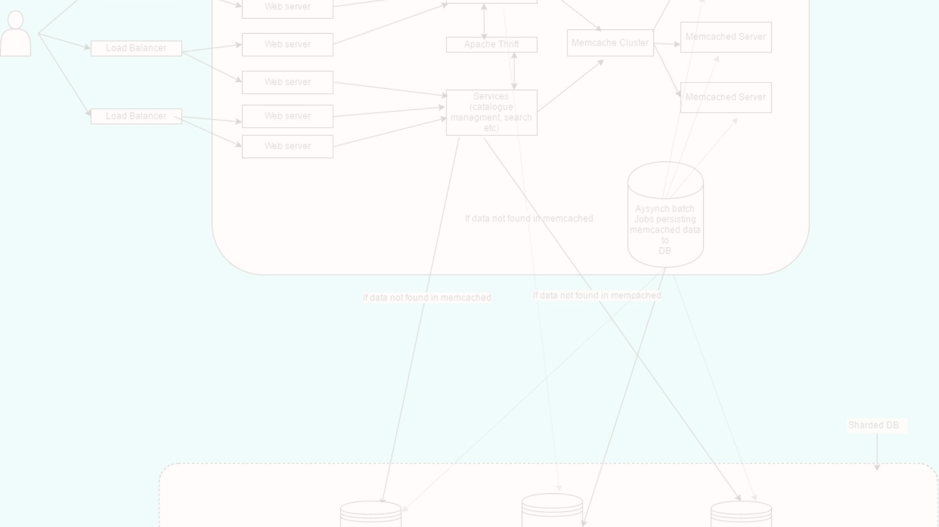

Proposed Solution
1
Data Integration
2
Visualizations
3
Automated Reporting
The solution will focus on integrating multiple data sources seamlessly to create a unified and robust database for analysis.
Implementing engaging and insightful visualizations through Power BI to present complex sales data in a simplified and understandable manner.
Creating automated reporting mechanisms to generate regular insights into sales performance and market trends.

Slide 6
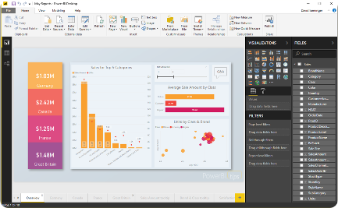
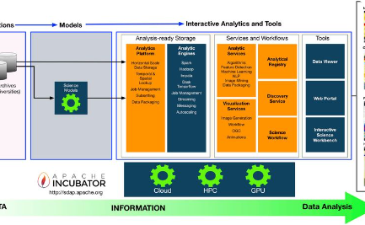
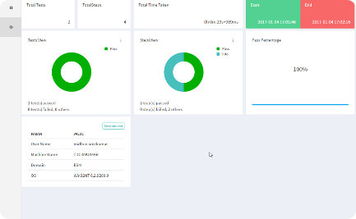
Technology Used
Power BI
Data Integration Tools
Automated Reporting Software
Analytical tool for visualizing and sharing insights from sales data.
Technologies for integrating and cleaning diverse sales data sources.
Tools to automate the generation and distribution of insightful sales reports.

Slide 7
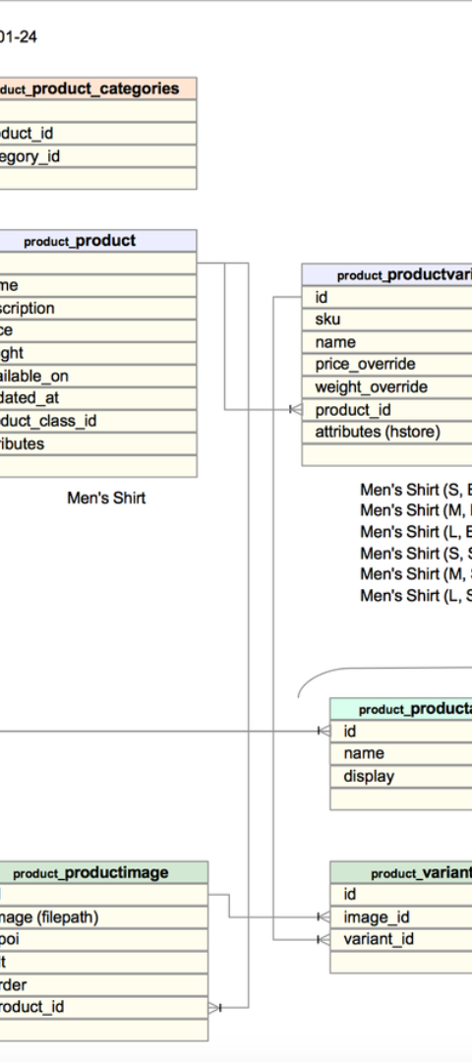
Modelling and Results
1
Data Modeling
Developing and refining data models to accurately represent the e-commerce sales data for analysis.
2
Analytical Insights
Deriving actionable insights from the analyzed data to identify trends, patterns, and areas for improvement.
3
Predictive Modeling
Implementing predictive models and machine learning algorithms to forecast sales performance and customer behavior.

Slide 8
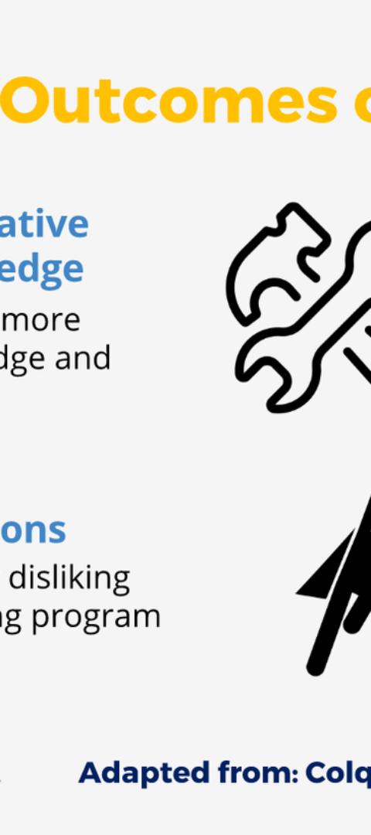



Conclusion
Valuable Insights
The project successfully provided valuable insights into sales performance, customer behavior, and market trends.
Enhanced Decision-Making
Enabled the company to make data-driven decisions leading to improved sales strategies and customer engagement.
Futuristic Approach
Demonstrated the potential impact of data analytics in shaping the future of the e-commerce company's operations.

Slide 9
Question and Answer
How did the project influence sales strategies?
The insights derived from the project led to the implementation of targeted marketing campaigns and product promotions, resulting in increased sales.
What were the major challenges faced during the analysis?
The primary challenges included data integration complexities, ensuring data accuracy, and selecting the most effective visualization techniques.
What are the future enhancements planned for the project?
Future enhancements involve expanding predictive analytics capabilities, incorporating real-time data processing, and integrating advanced AI algorithms for sales forecasting.

