Slide 1
Python for Web development
GowthamPrakash Y

Slide 2
Topics
Introduction to Python
Gist of History
Analogy of Programming Languages
Python vs Other Programming languages
Multi Paradigm Programming with Python
Executing in Python Console
Basic types/modules used
I/O operations
Exceptions
How to host python web services
CRUD Project

Slide 3
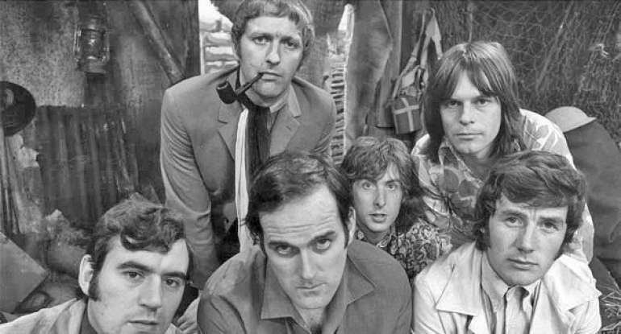
Introduction to Python
Back to chapter slide

Slide 4

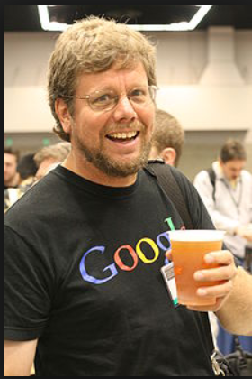
Gist of History
It started as Hobby Project
Python was conceptualized by Guido Van Rossum in late 1980s
Rossum published first version of python in 1992 at CWI (Centrum Wiskunde & Informatica) in Amsterdam.
Name came from his favorite Monty Python’s Flying Circus(refers to picture from previous slide).
Python is derived from ABC programming language, Which is general purpose programming language that had been developed at CWI
Python now maintained by core team at CWI.
Python is a high-level programming language, with applications in numerous areas, including web programming, scripting, scientific computing, and artificial intelligence.

Slide 5
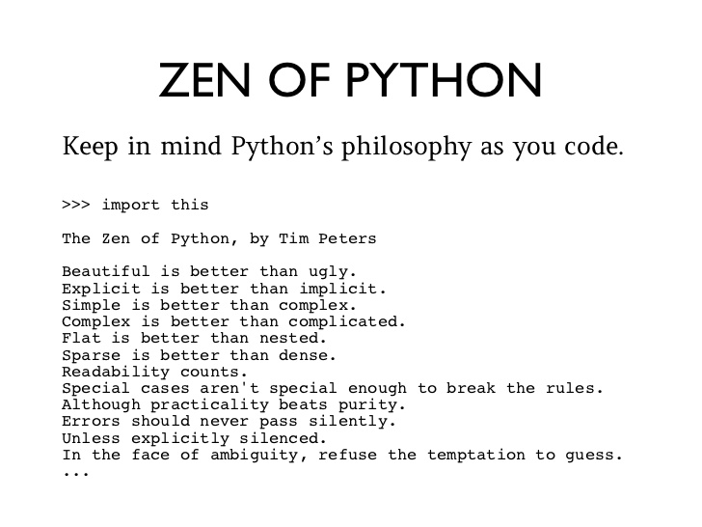
Get In Depth Analysis of Zen Philosophy here…..

Slide 6
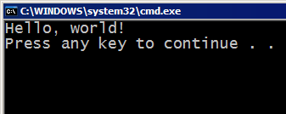



Many languages require you to compile (translate) your program into a form that the machine understands.
Python is instead directly interpreted into machine instructions.
interpret
compile
execute
source code
Hello.java
byte code
Hello.class
output

Slide 7
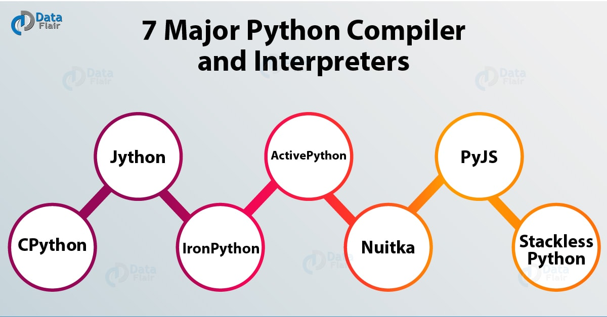

Slide 8
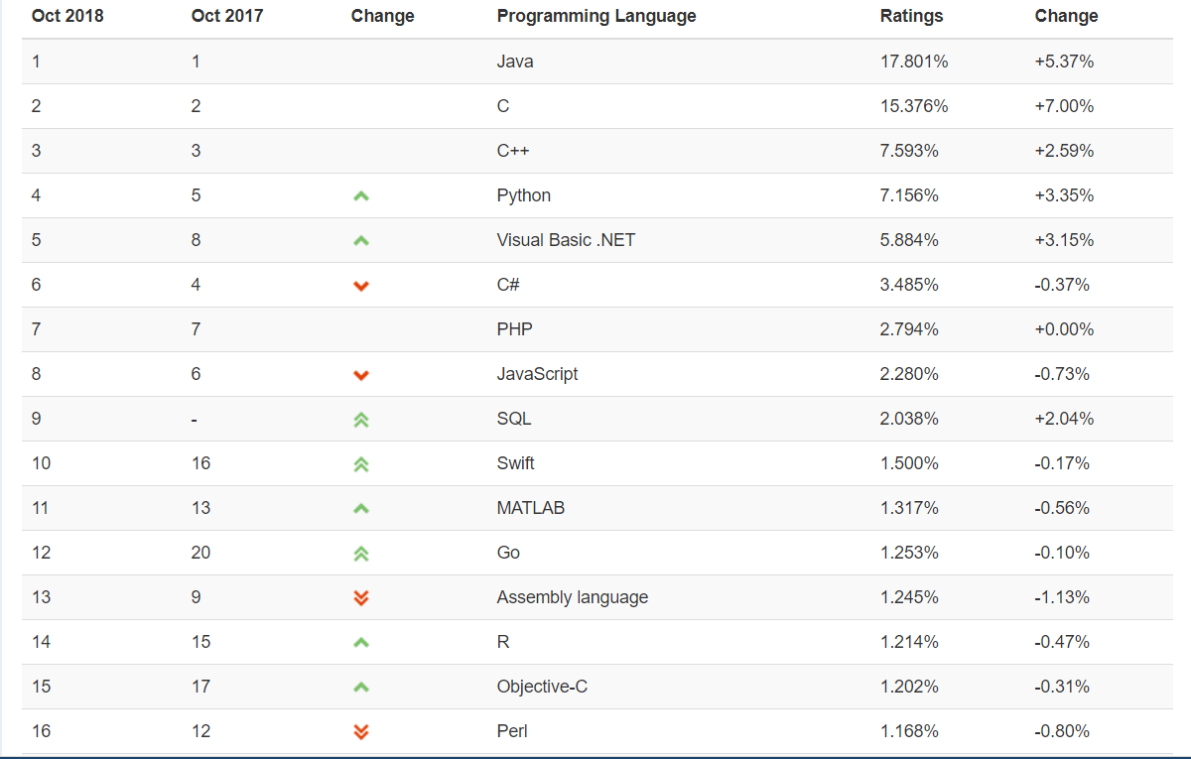
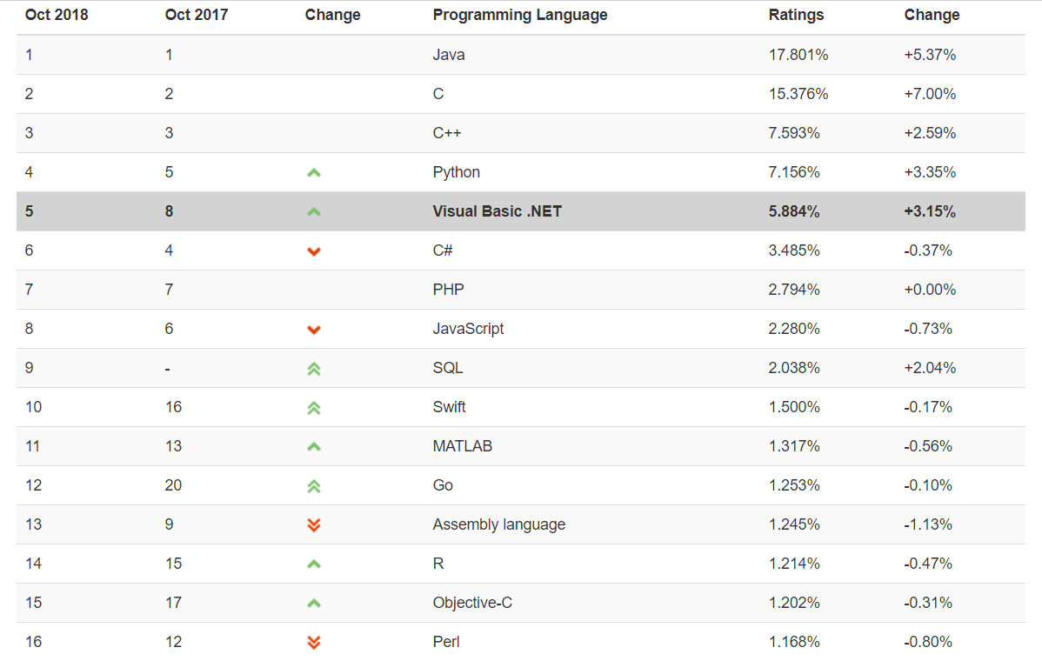
Tiobe Index

Slide 9
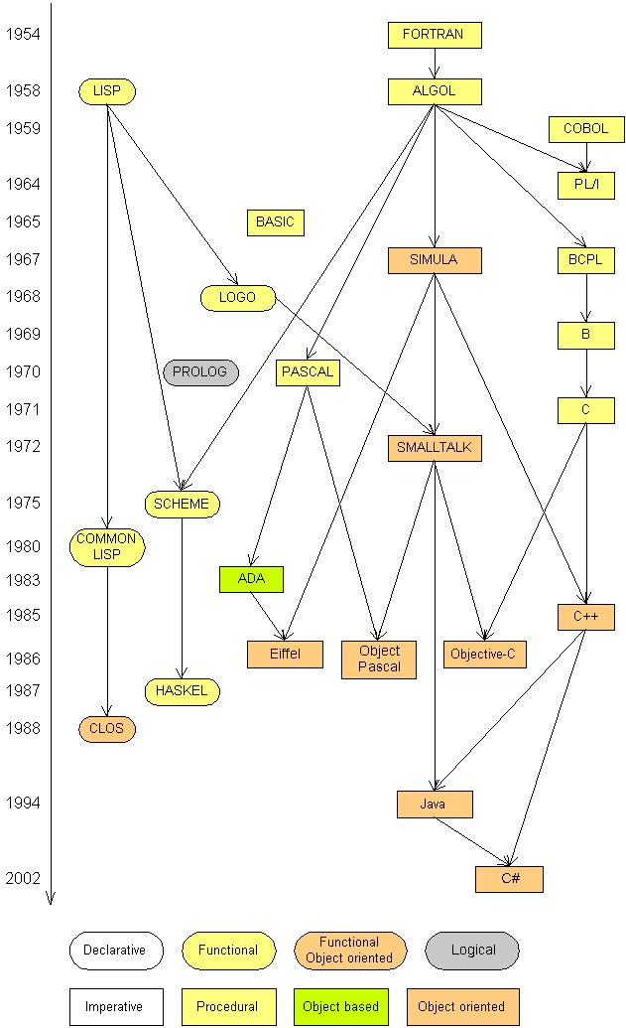
Gist of History
Programming Languages Over the Period other than Python
Some influential ones:
FORTRAN
science / engineering
COBOL
business data
LISP
logic and AI
BASIC
a simple language

Slide 10
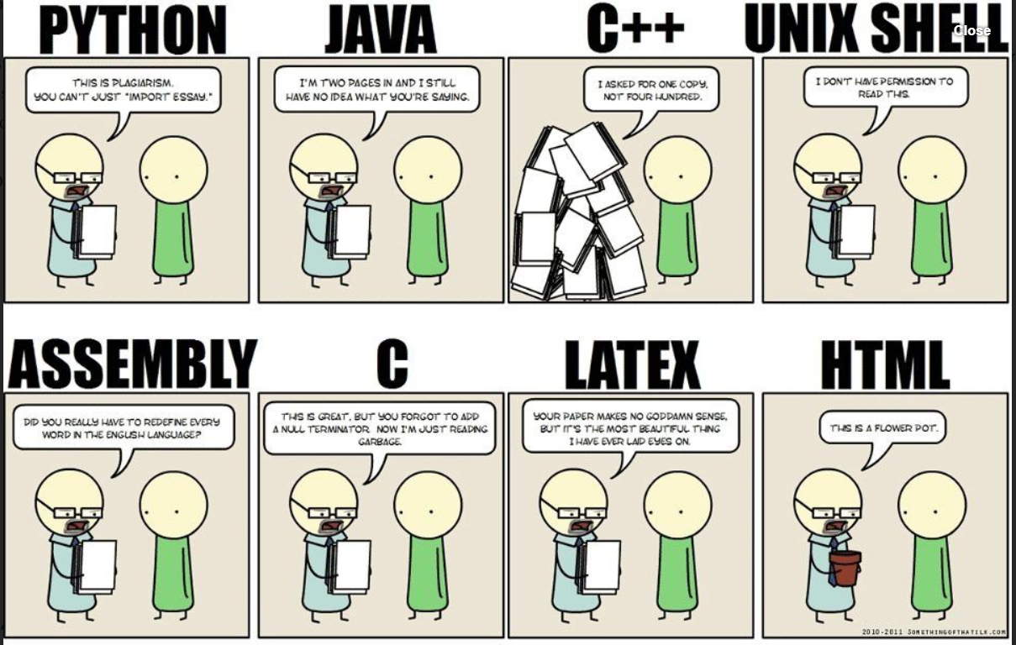
Analogy of Programming Languages

Slide 11
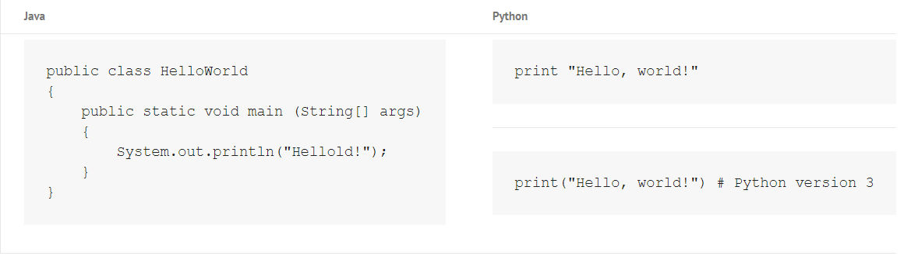
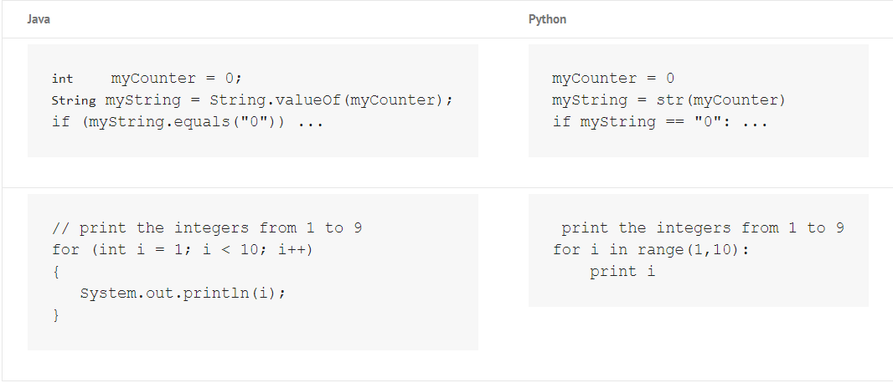
Compare Python with Java

Slide 12
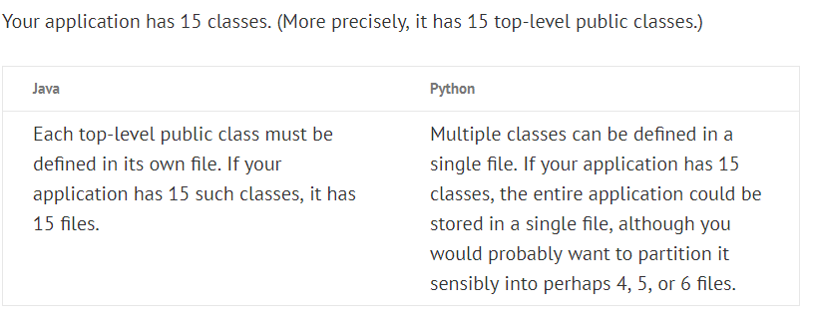
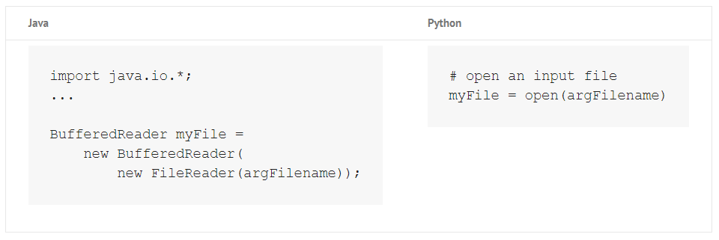
Cont..

Slide 13
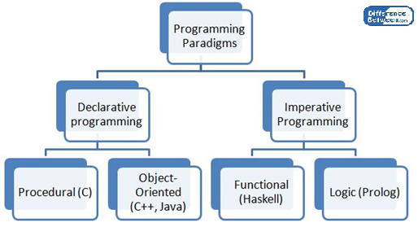
Multi Paradigm Programming with Python

Slide 14
Executing in Python Console
>>> print('Hello world!') Hello world!
When using a computer, you will need to download and install Python from www.python.org. Note the >>> in the code above. They are the prompt symbol of the Python console. Python is an interpreted language, which means that each line is executed as it is entered. Python also includes IDLE, the integrated development environment, which includes tools for writing and debugging entire programs.
Simple Operations
Dividing by zero in Python produces an error, as no answer can be calculated.>>> 11 / 0 Traceback (most recent call last): File "<stdin>", line 1, in <module> ZeroDivisionError: division by zero In Python, the last line of an error message indicates the error's type. Read error messages carefully, as they often tell you how to fix a program!
Floats
Floats are used in Python to represent numbers that aren't integers. Some examples of numbers that are represented as floats are 0.5 and -7.8237591. They can be created directly by entering a number with a decimal point, or by using operations such as division on integers. Extra zeros at the number's end are ignored.>>> 3/4 0.75 >>> 9.8765000 9.8765 Computers can't store floats perfectly accurately, in the same way that we can't write down the complete decimal expansion of 1/3 (0.3333333333333333...). Keep this in mind, because it often leads to infuriating bugs!

Slide 15
Indentation
Python uses indentation (white space at the beginning of a line) to delimit blocks of code. Other languages, such as C, use curly braces to accomplish this, but in Python indentation is mandatory; programs won't work without it. As you can see, the statements in the if should be indented.
if expression: statements
num = 12 if num > 5: print("Bigger than 5") if num <=47: print("Between 5 and 47")
In other programming languages, equivalents to the elif statement have varying names, including else if, elseif or elsif.
Python uses words for its Boolean operators, whereas most other languages use symbols such as &&, || and !.

Slide 16
Basic types/modules used
Type:
Strings
String Operators
Lists
Tuples
Dictionaries
List comprehensions
Type Conversion
Operators and Operators precedence
Modules:
Bottle (rest api calls)
OS, Socket
WSGIServer
JSON
Nacked.toolshed.shell- Muterun_js, execute_js
requests

Slide 17
I/O Operations
Opening Files
You can specify the mode used to open a file by applying a second argument to the open function. Sending "r" means open in read mode, which is the default. Sending "w" means write mode, for rewriting the contents of a file. Sending "a" means append mode, for adding new content to the end of the file. Adding "b" to a mode opens it in binary mode, which is used for non-text files (such as image and sound files). For example:# write mode open("filename.txt", "w") # read mode open("filename.txt", "r") open("filename.txt") # binary write mode open("filename.txt", "wb")
Writing a File
file = open("newfile.txt", "w") file.write("This has been written to a file") file.close() file = open("newfile.txt", "r") print(file.read()) file.close()
Reading Files
The contents of a file that has been opened in text mode can be read using the read method.
file = open("filename.txt", "r") cont = file.read() print(cont) file.close()

Slide 18
Exceptions
Different exceptions are raised for different reasons. Common exceptions: ImportError: an import fails; IndexError: a list is indexed with an out-of-range number; NameError: an unknown variable is used; SyntaxError: the code can't be parsed properly; TypeError: a function is called on a value of an inappropriate type; ValueError: a function is called on a value of the correct type, but with an inappropriate value. Python has several other built-in exceptions, such as ZeroDivisionError and OSError. Third-party libraries also often define their own exceptions.

Slide 19
Python Web Frameworks
Flask Framework : is a small and powerful web framework for Python. It's easy to study and simple to use, This will enabling you to build your web applications in a short time span.
Bottle Framework : fast and powerful Python micro-framework, perfect for small web applications and rapid prototyping. It’s also an excellent learning tool for those just getting starting with web development.
Django Framework : is a free and open source web application framework, written in Python, which follows the model view controller (MVC) architectural pattern. Django is a web framework designed to help you build complex web applications simply and quickly. It’s written in the Python programming language.

Slide 20
How to host python web services
from bottle import get,post,static_file,default_app,request from gevent import monkey, sleep, spawn from gevent.pywsgi import WSGIServer
if __name__ == '__main__': # Set up when running stand alone
print('Starting localhost webserver at port 3030') server = WSGIServer(('localhost', 3030), default_app()) server.serve_forever()

Slide 22
Basic types/modules used
Strings
Some characters can't be directly included in a string. For instance, double quotes can't be directly included in a double quote string; this would cause it to end prematurely. Characters like these must be escaped by placing a backslash before them. Other common characters that must be escaped are newlines and backslashes. Double quotes only need to be escaped in double quote strings, and the same is true for single quote strings.
>>> 'Brian\'s mother: He\'s not the Messiah. He\'s a very naughty boy!' 'Brian's mother: He's not the Messiah. He's a very naughty boy!' \n represents a new line. Backslashes can also be used to escape tabs, arbitrary Unicode characters, and various other things that can't be reliably printed. These characters are known as escape characters.
String Concatenation
>>> print("First string" + ", " + "second string")
Input
To get input from the user in Python, you can use the intuitively named input function. The function prompts the user for input, and returns what they enter as a string (with the contents automatically escaped).
>>> input("Enter something please: ") Enter something please: This is what\nthe user enters! 'This is what\\nthe user enters! The print and input functions aren't very useful at the Python console, which automatically does input and output. However, they are very useful in actual programs.

Slide 23
Basic types/modules used
Type Conversion
In Python, it's impossible to complete certain operations due to the types involved. For instance, you can't add two strings containing the numbers 2 and 3 together to produce the integer 5, as the operation will be performed on strings, making the result '23'. The solution to this is type conversion. In that example, you would use the int function.>>> "2" + "3" '23' >>> int("2") + int("3") 5T In Python, the types we have used so far have been integers, floats, and strings. The functions used to convert to these are int, float and str, respectively.

Slide 24
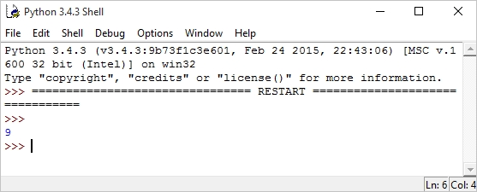
Using an editor
Using an Editor
So far, we've only used Python with the console, entering and running one line of code at a time. Actual programs are created differently; many lines of code are written in a file, and then executed with the Python interpreter. In IDLE, this can be done by creating a new file, entering some code, saving the file, and running it. This can be done either with the menus or with the keyboard shortcuts Ctrl-N, Ctrl-S and F5. Each line of code in the file is interpreted as though you entered it one line at a time at the console.x = 7 x = x + 2 print(x)

Slide 25
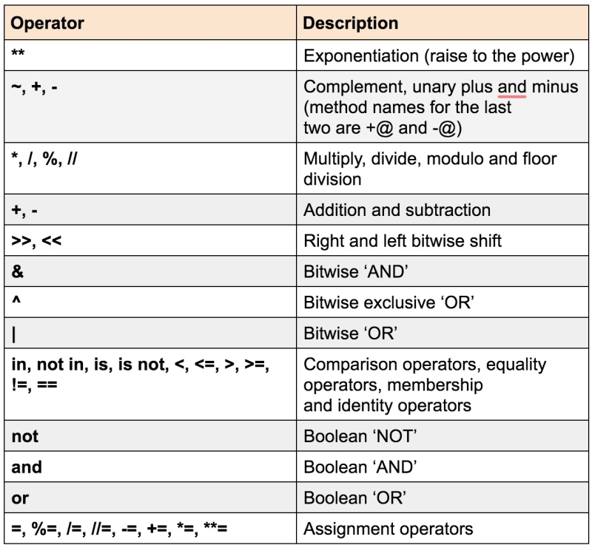
Operator and Operator Precedence
Operator Precedence
Operator precedence is a very important concept in programming. It is an extension of the mathematical idea of order of operations (multiplication being performed before addition, etc.) to include other operators, such as those in Boolean logic. The below code shows that == has a higher precedence than or:>>> False == False or True True >>> False == (False or True) False >>> (False == False) or True True Python's order of operations is the same as that of normal mathematics: parentheses first, then exponentiation, then multiplication/division, and then addition/subtraction.
Operators in the same box have the same precedence.

Slide 26
Lists
Lists of lists are often used to represent 2D grids, as Python lacks the multidimensional arrays that would be used for this in other languages.
Lists
Lists are another type of object in Python. They are used to store an indexed list of items. A list is created using square brackets with commas separating items. The certain item in the list can be accessed by using its index in square brackets. For example:words = ["Hello", "world", "!"] print(words[0]) print(words[1]) print(words[2])
Typically, a list will contain items of a single item type, but it is also possible to include several different types. Lists can also be nested within other lists.number = 3 things = ["string", 0, [1, 2, number], 4.56] print(things[1]) print(things[2]) print(things[2][2])

Slide 27
Dictionaries
Dictionaries
An empty dictionary is defined as {}. Trying to index a key that isn't part of the dictionary returns a KeyError. Example:primary = { "red": [255, 0, 0], "green": [0, 255, 0], "blue": [0, 0, 255], } print(primary["red"]) print(primary["yellow"]) Result:>>> [255, 0, 0] KeyError: 'yellow' >>>
Only immutable objects can be used as keys to dictionaries. Immutable objects are those that can't be changed. So far, the only mutable objects you've come across are lists and dictionaries. Trying to use a mutable object as a dictionary key causes a TypeError.bad_dict = { [1, 2, 3]: "one two three", } Result:>>> TypeError: unhashable type: 'list' >>>

Slide 28
Dictionaries
Dictionaries
A useful dictionary method is get. It does the same thing as indexing, but if the key is not found in the dictionary it returns another specified value instead ('None', by default). Example:pairs = {1: "apple", "orange": [2, 3, 4], True: False, None: "True", } print(pairs.get("orange")) print(pairs.get(7)) print(pairs.get(12345, "not in dictionary"))
Result:>>> [2, 3, 4] None not in dictionary >>>

Slide 29
Tuples
Tuples
Tuples are very similar to lists, except that they are immutable (they cannot be changed). Also, they are created using parentheses, rather than square brackets. Example:words = ("spam", "eggs", "sausages",) You can access the values in the tuple with their index, just as you did with lists:print(words[0]) Trying to reassign a value in a tuple causes a TypeError.words[1] = "cheese" Result:>>> TypeError: 'tuple' object does not support item assignment >>> Like lists and dictionaries, tuples can be nested within each other
# list
list = ["one", "two" ]
# dictionary
dict = {
1:"one",
2:"two“
}
# tuple
tp = ("one", "two")

Slide 30
List Slices
List Slices
List slices provide a more advanced way of retrieving values from a list. Basic list slicing involves indexing a list with two colon-separated integers. This returns a new list containing all the values in the old list between the indices. Example:squares = [0, 1, 4, 9, 16, 25, 36, 49, 64, 81] print(squares[2:6]) print(squares[3:8]) print(squares[0:1]) Result:>>> [4, 9, 16, 25] [9, 16, 25, 36, 49] [0] >>> Like the arguments to range, the first index provided in a slice is included in the result, but the second isn't.

Slide 31
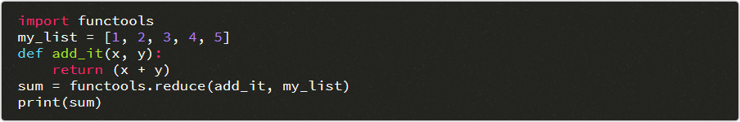
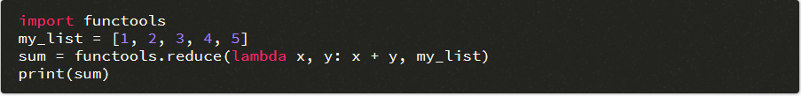
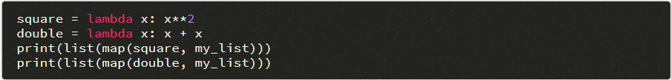
Functional Programming paradigm
The functional coding style treats everything like a math equation. The two most common ways to compute the sum of my_list would be to use a local function or a lambda expression. Here’s how you’d do it with a local function in Python 3.6:

Slide 32
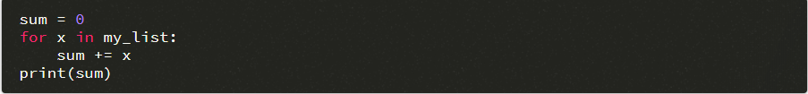
Imperative Programming Paradigm
In imperative programming, you focus on how a program operates. Programs change state information as needed in order to achieve a goal. Here’s an example using my_list:
Unlike the previous examples, the value of sum changes with each iteration of the loop. As a result, sum has state. When a variable has state, something must maintain that state, which means that the variable is tied to a specific processor. Imperative coding works on simple applications, but code executes too slowly for optimal results on complex data science applications.

Slide 33
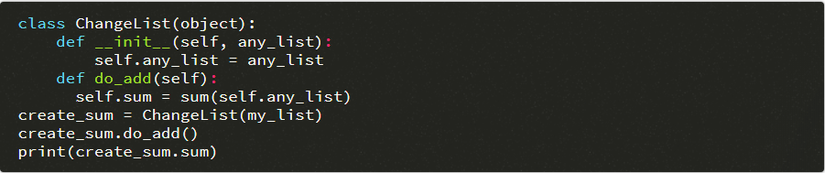
Object Oriented Approach
Object-oriented coding is all about increasing an application’s ability to reuse code and make it easier to understand. The encapsulation that object-orientation provides allows developers to treat code as a black box. Using object-orientation features like inheritance make it easier to expand the functionality of existing code. Here is the my_list example in object-oriented form:
In this case, create_sum is an instance of ChangeList. The inner workings of ChangeList don’t matter to the person using it. All that really matters is that you can create an instance using a list and then call the do_add() method to output the sum of the list elements. Because the inner workings are hidden, the overall application is easier to understand.

Slide 34
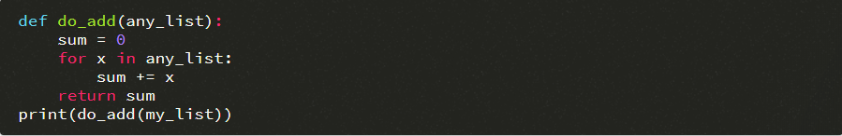
Procedure Oriented paradigm
The procedural style relies on procedure calls to create modularized code. This approach simplifies your application code by breaking it into small pieces that a developer can view easily. Even though procedural coding is an older form of application development, it’s still a viable approach for tasks that lend themselves to step-by-step execution. Here’s an example of the procedural coding style using my_list:
The use of a function, do_add(), simplifies the overall code in this case. The execution is still systematic, but the code is easier to understand because it’s broken into chunks. However, this code suffers from the same issues as the imperative paradigm in that the use of state limits execution options, which means that this approach may not use hardware efficiently when tackling complex problems.

