Slide 1
Project Presentation
Retail Sales Prediction
Prepared by
Bharath Muthusivam

Slide 2
Content
Problem Statement
Data Study
Data Preprocessing for EDA
Exploratory Data Analysis (EDA)
EDA on Sales and Stores data
EDA on merged data
Data Preprocessing for modelling
Feature Scaling
Feature Selection
Model building
Stacking
Conclusion
Click the below link to open Googlecolab file:
Retail_Sales_Prediction

Slide 3
Problem Statement
XYZ operates over 3,000 drug stores in 7 countries.
XYZ store managers are tasked with predicting their daily sales up to six weeks in advance.
Store sales are influenced by many factors, including promotions, competition, school, and state holidays, seasonality, and locality.
The task is to forecast the "Sales" column for the test set.

Slide 4
Data Study
Sales data is given for the years 2013, 2014 and 2015 with 9 features and 101209 observations.
Stores data is given for 1115 stores.
Features in sales data are 'Store', 'DayOfWeek', 'Date', 'Sales', 'Customers', 'Open', 'Promo', 'StateHoliday', 'SchoolHoliday'
Features in stores data are 'Store', 'StoreType', 'Assortment', 'CompetitionDistance', 'CompetitionOpenSinceMonth', 'CompetitionOpenSinceYear', 'Promo2', 'Promo2SinceWeek', 'Promo2SinceYear', 'PromoInterval'

Slide 5
Data Study continuation
There are no duplicates in sales and stores data.
There are no NULL values in stores data.
There are 5 features (CompetitionOpenSinceMonth, CompetitionOpenSinceYear, Promo2SinceWeek, Promo2SinceYear, PromoInterval) in sales data with more than 30% NULL values.
CompetitionDistance has 3 missing values out of the 1115 stores.
There are outliers present in Sales, Customers and CompetitionDistance features of sales and stores data.

Slide 6
Data Preprocessing for EDA
Created a user-defined function named preprocess_eda to perform the below tasks.
Converting ‘Date’ column to datetime datatype and extracting ‘Day’, ‘Month’, ‘Year’, ‘WeekOfYear’.
Mapping 0 and ‘0’ as 0 and ‘a’, ’b’ and ‘c’ as 1 in ‘StateHoliday’ column which will now indicate binary value of 0 and 1 if the store has a state holiday or not.
Imputing the 3 missing values present in ‘CompetitionDistance’ with the median value as outliers are present in it and converting the column to integer datatype.

Slide 7
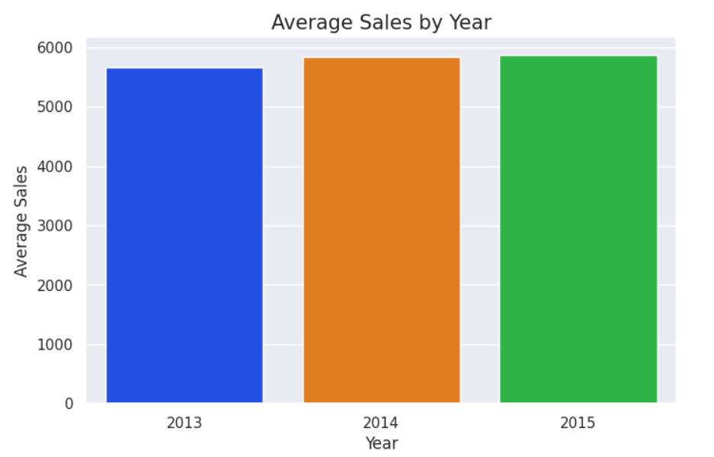
Exploratory Data Analysis (EDA)
EDA on Sales and Stores data
There is no significant change in the average sales per year for all 3 years.

Slide 8
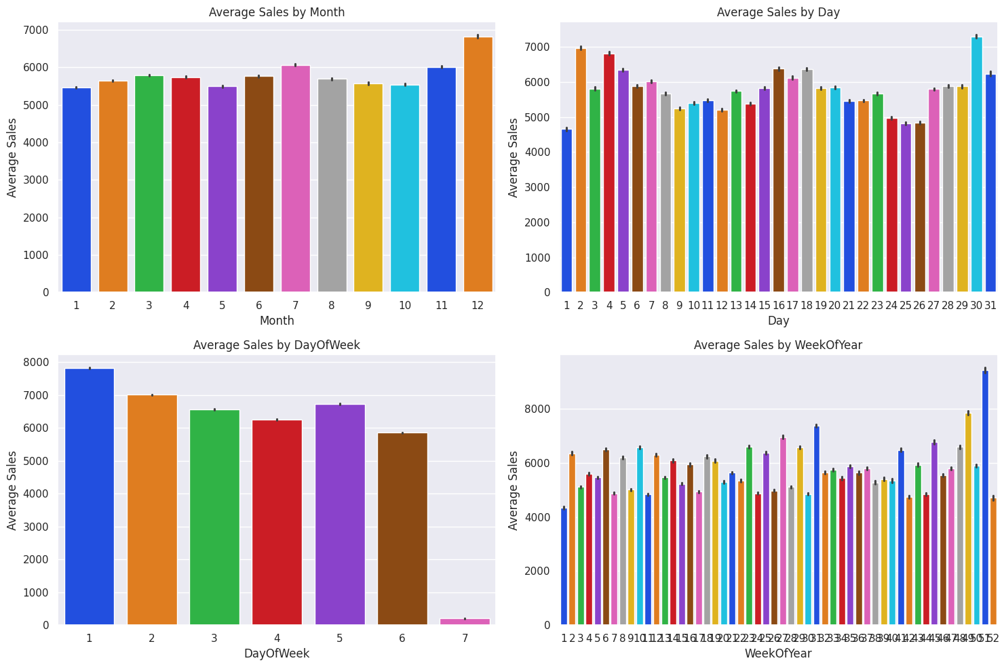
EDA continued
Analysis of sales vs 'Month', 'Day’, 'DayOfWeek', 'WeekOfYear’ indicates that there is a significant increase in sales in the month of December, that too during the 51st week of the year which clearly indicates high sales during Christmas Eve.

Slide 9
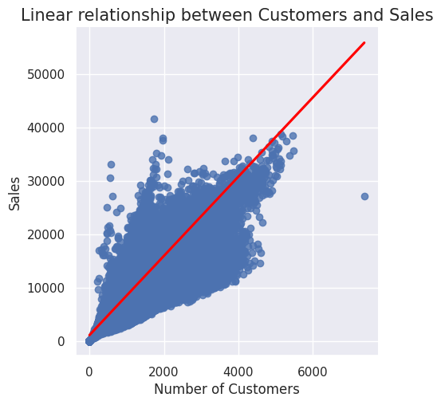
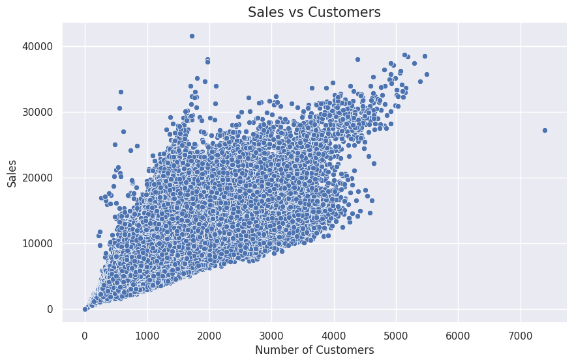
EDA continued
Relationship between Sales and Customers. There is an increase in Sales with increase in Customers.

Slide 10
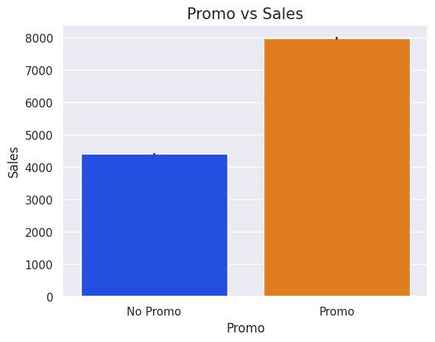
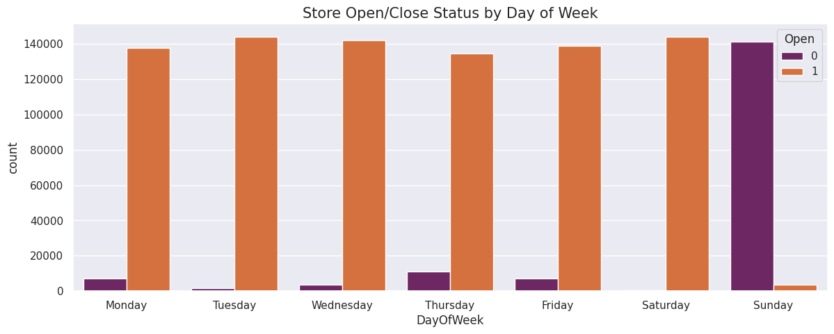
EDA continued
Promo has a significant impact on the sales. When promo is running we could see the sales is almost doubled when compared to when promo is not.
Most of the stores are closed on Sunday.

Slide 11
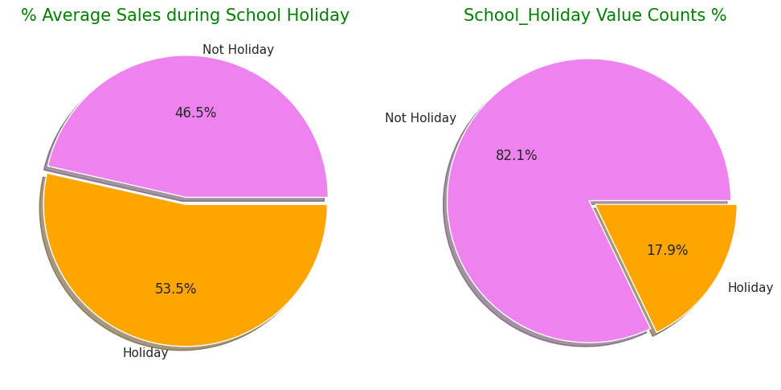
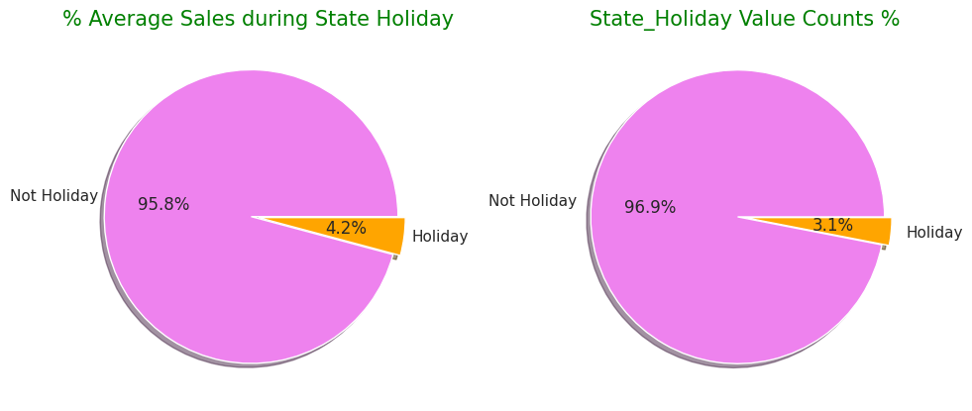
EDA continued
Sales during school holidays are high when compared to other days even though we have only around 18% of the total days as school holidays.
State holidays doesn’t have much impact on the sales.

Slide 12
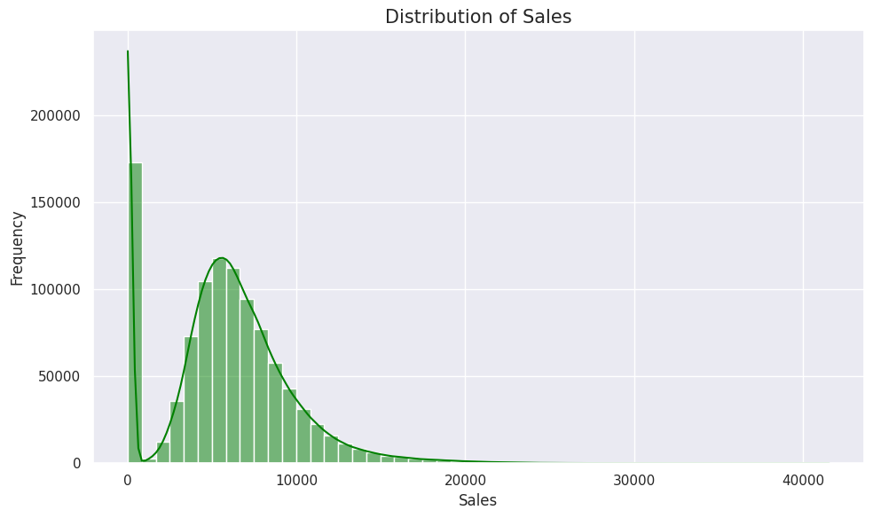
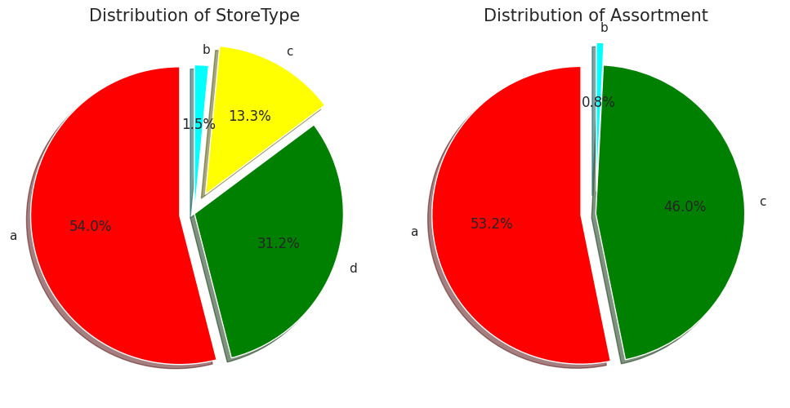
EDA continued
We have a normally distributed sales with some right skewed data. The peak at 0 indicates no sales on holidays as stores are closed on all Sundays and most state holidays.
Pie chart shows the percentage of stores in each store type and assortment

Slide 13
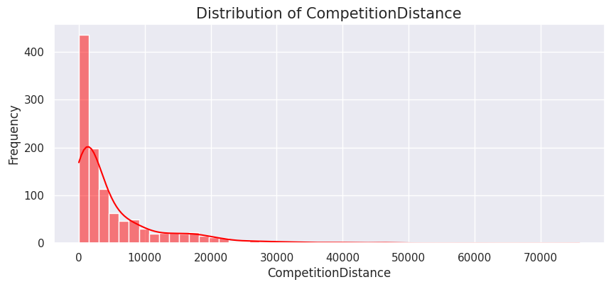
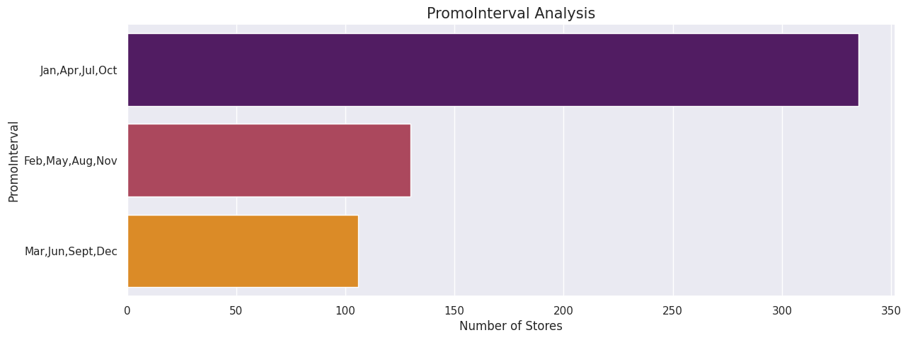
EDA continued
The CompetitionDistance is right skewed. Most of the competition stores are within close range to each other.
Almost 49% of the data is missing in PromoInterval feature. Among the remaining stores, many stores start their Promo2 in Jan,Apr,Jul,Oct cycle.

Slide 14
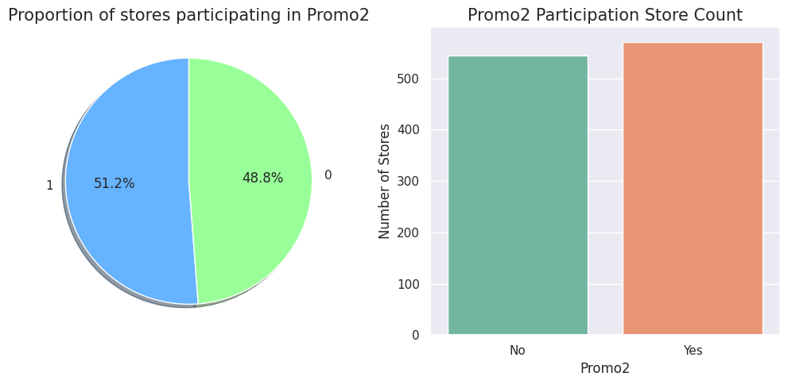
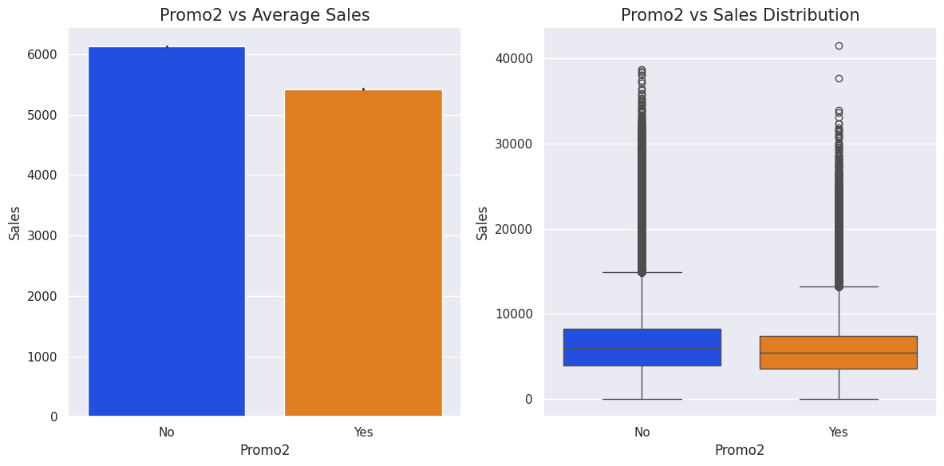
EDA continued
The number of stores that participates in the Promo2 is slightly higher than that of the ones that do not participate.
But the average sales is less during Promo2 even though there are some high sale transactions happened during Promo2.

Slide 15
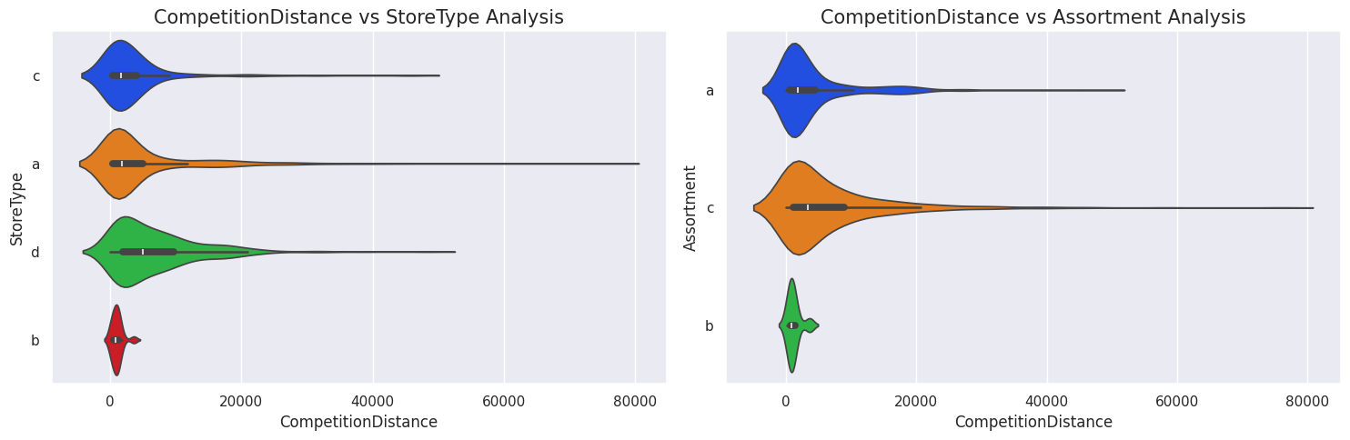
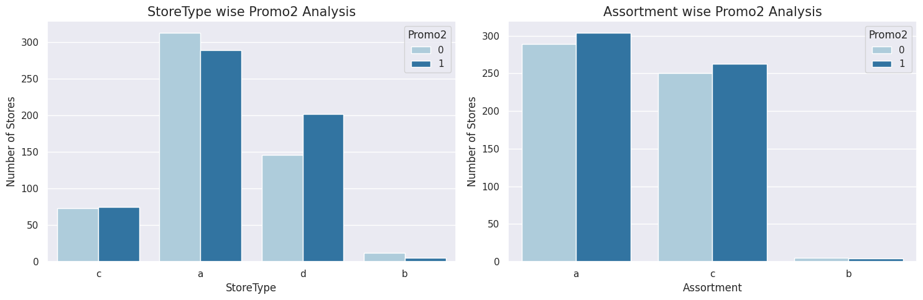
EDA continued
On an average, ‘d’ StoreType and ‘c’ Assortment stores have greater competition distance than others.
Stores under StoreType 'b' and Assortment 'b' are close to each than other types of stores.
Number of stores under StoreType 'a' is higher than others, but it has less stores that run Promo2 than which doesn't. But stores that run Promo2 are higher in Assortment 'a'.

Slide 16
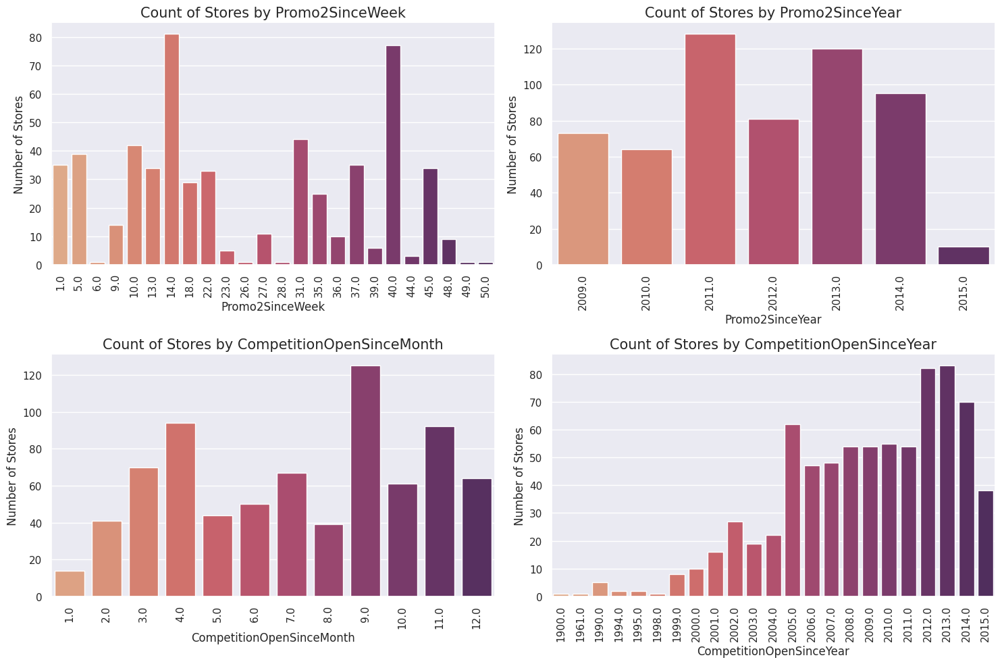
EDA continued
Competition stores have been in raise since 1999 and there is a gradual increase every year till 2013. Then the competition stores seems to have fallen drop.

Slide 17
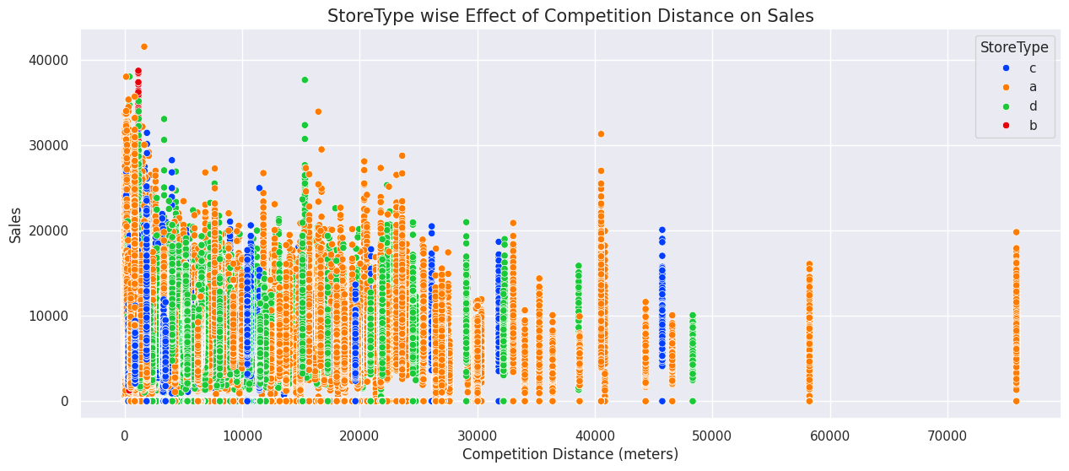
EDA continued b) EDA on merged data
Competition Distance vs Sales shows that the sales is high when the competition distance is less and StoreType ‘a’ has the larger number of sales as well.

Slide 18
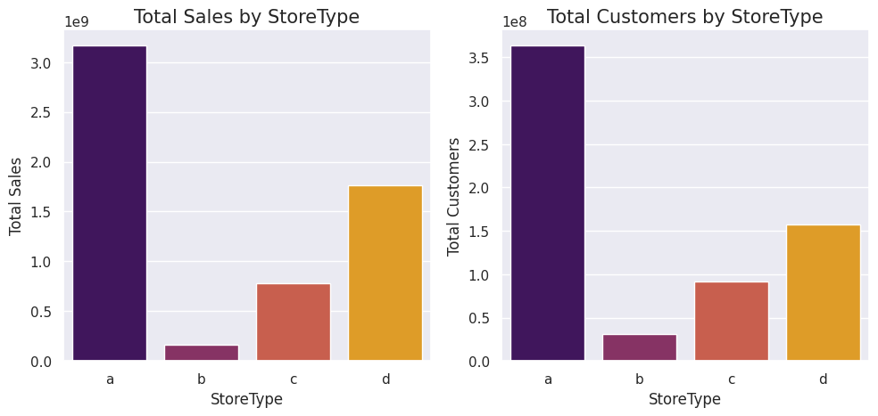
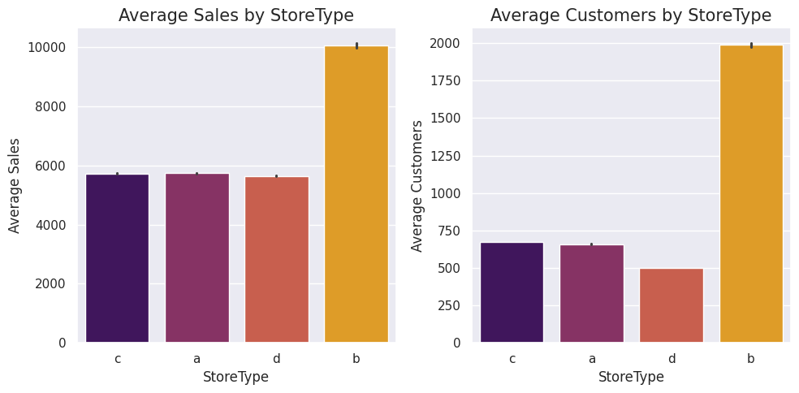
EDA continued
Total sales and customers in store type 'a' is higher than other store types.
But the average spending of customers and average number of customers is high in StoreType 'b'

Slide 19
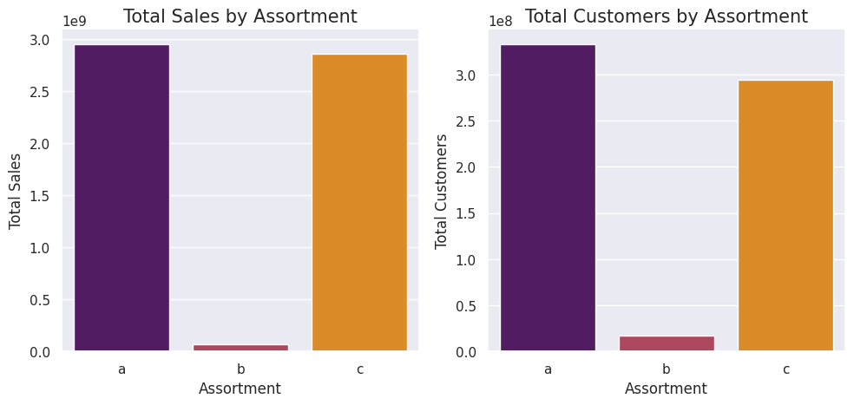
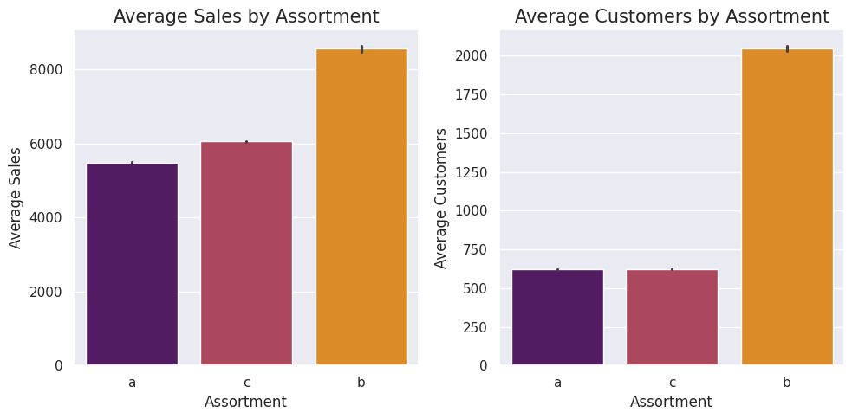
EDA continued
‘a’ assortment level, which is the basic stores get more sales and more customers when compared to others.
But when we look at the average sales and customers, ‘b’ assortment level stores have greater average sales and high average customers.

Slide 20
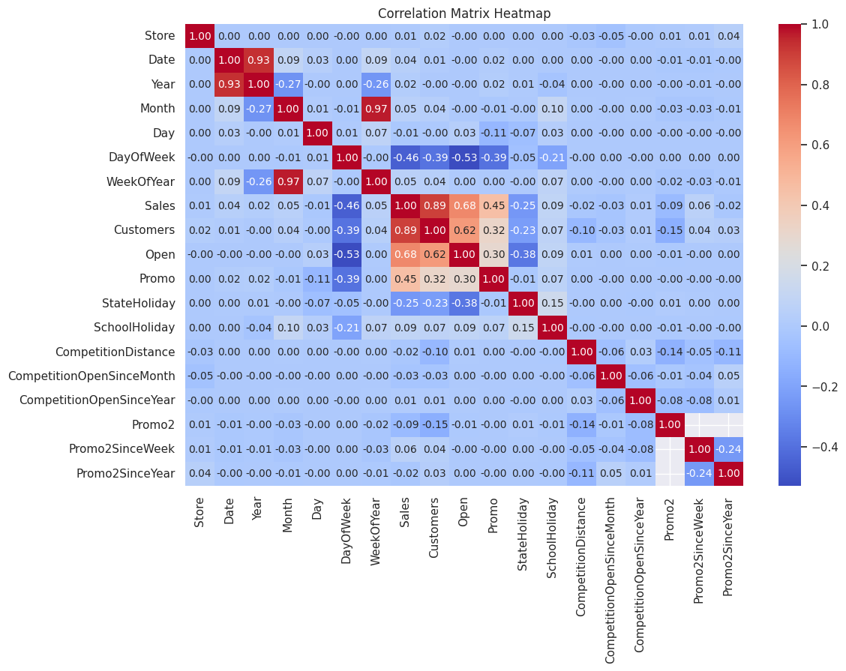
EDA continued
Heatmap shows the correlation between the numerical features of the merged dataset.
Date and WeekOfYear shows high correlation with other features, so it will be removed while modelling.

Slide 21
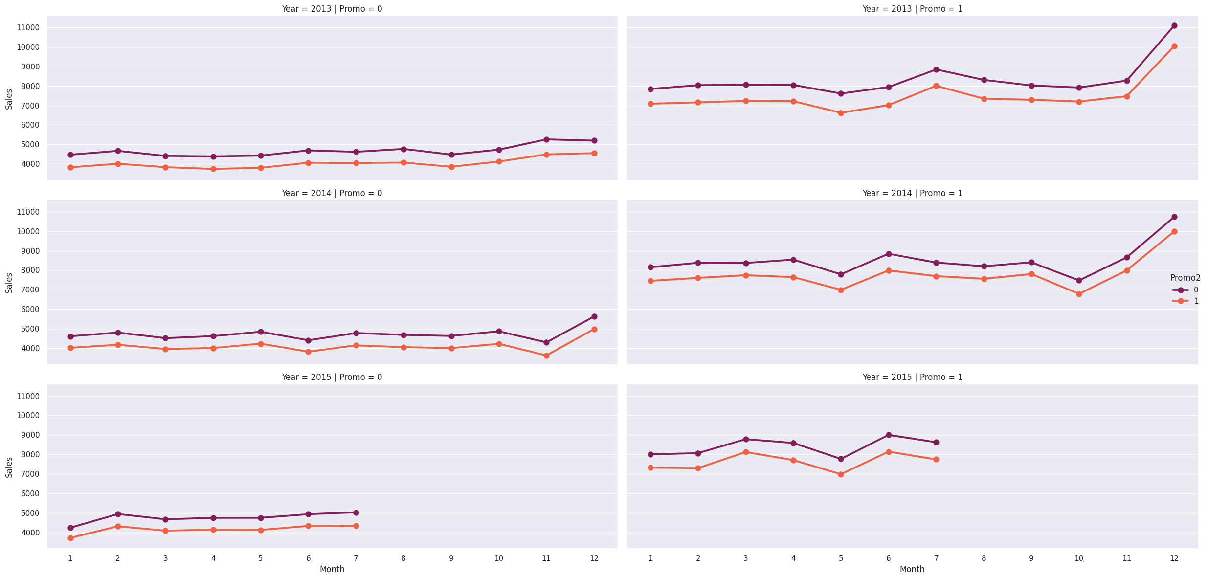
EDA continued
We know Promo has a significant impact on the sales, but Promo2 generates less sales even when the Promo is running.

Slide 22
Data Preprocessing for Modelling
Sampling of data
As the total no of rows is more than 10lakh, we are taking a sample of 2lakh rows.
To ensure that we get data from all stores equally, we have followed the stratified sampling technique.
Data has been grouped based on stores and equal number of random samples has been taken from each group.
No of rows required/No of stores = 200000/1115 = 179.37
So we have taken 180 rows of data randomly from each store.
Now the sample dataset has 200700 rows of data with 22 features (combined sales and stores data)

Slide 23
Data Preprocessing for Modelling continues
Encoding of categorical variables
StoreType’ and ‘Assortment’ features have categorical variables which have been converted to numerical using One Hot Encoding technique.
Features with more than 30% missing values have been dropped along with ‘Date’ and ‘Store’ features.
Feature Scaling
All other features have been scaled using StandardScaler()
A function called preprocess_modelling() was created for the above tasks.

Slide 24
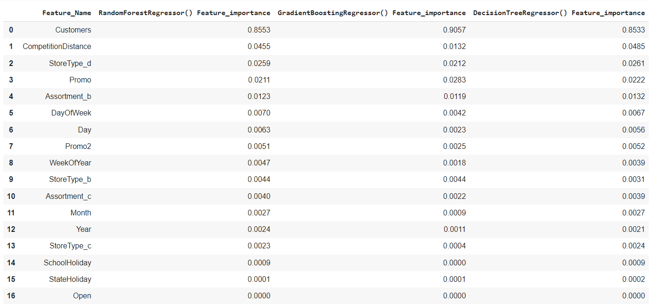
Data Preprocessing for Modelling continues
Feature Selection
Selection of important features has been done using feature_importance of RandomForestRegressor, DecisionTreeRegressor and GradientBoostingRegressor.

Slide 25
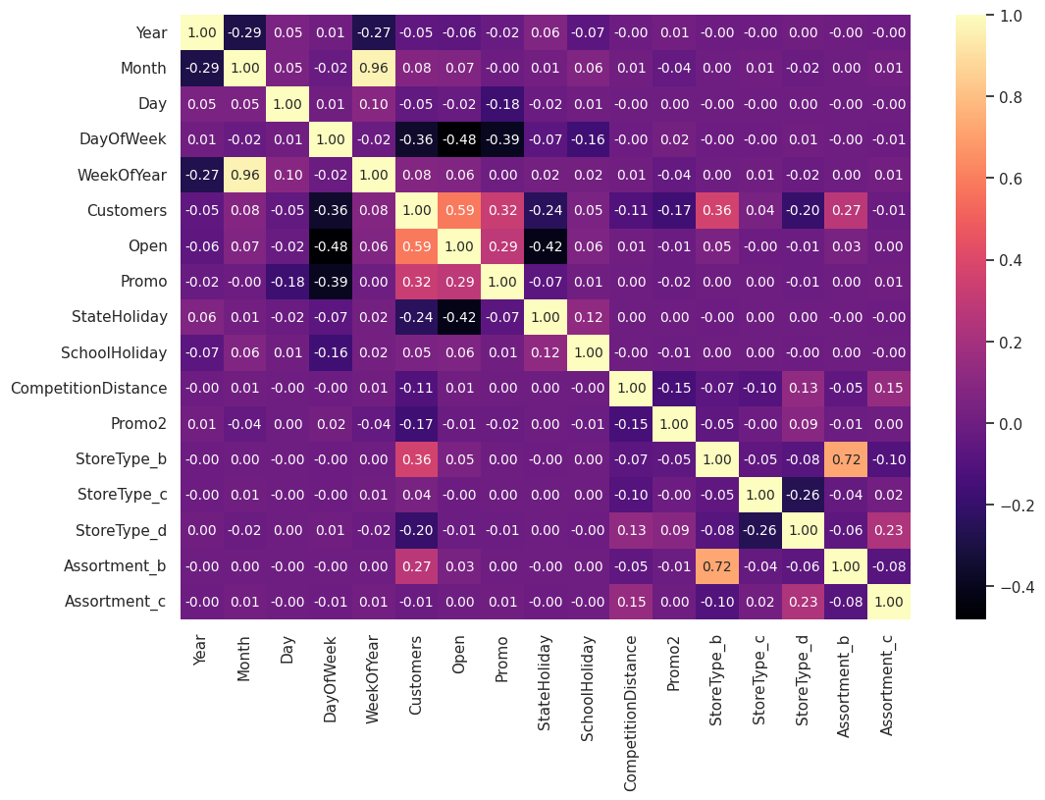
Data Preprocessing for Modelling continues
‘StateHoliday’, ‘SchoolHoliday’ and ‘Open’ features are least important in all 3 findings.
Correlation heatmap shows that ‘WeekOfYear’ feature has high correlation.
Dropping these features from the dataset to get our final data.

Slide 26
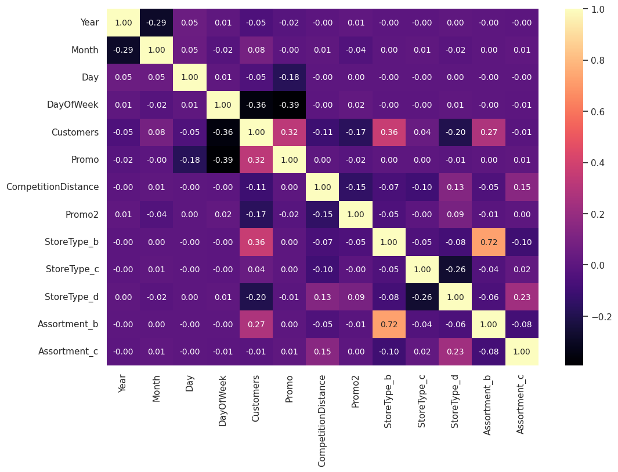
Data Preprocessing for Modelling continues
Heatmap of rest of the features in our final data shows that there is no features with high correlation.

Slide 27
Model building
Necessary libraries were used to import the models, metrics and train_test_split was performed to split the training and testing data.
Models implemented
LinearRegression
RandomForestRegressor
XGBRegressor
GradientBoostingRegressor
AdaBoostRegressor
DecisionTreeRegressor
KNeighborsRegressor

Slide 28
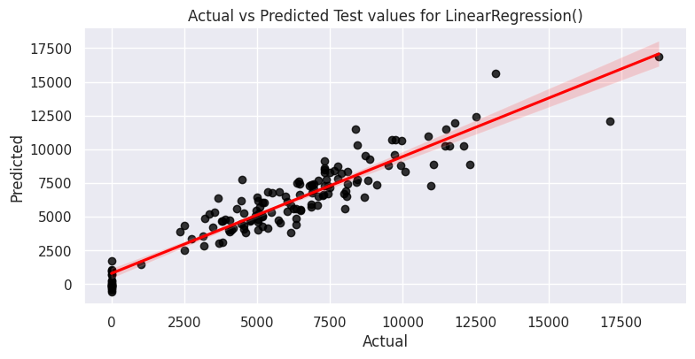
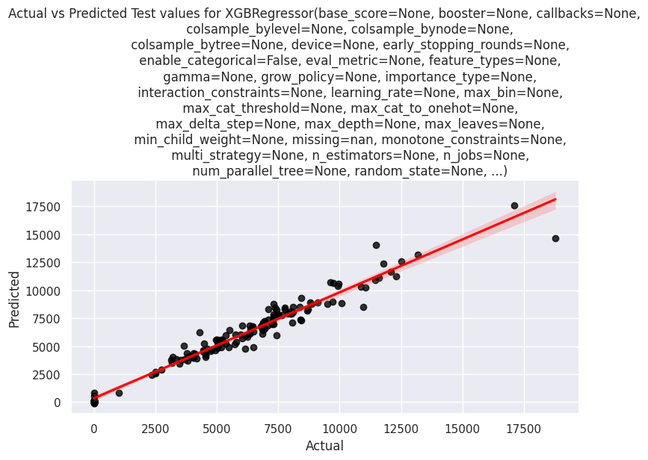
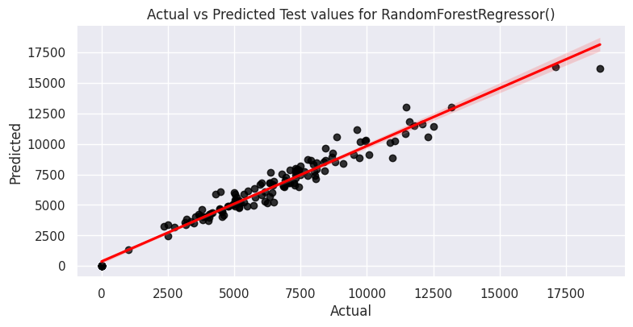
Model building continues
Models Evaluation
Evaluate_model() function has been built for model building, to calculate the evaluation metrics and to display how well the model fits our data.

Slide 29
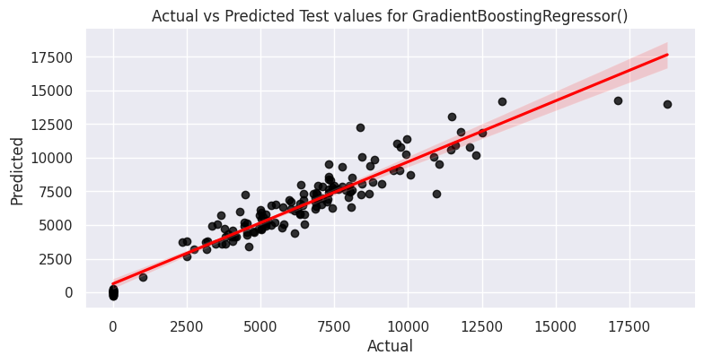
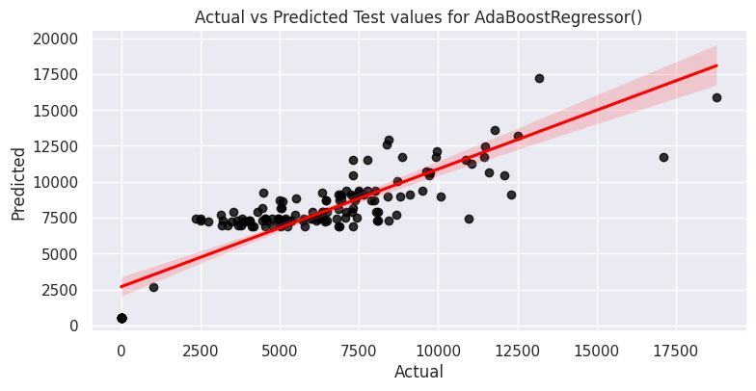
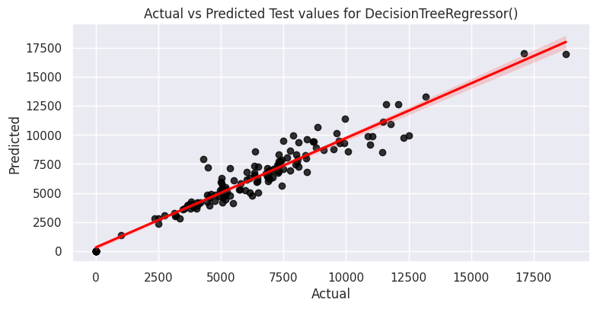
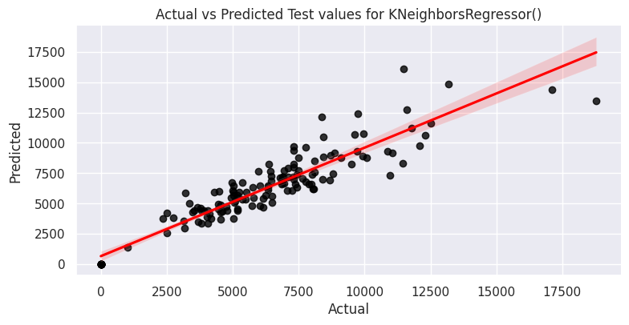
Model building continues

Slide 30
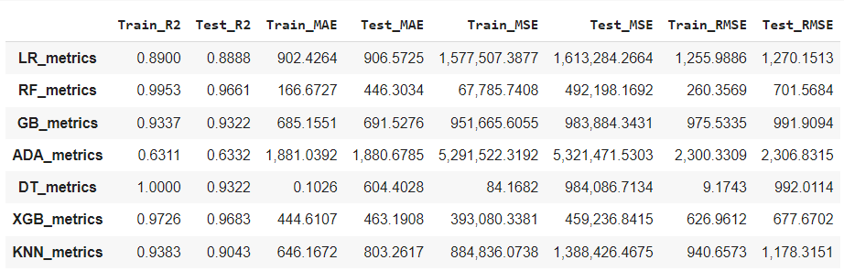
Model building continues
Evaluation metrics of models used
We could see that Random Forest and XGBoost has given better performance than other models. Amongst the models used, ADABoost has performed poorly.

Slide 31
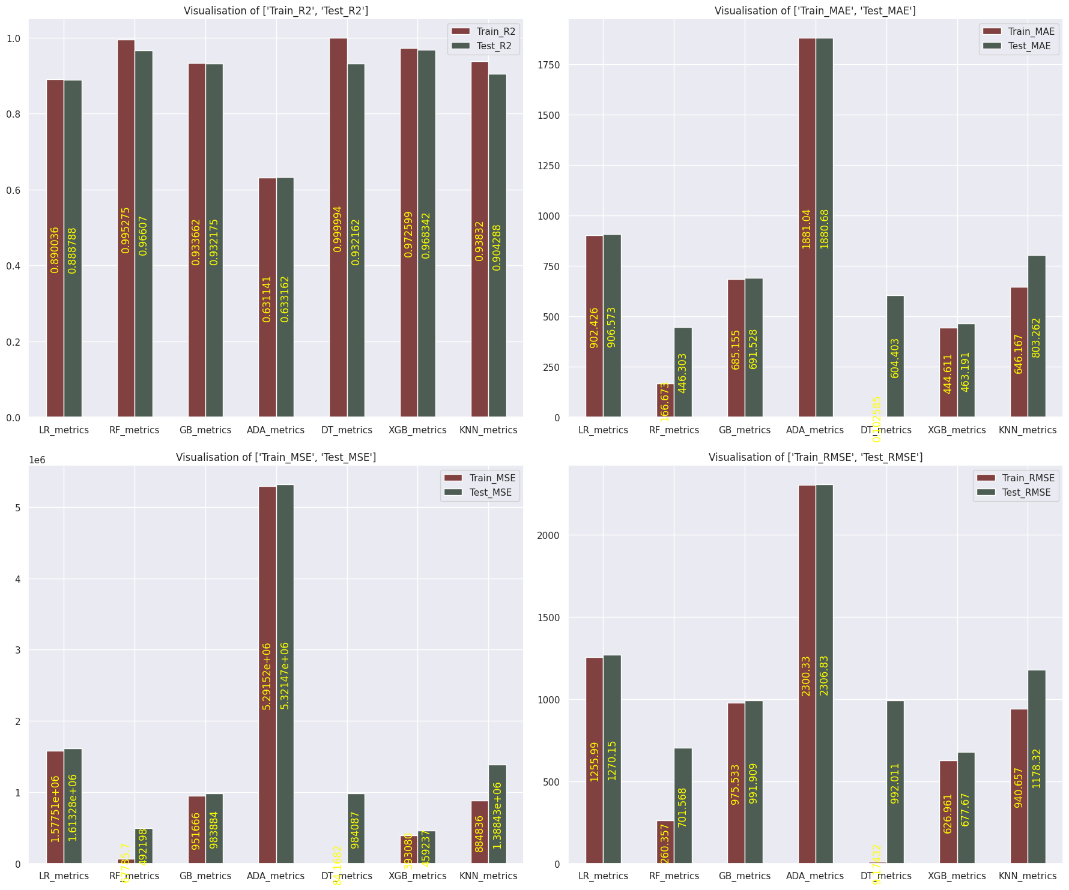
Model building continues
Evaluation metrics visualization

Slide 32
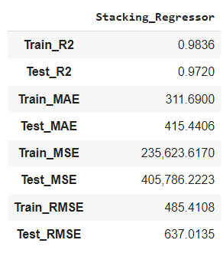
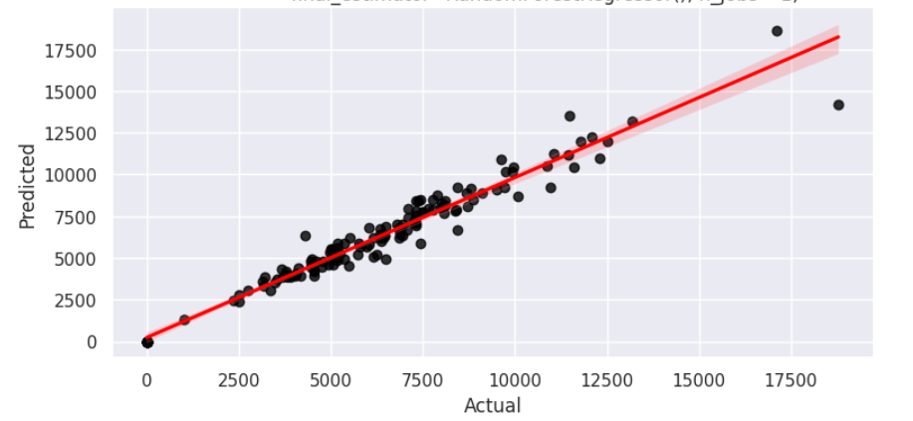
Stacking
A stacking model has been built using the models except ADABoost as it has poor performance.
Stacking result has given a R2_score of 0.972 and RMSE of 637 which is good when compared with other models.

Slide 33
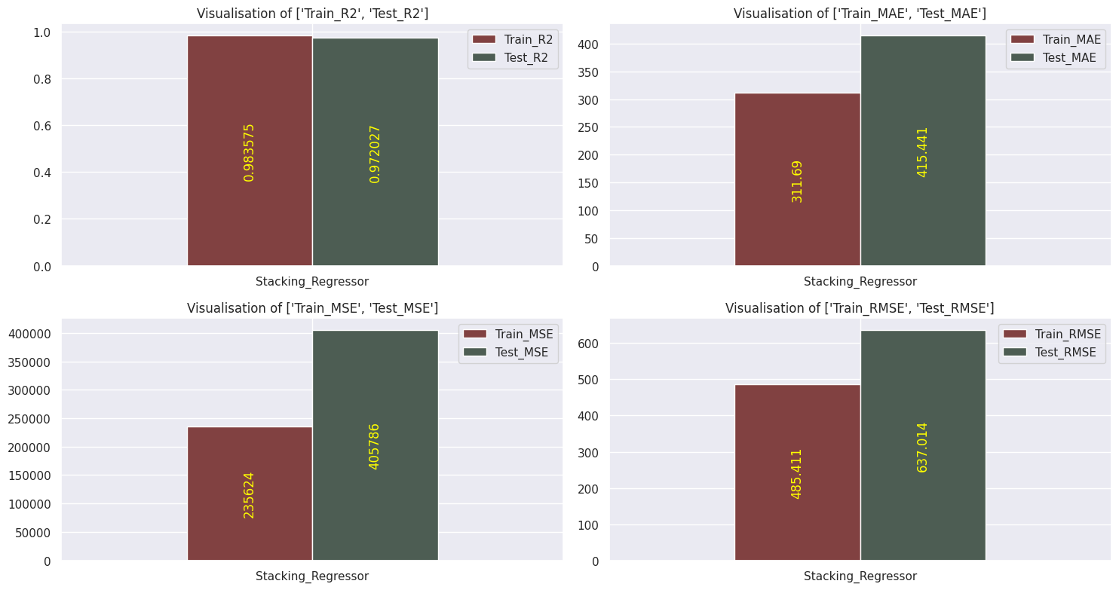
Stacking continues
Visualization of stacking results

Slide 34
Conclusion
Stacking model is best to predict the sales and ‘Customers’, ‘CompetitionDistance’, ‘StoreType’ and ‘Promo’ are the important features that has to be focused to increase the sales.

