Slide 1





►
Image►Text
►
►
►
►
IMGENIE
Text►Image
►
Load Models
Select Image
Description
New Image
Image►Image
►
INFO / ERROR / WARNING Messages (Hidden unless there is something to show)
►
X
▬

Slide 2
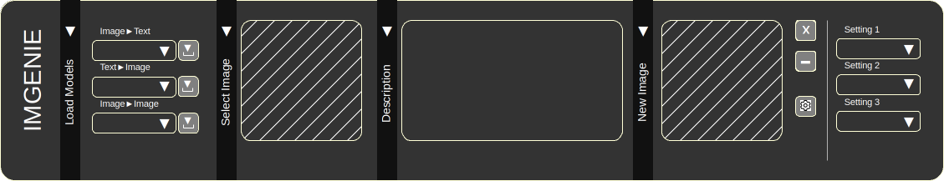
►
Image►Text
►
►
►
Setting 1
►
►
IMGENIE
Text►Image
Setting 2
►
►
Load Models
Select Image
Description
New Image
Image►Image
Setting 3
►
►

Slide 3
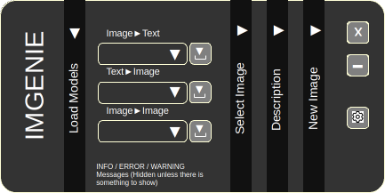
►
Image►Text
►
►
►
►
IMGENIE
Text►Image
►
Load Models
Select Image
New Image
Description
Image►Image
►
INFO / ERROR / WARNING Messages (Hidden unless there is something to show)

Slide 4
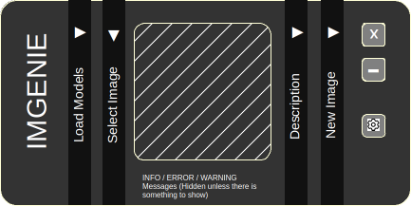
►
►
►
►
IMGENIE
Load Models
Select Image
New Image
Description
INFO / ERROR / WARNING Messages (Hidden unless there is something to show)

Slide 5
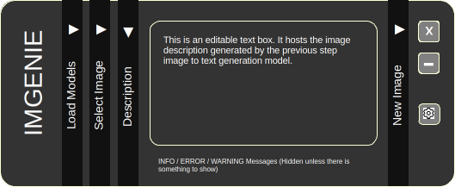
►
►
►
►
This is an editable text box. It hosts the image description generated by the previous step image to text generation model.
IMGENIE
Load Models
Select Image
New Image
Description
INFO / ERROR / WARNING Messages (Hidden unless there is something to show)

Slide 6
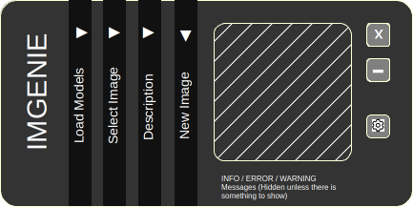
►
►
►
►
IMGENIE
Load Models
Select Image
New Image
Description
INFO / ERROR / WARNING Messages (Hidden unless there is something to show)

Slide 7
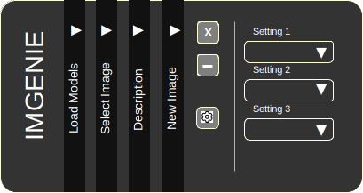
►
►
►
►
Setting 1
►
IMGENIE
Setting 2
►
Load Models
Select Image
New Image
Description
Setting 3
►

