Slide 1
An Introduction to Software Engineering

Slide 2
FAQs about software engineering
What is software?
What is software engineering?
What is the difference between software engineering and computer science?
What is the difference between software engineering and system engineering?
What is a software process?
What is a software process model?

Slide 3
FAQs about software engineering
What are the costs of software engineering?
What are software engineering methods?
What is CASE (Computer-Aided Software Engineering)?
What are the attributes of good software?
What are the key challenges facing software engineering?

Slide 4
What is software?
Computer programs, associated documentation and configuration data.
Software products may be
  Generic - developed and sold to a range of different customers e.g. PC software such as Excel or Word.
  custom (Bespoke) - developed for a single customer according to their specification e.g. Air traffic control systems.

Slide 5
What is software engineering?
Software engineering is an engineering discipline that is concerned with all aspects of software production.
  Engineering discipline
  All aspects of software production ( methods, theories, software project management )

Slide 6
What is the difference between software engineering and computer science?
Computer science is concerned with theory and methods that underlie computers and software systems.
Software engineering is concerned with the practicalities of developing and delivering useful software.

Slide 7
What is the difference between software engineering and system engineering?
System engineering is concerned with all aspects of computer-based systems development including hardware, software and process engineering.
Software engineering is part of this process concerned with developing the software infrastructure, control, applications and databases in the system.
System engineers are involved in system specification, architectural design, integration and deployment.

Slide 8
What is a software process?
A set of activities whose goal is the development or evolution of software.
A set of activities and associated results that produce a software product.
Generic activities in all software processes are:
  S/W Specification - what the system should do and its development constraints
  Development - production of the software system
  Validation - checking that the software is what the customer wants
  Evolution - changing the software in response to changing demands.

Slide 9
What is a software process model?
A simplified representation of a software process, presented from a specific perspective.
Examples of process perspectives are
  Workflow perspective - sequence of activities in the process along with their inputs, outputs and dependencies.
  Data-flow perspective - information flow; how the input to the process(specification) is transformed as output(design).
  Role/action perspective - who does what; roles of the people involved in the software process..

Slide 10
Generic process models
  Waterfall: represents activities as separate process phases such as requirement specification, design, implementation and testing.
  Iterative development: this approach interleaves the activities of specification, development and validation. Initial system may is rapidly developed from very abstract specifications.
  Component-based software engineering: this technique assumes that part of the system already exist. Development focuses on integrating theses parts.

Slide 11
What are the costs of software engineering?
Roughly 60% of costs are development costs, 40% are testing costs. For custom software, evolution costs often exceed development costs.
Costs vary depending on the type of system being developed and the requirements of system attributes such as performance and system reliability.
Distribution of costs depends on the development model that is used.

Slide 12
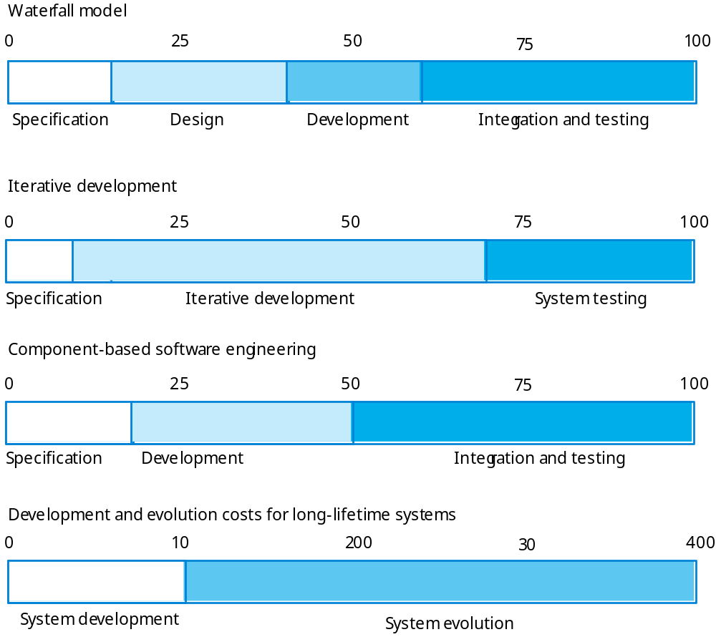
Activity cost distribution

Slide 13
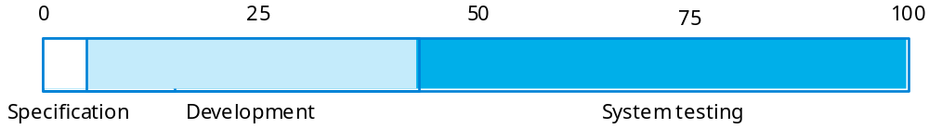
Product development costs (generic)

Slide 14
What are software engineering methods?
Structured approaches to software development which include system models, notations, rules, design advice and process guidance.
Model descriptions
  Descriptions of graphical models which should be produced;
Rules
  Constraints applied to system models;
Recommendations
  Advice on good design practice;
Process guidance
  What activities to follow.

Slide 15
What is CASE (Computer-Aided Software Engineering)
Software systems that are intended to provide automated support for software process activities.
Upper-CASE
  Tools to support the early process activities of requirements and design;
Lower-CASE
  Tools to support later activities such as programming, debugging and testing.

Slide 16
What are the attributes of good software?
The software should deliver the required functionality and performance to the user and should be maintainable, dependable, efficient and usable.
Maintainability
  Software must evolve to meet changing needs;
Dependability
  Software must be reliable, safe and secure;
Efficiency
  Software should not make wasteful use of system resources;
Usability
  Software must be usable, without undue effort, by the type of user for whom it is designed.

Slide 17
What are the key challenges facing software engineering?
Heterogeneity, delivery and trust.
Heterogeneity
  Developing techniques for building software that can cope with heterogeneous platforms and execution environments;
Delivery
  Developing techniques that lead to faster delivery of software;
Trust
  Developing techniques that demonstrate that software can be trusted by its users.

Slide 18
Professional and ethical responsibility
Software engineering involves wider responsibilities than simply the application of technical skills.
Software engineers must behave in an honest and ethically responsible way if they are to be respected as professionals.
Ethical behaviour is more than simply upholding the law.

Slide 19
Issues of professional responsibility
Confidentiality
  Engineers should normally respect the confidentiality of their employers or clients irrespective of whether or not a formal confidentiality agreement has been signed.
Competence
  Engineers should not misrepresent their level of competence. They should not knowingly accept work which is outwith their competence.

Slide 20
Issues of professional responsibility
Intellectual property rights
  Engineers should be aware of local laws governing the use of intellectual property such as patents, copyright, etc. They should be careful to ensure that the intellectual property of employers and clients is protected.
Computer misuse
  Software engineers should not use their technical skills to misuse other people’s computers.

