Slide 1
Socio-technical Systems

Slide 2
What is a system?
A purposeful collection of inter-related components working together to achieve some common objective.
A system may include software, mechanical, electrical and electronic hardware and be operated by people.
E.g. Pen, air traffic control system

Slide 3
System categories
Technical computer-based systems
  Systems that include hardware and software but not processes and procedures. E.g. Televisions, mobile phones.
Socio-technical systems
  Systems that include technical systems but also operational processes and people who use and interact with the technical system. Socio-technical systems are governed by organisational policies and rules.

Slide 4
Socio-technical system characteristics
Emergent properties
  Properties of the system of a whole that depend on the system components and their relationships.
Non-deterministic
  They do not always produce the same output when presented with the same input because the systems’s behaviour is partially dependent on human operators.
Complex relationships with organisational objectives
  The extent to which the system supports organisational objectives does not just depend on the system itself.

Slide 5
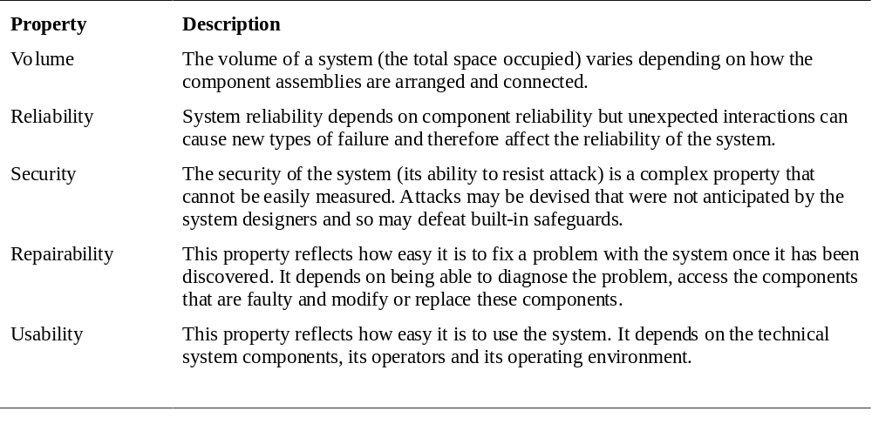
Examples of emergent properties

Slide 6
Types of emergent property
Functional properties
  These appear when all the parts of a system work together to achieve some objective. For example, a bicycle has the functional property of being a transportation device once it has been assembled from its components.
Non-functional emergent properties
  Examples are reliability, performance, safety, and security. These relate to the behaviour of the system in its operational environment.

Slide 7
Influences on reliability
Hardware reliability
  What is the probability of a hardware component failing and how long does it take to repair that component?
Software reliability
  How likely is it that a software component will produce an incorrect output? Software failure is usually distinct from hardware failure in that software does not wear out.
Operator reliability
  How likely is it that the operator of a system will make an error?

Slide 8
The ‘shall-not’ properties
Properties such as performance and reliability can be measured.
However, some properties are properties that the system should not exhibit
  Safety - the system should not behave in an unsafe way;
  Security - the system should not permit unauthorised use.
Measuring or assessing these properties is very hard.

Slide 9
Systems engineering
Specifying, designing, implementing, validating, deploying and maintaining socio-technical systems.
Concerned with the services provided by the system, constraints on its construction and operation and the ways in which it is used.

Slide 10
The system engineering process
Distinction between system Engg and software Engg
  Little scope for iteration between phases because hardware changes are very expensive. Software may have to compensate for hardware problems.
  Involves engineers from different disciplines who must work together . Much scope for misunderstanding here because different disciplines use a different terminology and conventions.

Slide 11
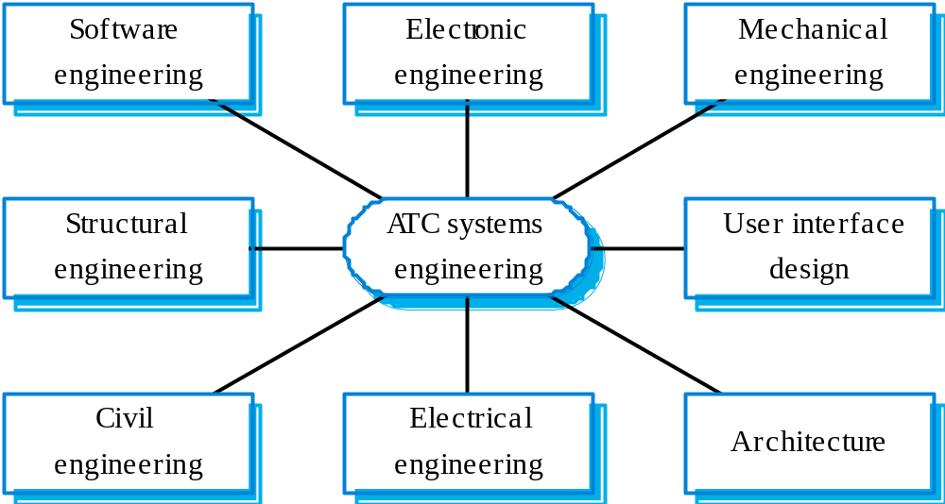
Inter-disciplinary involvement

Slide 12
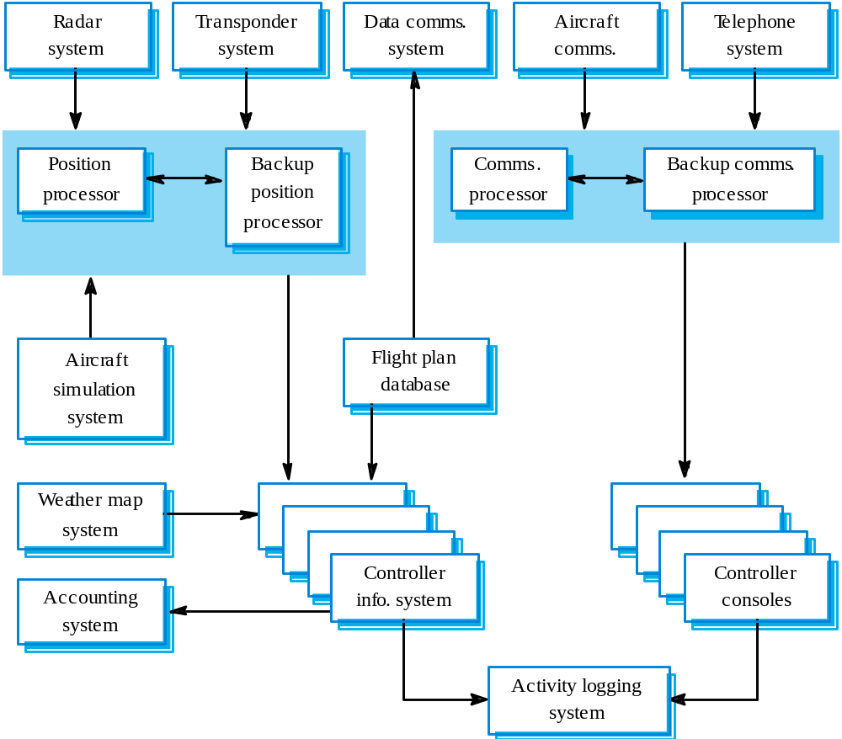
ATC system architecture

Slide 13
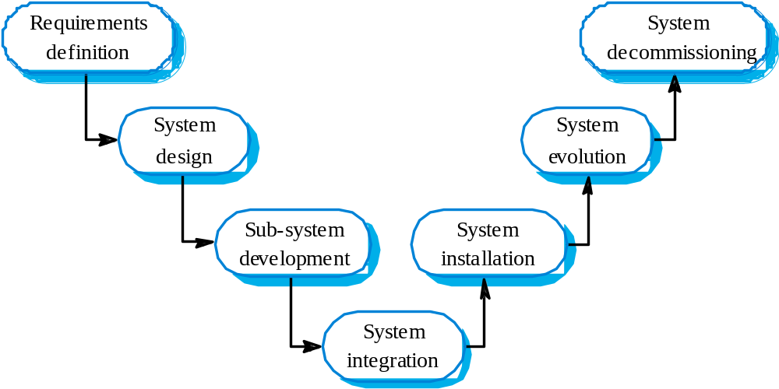
The systems engineering process

Slide 14
System requirements definition
Three types of requirement defined at this stage
  Abstract functional requirements. System functions are defined in an abstract way;
  System properties. Non-functional requirements for the system in general are defined;
  Undesirable characteristics. Unacceptable system behaviour is specified.
Should also define overall organisational objectives for the system.

Slide 15
System objectives
Should define why a system is being procured for a particular environment.
Functional objectives
  To provide a fire and intruder alarm system for the building which will provide internal and external warning of fire or unauthorized intrusion.
Organisational objectives
  To ensure that the normal functioning of work carried out in the building is not seriously disrupted by events such as fire and unauthorized intrusion.

Slide 16
The system design process
Partition requirements
  Organise requirements into related groups.
Identify sub-systems
  Identify a set of sub-systems which collectively can meet the system requirements.
Assign requirements to sub-systems
  Causes particular problems when COTS are integrated.
Specify sub-system functionality.
Define sub-system interfaces
  Critical activity for parallel sub-system development.

Slide 17
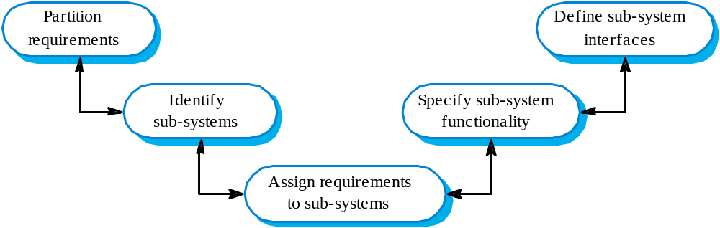
The system design process

Slide 18
Requirements and design
Requirements engineering and system design are inextricably linked.
Initial design may be necessary to structure the requirements.
As you do design, you learn more about the requirements.

Slide 19
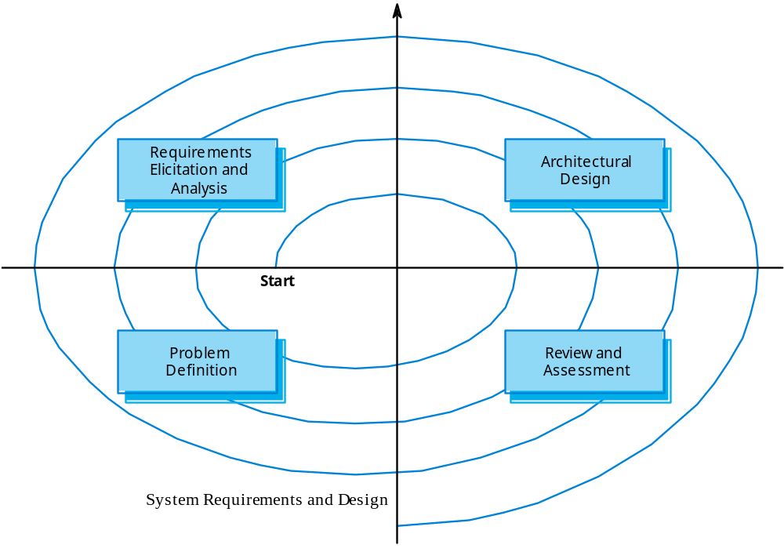
Spiral model of requirements/design

Slide 20
System modelling
An architectural model presents an abstract view of the sub-systems making up a system
May include major information flows between sub-systems
Usually presented as a block diagram
May identify different types of functional component in the model

Slide 21
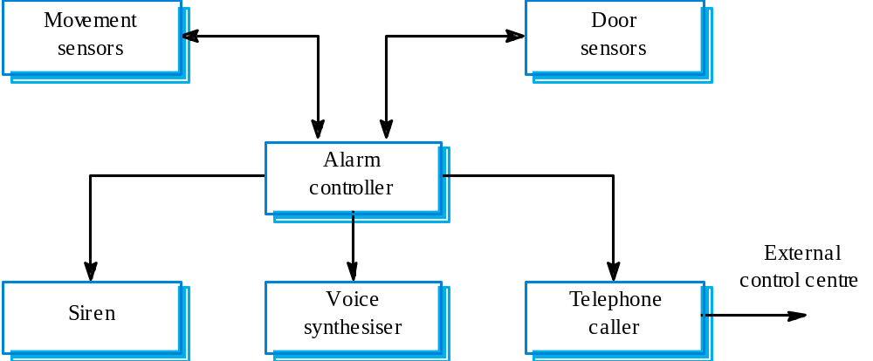
Burglar alarm system

Slide 22
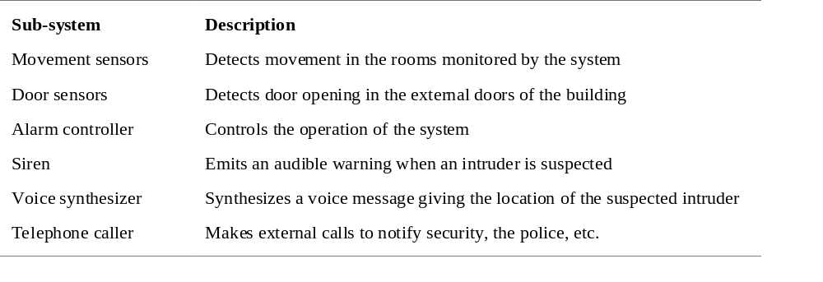
Sub-system description

Slide 23
Sub-system development
Typically parallel projects developing the
hardware, software and communications.
May involve some COTS (Commercial Off-the-Shelf) systems procurement.
Lack of communication across implementation
teams.
Bureaucratic and slow mechanism for
proposing system changes means that the development schedule may be extended because of the need for rework.

Slide 24
System integration
The process of putting hardware, software and
people together to make a system.
Should be tackled incrementally so that sub-systems are integrated one at a time.
Interface problems between sub-systems are usually found at this stage.
May be problems with uncoordinated deliveries
of system components.

Slide 25
System installation
After completion, the system has to be installed in the customer’s environment
  Environmental assumptions may be incorrect;
  May be human resistance to the introduction of
  a new system;
  System may have to coexist with alternative
  systems for some time;
  May be physical installation problems (e.g.
  cabling problems);
  Operator training has to be identified.

Slide 26
System evolution
Large systems have a long lifetime. They must evolve to meet changing requirements.
Evolution is inherently costly
  Changes must be analysed from a technical and business perspective;
  Sub-systems interact so unanticipated problems can arise;
  There is rarely a rationale for original design decisions;
  System structure is corrupted as changes are made to it.
Existing systems which must be maintained are sometimes called legacy systems.

Slide 27
System decommissioning
Taking the system out of service after its useful lifetime.
May require removal of materials (e.g. dangerous chemicals) which pollute the environment
  Should be planned for in the system design by encapsulation.
May require data to be restructured and converted to be used in some other system.

Slide 28
Organisations/people/systems
Socio-technical systems are organisational systems intended to help deliver some organisational or business goal.
If you do not understand the organisational environment where a system is used, the system is less likely to meet the real needs of the business and its users.

Slide 29
Human and organisational factors
Process changes
  Does the system require changes to the work processes in the environment?
Job changes
  Does the system de-skill the users in an environment or cause them to change the way they work?
Organisational changes
  Does the system change the political power structure in an organisation?

Slide 30
Organisational processes
The processes of systems engineering overlap and interact with organisational procurement processes.
Operational processes are the processes involved in using the system for its intended purpose. For new systems, these have to be defined as part of the system design.
Operational processes should be designed to be flexible and should not force operations to be done in a particular way. It is important that human operators can use their initiative if problems arise.

Slide 31
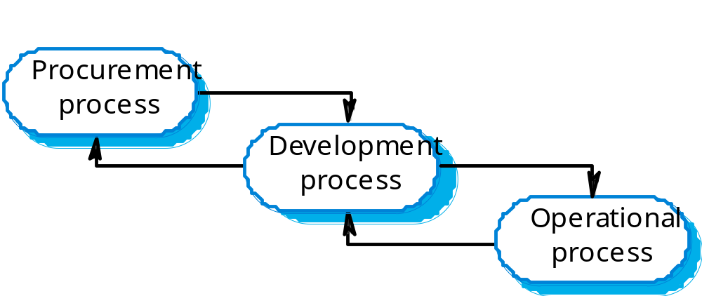
Procurement/development processes

Slide 32
System procurement
Acquiring a system for an organization to meet some need
Some system specification and architectural design is usually necessary before procurement
  You need a specification to let a contract for system development
  The specification may allow you to buy a commercial off-the-shelf (COTS) system. Almost always cheaper than developing a system from scratch
Large complex systems usually consist of a mix of off the shelf and specially designed components. The procurement processes for these different types of component are usually different.

Slide 33
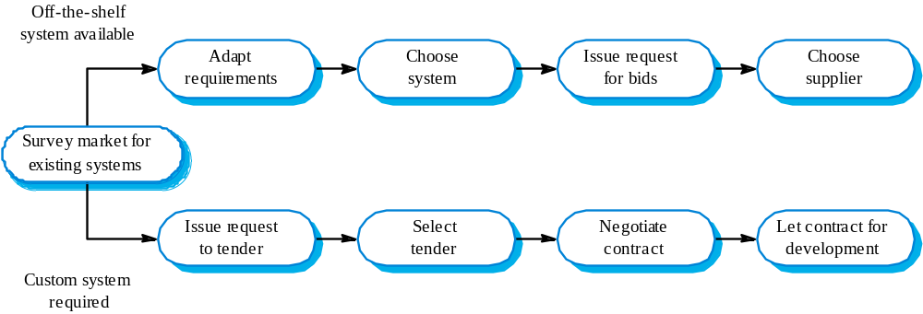
The system procurement process

Slide 34
Procurement issues
Requirements may have to be modified to match the capabilities of off-the-shelf components.
The requirements specification may be part of the contract for the development of the system.
There is usually a contract negotiation period to agree changes after the contractor to build a system has been selected.

Slide 35
Contractors and sub-contractors
The procurement of large hardware/software systems is usually based around some principal contractor.
Sub-contracts are issued to other suppliers to supply parts of the system.
Customer liases with the principal contractor and does not deal directly with sub-contractors.

Slide 36
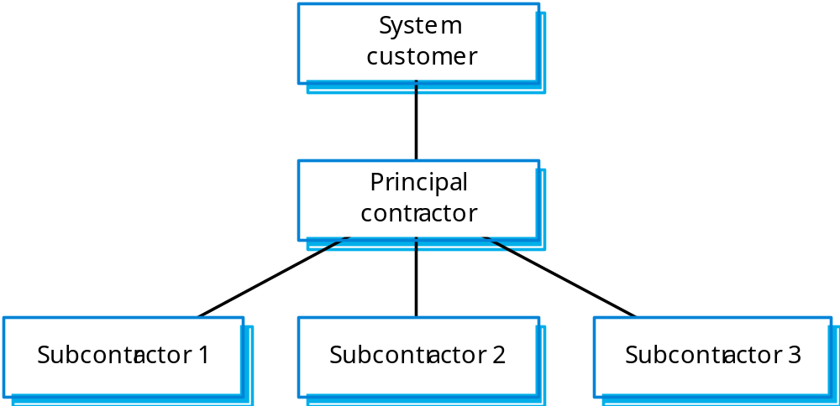
Contractor/Sub-contractor model

Slide 37
Legacy systems
Socio-technical systems that have been developed using old or obsolete technology.
Crucial to the operation of a business and it is often too risky to discard these systems
  Bank customer accounting system;
  Aircraft maintenance system.
Legacy systems constrain new business processes and consume a high proportion of company budgets.

Slide 38
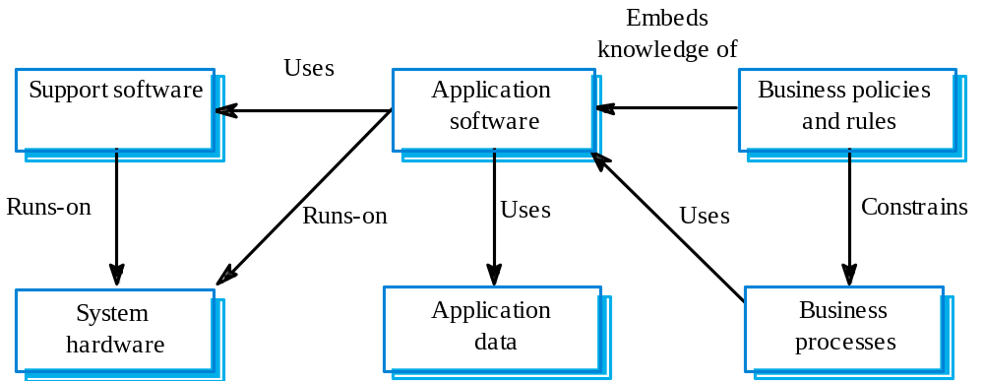

Slide 39
Legacy system components
Hardware - may be obsolete mainframe hardware.
Support software - may rely on support software from suppliers who are no longer in business.
Application software - may be written in obsolete programming languages.
Application data - often incomplete and inconsistent.
Business processes - may be constrained by software structure and functionality.
Business policies and rules - may be implicit and embedded in the system software.

Slide 40
