Slide 1

AI – DRIVEN SMART SURVEILLANCE FOR WEAPON DETECTION USING YOLOv8
Department: Information Technology
Supervisor:
Dr. K. Nagamani
Assistant Professor
Department of Information Technology
Presented by:
Kolloju Srinivas Bharath Raj
Master of Computer Applications (MCA)
2023 – 2025

Slide 2
contents
Abstract
Introduction
Objective and Scope of the project
Literature review
Research Gaps
Importance of the project
Proposed System
Implementation Methodology
Technology Support for Execution
UML Diagrams
UTP & ITP
Results
Conclusion

Slide 3
ABSTRACT
Security risks caused by firearms carried either openly or concealed demand more advanced intelligent surveillance systems. The research presents a weapon identification system operating in real time and the Django-based server handles storage, together with OpenCV image processing and YOLOv8 object detection capabilities. The system collects video frames as its input and performs deep learning analyses to detect weapons in the frames as they are received in real time. The suggested method delivers fast weapon identification alerts to enhance security surveillance capabilities alongside faster response capabilities for threats that help protect public safety and law enforcement.

Slide 4
INTRODUCTION
Technologies Used:
Category | Technology | How it Helps
Models | YOLOv8 | Detects weapons in real-time for security.
Libraries | OpenCV | Enhances video frames for better detection accuracy.
Frameworks | Django | Manages real-time monitoring and weapon detection requests.
Programming Languages | Python | Development, machine learning, and image processing.
Datasets | Custom Weapon Detection Datasets annotated on Roboflow. | Labeled datasets for training and testing weapon detection.

Slide 5
OBJECTIVE AND SCOPE OF THE PROJECT
Objectives:
Develop a real-time weapon detection system using YOLOv8 and OpenCV.
Provide instant alerts to security personnel upon detecting weapons.
Enhance public safety and reduce response time to potential threats.
Scope:
Focus on detecting weapons in video streams from surveillance cameras.
The system is limited to identifying weapons and not other security threats such as explosives, mines etc.
Deployed in public spaces like airports, malls, and stadiums.

Slide 6
OBJECTIVE AND SCOPE OF THE PROJECT
Potential Applications:
Public Security: Airports, shopping malls, public events.
Law Enforcement: Assists police in monitoring high-risk areas.
Smart Cities: Integration into smart city infrastructure for enhanced safety.

Slide 7
LITERATURE REVIEW
Summary of Existing Research/Studies:
Research Paper | Authors | Model | Findings | Limitations
Application of Deep Learning for Weapons Detection in Surveillance Videos | Tufail Sajjad Shah Hashmi et al. | YOLOv3 & YOLOv4 | YOLOv4 outperforms YOLOv3 in sensitivity and processing time. | No real-time alert system, no storage.
Real-time Weapon Detection using Drone | Deepak R. Hawale, Pavin S. Game. | YOLOv3 with OpenCV | Real-time detection with drone-mounted cameras. | Relies on internet connectivity, no storage.
Weapon Detection from Images using YOLO and OpenCV | Divyanshi Chitravanshi et al. | YOLOv5 with Transfer Learning | Improved detection accuracy with YOLOv5. | Lacks storage and alert system.

Slide 8
RESEARCH GAP
1. High Computational Demands
Gap:
Systems need powerful hardware, limiting deployment in resource-constrained environments.
Solution:
Efficient YOLOv8 Model that works on less powerful devices.
2. Limited Scalability:
Gap:
Systems struggle to scale for larger environments like airports or stadiums.
Solution:
Django enables for easy scaling across multiple locations.

Slide 9
RESEARCH GAP
3. Complex User Interfaces
Gap:
Systems have complicated dashboards, making quick decision-making difficult.
Solution:
Simplified Web Interface for easy access to live feeds, alerts, and logs.

Slide 10
IMPORTANCE OF THE PROJECT
Need: Rising firearm-related threats require efficient weapon detection systems for faster response and improved safety.
Real-world Applications:
Enhances public safety in places like airports, malls, and schools.
Supports law enforcement in quick identification of potential threats.
Improves private security response times.
Industry/Society Potential:
Transforms the security industry with AI-driven real-time detection.
Contributes to smart cities with automated surveillance.
Offers global impact by reducing weapon-related violence and enhancing public security.

Slide 11
PROPOSED SYSTEM
Proposed Solution:
A Real-Time Weapon Detection System using YOLOv8 for object detection, OpenCV for image processing, and a Django server for storage.
Detected frames for efficient data management and triggers instant alerts for rapid security response.
Features & Functionalities:
Real-time detection of handguns.
Deep learning with YOLOv8 and OpenCV for image processing.
Instant alerts to security personnel upon weapon detection.

Slide 12
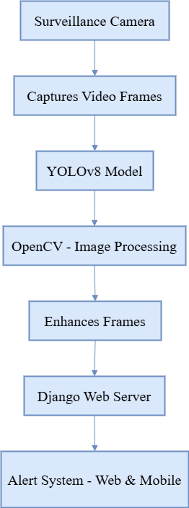
PROPOSED SYSTEM
Proposed System Architecture:

Slide 13
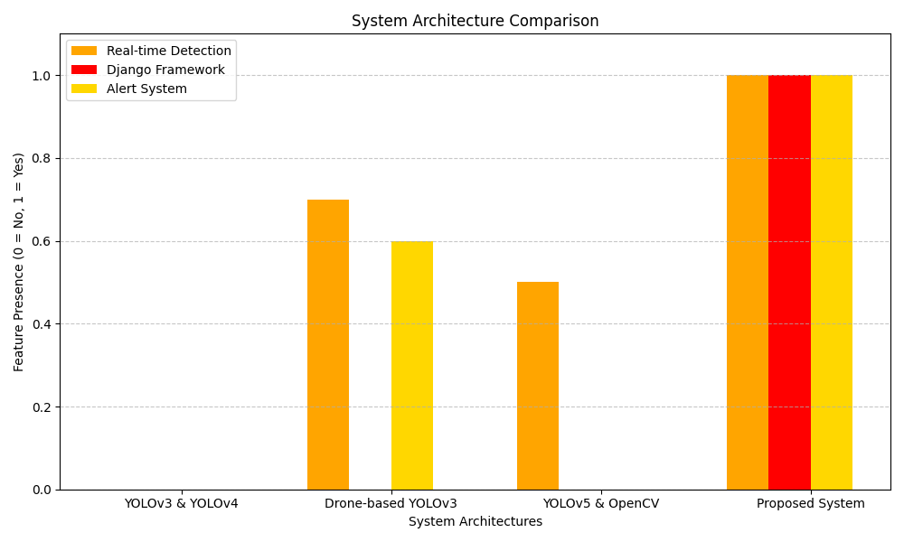
PROPOSED SYSTEM
System Architecture Comparison with previous versions:

Slide 14
IMPLEMENTATION METHODOLOGY
Step-by-Step Execution:
1. Requirements Gathering: Define system needs (camera, hardware, software) and research technologies (YOLOv8, OpenCV, Django).
2. System Design: Design architecture, integrate YOLOv8, image processing.
3. Development:
Integrate YOLOv8 for detection.
Implement OpenCV for image enhancement.
4. Testing: Integrate and test system components, validate detection accuracy, and test scalability.
5. Alert Setup: Develop instant alert system for security personnel (SMS or E-mail).

Slide 15
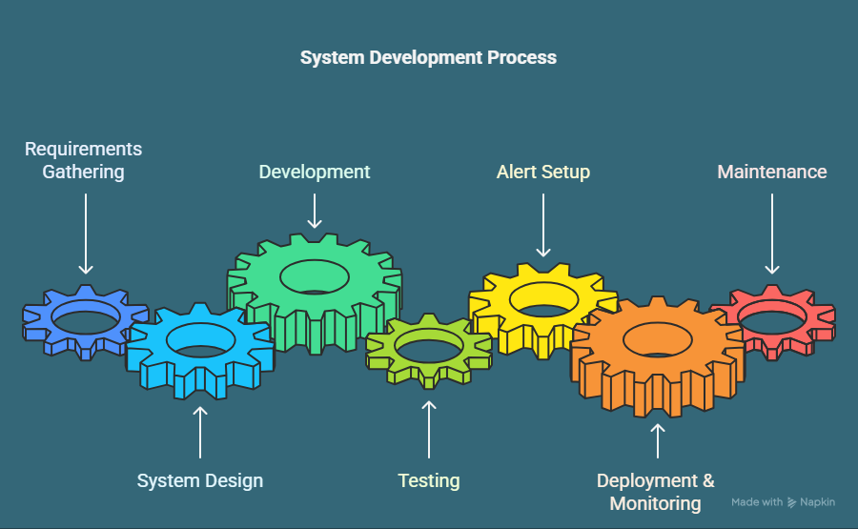
6. Deployment & Monitoring: Deploy in target environments and monitor performance.
7. Maintenance: Continuously improve system accuracy and performance.

Slide 16
TECHNOLOGY SUPPORT FOR EXECUTION
Category | Technology | Reason for choice
Model | YOLOV8 | Real-time weapon detection
Libraries | OpenCV | Image processing and enhancement
Frameworks | Django | Backend framework for deployment and alert management
Programming Languages | Python | Ideal for AI and image processing with robust libraries
Datasets | Weapon Detection Datasets | Labeled datasets for training and testing

Slide 17
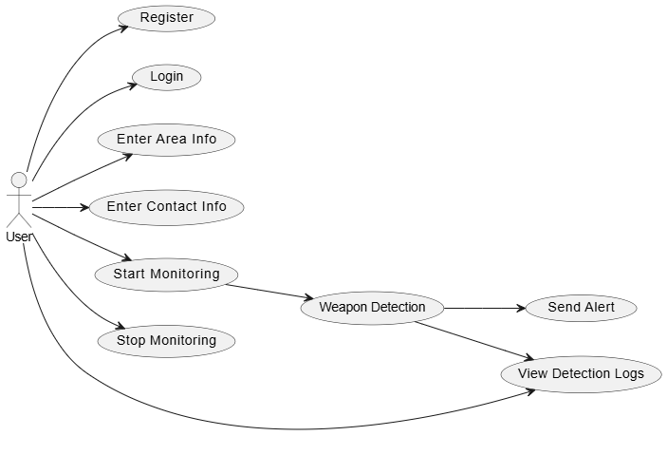
UML Diagrams:
Use Case Diagram:

Slide 18
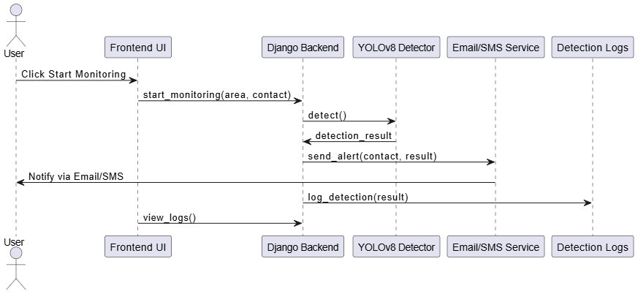
UML Diagrams:
Sequence Diagram:

Slide 19
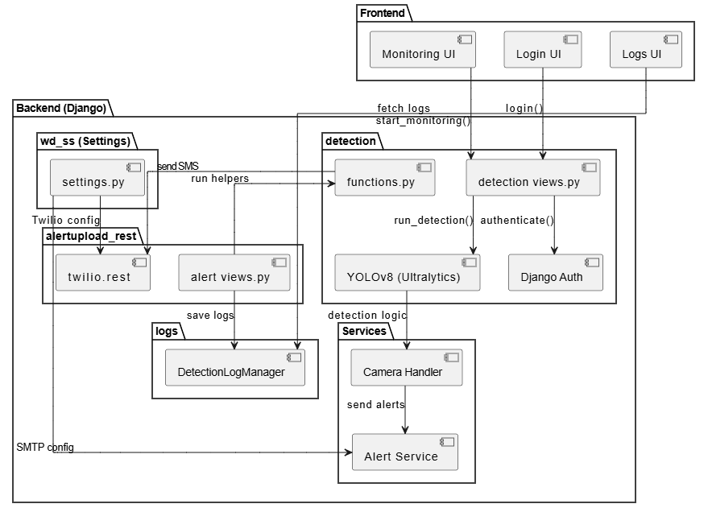
UML Diagrams:
Package Diagram:

Slide 20
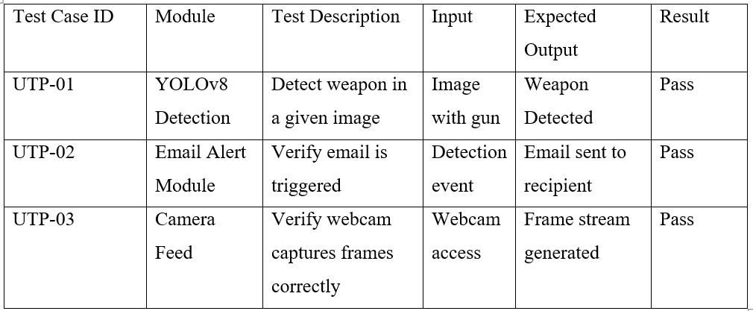
UTP & ITP
UTP – Unit Test Plan

Slide 21
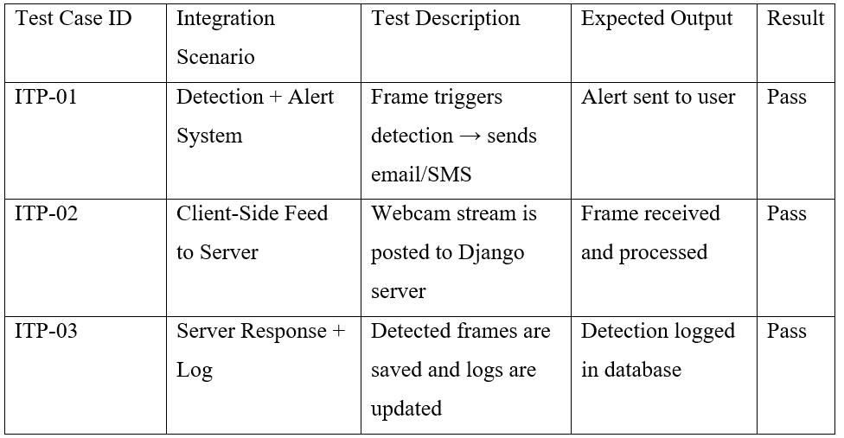
UTP & ITP
ITP – Integration Test Plan

Slide 22
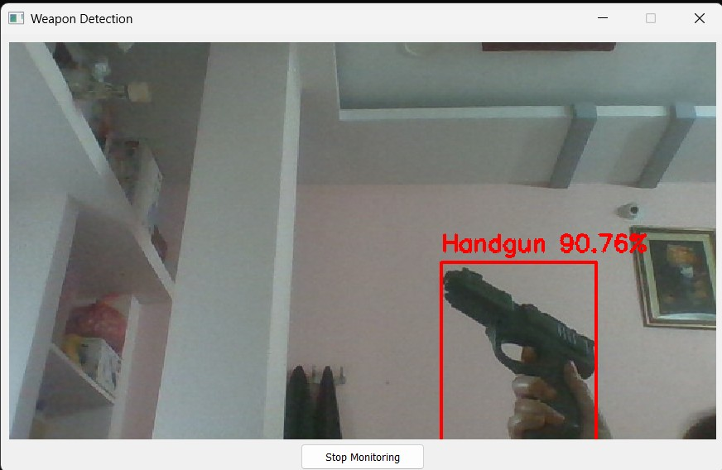
RESULTS
Weapon Detected

Slide 23
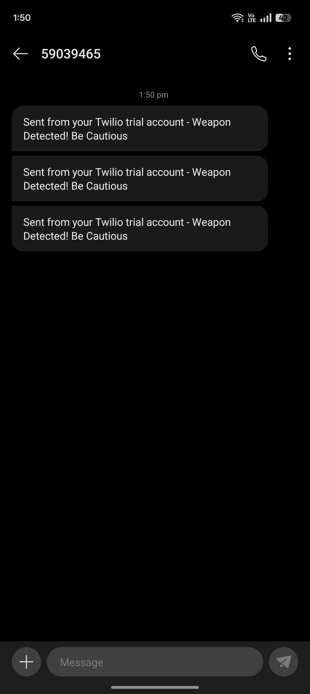
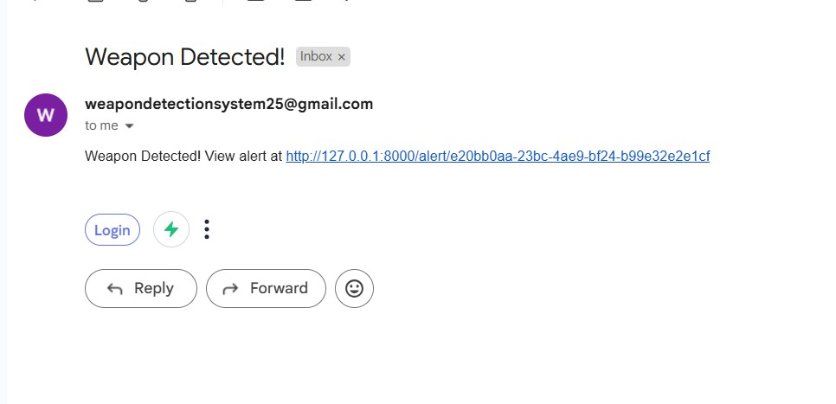
RESULTS
SMS Alert
Email Alert

Slide 24
CONCLUSION
Summary:
The project develops a Real-Time Weapon Detection System using YOLOv8, OpenCV, Django.
Stores detected frames, and instant alerts are sent for rapid security responses.
The system aims to improve public safety and security through accurate and timely weapon detection.
Expected Outcomes:
Real-time detection of weapons with high accuracy.
Instant alerts for security personnel.
Scalable deployment and efficient data management.

Slide 25
CONCLUSION
Future Scope:
Expand detection to other threats (e.g., explosives).
Improve adaptability for different environments.
Smart city and public safety integration

Slide 26

AI – DRIVEN SMART SURVEILLANCE FOR WEAPON DETECTION USING YOLOv8
Developed By Kolloju Srinivas Bharath Raj GitHub Repository
https://github.com/bharathraj1024/AI-Driven-Smart-Surveillance-for-Weapon-Detection-Using-YOLOv8 Demo Video https://youtu.be/vkhxaQHgLU0?si=3aFgimUsW_8EpK3y
Portfolio https://react-portfolio-ochre-gamma.vercel.app/ For academic or project-related queries bharathraj1024@gmail.com

